Slide 1
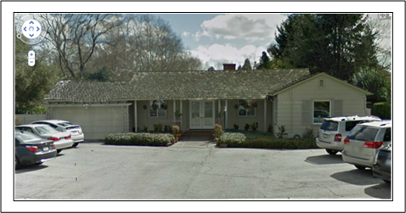
Pai Accountancy LLP
1413 Grant Rd.
Mountain View, CA 94040
650.965.8188

