Slide 1
Team Gaurav
Addressing Technology Facilitated Gender Based Violence (TFGBV)
[CASE STYDY 2]
Gaurav Pal

Slide 2
Problem at hand
The emergence of, and the increasing reliance on digital technologies and spaces, is a global megatrend, a universal phenomenon that is shaping our current world. However, it is also a space through which harm may be perpetrated. Addressing TFGBV, is thus no longer negotiable. Ensuring that everyone can freely participate online and without fear of violence and abuse is vital to upholding and advancing critical human rights.
Technology facilitated gender based violence (TFGBV) is a modern form of gender-based violence that utilizes digital technologies to cause harm. TFGBV is an act of violence perpetrated by one or more individuals that is committed, assisted, aggravated and amplified in part or fully by the use of information and communication technologies or digital media, against a person on the basis of their gender.
TFGBV is carried out through text, images and unwanted digitally-enabled or enhanced surveillance and monitoring, using a variety of devices and platforms from basic digital tools, such as texting, email and social media, to more advanced technologies such as artificial intelligence (AI), GPS tracking and drones. Various forms of Technology Facilitated Gender Based Violence (TFGBV)
Online Harassment- is the use of technology to repeatedly contact, annoy, threaten or scare another person
2. Cyberstalking, tracking- is the use of technology to stalk and monitor someone’s activities and behaviors in real-time or historically.
3. Image Based Abuse (IBA)- using images to coerce, threaten, harass, objectify or abuse. It involves taking, sharing or threatening to share sexually explicit images without consent, photographing or filming someone without their consent or knowledge, or coercing someone to engage in unwanted sexual behaviour online.
4. Technology Facilitated Sexual Abuse- is the use of communication technologies, such as cell phones, email, social networking sites, chat rooms or online dating sites and apps, to commit or procure sexual assault or abuse
5. Doxing- is the non-consensual disclosure of personal information. It involves the public release of an individual’s private, personal, sensitive information, such as home and email addresses, phone numbers etc.
6. Hacking- is the defines as the use of technology to gain illegal or unauthorized access to systems or resources for the purpose of acquiring personal information, altering or modifying information, or slandering and denigrating the survivor and/or violence against women’s organizations
7. Hate speech- is “any kind of communication in speech, writing or behaviour, that attacks or uses pejorative or discriminatory language with reference to a person or a group on the basis of who they are, in other words, based on their religion, ethnicity, nationality, race, colour, descent, gender or other identity factor.

Slide 3
Solution
The problem of the given solution is to make gender individually recognize by itself, so based on the gender security and safety we created a taxi booking app which ensure the safety on the gender.

Slide 4
Tools Used
Microsoft Power point
MMicrosft Word.

Slide 5
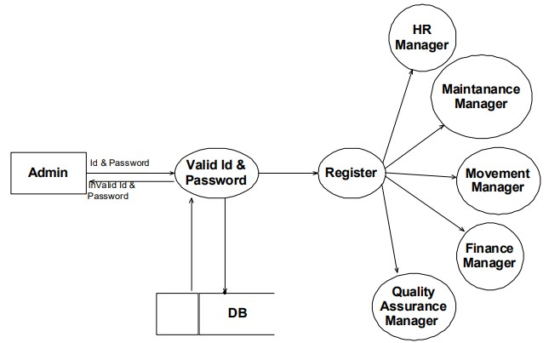
DATA FLOW DIAGRAM

Slide 6
Why our team is the best!
Team Consisting of persons who are self motivated, creative and innovative, who work in team and as well as an individual.
Team consisting of students of computer science and engineering, most of them are working professionals in IT industry.
Our strength as a team is to be an expert in the technology which we work on and try to innovate our project as much as possible.
Also try to make new and innovative and cost effective solutions of the problems.

Slide 7
Thank you

