Slide 1


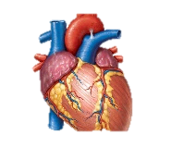

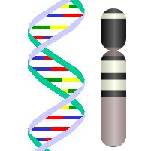



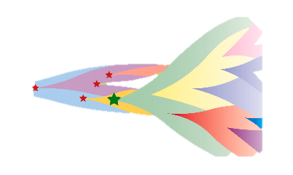
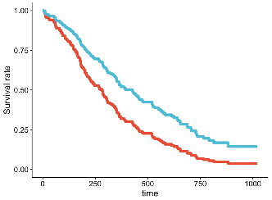
Variability across tissues
Somatic mutations and CNA
Rare pLoF germline variants
Somatic selection in TSGs
Cancer survival and immunotherapy response
ETG
ASE
TCGA
9,766 samples
33 cancer types
iNMDeff
Matched
RNA-Seq and WES
GTex
17,382 samples
56 normal tissues

