Slide 1

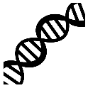
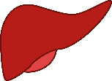
Individual NMD efficiency
Inherited rare variants
impacting iNMDeff?
9,766 samples
17,382 samples
TCGA
GTex
Discovery
Validation
18 matched cancer-tissues
Validation
Discovery
+ randomization
(as control)
X
Rare pLoF germline variants sets (MAF <0.1%)
(i) pLoF only
(ii) pLoF + Missense with CADD >= 15
(iii) pLoF + Missense with CADD >= 25
X
NMD methods
(i) ASE iNMDeff
(ii) ETG iNMDeff
=
216 maximum tests per gene

Slide 2
