Slide 1
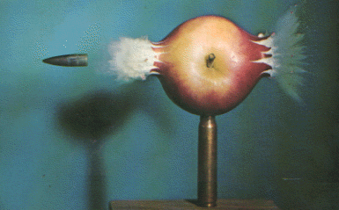
Escherichia coli O157:H7 in Apple Cider: A Quantitative Risk Assessment
Don Schaffner, PhD Siobain Duffy Food Risk Analysis Initiative Rutgers University

Slide 2
What is QRA?
A blend of published scientific literature, and expert opinion linked together by computer simulation
An organized warehouse of data collected on a certain topic
A summary of the influence of specific factors on the overall safety of a product
A science-based, cost-effective way to estimate risk

Slide 3

Why QRA?
Quantitative results
Combines data from many different labs, experiments
Incorporates variability and uncertainty
Customizable for individual producer’s needs
QRA can help to identify HACCP Critical Control Points

Slide 4
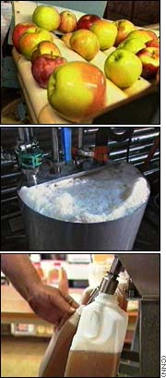
What can be part of a QRA?
Pre-harvest conditions
manure, animal contamination, drops, fruit fly transmission, cultivars
Processing
flume water, washing, brushing, equipment contamination, pasteurization, human and storage bin contamination
Storage Conditions
preservatives, temperature, freeze/thaw cycles, time to sale

Slide 5
The end results of a QRA
Conceptual framework for thinking about the problem
Dynamic model of a particular food processing and storage system
Sensitivity analysis, i.e. what factors are important
Avenues of future research

Slide 6
The User Interface pull down menus hidden model result button

Slide 7
The Modules
Birds contaminate tree-picked apples
Animals in the orchard influence CFUs on drops
Flume water, chlorine rinses vary the pre-pressing microbial counts
Use of sanitizers on equipment control O157
Pasteurization, freeze-thaw and preservatives all reduce bacterial counts

Slide 8
A look under the hood, part 1
Refrigeration (4-8 °C) of cider contaminated with E. coli O157:H7
Decreases (and occasionally increases) in O157 counts per day from all papers
Summarized as a histogram
Fit with a statistical distribution
D.W. Dingman, J.Food Protect. 62, 567 (1999).
L. Garland-Miller, C.W. Kaspar, J.Food Protect. 57, 460 (1994).
G.J. Leyer, L.-L. Wang, E.A. Johnson, Appl.Environ.Microbiol. 61, 3752 (1995).
A.M. Roering, et al, Int.J.Food Microbiol. 46, 263 (1999).
T. Zhao, M.P. Doyle, R.E. Besser, Appl.Environ.Microbiol. 59, 2526 (1993).

Slide 9
A look under the hood, part 1
Uses Excel and Bestfit software programs
Distribution describes the log change occurring in a single day
Change per day is simulated over the shelf life of the cider

Slide 10
A look under the hood, part 2
Freeze-Thaw Cycles
Uljas and Ingham (JFP, 5/99)
Polynomial regression (SAS) to create model
freeze/thaw, holding temperature, time and pH on log reduction of O157:H7
Variable Parameter P value
INTERCEPT 69.59985789 0.0036
TEMP -0.04081142 0.0003
PH -44.94493941 0.0007
HOURS -0.36421373 0.0011
PH² 6.77622727 0.0002
HOURS² 0.01875504 0.0317
R² = 0.8914

Slide 11
Simulation
Analytica uses Monte Carlo simulation to run a user-defined number of iterations on the conditions specified
Graphical output or statistics on CFU E. coli O157:H7 on day of sale in a gallon of cider
Can be run by any person who could download the free Analytica reader and our simulation

Slide 12
*Assuming birds infected with O157:H7, animal manure used, no chlorine rinse, No freeze-thaw cycle, no preservative used, no cleaning or sanitizing of equipment

Slide 13

Future Research
Real-life studies to ascertain realistic levels of contamination
More accurate distributions for all variables, as more data are collected
Validation?

Slide 14
Summary
A risk assessment is only as good as the data it models
O157: H7 in cow manure vs.
Brushing of apples
This risk assessment is a good start, but it’s only the first step
Peer review
More data, better data

Slide 15
“All models are wrong… but some are useful.”
- G. Cox

