Slide 1
Threshold Selection Based on a Simple image Statistic
BY
G.Pandu(14EC65R28)
P.Akhilesh Reddy(14EC65R30)

Slide 2
Contents
Introduction
Overview of thresholding Methods
Absorption Edge Detector
RATS Algorithm
Thresholding of Retinal Image
Test results
Conclusion
References

Slide 3
Introduction
Thresholding is usually the first step in any segmentation approach
For medicine or industrial application, the main features of an image can be represented by as few as two gray levels.
It is useful because it is a data reduction step and it produces a binary representation of an image.
Binary images are readily manipulated to produce higher level descriptions of the scenes and objects, i.e., borders, relational graphs, etc.

Slide 4

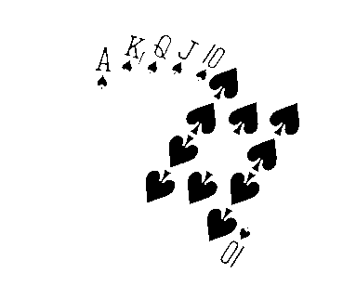
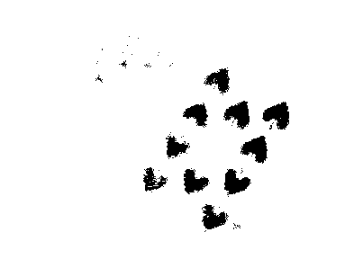
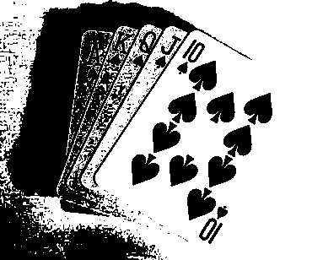
Need for Accurate thresholding

Slide 5
Overview of Thresholding Techniques
Chow and Kaneko proposed a method of variable thresholding in which an image is divided into windows.
Assumes that the grey level histogram contains only two prominent modes and they are both Normally (Gaussian) distributed.
Thresholds are selected for those windows that have bimodal histograms .
These thresholds are interpolated to define a variable threshold for the entire image .

Slide 6
Ridler Meathod:
Iterative Meathod.
Uses switching function image which is the binary version of picture obtained by using threshold of last iteration.
Average of mean luminance of pixels in background and object classes of the associated switching function is used as next threshold.
Iterated until stable solution is found.
.

Slide 7
Shannon Entropy Based thresholding
Describes an automatic threshold selection method for image segmentation.
Aims to maximize the entropy of the thresholded image while considering its relationship to the entropy of the grey level distribution of the original image.
Strongly favors the solution in which there are equal numbers of pixels in each class of the thresholded image histogram.

Slide 8
Thresholding using second-order statistics
Threshold selection based on a grey level transition matrix.
The matrix is constructed by horizontally and then vertically scanning the image and incrementing the (i, j) entry of the matrix by one if a transition from an i grey level to a i grey level is encountered.
A trial threshold at TO will partition this matrix into four parts.
The sum of two of these parts suitably normalised yields a measure of the number of ti mes a pixel is followed by a pixel of the opposite class which should be minimum.

Slide 9
Absorption Edge Detector
Basic Principle:
~ The search for a simple statistic which could provide a basis for a thresholding method is based on Absorption edge detection.
~ This detector has the desirable property of yielding the edge magnitude proportional to the contrast between the background and the object independent of the actual edge position and orientation.

Slide 10
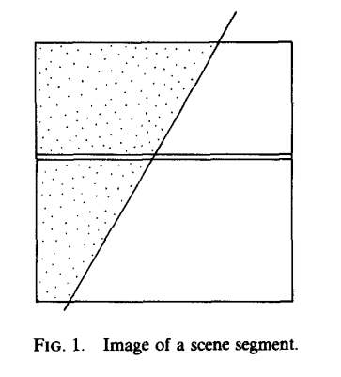

Absorption Edge Detector
Let e j, j = 1... N be the outputs of the differentiation operator along a horizontal scan line intersecting one vertical edge. Then
where E = B-D.
Assumed that B and D do not
vary over the image.

Slide 11
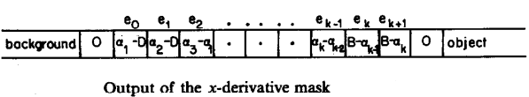
Continued....
Grey level values in the boundary region along one scan line.
Applying x-derivative mask

Slide 12


RATS ALGORITHM
Assuming that the total number of horizontal scan lines is equivalent to the number of pixels in each scan line. For whole image, we obtain
A complicated shape of an object or several objects may give rise to several vertical edges being intersected by one scan line.
ni is the no of vertical edge pixels.

Slide 13
Continued...
Similarly for Horizontal edge:
Applying y-derivative mask we can obtain
Irrespective of the edge directions it makes no difference to the output of the summation operator whether the summation is carried out row-wise or column-wise.

Slide 14


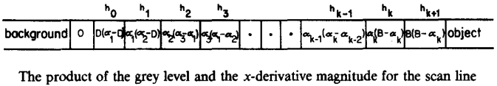
RATS Algorithm
First defining a candidate, namely the sum of grey values each multiplied by corresponding magnitudes of the x derivatives.
simplifying, we get
= (B+D).E

Slide 15

Considering Entire image
Let eij be the maximum of the outputs of the x and y gradient masks centered at the (i, j)th pixel.
The sum of the absolute values of the products hij of eij and the grey level values g,, over the entire image is equal to the contrast E times the sum of the background and object intensities times the number n of edge pixels in the image.

Slide 16
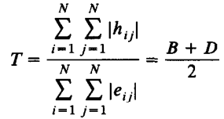
Defining Threshold
The threshold is given by the ratio of the sum of grey-grad values to the sum of grad values.

Slide 17
Thresholding of Retinal Image
Vessel Segmentation is obtained by using multiscale Gabor filters.
Thresholding and binarization of the result of vessel detection is a crucial step for further analysis of the characteristics of blood vessels such as thickness and tortuosity.
For Thresholding , we applied RATS algorithm.

Slide 18
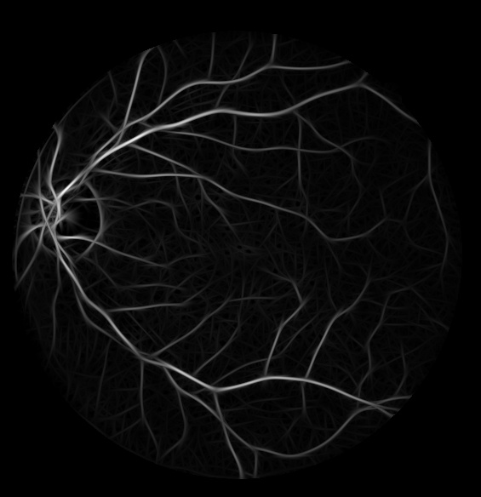
Gabor Response
Gabor response of image 21 of the DRIVE database.

Slide 19
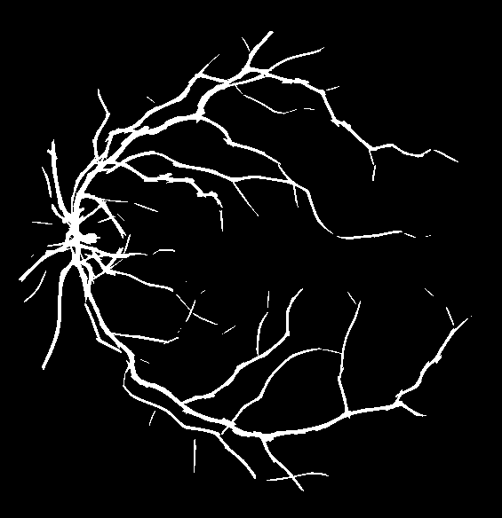
Output
Implementing RATS algorithm on the gabor response of the Retinal image 21 we obtain,

Slide 20
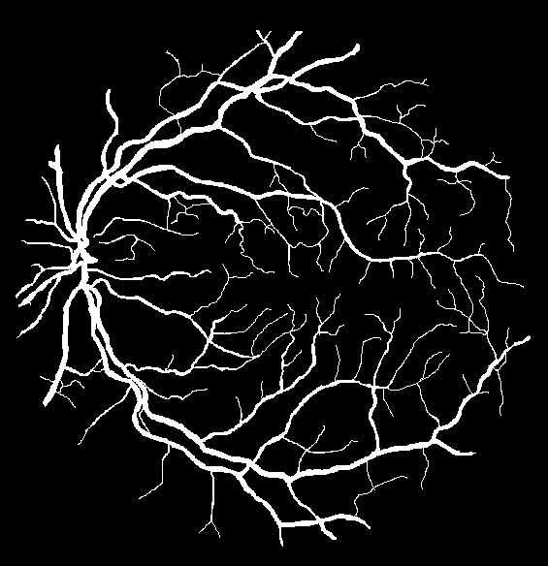
Test Results
Applying RATS algorithm to set of test images, average accuracy of 95% is obtained.
Segmented image Ground truth image

Slide 21
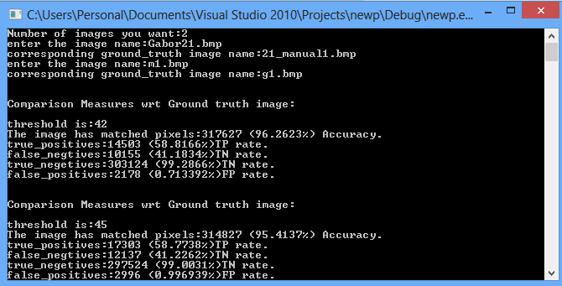
Comparison Measures

Slide 22
Conclusion
Thresholding using RATS Algorithm is implemented by using simple image statistics.
It is computationally less intensive, as it doesn’t include iterative calculations over histogram unlike other methods.
Thresholding on Gobor response images using RATS Algorithm provided an accuracy of 95% with respect to ground truth images.

Slide 23
REFERENCES
1. J. Kittler, J. Illingworth, J. F¨oglein. “Threshold selection based on a simple image statistic,” Computer Vision, Graphics, and Image Processing, vol. 30, pp. 125–147, 198
Faraz Oloumi, Ashis K. Dhara, Rangaraj M. Rangayyan, Sudipta Mukhopadhyay, ‘Detection of Blood Vessels in Retinal Fundus Images’, Computer Science Journal of Moldova, vol.22, no.2(65), 2014.
J. Kittler, J. Illingworth, and K. Paler, The magnitude accuracy of the template edge detector, Pattern Recognition, 16,1983,607-613.

