Slide 1
COVID-19 Vaccination Effectiveness
By Geoffrey Pang, Cayley Morrow, and John Porretta

Slide 2
Background
COVID-19 is a viral respiratory illness caused by the coronavirus (SARS-CoV-2)
Transmission
COVID-19 mainly spreads from person to person through respiratory droplets of an infected person and can also spread by touching contaminated surfaces. Symptoms can vary widely and can appear 2 – 14 days after exposure to the virus.
Severity
COVID-19 symptoms can range from mild to severe, with some people remaining asymptomatic. Severe cases can lead to pneumonia, acute respiratory distress syndrome (ARDS), organ failure, and death.
Vaccination
Several COVID-19 vaccines were developed and authorized for emergency use around the world. Vaccination efforts aim to achieve herd immunity and reduce the spread of the virus.
Variants
Multiple variants of the SARS-CoV-2 virus have emerged since 2020, some of which have different transmission rates or resistance to immunity generated by previous vaccinations.

Slide 3
Project Overview
Objective:
In this project, we will look at how effective the COVID-19 vaccinations were on factors such as hospitalisations, confirmed cases and mortality rates.
Data Sources:
Our World In Data – third-party website with a collation of data from WHO, John Hopkins, etc.
World Bank (using API requests) – GDP Per Capita
Key Questions to Answer:
1. How have COVID-19 vaccinations affected ICU patient admissions, confirmed cases and mortality rates?
2. Does a difference in Gross Domestic Product (GDP) Per Capita affect COVID-19 cases (using World Bank API)?
3. Were the COVID-19 vaccinations effective in Australia?
4. How effective were the different types of vaccinations?

Slide 4

Data Sources
COVID-19 Dataset by Our World in Data
Using owid-covid-data.csv
Selected the columns of interest for our questions
Created output as a CSV file
The dataset is presented by day
We used the ‘groupby’ function to make the data manageable

Slide 5
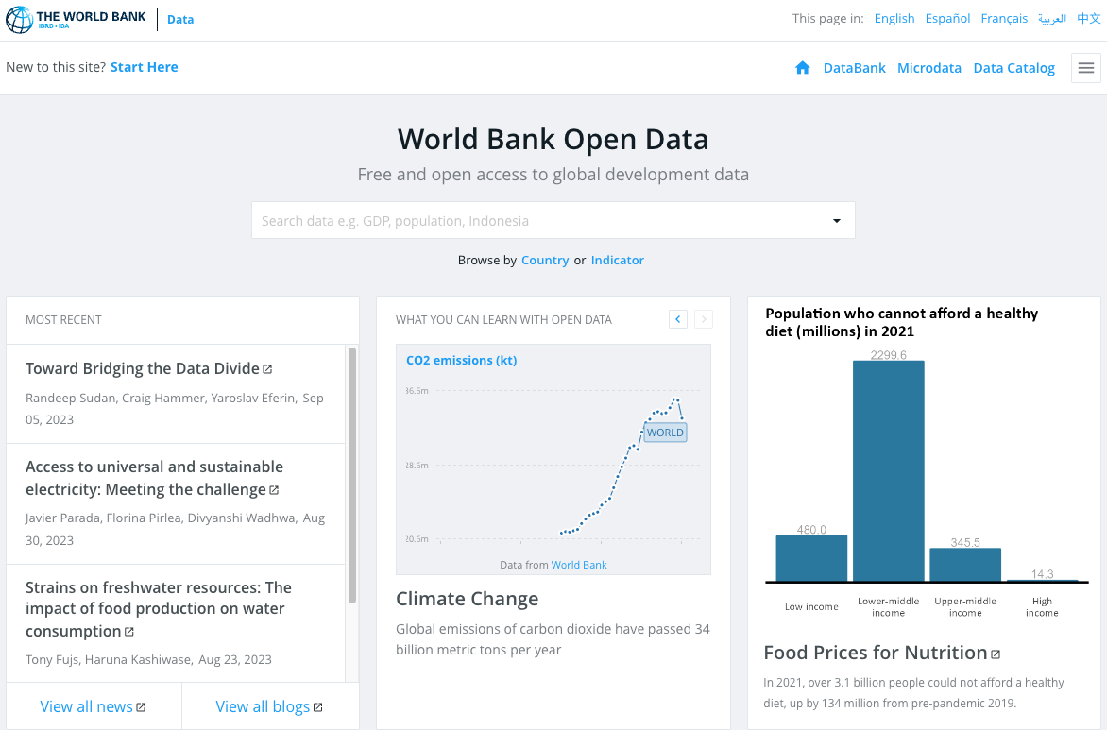
Data Sources
World Bank Open Data
Using API requests to access GDP Per Capita for specific countries

Slide 6
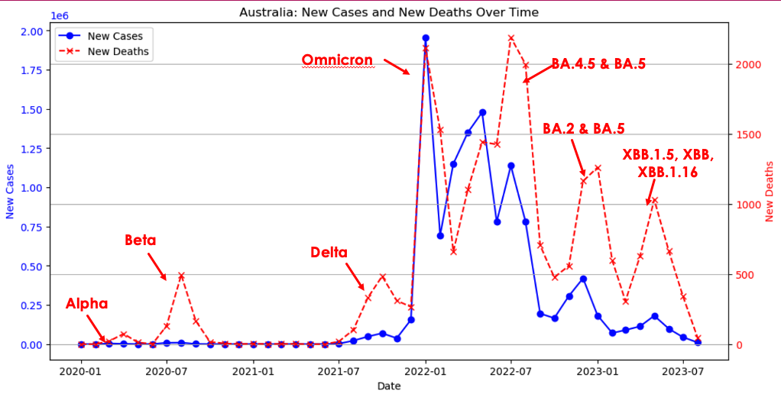
Australia: Relationship of New Cases vs New Deaths
Key Messages
7 waves identified
Each wave is associated with Peak New Deaths

Slide 7
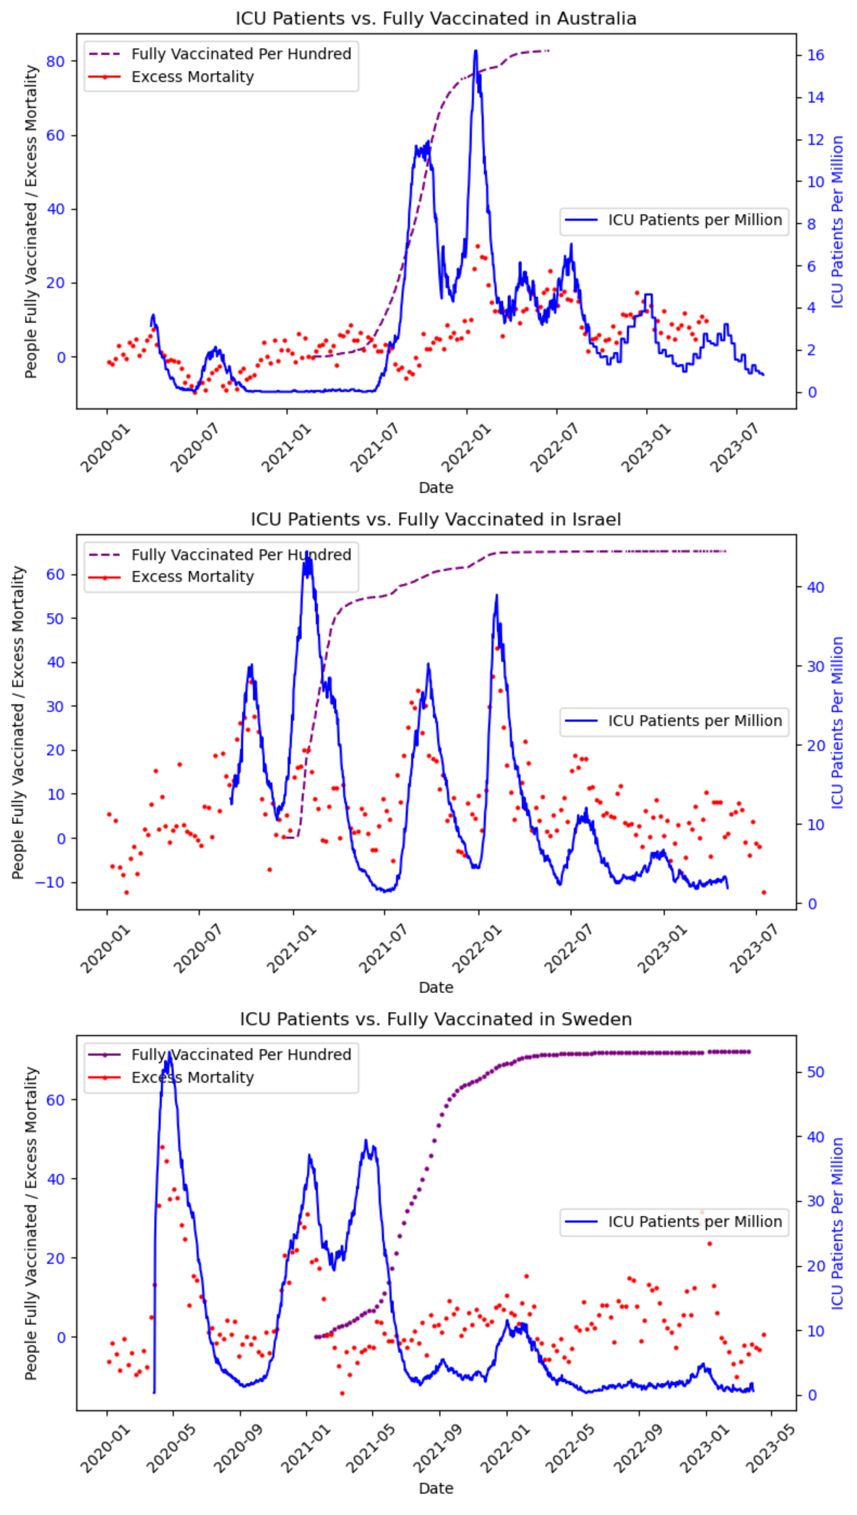
How have COVID-19 vaccinations affected ICU patient admissions, confirmed cases and mortality rates?
Key Messages
COVID-19 has increased the number of ICU patients in Australia, Israel and Sweden.
COVID-19 has increased the number of people dying in Australia, Israel and Sweden.
Increasing vaccinations appear to lower the ICU patients and excess mortality in Australia, Israel and Sweden.
Excess Mortality is "The percentage difference between the reported number of weekly or monthly deaths in 2020–2021 and the projected number of deaths for the same period based on previous years" (One World in Data (2023))

Slide 8
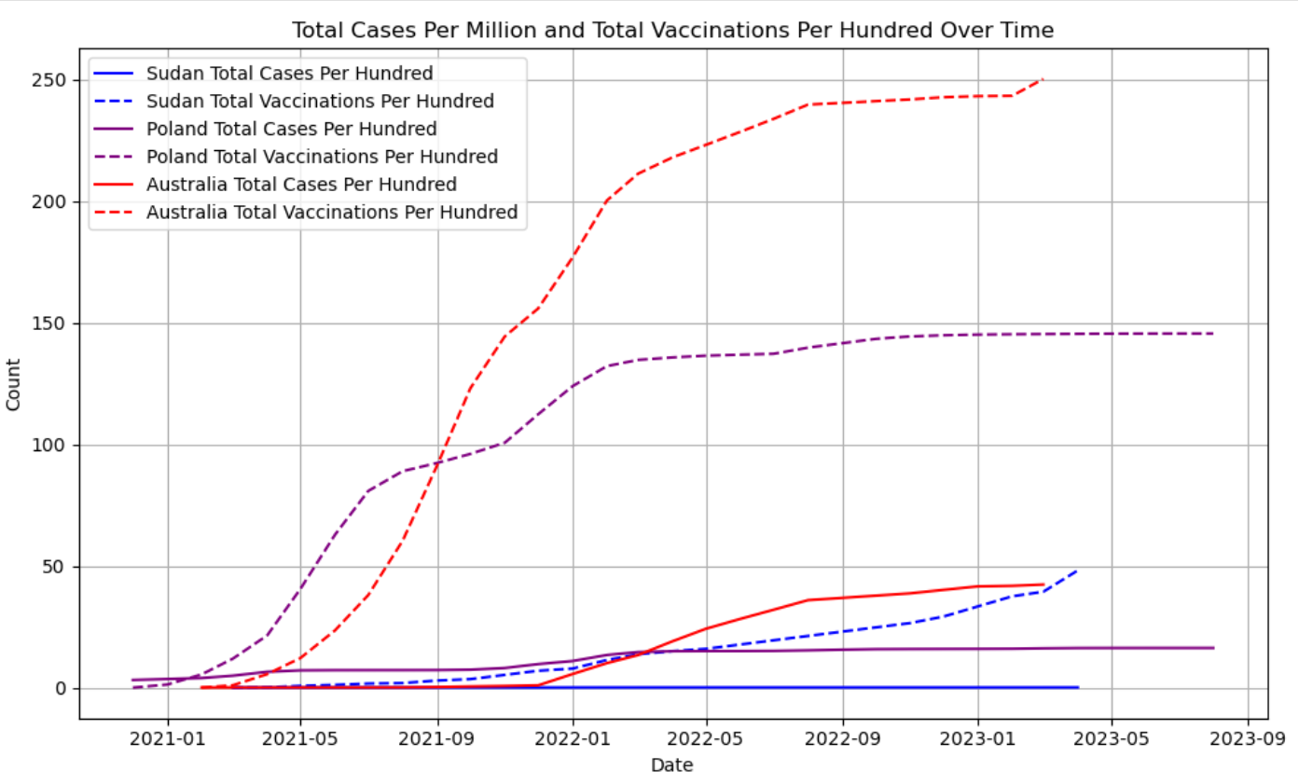
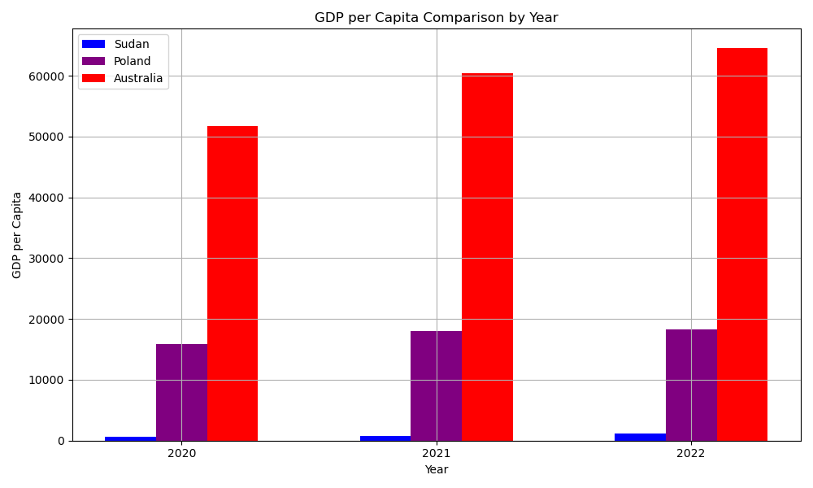
Does a difference in Gross Domestic Product (GDP) Per Capita affect COVID-19 cases (using World Bank API)?
Key Messages
Richer countries spend more money on vaccination but also record more cases.
Lower numbers in poorer countries may be due to under-reporting,

Slide 9
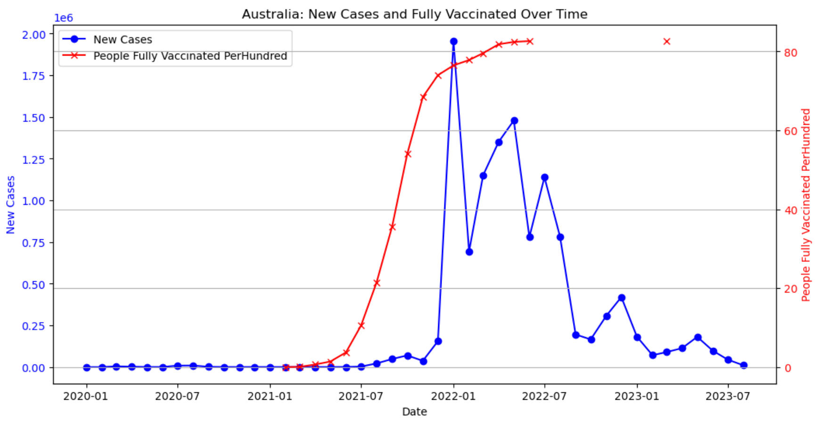
Were COVID-19 vaccinations effective in Australia?
Key Messages
Vaccination appears to work: Drastic drop in New Cases after >80% People Fully Vaccinated Per Hundred.
No new recordings are available in this dataset beyond 2023

Slide 10
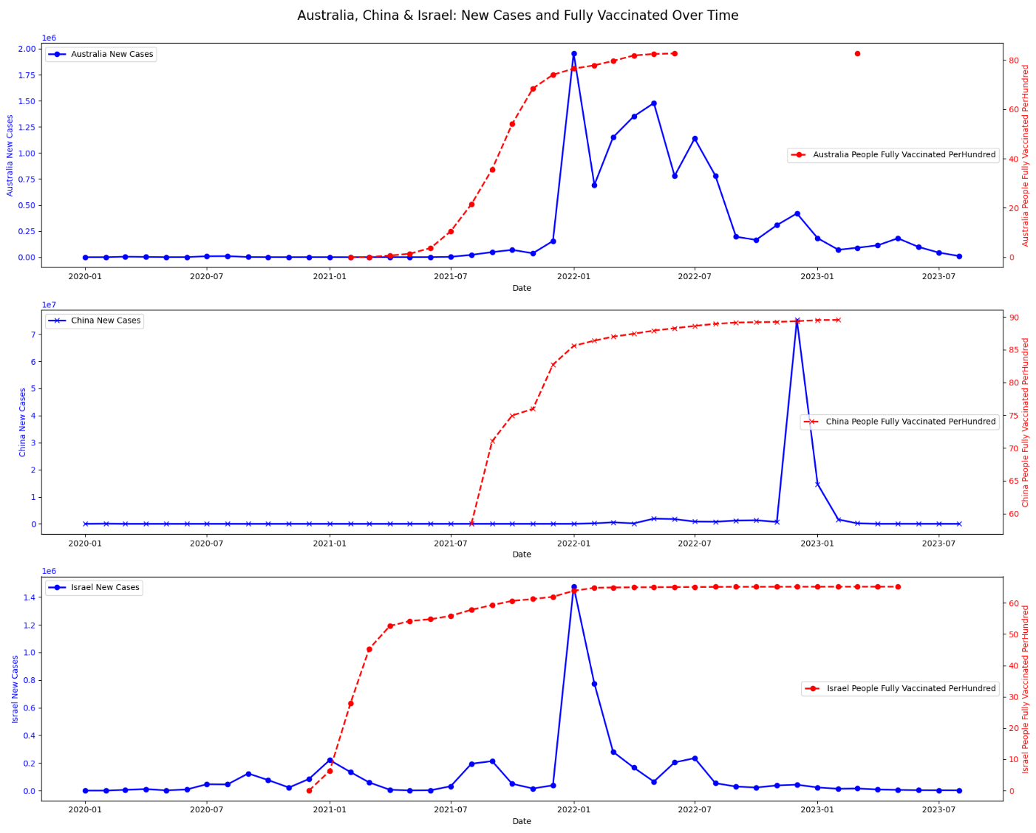
How effective were the different types of vaccinations?
Key Messages
Different vaccinations being used(from news media):
Australia (AstraZ, Moderna, Pfizer)
China (SinoVac & SinoPharm)
Israel (Pfizer)
Different Vaccination Programs
Australia: ramped up vaccination for over one year with up to 80%.
China: Rapid vaccinations over 1.5 years. Up to 90%.
Israel: Earliest to vaccinate and maintained relatively lower vaccination rates (65%) over 2.5 years.
Result
Australia: the vaccination appears to work.
China: worked initially but had a spike at the end of 2022 with Omicron
Israel: Seem to work but not protected against Omicron (Jan-2022)
Australia
China
Israel

Slide 11
Conclusions
Is the vaccination effective?
Vaccination appears to be effective in controlling the spread of the COVID-19 virus. However, this could be coincidental.
Different vaccinations seem to work. However, none of the vaccinations had much of an effect against the spread of Omicron.
COVID-19 spread has decreased significantly since 2020.
Vaccinations are only one part of the response to COVID-19, there are too many other contributing factors
It is not conclusive that vaccinations have been effective in controlling the spread of the virus.

