Slide 1
SIT720 Machine Learning Mini Research – HD Task
Reproduction and Extension of a Stacking-Based Ensemble
for Early Heart Attack Prediction
Pranjal Gupta • S226230386
Reproducing: Bhagat, Sharma & Agarwal (2025), Multimedia Tools and Applications
Notes:
Hello, I'm Pranjal Gupta. This is my SIT720 Machine Learning mini research HD task.

Slide 2
What this video covers
1
The paper
What it claims, and why I chose it
2
Reproduction
What I found when I rebuilt it faithfully
3
Proposed solution
Two original contributions, and why they differ
4
Live demo
Code, notebooks and results running for real
5
Reflection
Lessons, limitations, future work
Notes:
I'll cover my reproduction and findings, my proposed solution, a demo, and lessons/limitations.

Slide 3
01
The Paper
What was claimed, and why this paper was chosen for reproduction
Notes:
(Section divider - pause briefly, let it sit on screen 2-3 seconds)

Slide 4
BACKGROUND
Bhagat, Sharma & Agarwal (2025)
Six base classifiers: Logistic Regression, Decision Tree, Random Forest, XGBoost, Naive Bayes, KNN
Combined with a 5-fold stacking ensemble
Dataset: 1,025 patients, 13 clinical features — claimed merge of 4 hospitals
Headline result: 98.53% accuracy, 98.8% AUC
Why this paper?
Small, fully public tabular dataset
I could verify the data myself
Standard, reproducible classifiers
(the other two candidates relied on harder-to-verify pipelines)
SIT720 Mini Research – Pranjal Gupta S226230386
4
Notes:
I reproduced Bhagat, Sharma and Agarwal (2025): six classifiers combined with stacking, 98.53% accuracy on 1,025 patients. I chose it because it's a small public tabular dataset I could verify myself.

Slide 5
02
Reproduction & Key Findings
Rebuilding the paper's pipeline exactly — and checking the data behind it
Notes:
(Section divider)

Slide 6
STEP 1
Verifying the dataset
Every feature range reported in the paper's Table 9 was checked against the file I sourced:
Feature | Paper's range | My file | Match
age | 29 – 77 | 29.0 – 77.0 | ✓
trestbps | 94 – 200 | 94.0 – 200.0 | ✓
chol | 126 – 564 | 126.0 – 564.0 | ✓
thalach | 71 – 202 | 71.0 – 202.0 | ✓
oldpeak | 0 – 6.2 | 0.0 – 6.2 | ✓
✓ Confirmed: this is the correct file the paper used.
SIT720 Mini Research – Pranjal Gupta S226230386
6
Notes:
All five feature ranges in my file match the paper's Table 9 exactly. So I'm confident this is the correct dataset.

Slide 7
STEP 2 — THE KEY FINDING
70.5% of the dataset is duplicated
723 / 1025
302
≈1
rows are exact
duplicates
unique patients
remain
hospital — not the
claimed 4-site merge
Why it matters: a random train/test split places identical patients on both sides. A model that memorises a training row “predicts” it perfectly when it reappears in the test set — inflating every metric without any real generalisation.
SIT720 Mini Research – Pranjal Gupta S226230386
7
Notes:
But then I checked for duplicates. 723 of 1,025 rows -- 70.5% -- are exact duplicates. Only 302 unique patients remain. That's essentially the original Cleveland dataset, not a four-hospital merge. Duplicates cause leakage: identical patients land in both train and test, so models can memorise rows and inflate every metric.

Slide 8
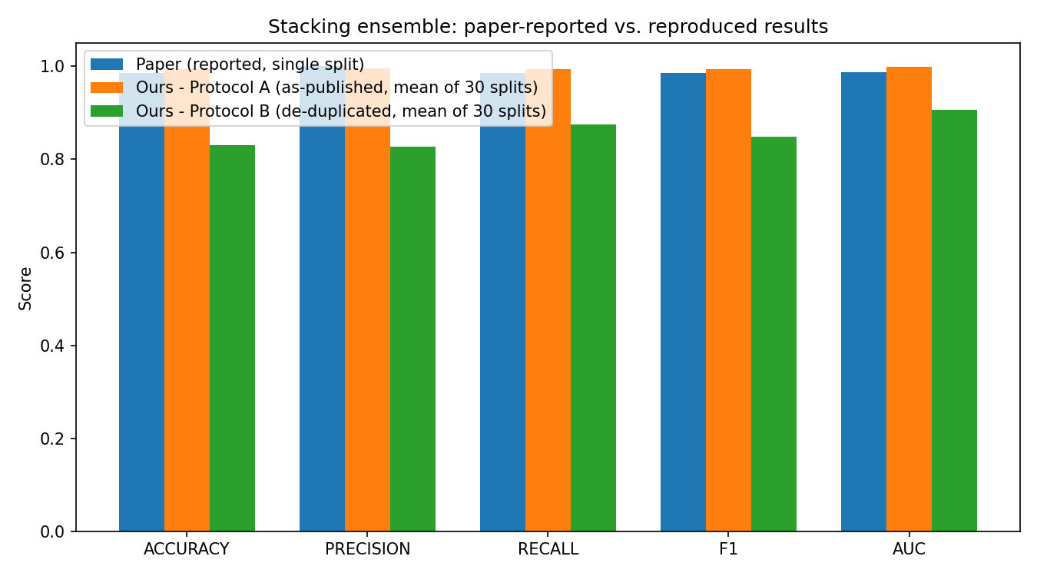
STEP 3
Isolating the effect: Protocol A vs. Protocol B
Protocol A
data exactly as published, random split
Protocol B
identical pipeline, duplicates removed first
Only duplicate-handling changed — yet stacking accuracy falls from 99.4% to 83.1%. A ~16-point gap explained by leakage alone.
SIT720 Mini Research – Pranjal Gupta S226230386
8
Notes:
I ran the identical pipeline under two protocols: A as published, B with duplicates removed first. Only duplicate-handling changed, and stacking accuracy drops from 99.4% to 83.1% -- a 16-point gap caused by leakage alone.

Slide 9
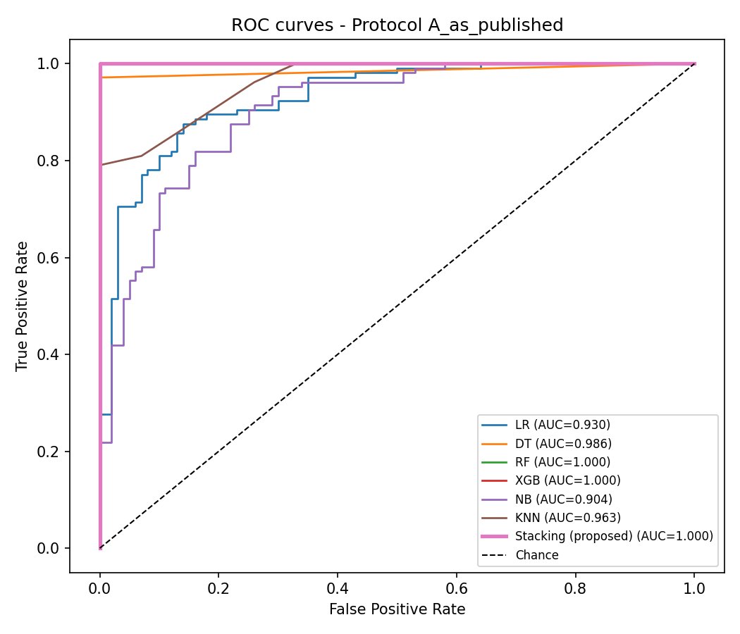
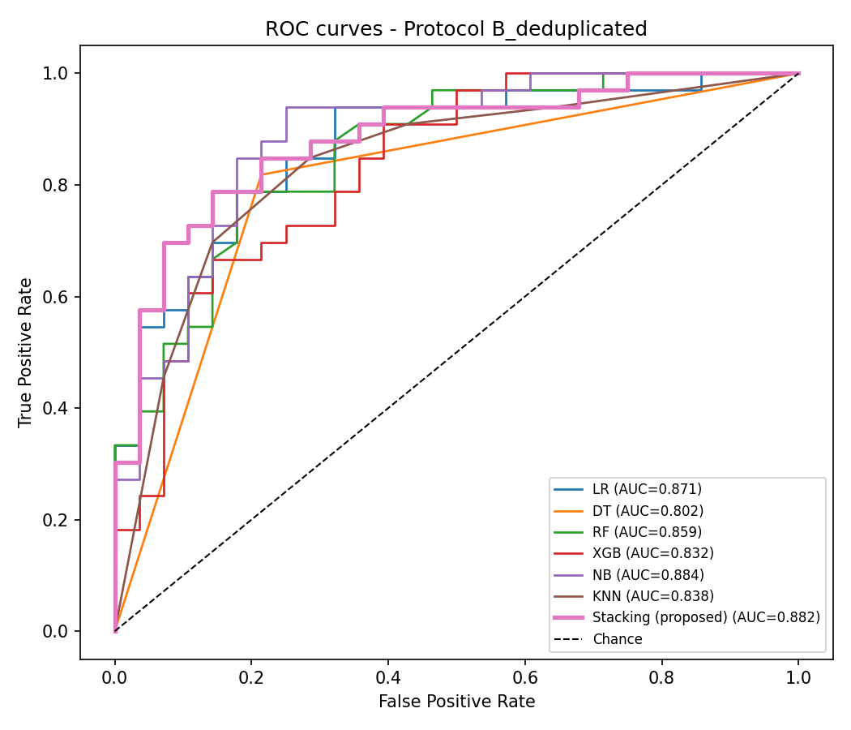
VISUAL EVIDENCE
AUC = 1.000 vs. a realistic 0.80–0.88
Protocol A (leaky)
Protocol B (de-duplicated)
SIT720 Mini Research – Pranjal Gupta S226230386
9
Notes:
On the left, with duplicates, Random Forest, XGBoost and stacking all hit AUC = 1.000. On the right, without duplicates, every model falls to a realistic 0.80-0.91.

Slide 10
MECHANISTIC EVIDENCE
Why only some models show the gap
Model | Can it memorise a row? | Accuracy gap (A − B)
Decision Tree | Yes — unconstrained splits | 23.4 pts
XGBoost | Yes — boosted trees | 19.5 pts
Random Forest | Yes — ensembled trees | 16.5 pts
Stacking | Built from the above | 16.3 pts
KNN | Partially — exact-match neighbour | 2.6 pts
Logistic Regression | No — smooth boundary | 0.9 pts
Naive Bayes | No — smooth boundary | 0.6 pts
Models that can memorise individual rows show large A–B gaps; smooth models barely move. Exactly what leakage predicts — independent confirmation.
SIT720 Mini Research – Pranjal Gupta S226230386
10
Notes:
The pattern confirms this: models that can memorise rows -- Decision Tree, XGBoost, Random Forest -- show 16-23 point gaps. Logistic Regression and Naive Bayes, which fit a smooth boundary, change by under one point. That's exactly what leakage predicts.

Slide 11
03
Proposed Solution
Two original contributions that address the limitations found above
Notes:
(Section divider)

Slide 12
MOTIVATION
Five limitations I targeted
L1
Data leakage from duplicate rows
L2
One split, no significance testing
L3
No hyperparameter tuning
L4
Nominal features treated as ordered numbers
L5
No test of generalisation across hospitals
SIT720 Mini Research – Pranjal Gupta S226230386
12
Notes:
I identified five limitations: leakage, a single split with no significance testing, no tuning, categorical features treated as ordered numbers, and no test of generalisation across hospitals.

Slide 13
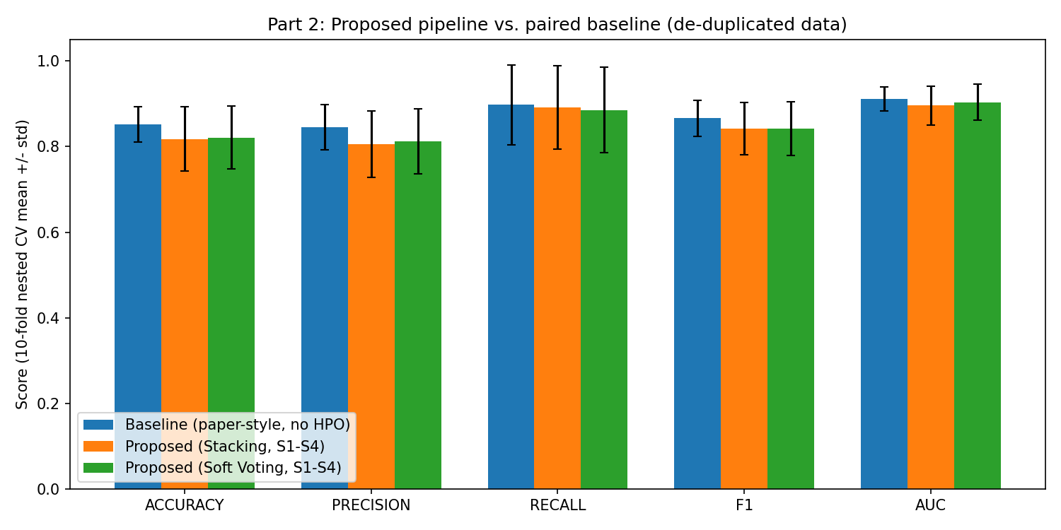
CONTRIBUTION 1
Part 2a: Leakage-safe, tuned pipeline
De-duplicated data only, nested 10×3-fold CV
One-hot encoding of nominal features (L4)
4 engineered clinical features
Mutual-info feature selection + RandomizedSearchCV on all 6 learners + meta-classifier
Paired Wilcoxon test vs. untuned baseline
Honest result: the tuned pipeline does NOT beat the simple baseline (all p > 0.05). The real contribution is a trustworthy, leakage-free evaluation — not a bigger number.
SIT720 Mini Research – Pranjal Gupta S226230386
13
Notes:
Part 2a uses only de-duplicated data, nested cross-validation, proper encoding, engineered features, and tuned hyperparameters, tested with a paired Wilcoxon test. Honest result: the tuned pipeline does not significantly beat the simple baseline -- all p-values above 0.05. My real contribution is a trustworthy, leakage-free evaluation, not a bigger number.

Slide 14
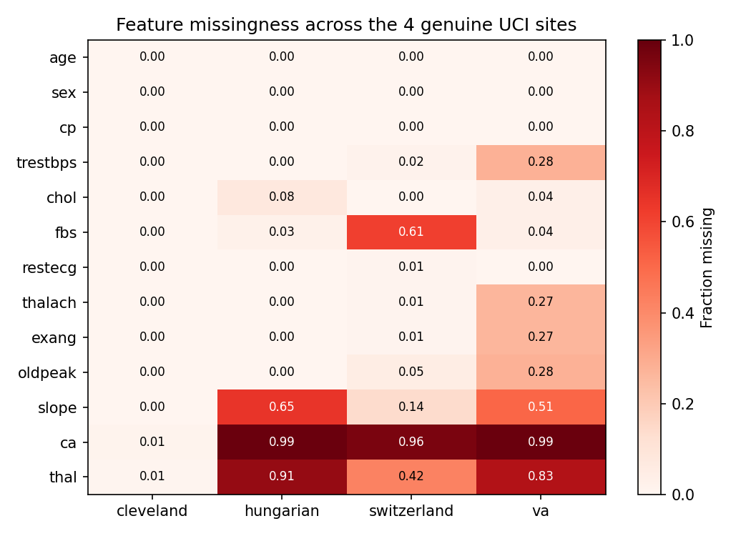
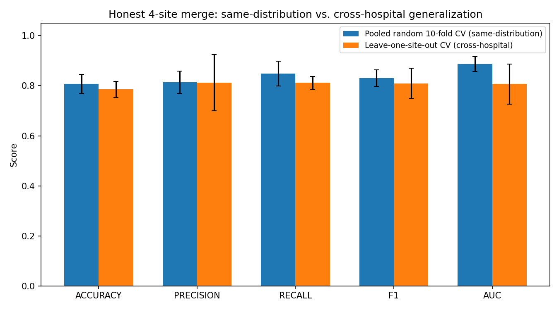
CONTRIBUTION 2
Part 2b: Real cross-hospital test
Pooled AUC 0.886 vs. leave-one-hospital-out AUC 0.807 (down to 0.717 for VA)
ca is 96–99% missing outside Cleveland (thal similarly high at 2 of 3 sites) → the paper's file is not a real 4-hospital merge.
SIT720 Mini Research – Pranjal Gupta S226230386
14
Notes:
Part 2b downloads the four real UCI hospital files. ca and thal are 83-99% missing outside Cleveland -- strong evidence the paper's file isn't a genuine four-hospital merge. Pooled AUC is 0.886, but training on three hospitals and testing on the fourth drops average AUC to 0.807, and as low as 0.717 for the VA hospital.

Slide 15
04
Reflection
Lessons, limitations and where this work goes next
Notes:
(Section divider)

Slide 16
Lessons, limitations, future work
Lessons
Limitations
Future work
Always check data for duplicates & provenance first
A single split hides variance — use repeated/nested CV + tests
A negative result, reported honestly, is still valuable
Hidden randomness (e.g. unseeded functions) can silently break reproducibility
Only 302 unique patients → low statistical power
Reduced search budget (single CPU core)
Part 2b uses 10 features, not 13 — not directly comparable to Part 1
Paper's missing hyperparameters forced documented assumptions
Larger multi-centre / federated datasets
Full-scale HPO on more compute
Calibration & threshold tuning
Site-aware / domain-adaptation models
SHAP interpretability + prospective validation
SIT720 Mini Research – Pranjal Gupta S226230386
16
Notes:
Key lessons: check data for duplicates first, use repeated/nested CV with significance tests instead of one split, and report negative results honestly. Limitations: small sample, reduced compute, Part 2b's reduced feature set, and assumptions where the paper was silent. Future work: larger datasets, full-scale tuning, calibration, domain-adaptation models, interpretability, and prospective validation.

Slide 17
Thank you
All code, data, notebooks and the full report are in the GitHub repository linked in the report.
github.com/gpariee/HD-Machine-Learning-Mini-Project
Notes:
All code, data, notebooks and the report are in my GitHub repository. Thank you for watching.

