Slide 1
Hybrid LSTM-Transformer Approach for Intraday Financial Forecasting
Filippo Tomelleri, Sean Boos, Giovanni Parri, Said Haji Abukar
Advanced Machine Learning - University of Zurich

Slide 2
Introduction
Goal: Predicting Intraday Financial Time Series using Transformers
Model: based on the paper “Trading with the Momentum Transformer: An Intelligent and Interpretable Architecture” (arXiv:2112.08534)
Data: Kaggle competition “Optiver - Trading at the Close”

Slide 3
Formal Problem Setting
Observables: limit order book and auction data at time available at time t which we denote as 𝑋_{t}
The filtration 𝐹_{t} contains all the information available up to time t
Formally, the filtration 𝐹_{t} is defined as: 𝐹_{t} = σ( 𝑋_{t} : 0 ≤ s ≤ t)
Objective: Find a model 𝒇 and predict ŷ_{t+1}= 𝒇(𝑋ₜ, 𝛳) that minimizes the objective function
Formally, we define 𝒇 to be adapted to the filtration 𝐹_{t}. This ensures that the model only uses information known at that point in time.
Objective Function: Mean Squared Error (MSE): MSE( ŷ_{t+1} , y_{t+1} )

Slide 4
Features and target
For each stock ID, historic data for the daily ten minute closing auction on the NASDAQ stock exchange
Features on trade timing and more technical aspects such as imbalance size, bid/ask price, far/near price and the weighted average price (WAP) in the non-auction book
Target measures the difference between the 60-second future move in the stock's WAP and the 60-second future move of a custom synthetic index.

Slide 5
Features Amplification
We added features as:
Exponential moving average (EMA), which gives more weight to recent prices
Spread, referring to the difference between the bid price and the ask price
Indices, representing the collective performance of a group of selected stocks, providing a benchmark for assessing market trends and investment performance.
D = 65 features in total

Slide 6
Data Preparation
Splitting data according to time:
training ⁓ 70%, “oldest”
validation ⁓ 15%, “2nd oldest”
test ⁓ 15%, “newest”
Scaling data:
features: StandardScaler
targets: MinMaxScaler in [-1,1]
Splitting data by stock
Turning data into sequences (S=10)
→ 𝑿 ∈ ℝ^{S✕D}
→ 𝑻 ∈ ℝ¹
Turning sequences into batches (B=64)
→ 𝒳 ∈ ℝ^{B✕S✕D}
→ 𝒯 ∈ ℝ^{BX1}

Slide 7
Overview of Models
Model from Reference Paper
Momentum Transformer
Variations of Momentum Transformer
Self-Attention Momentum Transformer
GRU Momentum Transformer
CNN Momentum Transformer
Benchmark Models
LSTM
Transformer (Encoder & Decoder)
Transformer (Encoder Only)
Random Forest

Slide 8
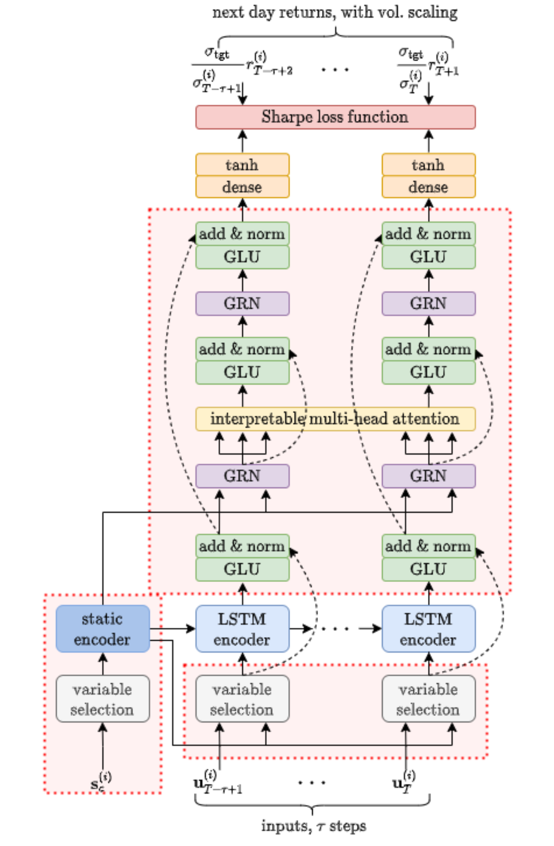
Reference Paper Model Architecture
Inputs: 𝛕 time steps of the stock i
Static Encoder
Variable selection
LSTM encoder
Gated Linear Unit (GLU)
Gated Residual Network (GRN)
Interpretable Multi-Head Attention (IMHA)

Slide 9
Variable Selection Network & Static Encoder
Variable Selection Network
Based on the idea that you have multiple features that belong to one feature
Take a weighted average of the features belonging to the same variable
Not implemented in our models because it is not applicable
Static Encoder
Encodes information for static covariates
In the paper they used it to encode what kind of asset the model was predicting
Not implemented because not directly applicable (all instances of the same asset class)

Slide 10
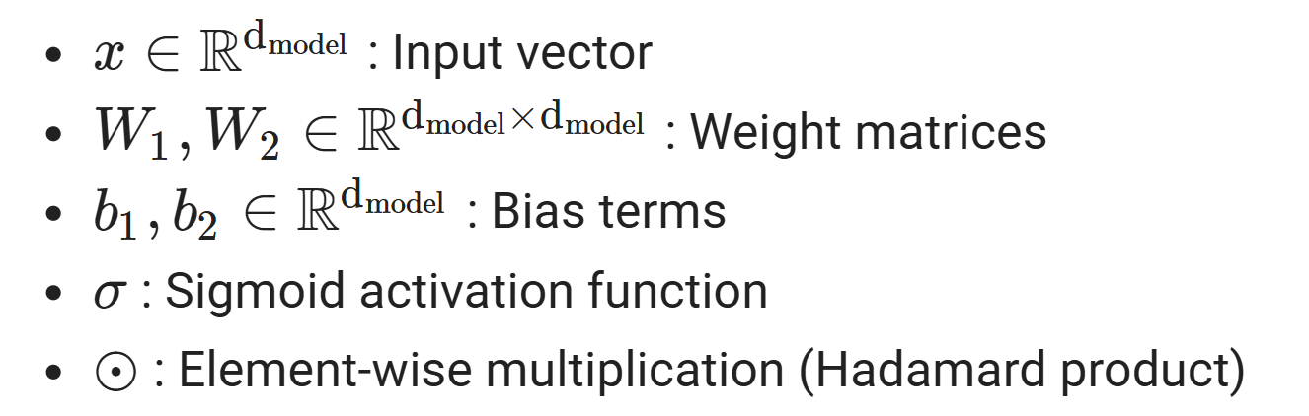
Gated Linear Units (GLU)
Suppress components of the architecture that aren't necessary
Applied position wise

Slide 11
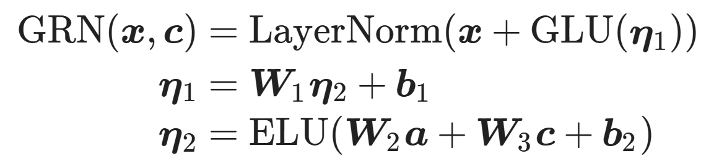
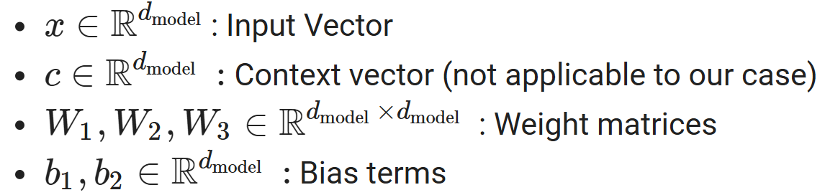
Gated Residual Network GRN
Allows the model to only apply non-linear processing when needed
Applied position wise

Slide 12
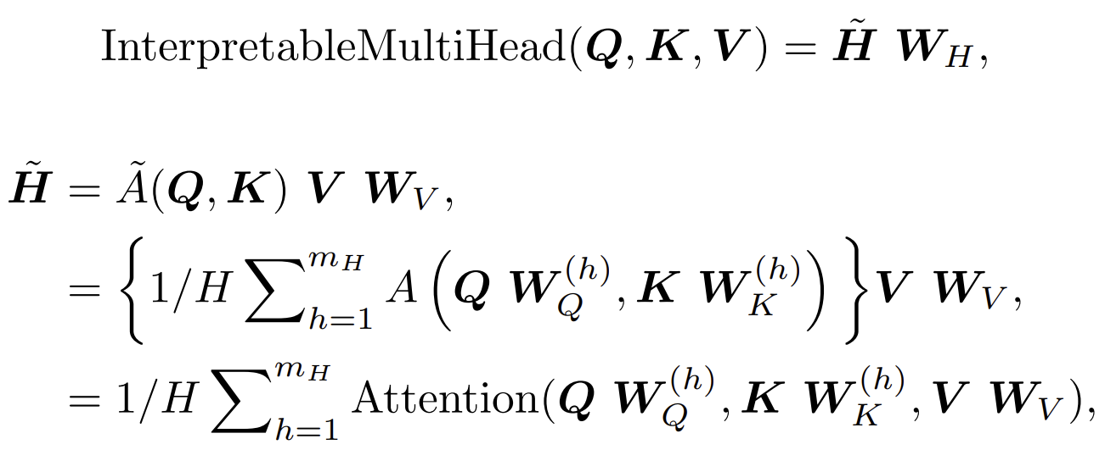
Interpretable MHA
Similar to standard MHA
Share values across all attention heads
Given that different values are used in each head, attention weights alone would not be indicative of a particular feature’s importance

Slide 13
Model Architecture: Self-Attention Momentum Transformer
Main Components
LSTM Encoder
GRN Components
(Regular) Multihead Attention
Motivation:
Finding out if using the custom attention architecture is beneficial over using regular multihead attention

Slide 14
Model Architecture: GRU Momentum Transformer
Main Components
GRU Encoder
GRN Components
Interpretable Multihead Attention
Motivation:
Literature tells us for some tasks LSTM networks are better than GRU ones but for others it’s the other way around.

Slide 15
Model Architecture: CNN Momentum Transformer
Main Components
LSTM Encoder
CNN Components
Interpretable Multihead Attention
Motivation
CNNs have the benefit of having fewer parameters than fully connected networks, making them better suited for handling noisy data due to their efficient feature extraction capabilities.
Architecture
We treat the different time steps of the sequences as different channels.

Slide 16
Benchmark models
Transformers (Encoder only and Encoder-Decoder)
LSTM model
Random Forest model

Slide 17
Transformer- Components Encoder
Neural network architecture designed for sequential data, leverages self-attention for efficient parallel processing to capture long-range dependencies, widely used in NLP.
Transformer Encoder Layer:
Multi-Head Self-Attention: Allows the model to focus on different parts of the sequence simultaneously
Feed-Forward Network Applies Transformation to each position
Layer Normalization: Stabilizing training

Slide 18
Transformer- Components Decoder
Target Mask: Each position in the target can only attend to previous positions, not future ones
Transformer Decoder: Processes the target input (tgt) along with the encoded source (src)
Output Linear Layer: maps output of the transformer to the target feature dimension
Tan Activation: Ensures output values are between -1 and 1

Slide 19
Long Short-Term Memory (LSTM) Model
Long short-term memory (LSTM) is a variation of the RNN architecture. RNN models can only memorize short-term information, LSTM can better handle long term relationships in the data. Moreover, RNN models suffer from the vanishing gradient problem for long data sequences; however, LSTM can reduce this issue.
Components:
LSTM Layer: Captures sequential dependencies
Dropout Layer: Regularizes the model
Linear Layer: Maps hidden state output to the desired output size
Tan Activation: Ensures output values are between -1 and 1

Slide 20
Random Forest Model
The Random Forest model is bagging based ensemble learning method used for regression and classification tasks. It operates by constructing multiple decision trees during training and outputting the average prediction of the individual trees to improve predictive accuracy and control overfitting.
Components:
RandomForestRegressor: sklearn model
n_estimators: number of trees in forest
max_depth: maximum depth of trees
criterion: measurement of split quality (squared error)

Slide 21
Training
Training
Batches shuffled at every epoch
Gradient clipped
Optimizer: Adam
Loss function: MSELoss
Long time to train some models (≈ 4 hours for GRU Momentum Transformer)
Mostly on CPU because free GPU on colab was used up quickly

Slide 22
Hyperparameters Optimization & Evaluation Protocol
Hyperparameters Optimization
Implemented Random Gridsearch
Not enough power and time to run it for the large models
Evaluation Protocol
Time-based Splitting (15% of the most recent part of the time series)
Testing on unseen Test Set
MSE as Evaluation Metric

Slide 23
Evaluation Results
MODEL | # PARAMETERS | TEST LOSS
IMHA Momentum Transformer | 119246 | 3.9019851267221384
Self-Attention Momentum Transformer | 140206 | 3.9260342489287723
GRU Momentum Transformer | 126751 | 4.01184778381139
CNN Momentum Transformer | 101919 | 3.907413617038401
BENCHMARK MODEL | # PARAMETERS | TEST LOSS
LSTM | 23451 | 3.998927083594026
Transformer (Encoder+Decoder) | 223205 | 4.068714729597559
Transformer Encoder | 154701 | 4.125702866062056
Random Forest | 701328 (# of Leaf Nodes) | 5.415680542938186 (based on test data subset)
Constantly Guessing Training Mean | 0 | 4.0670643

Slide 24
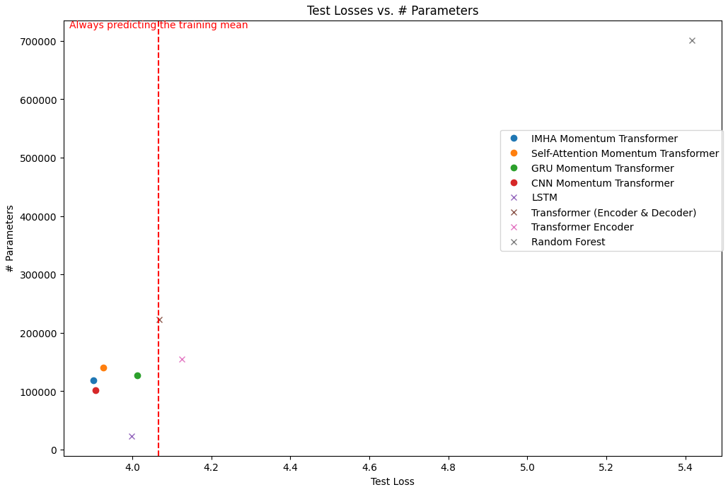
Evaluation Results

Slide 25
Conclusions
Results should be taken with a grain of salt given that the Hyperparameters were not optimized
After Hyperparameters Optimization results might be different
Momentum Transformers work better than benchmark models
More parameters ⇏ better results (at least across different models)
Modification study showed that for our given setup the LSTM, GRN and IMHA combination proposed by the paper performed better than the presented alternatives (GRU, CNN, regular MHA)
The CNN modification also performed well, suggesting potential in using CNNs for financial time series prediction, specifically by treating sequence elements as separate channels.

Slide 26
References
“Trading with the Momentum Transformer: An Intelligent and Interpretable Architecture” (https://arxiv.org/abs/2112.08534)
“Temporal Fusion Transformers for Interpretable Multi-horizon Time Series Forecasting” (https://arxiv.org/abs/1912.09363)
Data Set https://www.kaggle.com/competitions/optiver-trading-at-the-close

Slide 27
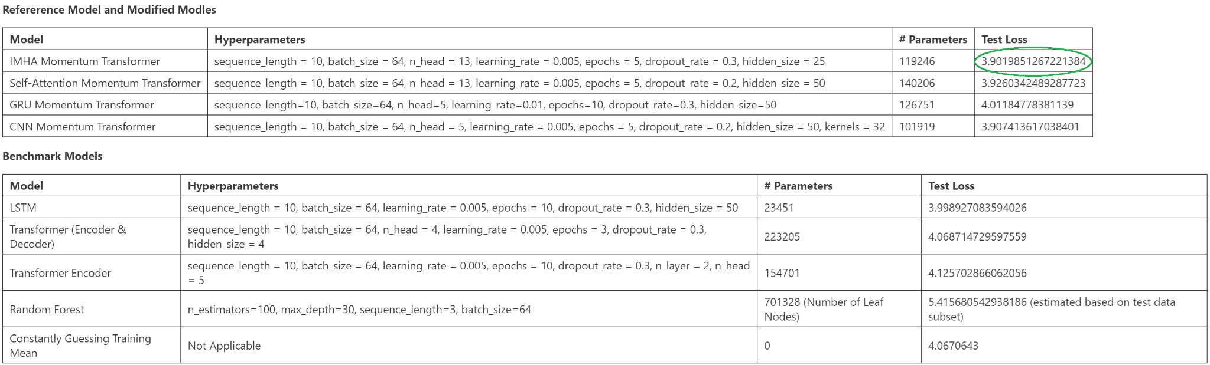
Appendix - Complete Testing Results

Slide 28
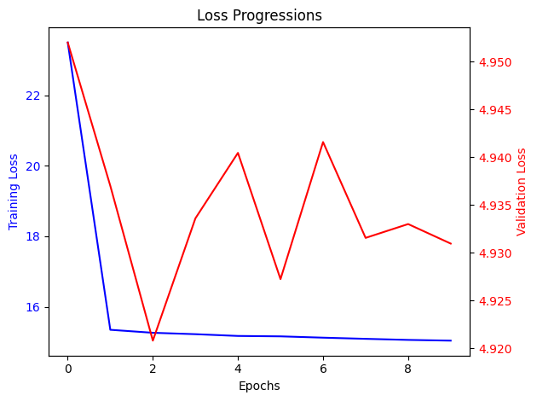
Appendix - LSTM benchmark model

Slide 29
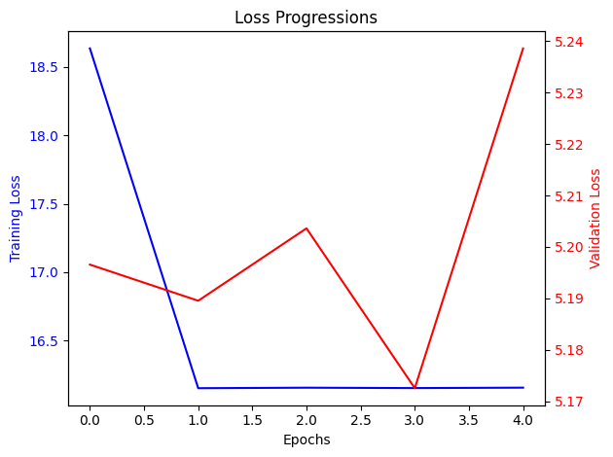
Appendix - Transformer (Encoder) benchmark model

