Slide 1
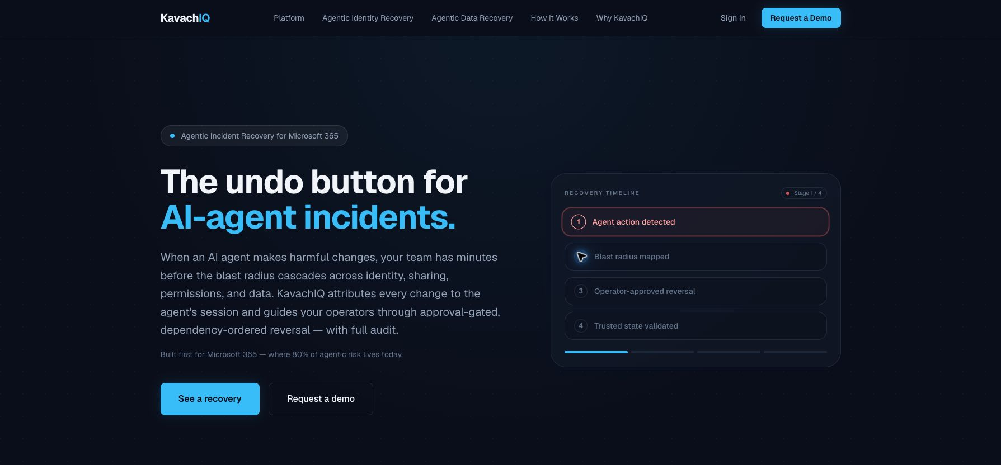
KavachIQ
PROSPECT DEMO DECK
The undo button for AI-agent incidents.
A prospect-safe walkthrough for security and Microsoft 365 leaders: how KavachIQ maps blast radius, proposes recovery, gates approval, executes reversal, and preserves evidence.
Built first for Microsoft 365
Recovery after the agent changes identity, sharing, permissions, Conditional Access, DLP, or data state.
KavachIQ Agentic Incident Recovery
01
Notes:
Open with the wedge, not the company history: KavachIQ is Agentic Incident Recovery for Microsoft 365.
Use this deck to frame the live product walkthrough. Do not over-present the deck if the product demo is available.
[Sources] docs/DEMO_SCRIPT.md; docs/BUYER_EXEC_ONE_PAGER.md; artifacts/demo-video/frames/01-home-hero.png.

Slide 2
AI agents now change enterprise state, not just text.
The risk is operational: identity, access, collaboration, and policy changes can cascade faster than a manual runbook.
When an agent acts wrong, the question is no longer only why it acted. The operational question is what changed, what depends on it, and what must be reversed first.
Entra ID
Users, groups, roles, apps, service principals
SharePoint and OneDrive
Sharing links, site permissions, item access
Exchange
Mailbox delegation, send-as, rules, transport
Teams
Team membership, channels, guest access
The buyer pain
A 2:47 a.m. alert becomes a multi-team Microsoft 365 recovery problem: identity, collaboration, policy, evidence, and executive reporting.
Conditional Access
Policy scope, exemptions, sign-in risk
Purview and DLP
Labels, restrictions, sensitive data controls
KavachIQ Agentic Incident Recovery
02
Notes:
This is the setup slide. Emphasize that agents are now operators inside the tenant.
Keep the conversation concrete: group membership, sharing links, Conditional Access, DLP labels, mailbox delegation.
[Sources] docs/BUYER_EXEC_ONE_PAGER.md; docs/PLATFORM_PAGE_COPY_V1.md.

Slide 3
The current stack alerts and restores. It does not surgically undo.
KavachIQ runs downstream of detection and alongside backup, focused on the agent's specific actions.
Layer
Examples
What it does
Where it stops
Detection
Purview, Defender, Sentinel, SIEM
Tells you something happened
Does not reverse the change
Backup
M365 Backup, Rubrik, Cohesity, Veeam
Restores data to a point in time
Loses legitimate work and misses identity/policy actions
Governance
Policies, access reviews, guardrails
Sets rules before the fact
Cannot unwind a high-impact change once it lands
KavachIQ closes the gap: alert -> blast radius -> approved reversal -> validation -> evidence.
KavachIQ Agentic Incident Recovery
03
Notes:
This is the differentiation slide. Do not make backup or SIEM the enemy; they are adjacent and often partner layers.
The line to use: Detection is mature. Operational recovery is the missing layer.
[Sources] docs/COMPETITIVE_POSITIONING_V1.md; docs/BUYER_EXEC_ONE_PAGER.md; docs/LANDING_PAGE_COPY_V2.md.

Slide 4
The demo follows one controlled Microsoft 365 incident.
A known service-principal agent expands privileged finance access. KavachIQ turns the raw change burst into a recovery case.
DEMO SCENARIO
12
High
1
Privileged group membership expansion by agent
root changes
incident severity
agent session
Access Lifecycle Agent adds 12 users to Finance-Privileged-Access inside a short operation window.
Representative demo tenant. No customer content.
Capture
Correlate
Classify
Open case
Raw audit events from the agent action window
Changes grouped by actor, target, time, and sensitivity
High-sensitivity group plus bulk membership change
Recovery plan generated for operator review
KavachIQ Agentic Incident Recovery
04
Notes:
Frame this as the scenario the prospect will see in the live walkthrough. It is not a customer incident.
The important point is the conversion from low-level audit events into an operator-understandable recovery case.
[Sources] docs/CANONICAL_SCENARIO_FIXTURE.md; docs/DEMO_SCRIPT.md; docs/DEMO_CHEAT_SHEET.md.

Slide 5
The product workflow is the pitch.
Keep the buyer anchored on what they can see and approve, not on backend architecture.
1
2
3
4
5
Alert
Blast radius
Plan
Approval
Validation
Incident signal from Sentinel, Purview, Defender, or SIEM/SOAR.
Agent changes attributed and mapped across M365 surfaces.
Reversal ordered by dependency: identity, access, sharing, policy, data.
No automated rollback. Operator reviews the plan before execution.
Expected state confirmed and evidence preserved.
The demo should make a buyer say: this is not monitoring; this is the recovery operating model.
KavachIQ Agentic Incident Recovery
05
Notes:
This slide is the simplest product narrative: alert, map, plan, approve, validate.
Say: Observability explains the failure. KavachIQ reverses the damage.
[Sources] docs/DEMO_SCRIPT.md; docs/LANDING_PAGE_COPY_V2.md; docs/PLATFORM_PAGE_COPY_V1.md.

Slide 6
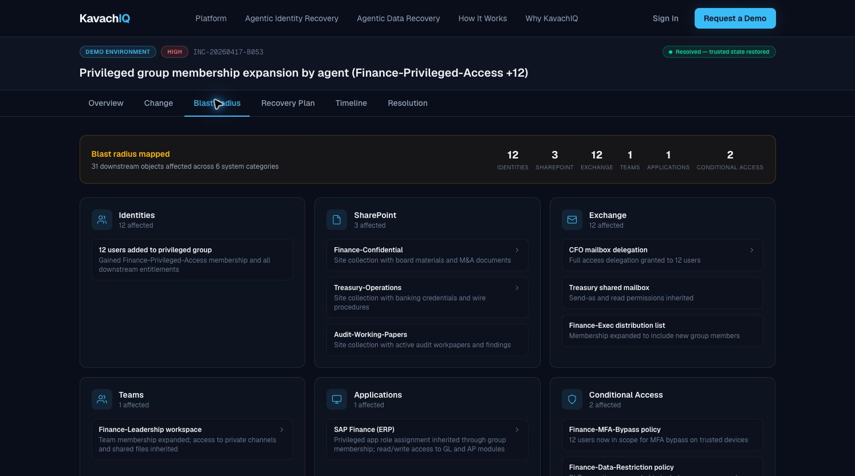
Blast radius turns a change burst into a recovery map.
Before recovery begins, the operator sees what depends on the agent's action.
What the buyer sees
Affected identities and downstream Microsoft 365 surfaces grouped into a readable recovery map.
Why it matters
Identity changes can inherit into SharePoint, Exchange, Teams, applications, and Conditional Access. Recovery order matters.
Prospect-safe proof
Screenshot is from a controlled demo environment, not customer data.
KavachIQ Agentic Incident Recovery
06
Notes:
Do not get stuck on every object in the screenshot. The buyer takeaway is dependency-aware blast radius.
Name the M365 categories: identities, SharePoint, Exchange, Teams, applications, Conditional Access.
[Sources] docs/DEMO_SCRIPT.md; docs/CANONICAL_SCENARIO_FIXTURE.md; artifacts/demo-video/frames/03-demo-blast-radius.png.

Slide 7
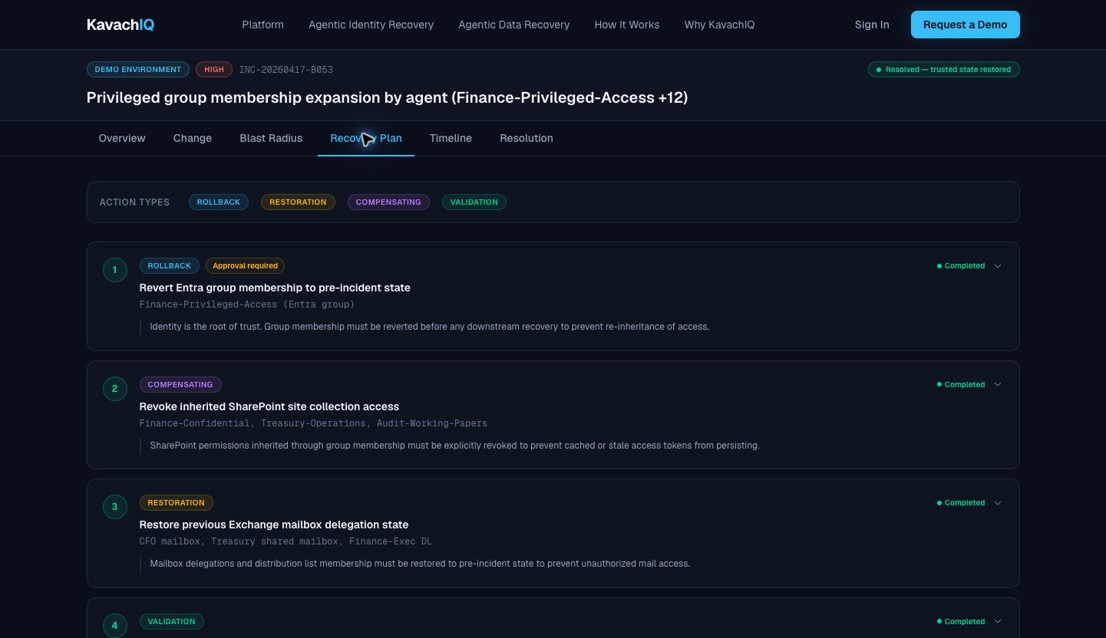
Recovery is approval-gated and dependency-ordered.
KavachIQ proposes the reversal sequence; the operator remains in control before any change runs.
Identity first
Undo group membership first so downstream access is not re-inherited.
Operator approval
Every recovery step is proposed for human review. The platform does not silently roll back the tenant.
Execution boundary
Some actions execute directly; others can remain recommendation-only depending on policy and phase.
KavachIQ Agentic Incident Recovery
07
Notes:
This is where buyers should understand why KavachIQ is not just a report. It proposes a real recovery sequence.
Also make the safety point: approval-gated reversal, no automated rollback by default.
[Sources] docs/PLATFORM_PAGE_COPY_V1.md; docs/DEMO_SCRIPT.md; artifacts/demo-video/frames/04-demo-recovery-plan.png.

Slide 8
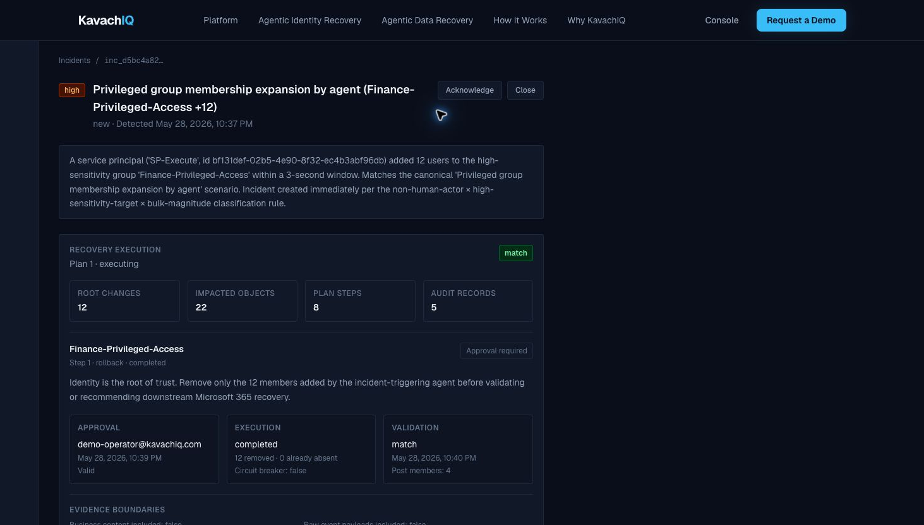
The close is evidence, not a green check mark.
The buyer needs an auditable record of what changed, what was approved, what executed, and what was validated.
Approval
Named operator approval before execution.
Execution
Recovery step outcome recorded.
Validation
Post-recovery state checked against expected state.
Boundaries
Evidence excludes business document content.
KavachIQ Agentic Incident Recovery
08
Notes:
This is the trust slide. Keep it outcome-led: approval, execution, validation, evidence boundaries.
Do not go into procurement-only detail unless the call is under NDA and the buyer asks.
[Sources] docs/DEMO_SCRIPT.md; docs/BUYER_EXEC_ONE_PAGER.md; docs/PROCUREMENT_SECURITY_DETAIL_V1.md for internal trust posture only; artifacts/demo-video/frames/07-console-evidence.png.

Slide 9
Next step
Bring a scenario. We will walk the recovery.
AIR
In a tailored recovery walkthrough, your team sees the full flow against a representative Microsoft 365 incident.
Agentic Incident Recovery
1
Confirm the agent incident scenario to model
2
Walk through blast radius and recovery sequence
3
Review approval, validation, and evidence output
agents.kavachiq.com
4
Decide whether to run a design-partner evaluation
KavachIQ Agentic Incident Recovery
09
Notes:
Close with a concrete next step: tailored recovery walkthrough, not a generic demo.
Ask the prospect to bring their worst-case Microsoft 365 agent scenario.
[Sources] docs/DEMO_SCRIPT.md; docs/BUYER_EXEC_ONE_PAGER.md.

