Slide 1
Parallel mycavity
Pavan Govindaraju Emeric Boigne
ME 469 Project

Slide 2
Objectives
Broad objective - Parallelizing mycavity
Two approaches
CPUs - Pavan
GPUs - Emeric

Slide 3
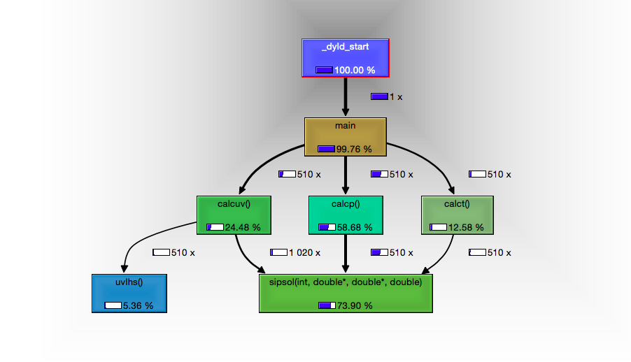
Default Code Profile
Number of calls = isteps(10) * timesteps(51)
3/4th of the time spent in sipsol

Slide 4
Objectives - CPUs
Use a more efficient solver
Currently uses SIP - Iterative
Direct solver?
Memory intensive (not for sparse-direct, but complex)
Must complete for useful results
Using a distributed linear solver?
Objectives
SuperLU - sequential sparse direct
Full throttle : FGMRES - distributed sparse iterative

Slide 5
SuperLU in mycavity
Support routines
Armadillo (http://arma.sourceforge.net/) - interface between mycavity (C++) and SuperLU (C)
Other supporting code - Sparse matrix class
Essentially replaced sipsol with sipsol_arma
Note that calcp() is NOT replaced with direct solver - extremely high condition number

Slide 6
SuperLU - Results
Solve time (For 100x100 grid) per timestep
SIP : 0.708s
SuperLU : 2.91s ☹
Direct solvers are expensive as well
Note that this is NOT a banded matrix. The band size depends on the grid.
Also something dumb : Dense solver
LAPACK : 1m 24s

Slide 7
M(assivel)y-parallel cavity
Definitely utilize sparse structure for this problem
Elemental (http://libelemental.org/) is a C++ distributed memory linear algebra library. Maintained by Stanford faculty Jack Poulson
Encapsulates MPI calls and other matrix support routines
In-built distributed sparse linear solver uses modified GMRES with a preconditioner
Successfully scaled mycavity to 2048 cores (and counting)

Slide 8
Elemental - Results
Solve time (For 100x100 grid) per timestep
SIP : 0.708s , SuperLU : 2.91s ☹
Elemental (1 core) : 0.431s ☺
Runtime test on NERSC Edison for 4000x4000 grid

Slide 9
Mycavity - Strong scaling
Tests performed on NERSC Edison for 1000x1000 grid
Speedup still increases beyond this range

Slide 10
Solver verification
First verified matrix structure and entries
Linear problem correctly constructed!
Verified one linear solve is gives similar results
This is checked for subsequent timesteps
Linear solve correctly performed!
Also field quantities correctly reassigned!
Finally, quantities of interest in mycavity.out are compared

Slide 11
Summary
Best way to speed up the code is to replace the solver
Used support routines and specialized libraries to replace mycavity solver
Two solvers demonstrated
SuperLU - sequential, sparse, direct
Elemental - parallel, sparse, iterative
Strong scaling demonstrated. Code speedup observed upto 2048 cores

Slide 12

References
Code is available on request(WiP) on GitHub https://github.com/gpavanb/mycavity
Poulson, Jack, et al. "Elemental: A new framework for distributed memory dense matrix computations." ACM TOMS 39.2 (2013): 13.
Li, Xiaoye S., et al. "SuperLU users’ guide.” Report, LBNL-44289 (1999).

