Slide 1
Agenda
BIDS
Background
Work completed to date with REACHnet
Extension to GPC
Catalyst for more VA-GPC work
GPC-VA-Linkage Pilot
Acxiom SDOH Data Integration Pilot

Slide 2

Brain Injury Data Sharing (BIDS)
Jacob Kean, PhD
VA Informatics and Computing Infrastructure (VINCI)

Slide 3
Background
Goals
Link DaVINCI data to health records for a cohort of patients identified with traumatic brain injury from private sector health systems that participate in the PCORI-funded Research Action for Health Network (REACHnet).
Describe the population and characterize health care utilization across the health systems.
Notes:
Resource center jointly funded by HSR&D and OI&T.
Been around for 10 years.
Salt Lake, Nashville, GLA, Bedford, Manhattan, Austin, remote sites

Slide 4


What is DaVINCI?
Officially: Department of Defense (DoD) and Department of Veterans Affairs (VA) Infrastructure for Clinical Intelligence (DaVINCI)
A joint streamlined governance structure and data exchange interface designed to provide data for research and operations
Notes:
DaVINCI is a data warehouse and analytic platform that combines DoD/MHS and VHA healthcare data
VA has sent over 53 billion rows of data to DoD for 41 million Veterans; DoD has transferred almost 19 billion rows of data to VA for
As a Government-developed middleware application, DAVINCI provides a desired level of interface between the data warehouses supporting the Electronic Health Record (EHR) applications for the Defense Health Agency (DHA) and Veterans Health Administration (VHA).

Slide 5
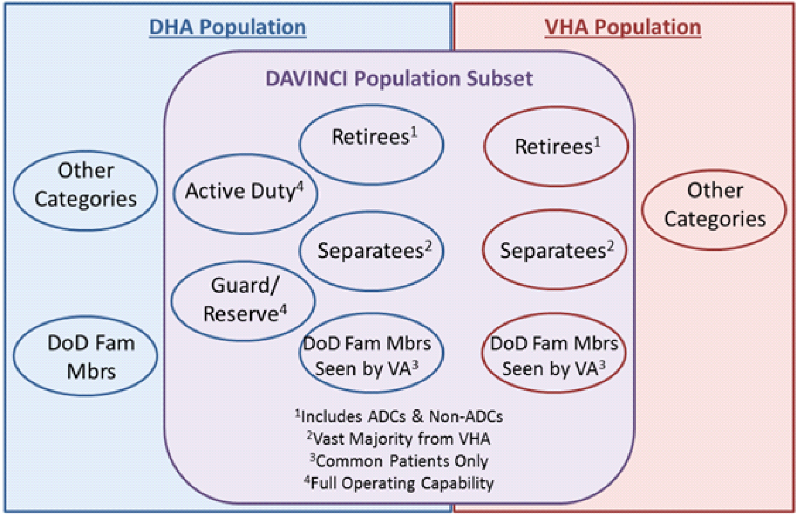
DaVINCI Cohort
Consolidated view of healthcare from accession to interment for Service women and men, Veterans, and other eligible patients receiving care from DoD or VA
Active Duty: 1.4M
Guard / Reserve: 380k
Retirees: 2.2M
DoD-only Separatees: 2M
Veterans: 9.2M
Deceased: 8.4M

Slide 6
Privacy-Preserving Record Linkage (PPRL)
Step 1. De-identified Overlap between DaVINCI x REACHnet
DaVINCI
REACHnet
DaVINCI consists of a
pre-linked VA DoD population
REACHnet Core Sites consist of 5 health systems covering Louisiana and Central Texas
Step 2. Flag Traumatic Brain Injury (TBI) Cohort from Overlapping Population
Overlap
TBI

Slide 7
How are de-identified tokens generated?
DaVINCI and REACHnet generate de-id tokens from PHI using Datavant DeID
6 de-identified site tokens generated per record
Zo4yqyLJe7w1MqUcsvvCOew5a0Sf6PSVS/aL2KjdxoM=
h7L2NYYmiyJ5io936pebgyNw4eh1xXMUTFset8KOCfA=
9CCwam3G5r/r3P4T2etTX9Nws4ueZDBuzn1B1CTuMWU=
V4ORjLaLacNSGPMhokSw8hpU2LMa8Wb9mi1S0W45qjg=
NosHifwJX2G+eY5eKecPVbClIh0G0AJKM6SxbgqfI7s=
Ik1QAMoiPDe1s+KO08AEHbcMHaJnl8GlFRUE5JBrJHQ=
John
Smith
03/27/1968
Male
Social
60602
DaVINCI and REACHnet generate a new set of transit tokens to be sent for linkage using Datavant Link
De-identified site tokens
De-identified transit tokens
Zo4yqyLJe7w1MqUcsvvCOew5a0Sf6PSVS/aL2KjdxoM=
h7L2NYYmiyJ5io936pebgyNw4eh1xXMUTFset8KOCfA=
9CCwam3G5r/r3P4T2etTX9Nws4ueZDBuzn1B1CTuMWU=
V4ORjLaLacNSGPMhokSw8hpU2LMa8Wb9mi1S0W45qjg=
NosHifwJX2G+eY5eKecPVbClIh0G0AJKM6SxbgqfI7s=
Ik1QAMoiPDe1s+KO08AEHbcMHaJnl8GlFRUE5JBrJHQ=
H9VrRJXpHuxdazEiVXAgDhe89bRATao5CJmq67+XoE4
oCNRVWt9Gh2jGRAsJKPUmNJijmg6C7UhSyQNmt59L1E
wCY5Z8bNJ6PUvQLtvbf8NIrik6rTB1zWOyjX6TlhHkc
LJ8lJ2WLUeZuM3H/x6/q2nIPebufOoV7jy+fPmIzRuc
mLmhc54xOz6/XJ/rDSIuJaejagc3q64NIVggQH9JAWA
nkEGXiE+6dATrY/Z26f5qJWoAatfMf10sixP8/o8Nvw=

Slide 8
Metrics
Comparison of cryptographic tokens generated between DaVINCI and REACHnet
Care Utilization was measured using inpatient, outpatient, and emergency department encounters
VA-rated disability for PTSD and disability from residuals of TBI
Comorbidity Measures including Charlson, Elixhauser, and VA Care Assessment Need (CAN) score

Slide 9

BIDS TBI Cohort (Identified with a TBI ICD Diagnosis in the VA OR DOD Ever)
Total N
1,344,975
No VA Encounters from Jan 1, 2010 to present
224,658
16.70%
Identified with TBI in VA, No VA Encounters from Jan 1, 2010 to present
45,335
3.37%
Identified with TBI in DOD, No VA Encounters from Jan 1, 2010 to present
180,884
13.45%

Slide 10
Initial Results
The population with service-connected disability is younger
Utilization encounters by percentage were similar when comparing VA use to REACHnet use overall
Those with VA-rated disability outcome
Utilized the VA at a higher percentage compared to the overall cohort
Favored utilization of the VA compared to REACHnet
Utilization is that those with a VA-rated disability can have reduced or no out-of-pocket costs for VA utilization.

Slide 11
Lessons Learned
Executing this work
Approval of hash/match software in VA Technical Reference Model
Development of an approvals pathway for sharing hashes and ingesting data
Commitment to new equipment that would allow the hash/match software to run on large datasets and allow the execution of advanced analytics

Slide 12
Conclusions
Successful linking in the BIDS project speaks to the feasibility of military, veteran and private sector linking for future projects
The reusable, multi-stakeholder approval pathway to address the technical, regulatory, privacy and security concerns of cross-system linkage projects developed in the BIDS project will expedite similar work

Slide 13
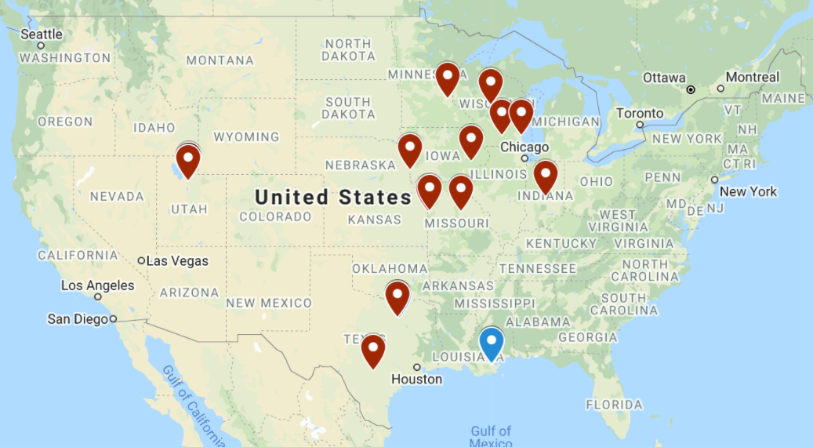
Current Status
Began with REACHnet linkage (4 systems, 4M; blue)
Expanding to Greater Plains Collaborative (12 systems, 20M; red)

Slide 14
Growing Ecosystem
VA
DoD
CMS
BIDS
DaVINCI
Opioid
PCORnet
AHRQ
HUD
FDA Sentinel
FDA
Rare Disease
Registries
HRSA
NIH
NDI to Sentinel
COVID-19
Surveillance
CTSA
CDC
Census
DOJ

Slide 15
Catalyst for more VA-GPC work
BIDS was practical proof of concept
Will yield insights in the clinical population
Funded as an operations project
Decisions were practical, not scientific
PaTH
REACHnet
GPC
Could be a wise investment
10% of the US general population
Unique socio-demographic profiles, unique exposures
“Allow us to enhance most everything that we are doing”

Slide 16
GPC-VA-Linkage Pilot
PCORnet Phase 3 Milestone
advance Datavant tokenization of the Veterans Administration (VA) and Department of Defense (DoD) electronic health records to support linkage across PCORnet and the corresponding governance process
Funding through BIDS
Demonstration linkage project to understand overlapping population between GPC EHR and DoD/VA EHR
Generate preliminary data for future funding opportunities (e.g., DoD)
Notes:
Staging in AWS
Current: Healthe EDW/Millennium, IDX, Pharmacy, Geocoding, SSDMF, Trial Databases
Future: Cancer Registry, Notes in AWS
PCORnet CDM in SnowFlake

Slide 17
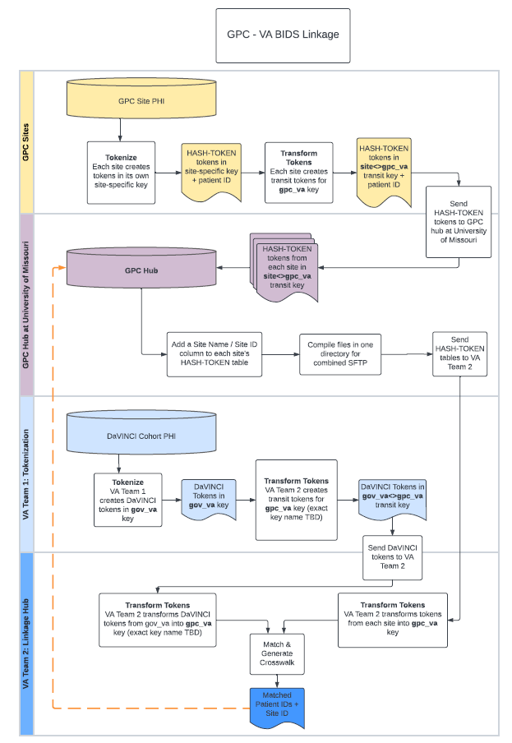
Project Timeline (tentative)
Complete workflow design – 09/22
Finalize site budget and SOW – 09/22
Datavant supplemental order form – 10/22
Non-human-subject determination at leading sites – 10/22
GPC DROC request submission – 10/22
Establish github repo and disseminate work plan – 11/22
GPC site generate gpc-va transit token and submit to MU – 01/23
MU aggregate, dedup and further transform transit token – 03/23
MU send hash token to VA where linkage will be performed – 05/23
VA generate crosswalk and send \back to GPC – 06/23
Analysis and characterizing overlapping population – 09/23

