Slide 1
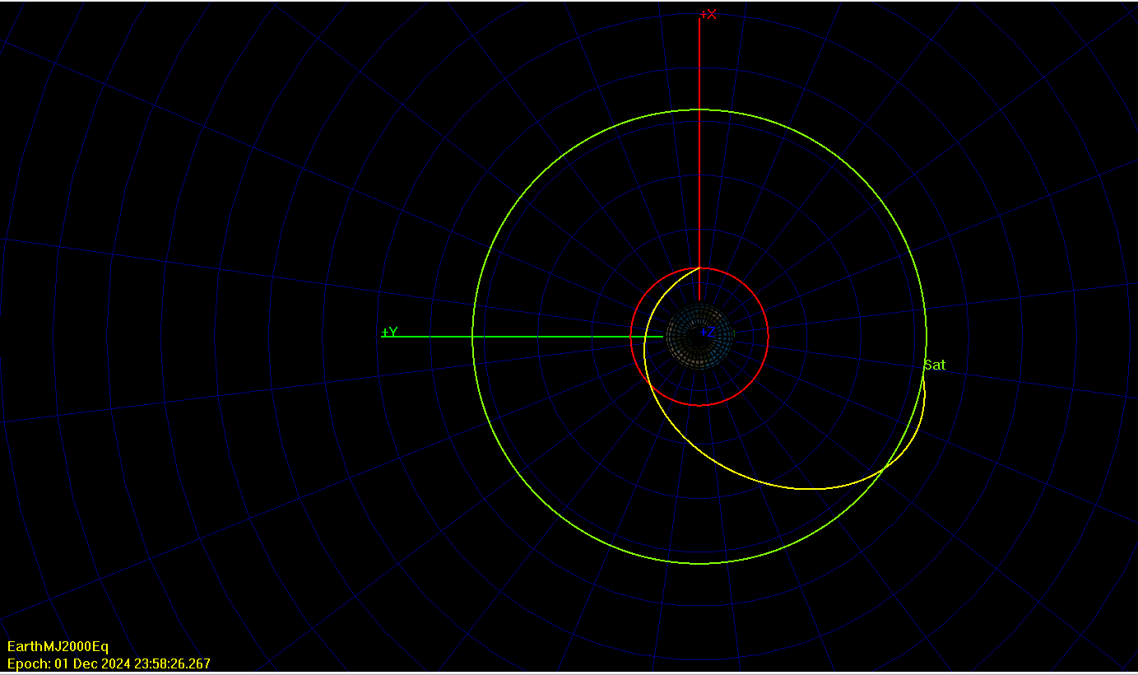






$${\overline{v}}_{1}$$
$$Δ\overline{v_{2}}$$
α₁
$${\overline{r}}_{1}$$
α₂
$${\overline{v}}_{2}$$
$$Δ\overline{v_{1}}$$
$${\overline{r}}_{2}$$

Slide 2
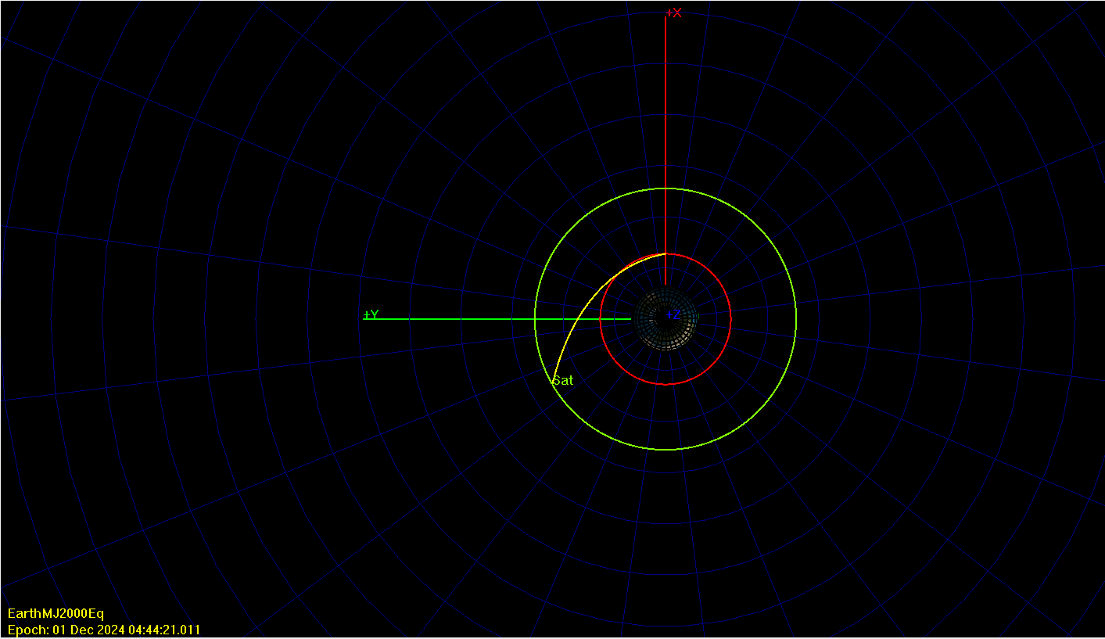






$${\overline{v}}_{1}$$
α₁
$${\overline{r}}_{1}$$
$$Δ\overline{v_{1}}$$
$${\overline{r}}_{2}$$
$${\overline{v}}_{2}$$
$$Δ\overline{v_{2}}$$
α₂

Slide 3
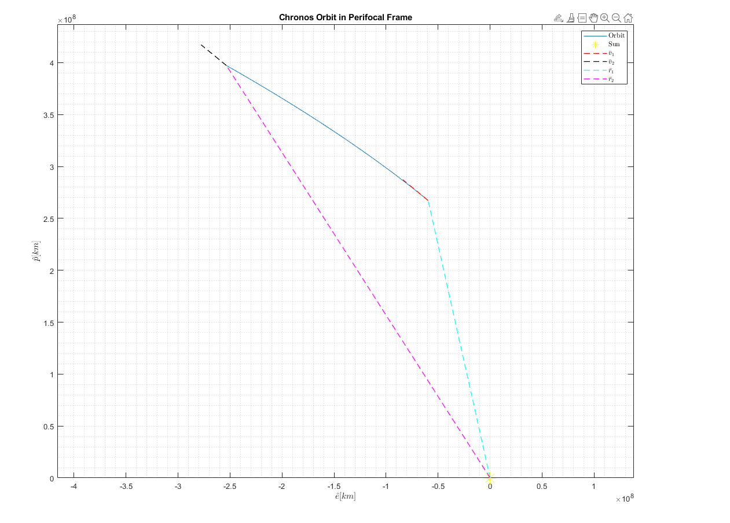




$$γ_{2}$$
L.H
$$γ_{1}$$
L.H
$$θ_{1}^{∗}$$
$$θ_{2}^{∗}$$

Slide 4
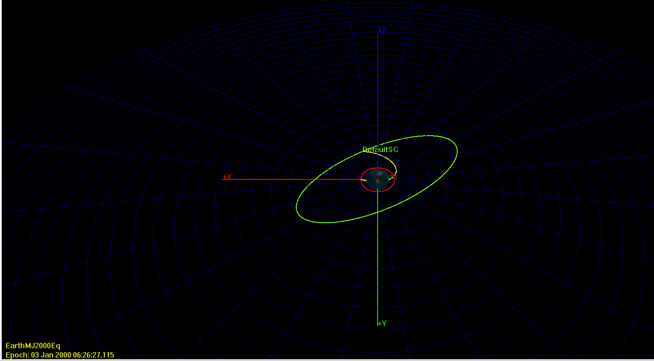


$$γ_{2}$$
L.H
$$γ_{1}$$
L.H
$$Δ\overline{v_{A}}$$
$$Δ\overline{v_{D}}$$
$$θ_{1}^{∗}$$
$$θ_{2}^{∗}$$

