Slide 1
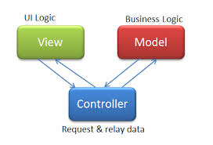
Setting up an MVC ASP.NET Project in Visual Studio using C# Tutorial Link

Slide 2
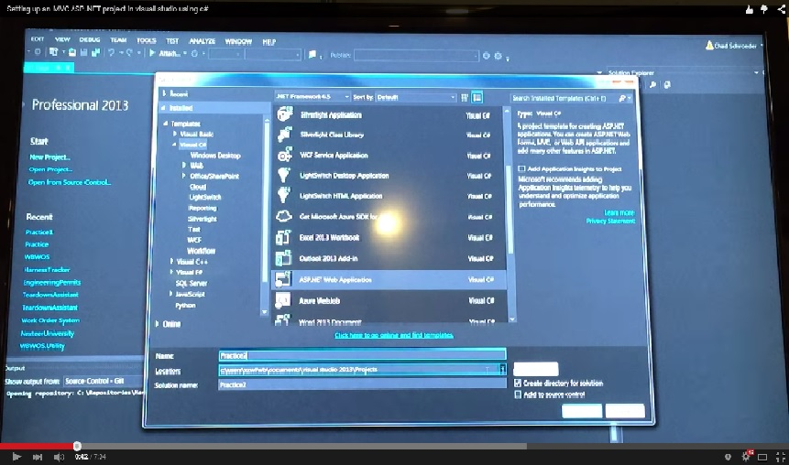
- Open Visual Studio 2013 and choose New Project on the left . - In the pop up choose ASP.NET Web Application - Name your project Practice2

Slide 3
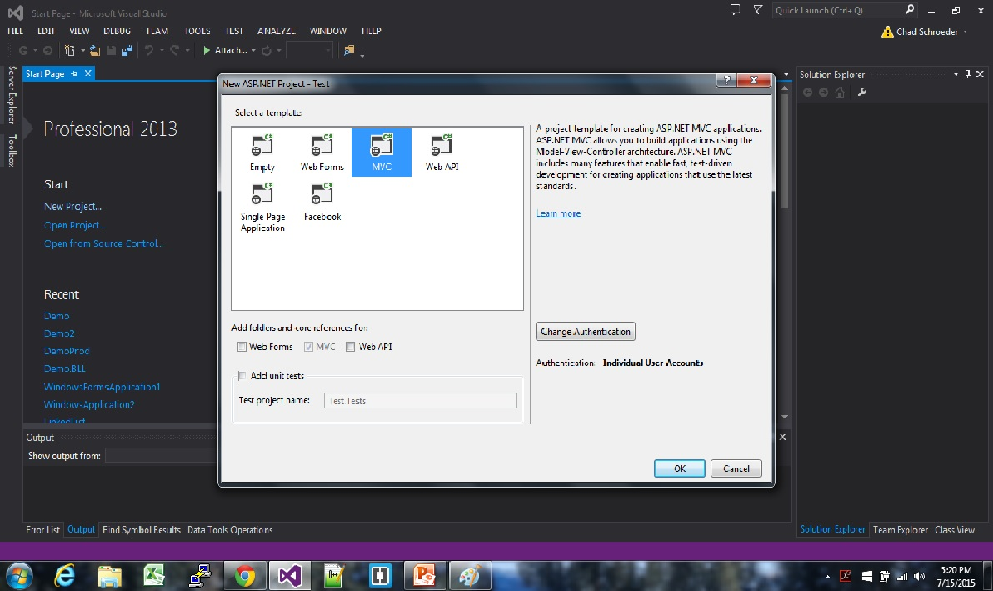
Choose MVC and click ok

Slide 4
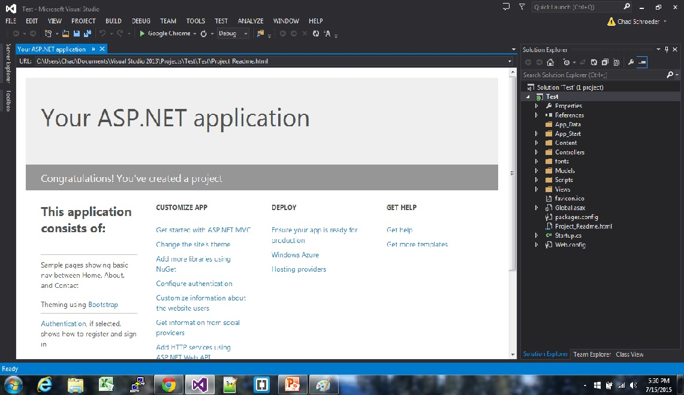
- A MVC project is loaded with some provided templates and folder on the right in the solution explorer - As you will see there are many folders including: Models , Views, Controllers, and scripts. - These folders will be the ones we will be focusing on for the time being.

Slide 5
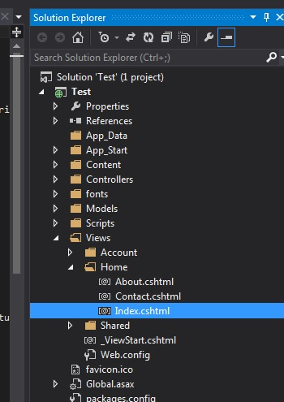
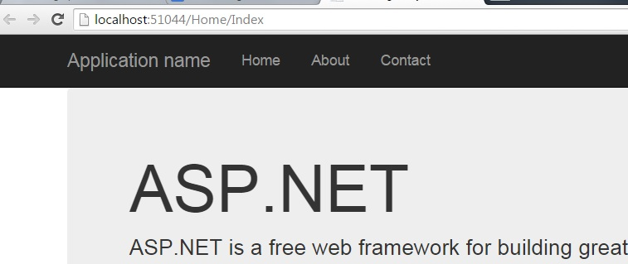
- In the Views folder there is a Home folder that contains a file called index.cshtml, this is the page that is first seen by a user - Up at the top there is a play button, when clicked the project is launched and the view file index.cshtml is loaded. - This home view also contains links to other views such as contact and about views in the nav bar up top.

Slide 6
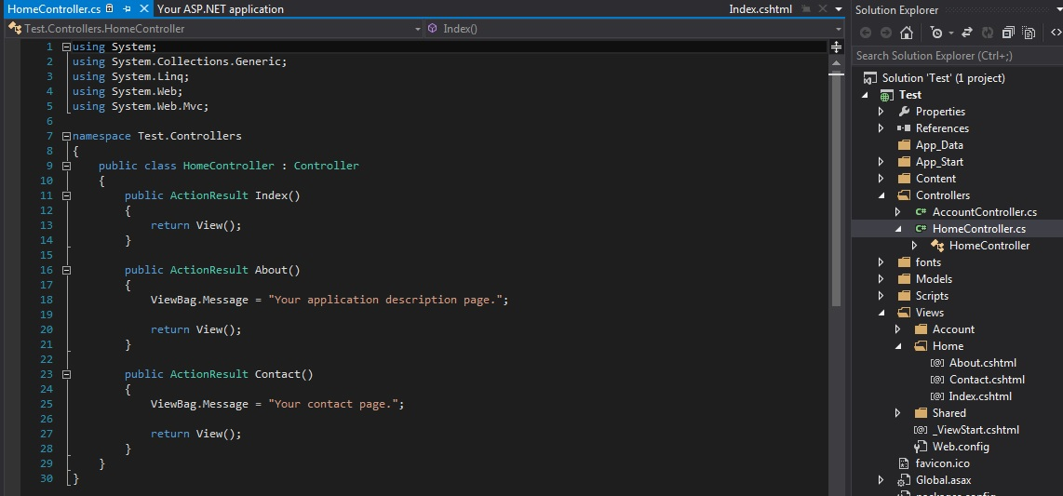
- MVC has controllers which are classes that contain actions or methods, such as, index(). - Action within these controllers can return View() which will render the views to the response. - As you see in the Views/Home folder there were 3 view files - For each view in the Home folder there is a corresponding action in a controller called Home (this is the naming convention typically used)

Slide 7
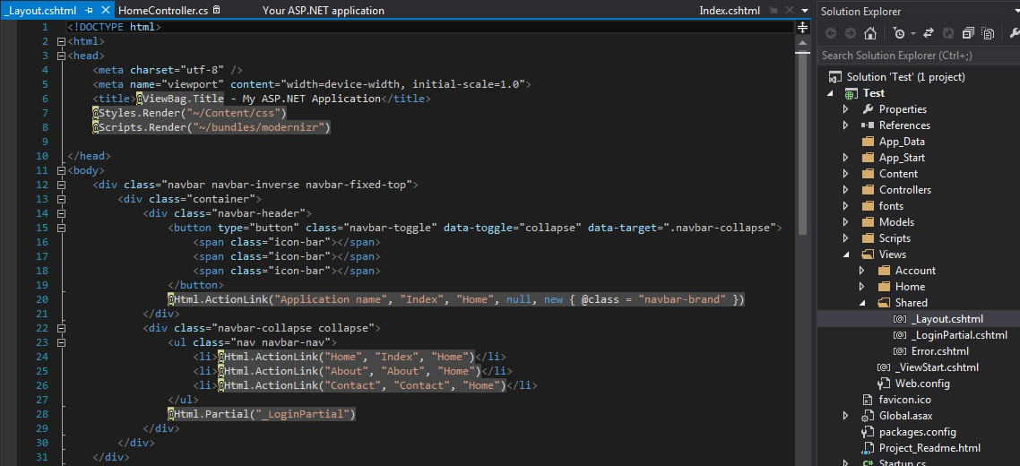
- There are some other folders you will become familiar with as you progress through the tutorials. - One folder is the Content folder which contains your css stylesheets and external stylesheets such as bootstrap. - Another folder called AppStart contains classes that run when the project starts up automatically. - There is a Views/Shared folder which contains a view call _Layout.cshtml and can be used by any other view in the project that you want it used. - This Layout view contains things like the nav bar and login/out options.

Slide 8
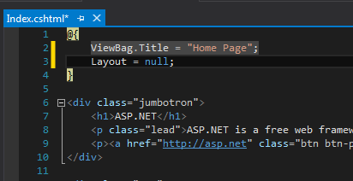
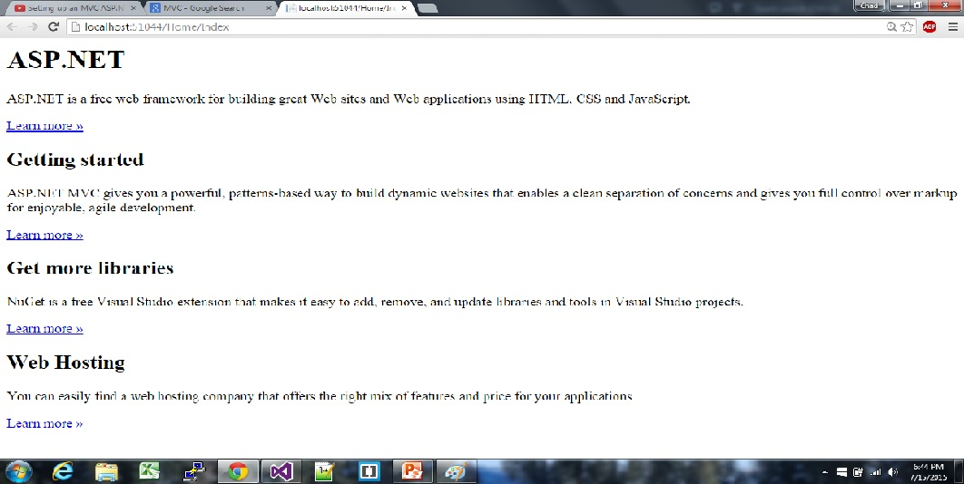
- On the top of the index.cshtml file in views there is something called a Viewbag and inside of it you can set the layout to be null for that view which means it is not used. Ex. @{ Layout =null ;}

Slide 9
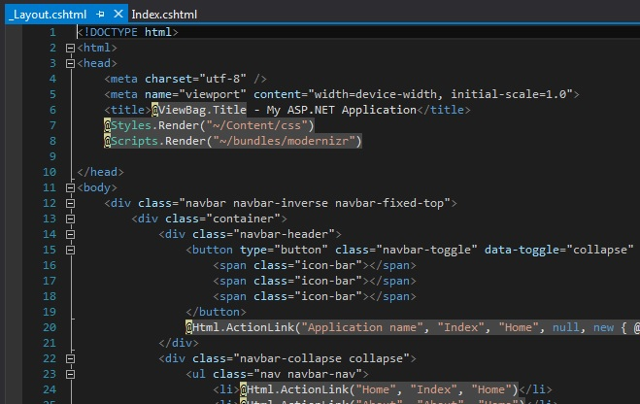
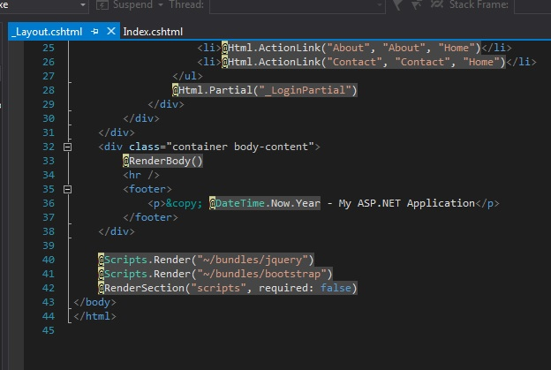
- You can also render stylesheets and Script bundles in the Layout - This will Render them in any other View that is including the Layout
At bottom of body
In <Head>

