Slide 1
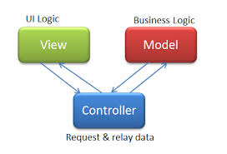
MVC Setting up a local database Video Tutorial 3

Slide 2
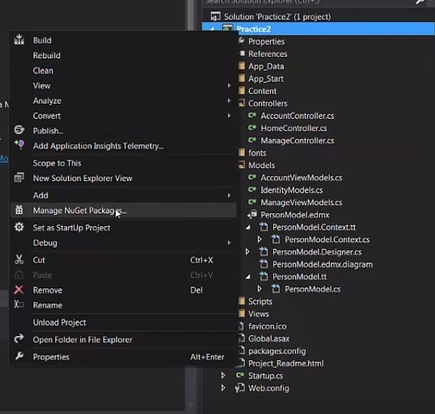
- To get started you need to right click on your project name in the solution explorer - Right click on the name, and choose Nuget Package Manager

Slide 3
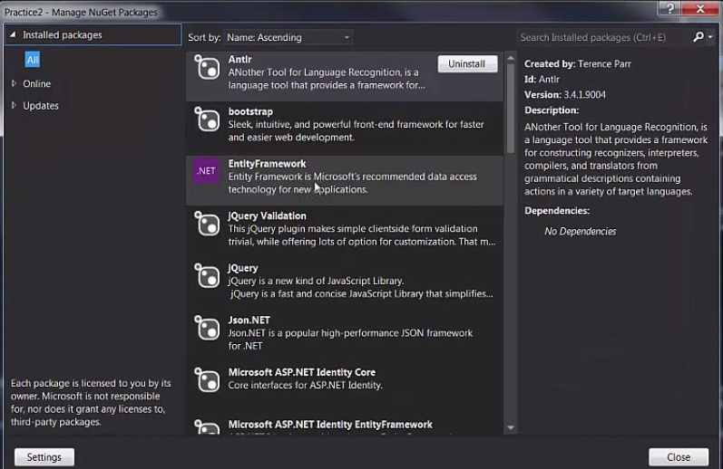
Choose Entity Framework and install

Slide 4
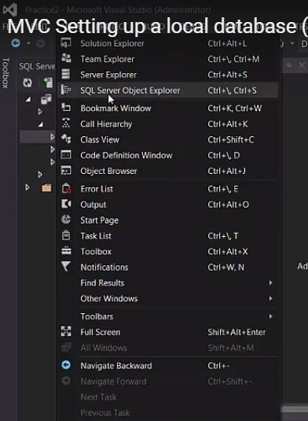
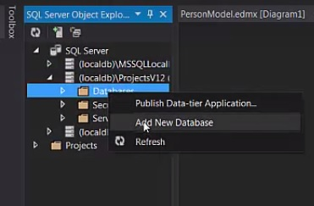
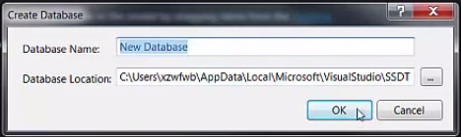
-Click on View in the top left corner and choose SQL Server Object Explorer - Expand your local db and right click on data bases and choose add new data base -Finally name your new database

Slide 5
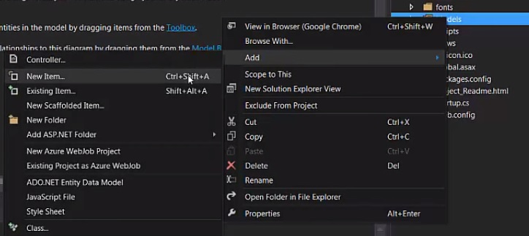
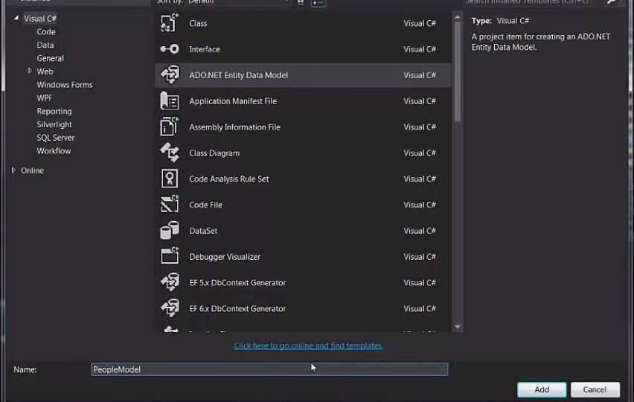
- Now go over to your models folder and right click, go to add, and then add a new item - In the pop up choose ADO.NET Entity Model, name it and click add

Slide 6
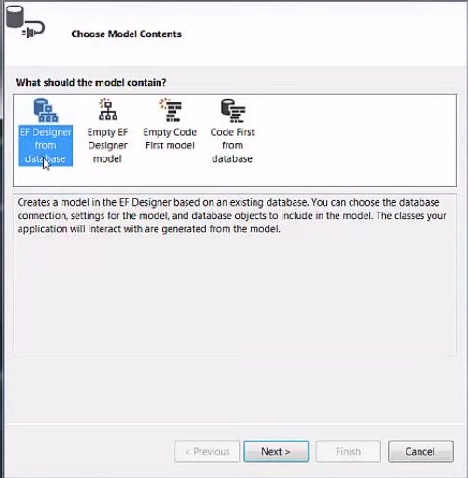
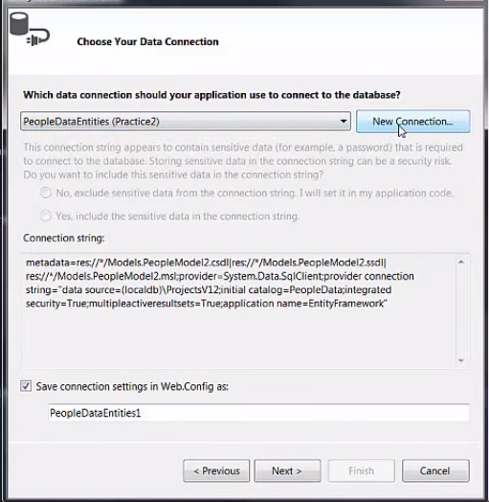
- In the next pop up you will want to choose EF Designer from database and click next - Another pop up will occur and you will want to click new connection

Slide 7
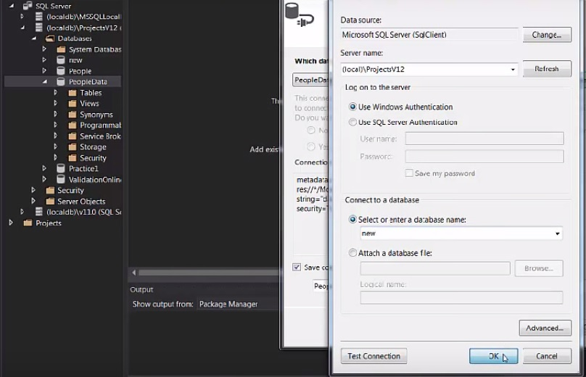
- Now in the this pop up you need to enter in the local db name in the box labeled Server Name. The name you want is located to the left where we added the new database and named it new. -Now in the box labeled – Select or enter database name, enter the name of the database we created (new) and click ok

Slide 8
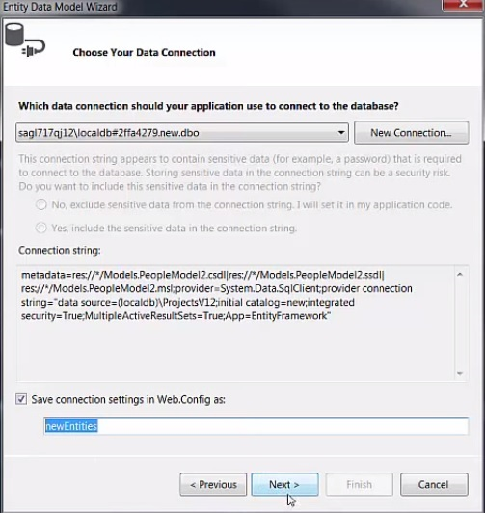
- In the next window you can see in the box at the bottom our entity will be referred to as newEntities throughout out program -Press Next then Finish on the next window

Slide 9
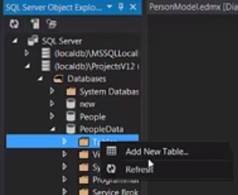
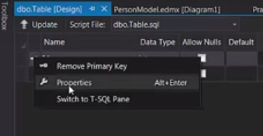
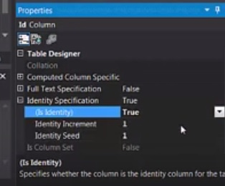
- Our new database will show up in the SQL Object explorer to the left - Expand the database (new) and add a table - In the table right click on id and choose add primary key (mine says remove because it is already the primary key) - Right click again on the id and choose properties, In the bottom right properties window find identity specifications and expand it. -You will see a little dropdown to the right, click it and set is Identity to true -This will ensure that every new entry has a unique id, incremented by one

Slide 10
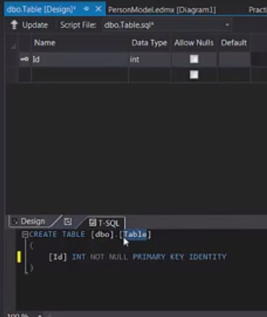
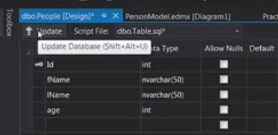
- Next name your table, I called mine people - Add a couple columns (fName,lName,age) with the the names being nvarchar(50) and the age being an int - Uncheck the nullable box so that all fields are required - Last click update, to update your entities. Then save all.

Slide 11
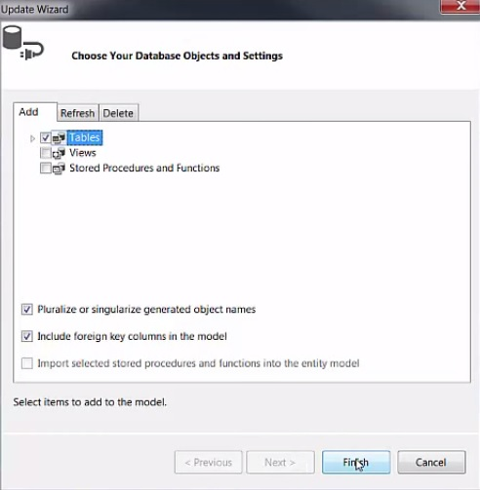
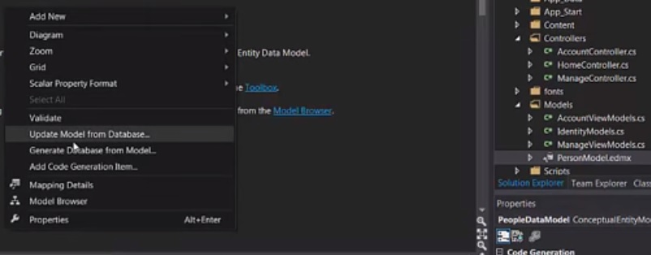
- To see our table in our edmx file we need to go over to our models folder and double click the edmx - In the window right click and click update - A window will pop up, check tables then Finish

Slide 12
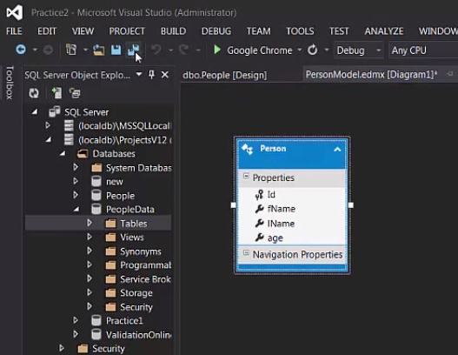
- Finally we see our table in our edmx which means we have successfully created a database and a table within it - Make sure you click save all

Slide 13
Here is a link to the video tutorial Video

