Slide 1
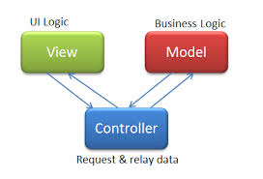
Creating data in our database Video

Slide 2
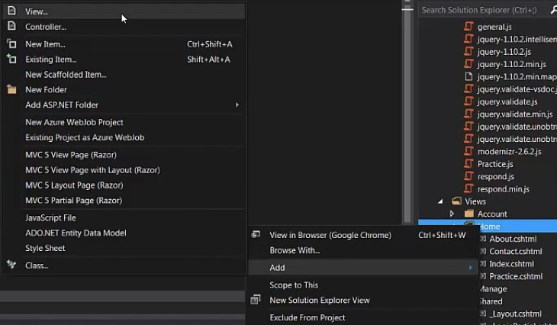
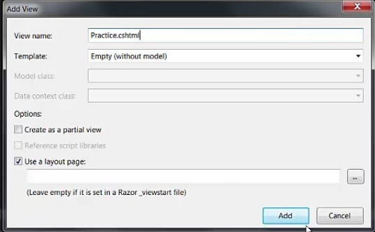
-First thing we are going to do is add a new view where we can enter information into inputs. -To do this we want to expand our views folder, right click on the home folder, go to add then choose view. - In the window that comes up we want to name our view Practice.cshtml and click add

Slide 3
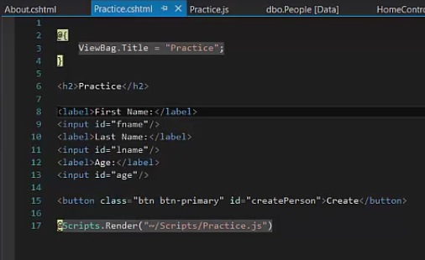
-On our Practice.cshtml page we are going to create a label and input for each of the following: First name, last name, age. - on each input we are going to want a id so we can access the values from our javascript. - These id’s will be fname, lname, age respectively - We will also add a Create button with an id = createPerson

Slide 4
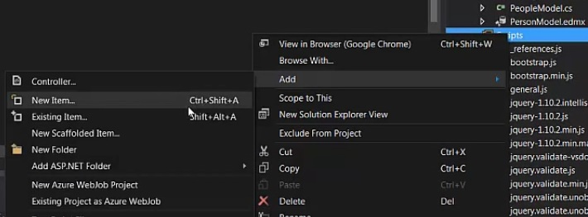
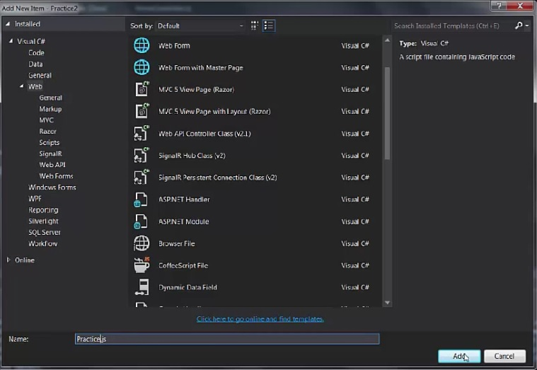
- Now we need to create our script for handling these inputs and our Create button - We need to go over to our scripts folder, right click on it, go to add and add new item. - We will choose javascript for the type of file and name it Practice.js

Slide 5
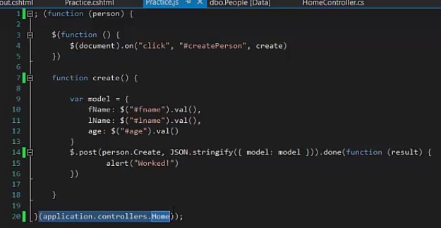
- In this javascript file we are going to wrap everything in a self invoking function. - We are going to pass the function a variable person - In the parenthesis at the bottom of the page we pass our navigation property that we created in our previous tutorial - This navigation property, if you remember, is basically a path to the home controller.

Slide 6
- Next we create a function that loads on document ready: $(function (){}) - Within that function we will create a function that has a click event listener, which is listening for the user to click our Create button. - Now, in the create function we build a object called model - We set some attributes for fName, lName, and age equal to the value within the inputs with the id’s we created earlier. - After the model is built a $.post (using Ajax) is performed - As you can see we use person (which stands for our Home controller) - We access the method Create in our home controller just by saying person.Create - We perform a JSON.stringify on the data we pass to format it correctly and assign our variable model to model, which represents the actual model we created in a previous tutorial -Finally when this is done a function will be passed the result and an alert should occur

Slide 7
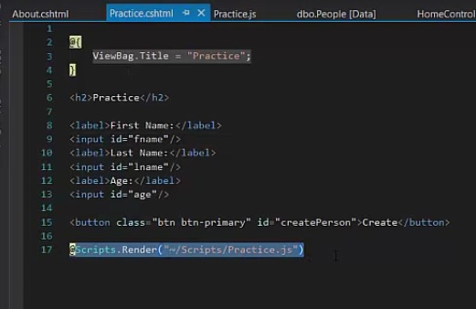
- Now we need to go back over to our Practice.cshtml file and make sure at the bottom we render our script that we just created.

Slide 8
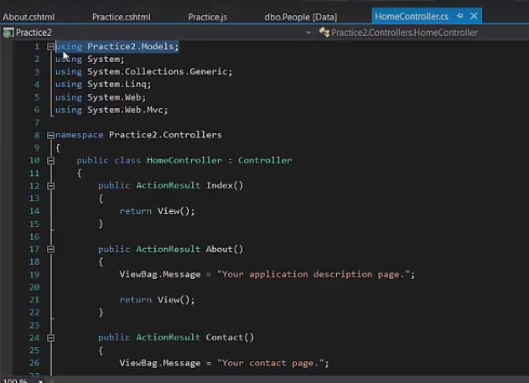
- Going over to our home controller, the first thing we need to do is add using Practice2.Models to our usings -We need this so we can use our PeopleModel and JsonResponse that we created in the previous video

Slide 9
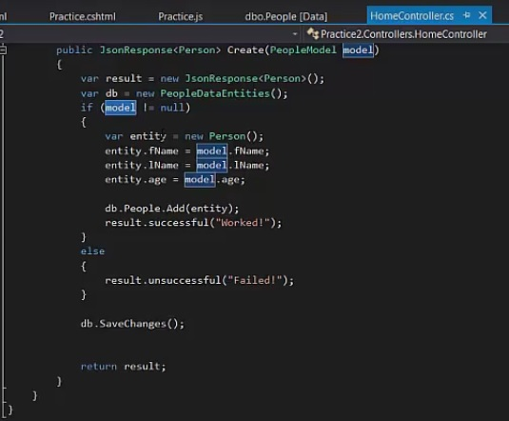
- Now in our Home controller we build our create method - We start by making it public and it will return a JsonResponse<Person>, this is followed by the name of the method Create - For parameters we are passing a PeopleModel called model, if you recall from the javascript - In the method we start by create a var result and making equal to a new JsonResponse<Person> - Next we create the var db to refer to our database - Then we check if model is null and if it is not we create a var entity equal to a new Person() - Now entity will have all the attributes we created for a Person (fName,lName, age) - So we assign entity.fName = model.fName (If you recall we made our var model with all the same attributes), entity.lNAme = model.lName … etc. - After assigning all properties we Add entity to our Person db -Then create a result.successful using our JsonResponse class with a message = “Worked!” -Lastly we save the changes to our db and end the method with: return result; - As you can see if model is null we return result.unsuccessful

Slide 10
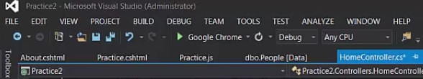
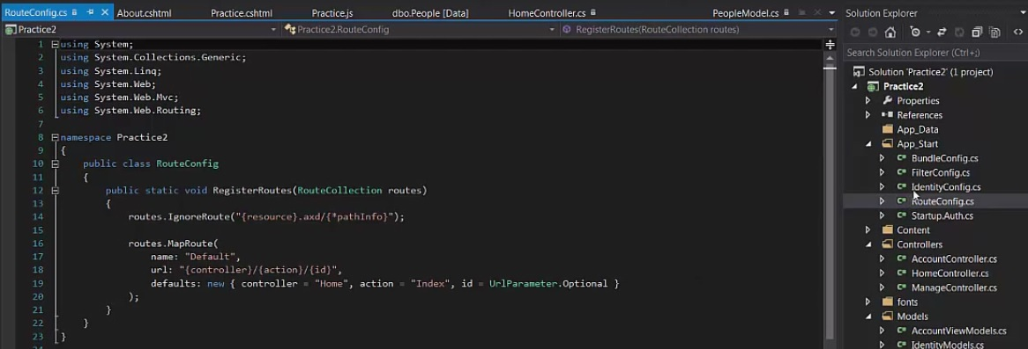
- Now lets load our project by pressing the play button at the top (mine is set to load in google) - The page will pop up on the default index.cshtml page - If you look in the App Start folder at the RouteConfig.cs class you can see within it that there is a default format used to access controller and methods ( this is auto created ) - The format is localhost/controller/method/any parameters

Slide 11
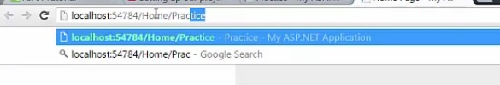
- So in our url we want to type in yourlocalhost/Home/Practice - Remember, our practice method will return the view practice.cshtml that we created containg our button and inputs

Slide 12
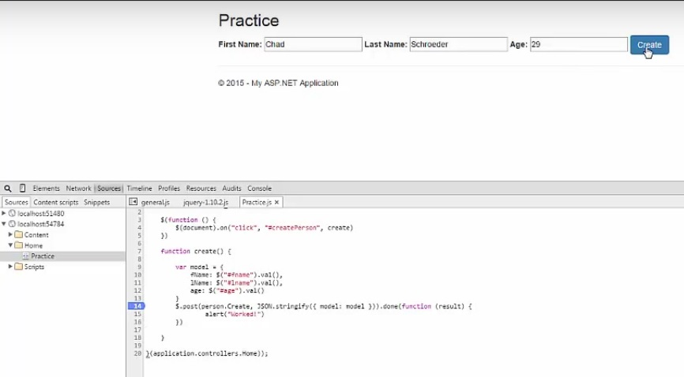
- Lets hit F12 to bring up our dev tools and set a break point on out $.post - Enter in some values into the inputs and press create

Slide 13
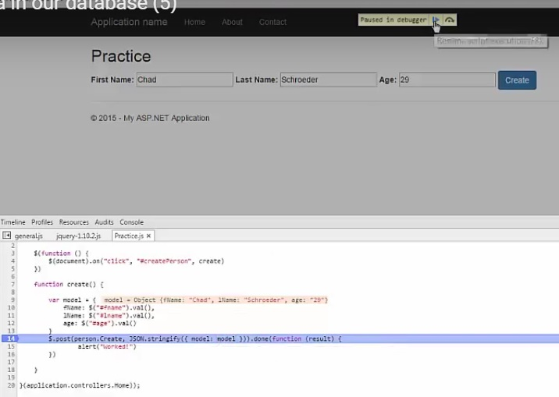
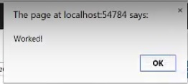
- As we can see, when we hit the break point the value of our var model are shown to the right of it. - This is a great way to make sure we are getting the correct values - We can hit the continue button at the top and see that our alert pops up, which is a good sign that our $.post worked corectly

Slide 14
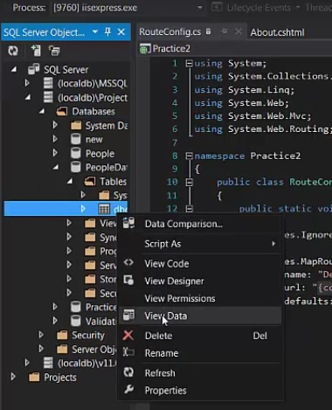
- Now lets go back to our code and in our SQL Server Object Explorer, expand your local db, expand the Databases folder within it, expand the databse you are working in, then the tables folder within that. - In the tables folder you will see your dbo file, which is the table we created previously, right click on that and click View Data to see if created any new data

Slide 15

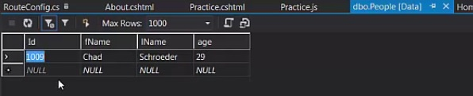
- At first you will see that there is no data at first, click the refresh button to update the table - Now you can see you newly created data!

Slide 16
Congrats!!! You have a working MVC project that creates data in your local db

