Slide 1
Laravel 5.0
PHP Web Application

Slide 2

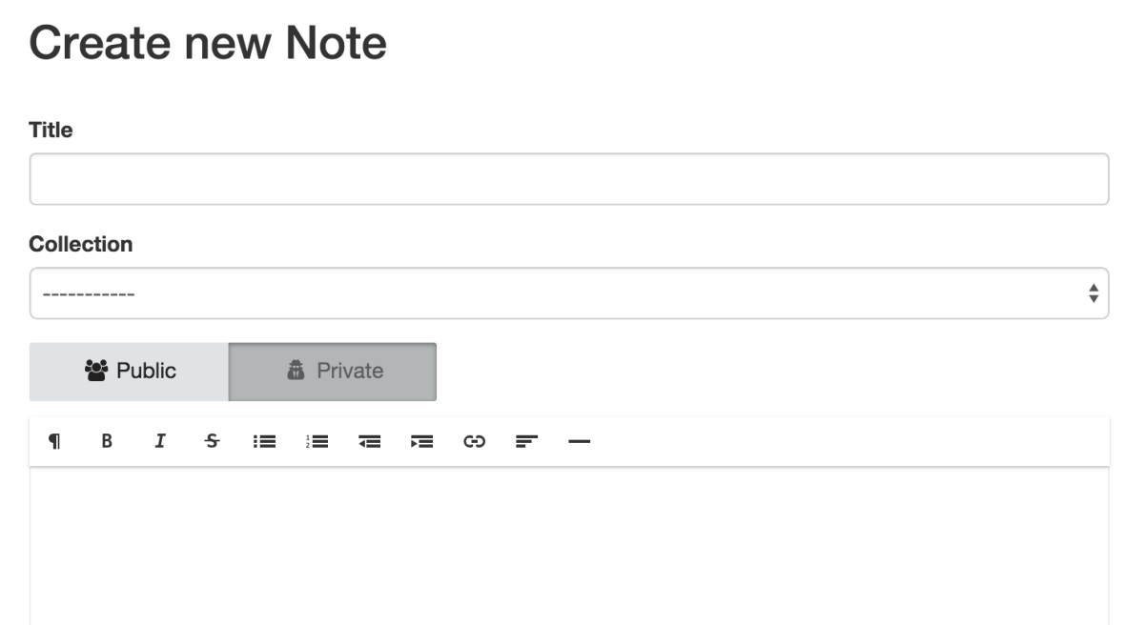

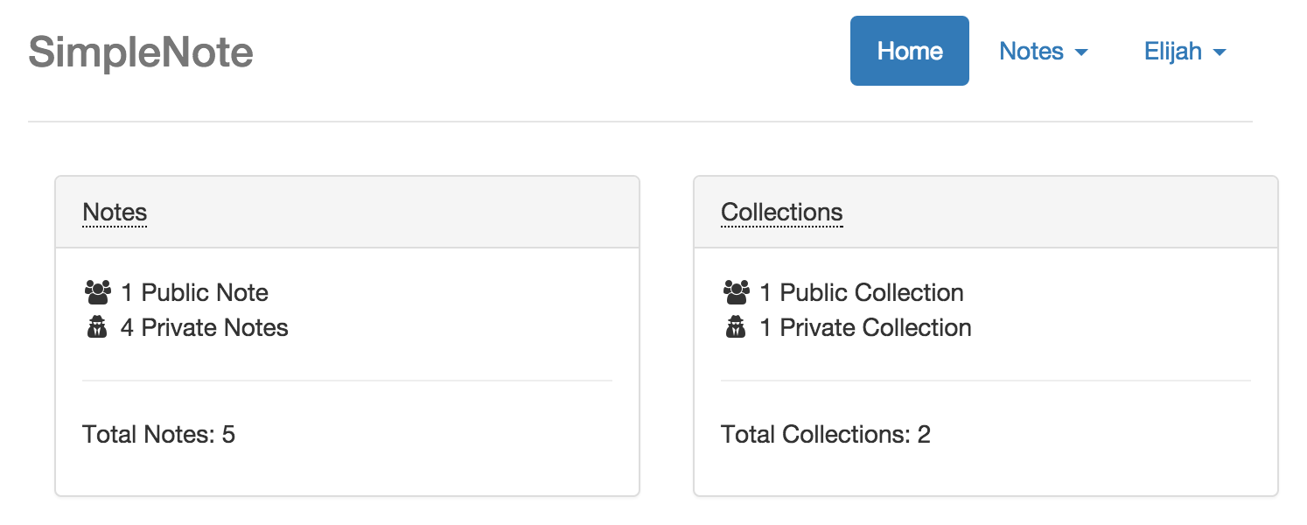

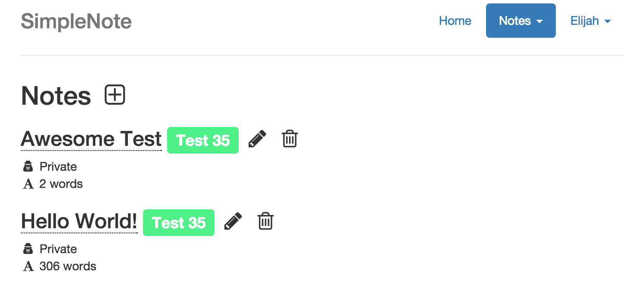

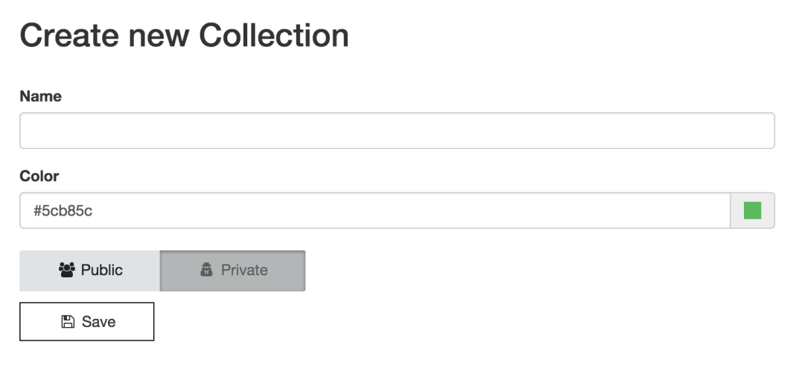
End Product
Simple Note Taking Application
Organize Notes in Collections

Slide 3
Implementation
Laravel 5.0 (PHP)
MySQL (Database)
Cloud9 (Web hosting)

Slide 4

Laravel 5.0
http://laravel.com/
PHP Web Application Framework

Slide 5

MySQL
http://www.mysql.com
SQL Database

Slide 6

Cloud9
https://c9.io
Online IDE and web hosting for small/public projects

Slide 7
Getting Started
Create free Cloud9 account

Slide 8
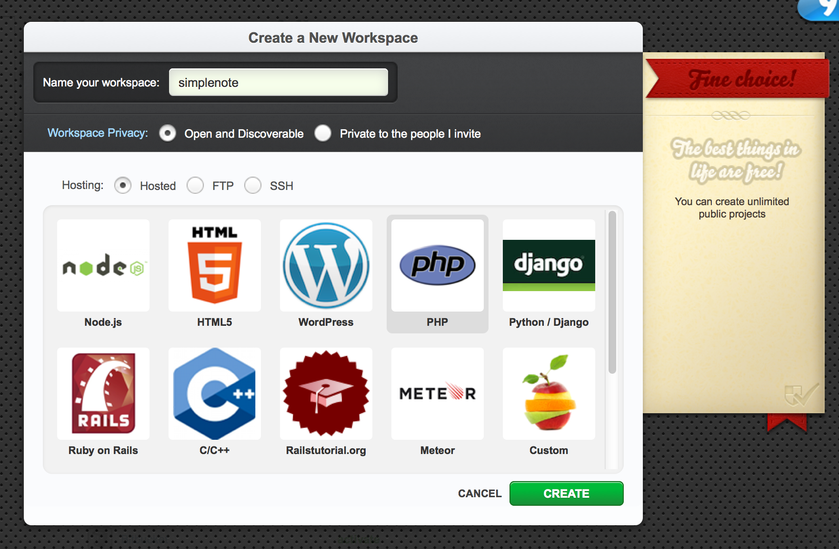
Create Cloud9 Workspace
Name it "simplecontacts"
Select "PHP"

Slide 9
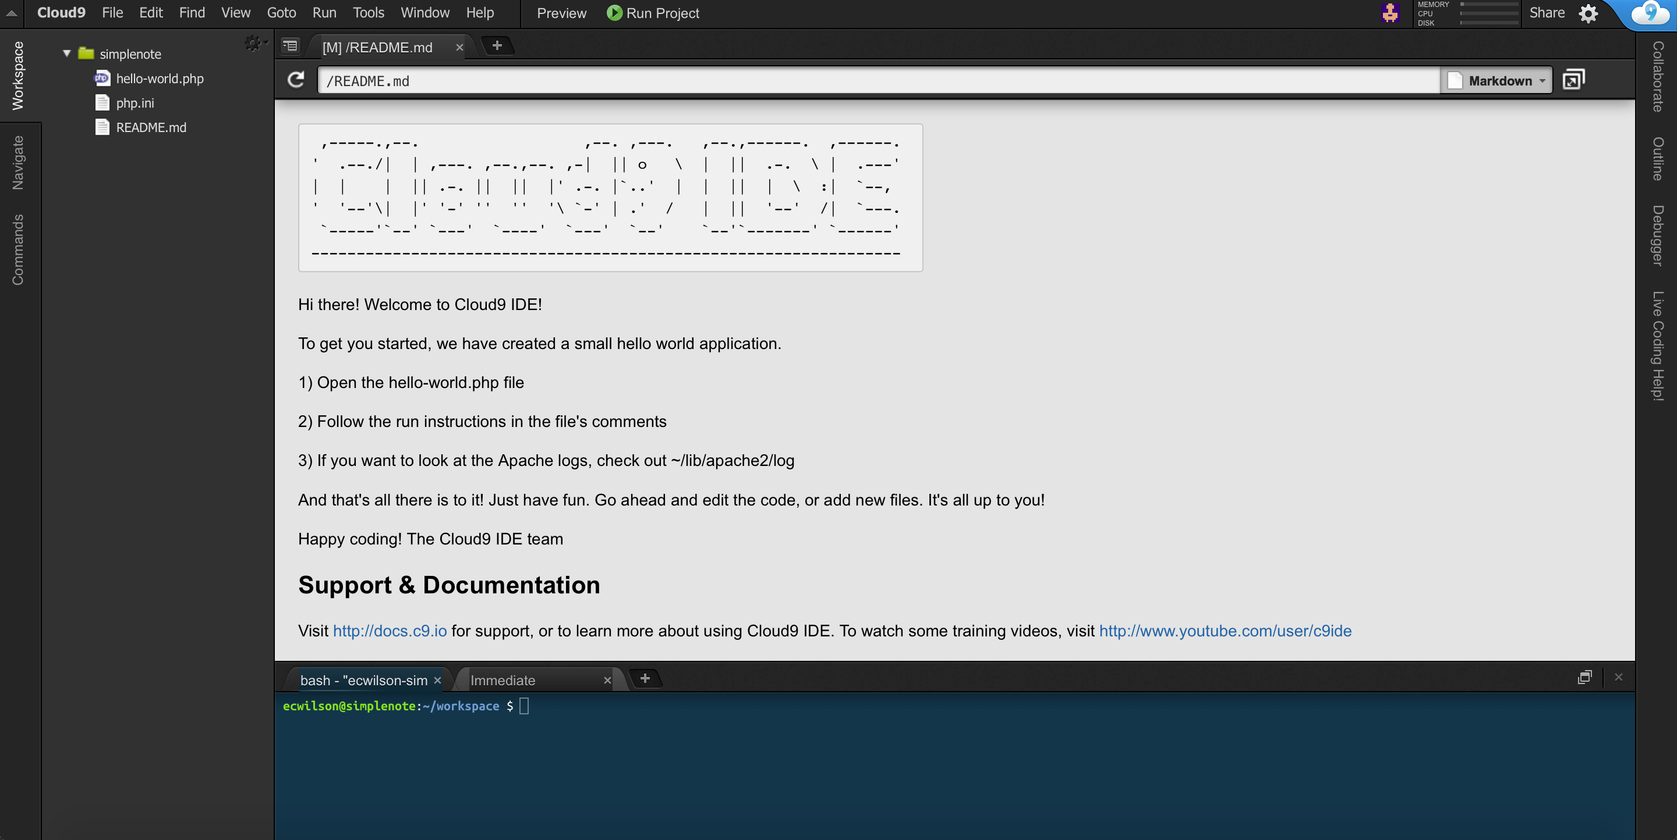
Open Workspace

Slide 10
Create Laravel Project
rm *
sudo composer self-update
composer create-project laravel/laravel ./laravel --prefer-dist
shopt -s dotglob
mv laravel/* ./
rm -rf laravel
sudo composer update

Slide 11
Modify Apache Config
sudo pico /etc/apache2/sites-enabled/001-cloud9.conf
// Change this line
DocumentRoot /home/ubuntu/workspace
// To following
DocumentRoot /home/ubuntu/workspace/public

Slide 12
Install Dependencies
sudo composer update

Slide 13
Compile Error?
mv ./vendor/compiled.php ./vendor/compiledold.php
php artisan down
php artisan clear-compiled
php artisan optimize
php artisan up
sudo composer update

Slide 14
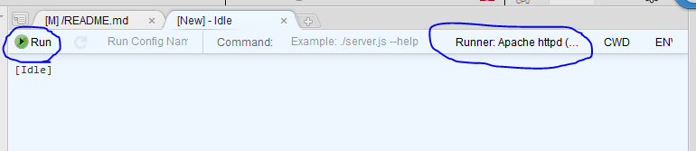
Apache Runner
Create a new tab & select "New Run Configuration"
On the right side, select "Apache httpd (PHP, HTML)"
Press "Run"

Slide 15
Database Setup
$ pico .env
DB_HOST=localhost
DB_DATABASE=simplecontacts
DB_USERNAME=doge
DB_PASSWORD=wow

Slide 16
Database Setup (cont.)
sudo mysql
CREATE DATABASE simplecontacts;
CREATE USER 'doge' IDENTIFIED BY 'wow';
GRANT ALL ON simplecontacts.* TO 'doge';
exit

Slide 17
Create Contact db Table
$ php artisan make:migration CreateContactTable
This will create the file:
database/migrations/2015_xx_xx_xxxxxx_CreateContactTable.php
Insert the code on the following slide.

Slide 18
<?php
use Illuminate\Database\Schema\Blueprint;
use Illuminate\Database\Migrations\Migration;
class CreateContactTable extends Migration
{
/**
* Run the migrations.
*
* @return void
*/
public function up()
{
Schema::create('contact', function($table)
{
$table->increments('id');
$table->string('fname');
$table->string('lname');
$table->string('email')->nullable();
$table->string('phone')->nullable();
});
}
/**
* Reverse the migrations.
*
* @return void
*/
public function down()
{
Schema::drop('contact');
}
}

Slide 19
Migrate Database
php artisan migrate
For more info on migrations see http://laravel.com/docs/5.1/migrations#introduction

Slide 20
Seed Database with Data
$ php artisan make:seeder ContactTableSeeder
This will create the file:
database/seeds/ContactTableSeeder.php
Insert the code on the following slide.

Slide 21
<?php
use Illuminate\Database\Seeder;
class ContactTableSeeder extends Seeder
{
/**
* Run the database seeds.
*
* @return void
*/
public function run()
{
DB::table('contact')->insert([
'fname' => 'Walter',
'lname' => 'White',
'email' => 'no-reply@savewalterwhite.com',
'phone' => '(555) 555-5555'
]);
}
}

Slide 22
Insert the following code into app/database/seeds/DatabaseSeeder.php
<?php
use Illuminate\Database\Seeder;
use Illuminate\Database\Eloquent\Model;
class DatabaseSeeder extends Seeder
{
/**
* Run the database seeds.
*
* @return void
*/
public function run()
{
Model::unguard();
$this->call(ContactTableSeeder::class);
Model::reguard();
}
}

Slide 23
Seed Database with Data cont.
$ php artisan db:seed

Slide 24
ContactController
Controllers receive requests directed to them via routes.php
Returns a view or redirect to another route
$ php artisan make:controller ContactController

Slide 25
routes.php
We will route the application root to the ContactsController which will handle all additional routing
Replace the code in app/Http/routes.php with the following:
<?php
/*
|--------------------------------------------------------------------------
| Application Routes
|--------------------------------------------------------------------------
|
| Here is where you can register all of the routes for an application.
| It's a breeze. Simply tell Laravel the URIs it should respond to
| and give it the controller to call when that URI is requested.
|
*/
Route::controller('/', 'ContactController');

Slide 26
Contact Model
$ php artisan make:model Contact
Insert the following code into the Contact class in app/Contact.php
public $timestamps = false;
/**
* The database table used by the model.
*
* @var string
*/
protected $table = 'contact';
/**
* The attributes that are mass assignable.
*
* @var array
*/
protected $fillable = ['fname', 'lname', 'email', 'phone'];

Slide 27
Contacts View
This will display a tabular listing of all contacts in the database
Create the file resources/views/contacts.blade.php
Insert the code on the following slides

Slide 28
<!DOCTYPE HTML>
<html>
<head>
<title>Contacts</title>
<link href="https://maxcdn.bootstrapcdn.com/bootstrap/3.3.5/css/bootstrap.min.css" rel="stylesheet">
<style>
.container
{
padding-top: 1em;
}
table td
{
border-top: none !important;
}
</style>
</head>
<body>
<div class="container">
<div class="row">
<p>
<a href="create" class="btn btn-success">New Contact</a>
</p>
</div>
<div class="row">
<table class="table">
<thead>
<tr>
<th>Name</th>
<th>Email</th>
<th>Phone</th>
</tr>
</thead>
<tbody>
<?php foreach ($contacts as $contact): ?>
<tr>
<td>{{$contact->lname. ', '. $contact->fname}}</td>
<td>{{$contact->email}}</td>
<td>{{$contact->phone}}</td>
<td>
<a href="edit/{{$contact->id}}" class="btn btn-success">Edit</a>
<a href="delete/{{$contact->id}}" class="btn btn-danger">Delete</a>
</td>
</tr>
<?php endforeach; ?>
</tbody>
</table>
</div>
</div>
</body>
</html>

Slide 29
Add Contacts Listing to ContactController
Remove all methods from the ContactController class in app/Http/Controllers/ContactController.php
Add the following method to the class:
/**
* Display a listing of contacts.
*
* @return Response
*/
public function getIndex()
{
return view('contacts', [
'contacts' => \App\Contact::orderBy('lname')->get()
]);
}
You should now be able to see the single contact we previously added to the database when you run the application
You will get errors if you attempt to create, edit, or delete. Don’t worry, we’ll fix that shortly!

Slide 30
Create the Create View
Create the file resources/views/create.blade.php
Insert the code on the following slide

Slide 31
<!DOCTYPE HTML>
<html>
<head>
<title>New Contact</title>
<link href="https://maxcdn.bootstrapcdn.com/bootstrap/3.3.5/css/bootstrap.min.css" rel="stylesheet">
</head>
<body>
<div class="container">
<h1>Create New Contact</h1>
<form method="post" class="form-horizontal">
<input type="hidden" name="_token" value="{{ csrf_token() }}">
<div class="form-group {{!empty($fnameError) ? 'has-error' : ''}}">
<label class="col-xs-2 control-label">First Name</label>
<div class="col-xs-6">
<input name="fname" type="text" class="form-control" value="{{$fname or ''}}" placeholder="First Name">
</div>
<p class="col-xs-4 help-block">{{$fnameError or ''}}</p>
</div>
<div class="form-group {{!empty($lnameError) ? 'has-error' : ''}}">
<label class="col-xs-2 control-label">Last Name</label>
<div class="col-xs-6">
<input name="lname" type="text" class="form-control" value="{{$lname or ''}}" placeholder="Last Name">
</div>
<p class="col-xs-4 help-block">{{$lnameError or ''}}</p>
</div>
<div class="form-group {{!empty($emailError) ? 'has-error' : ''}}">
<label class="col-xs-2 control-label">Email</label>
<div class="col-xs-6">
<input name="email" type="text" class="form-control" value="{{$email or ''}}" placeholder="Email">
</div>
<p class="col-xs-4 help-block">{{$emailError or ''}}</p>
</div>
<div class="form-group {{!empty($phoneError) ? 'has-error' : ''}}">
<label class="col-xs-2 control-label">Phone</label>
<div class="col-xs-6">
<input name="phone" type="text" class="form-control" value="{{$phone or ''}}" placeholder="Phone Number">
</div>
<p class="col-xs-4 help-block">{{$phoneError or ''}}</p>
</div>
<input type="submit" value="Create Contact">
</form>
</div>
</body>
</html>

Slide 32
Add Create Page to ContactController
Add the following methods to the ContactController class in app/Http/Controllers/ContactController.php
/**
* Show the form for creating a new contact.
*/
public function getCreate()
{
return view('create');
}
/**
* Save the contact to the database.
*/
public function postCreate(Request $request)
{
\App\Contact::create($request->all())->save();
return redirect('/');
}

Slide 33
Add Delete Functionality to ContactController
Add the following method to the ContactController class in app/Http/Controllers/ContactController.php
/**
* Delete the contact with the specified ID.
*/
public function getDelete($id)
{
\App\Contact::destroy($id);
return redirect('/');
}

Slide 34
Create the Edit View
Create the file resources/views/edit.blade.php
Insert the code on the following slide

Slide 35
<!DOCTYPE HTML>
<html>
<head>
<title>Edit Contact</title>
<link href="https://maxcdn.bootstrapcdn.com/bootstrap/3.3.5/css/bootstrap.min.css" rel="stylesheet">
</head>
<body>
<div class="container">
<h1>Edit Contact</h1>
<form method="post" class="form-horizontal">
<input type="hidden" name="_token" value="{{ csrf_token() }}">
<input type="hidden" name="id" value="{{$id}}">
<div class="form-group {{!empty($fnameError) ? 'has-error' : ''}}">
<label class="col-xs-2 control-label">First Name</label>
<div class="col-xs-6">
<input name="fname" type="text" class="form-control" value="{{$fname or ''}}" placeholder="First Name">
</div>
<p class="col-xs-4 help-block">{{$fnameError or ''}}</p>
</div>
<div class="form-group {{!empty($lnameError) ? 'has-error' : ''}}">
<label class="col-xs-2 control-label">Last Name</label>
<div class="col-xs-6">
<input name="lname" type="text" class="form-control" value="{{$lname or ''}}" placeholder="Last Name">
</div>
<p class="col-xs-4 help-block">{{$lnameError or ''}}</p>
</div>
<div class="form-group {{!empty($emailError) ? 'has-error' : ''}}">
<label class="col-xs-2 control-label">Email</label>
<div class="col-xs-6">
<input name="email" type="text" class="form-control" value="{{$email or ''}}" placeholder="Email">
</div>
<p class="col-xs-4 help-block">{{$emailError or ''}}</p>
</div>
<div class="form-group {{!empty($phoneError) ? 'has-error' : ''}}">
<label class="col-xs-2 control-label">Phone</label>
<div class="col-xs-6">
<input name="phone" type="text" class="form-control" value="{{$phone or ''}}" placeholder="Phone Number">
</div>
<p class="col-xs-4 help-block">{{$phoneError or ''}}</p>
</div>
<input type="submit" value="Update Contact">
</form>
<div class="colspan">
</div>
</div>
</body>
</html>

Slide 36
Add Edit Page to ContactController
Add the following methods to the ContactController class in app/Http/Controllers/ContactController.php
public function getEdit($id = 0)
{
try {
$contact = \App\Contact::findOrFail($id);
}
catch(\Exception $e) {
return redirect('/');
}
return view('edit', $contact->attributesToArray());
}
public function postEdit(Request $request)
{
$id = $request->input('id');
$contact = \App\Contact::find($id);
$contact->fill($request->all());
$contact->update();
return redirect('/');
}

Slide 37

Now, assuming you did everything correctly (no refunds!), you should have a fully functional CRUD application. Hooray!!!
There are still some nice features that we can add to make it a little more robust, such as form validation and sorting contacts.

Slide 38
Adding form Validation
$ php artisan make:request ContactFormRequest
This will create the file app/Http/Requests/ContactFormRequest.php
Insert the code on the following slide

Slide 39
<?php
namespace App\Http\Requests;
use App\Http\Requests\Request;
class ContactFormRequest extends Request
{
/**
* Determine if the user is authorized to make this request.
*
* @return bool
*/
public function authorize()
{
return true;
}
/**
* Get the validation rules that apply to the request.
*
* @return array
*/
public function rules()
{
extract($this->all());
return [
'fname' => 'required|unique:contact,fname,'. (isset($id) ? $id : 'NULL'). ',id,lname,'. $lname,
'lname' => 'required|unique:contact,lname,'. (isset($id) ? $id : 'NULL'). ',id,fname,'. $fname,
'email' => 'email',
'phone' => 'phone'
];
}
public function messages()
{
return [
'required' => 'Required field',
'email' => 'That is not a valid email address',
'phone' => 'A phone number must be of the form (###) ###-####',
'unique' => 'Full name must be unique',
];
}
}

Slide 40
Insert the following line near the top of app/Providers/AppServiceProvider next to the existing use clause.
use Validator;
Insert the following code into the boot() method
Validator::extend('email', function($attribute, $value, $parameters) {
return filter_var($email,FILTER_VALIDATE_EMAIL);
});
Validator::extend('phone', function($attribute, $value, $parameters) {
$phoneFilter = '/\(\d{3}\) \d{3}-\d{4}/';
return filter_var($value,FILTER_VALIDATE_REGEXP,array('options'=>array('regexp'=>$phoneFilter)));
});
In app/Http/Controllers/ContactController, modify the postCreate() and postEdit() function headers as below
public function postCreate(Requests\ContactFormRequest $request)
public function postEdit(Requests\ContactFormRequest $request)

Slide 41
Add the following PHP code to the top of the resources/views/create.blade.php and resources/views/edit.blade.php files.
<?php
$fnameError = $errors->first('fname');
$lnameError = $errors->first('lname');
$emailError = $errors->first('email');
$phoneError = $errors->first('phone');
$fname = isset($fname) ? $fname : old('fname');
$lname = isset($lname) ? $lname : old('lname');
$email = isset($email) ? $email : old('email');
$phone = isset($phone) ? $phone : old('phone')
?>

Slide 42
Adding Sort Functionality
Add the following code in an appropriate location in resources/views/contacts.blade.php
<?php $order = isset($order) ? $order : 'lname' ?>
<form id="order" method="post">
<input type="hidden" name="_token" value="{{ csrf_token() }}">
<label>Sort by:</label>
<select name="order" onchange="submitOrder()">
<option value="lname" {{$order == 'lname' ? 'selected' : ''}}>Name</option>
<option value="email" {{$order == 'email' ? 'selected' : ''}}>Email</option>
<option value="phone" {{$order == 'phone' ? 'selected' : ''}}>Phone</option>
</select>
</form>
Add the following script to the HTML header
<script type="text/javascript">
function submitOrder() {
document.getElementById("order").submit();
}
</script>

Slide 43
Adding Sort Functionality cont.
Add the following method to the ContactsController class
/**
* Display a list of sorted contacts.
*/
public function postIndex(Request $request)
{
$order = $request->input('order');
return view('contacts', [
'order' => $order,
'contacts' => \App\Contact::orderBy($order)->get()
]);
}

