Slide 1
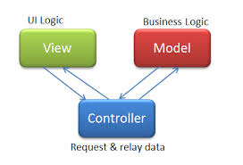
MVC ASP.NET Views and Controllers Video Link to tutorial 2

Slide 2
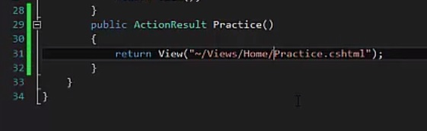
- In our project from tutorial one: - While in our home controller, be sure to stop the project because a controller cannot be edited while running. - Enter in the code below to create Practice(). - This controller method will return a view that we are going to create in our views folder, as you can see by the path we give in our return statement.

Slide 3
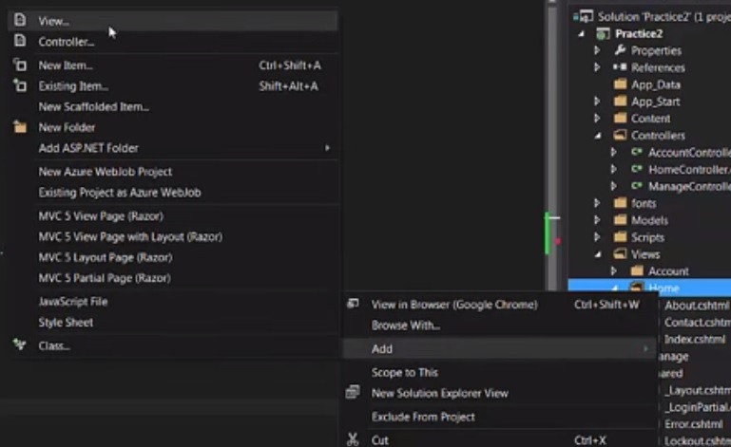
- Now right click on our Home folder, go to add, then add view. - Name the view Practice to follow a good naming convention of having the view names reflect their controller method. - Load the project and the new view, Practice.cshtml should load. - Be sure to return the correct file path: (~/Views/Home/Practice.cshtml) - Also be sure that once the project is loaded the url path is correct in the browser: (localhost/Home/Practice) your local host will be different than mine

Slide 4
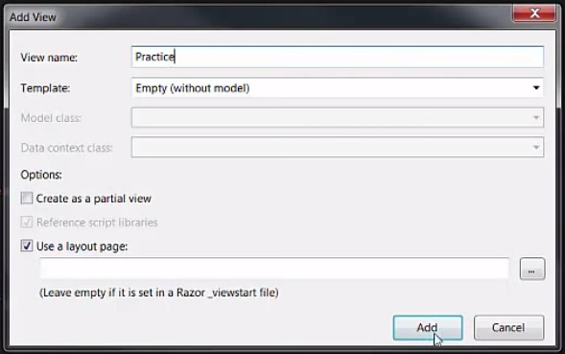
Naming your view

Slide 5
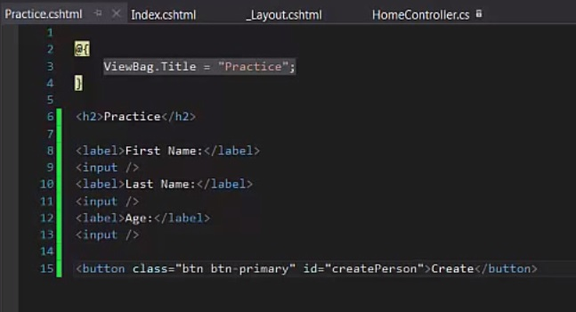
- In our Practice.cshtml file add the code below to create some input fields and a button.

Slide 6
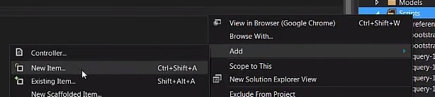
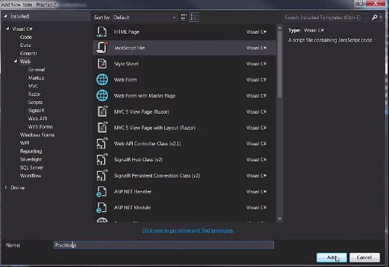
- Now we create a JavaScript file to handle the user inputs and button. - We go over to our scripts folder and right click, go to add, add new item, select javascript (you may have to search javascript in the upper right hand search bar) - Name the file according to our naming convention we talked about earlier (Practice.js)

Slide 7
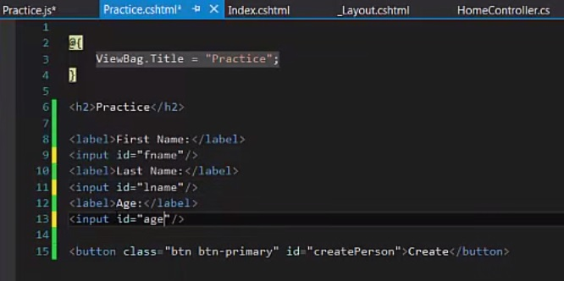
- Now we need a way to reference our inputs in Practice.cshtml from javascript so we need to give them each a unique id.

Slide 8
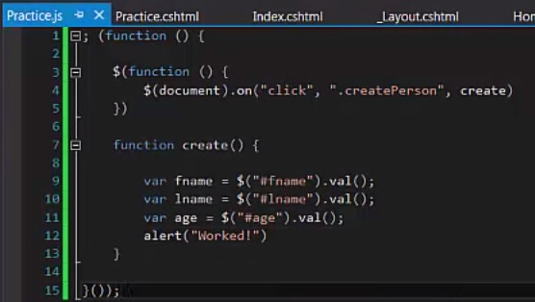
- In our Practice.js file we need to create a self invoking function to wrap everything in (this will be explained and used in a later tutorial for passing in parameters) - We create a function that loads on document ready, listening for our button click. - Now we use jquery to get the value from our input as well have a alert pop up when the button is clicked.
Should be a # because its an ID

Slide 9
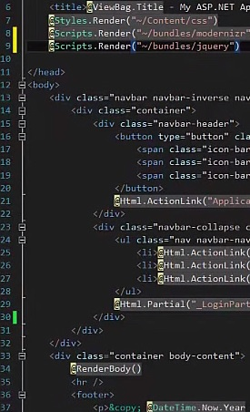
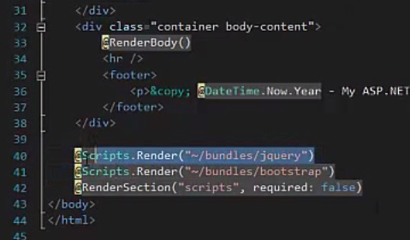
- Now we need to make sure in our _Layout.cshtml page our file reference to jquery loads before the javascript is ran or it will not be recognized causing an error. - We must place our reference to jquery before we @RenderBody() in our layout so before any of our views load jquery is loaded.
Correct
Incorrect

Slide 10
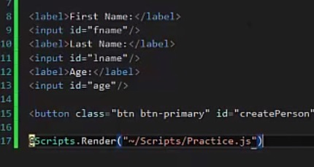
- Now we need to include our Practice.js in our Practice.cshtml file by using @Scripts.Render (), giving the correct file path in parenthses after. - Finally we can run the file with no errors and on document ready we can enter values in the input and click our button to see our js work.

Slide 11
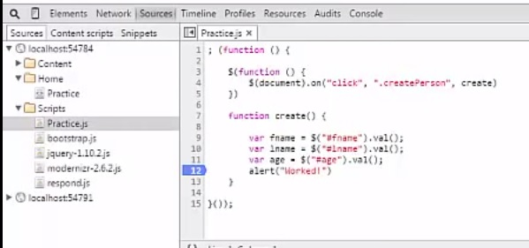
- Load the project now and once the page is loaded press F12 to bring up the dev tools (I am using Chrome) - Click on sources then open the scripts file and click Practice.js. -Set a break point on our alert so when we get to the point the project will pause and we can see if we have the correct values in our variables.

Slide 12
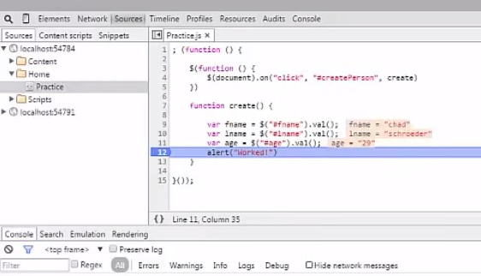
- Now run the project and notice to the right of your jquery .va() statements, the value you entered in the input is shown.

Slide 13
That is the end of this tutorial to see the next tutorial on setting up a local database go to: Tutorial 3

