Slide 1
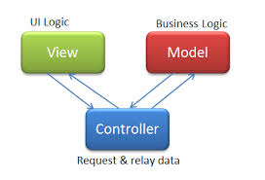
MVC, Setting up to use the database Video 4

Slide 2
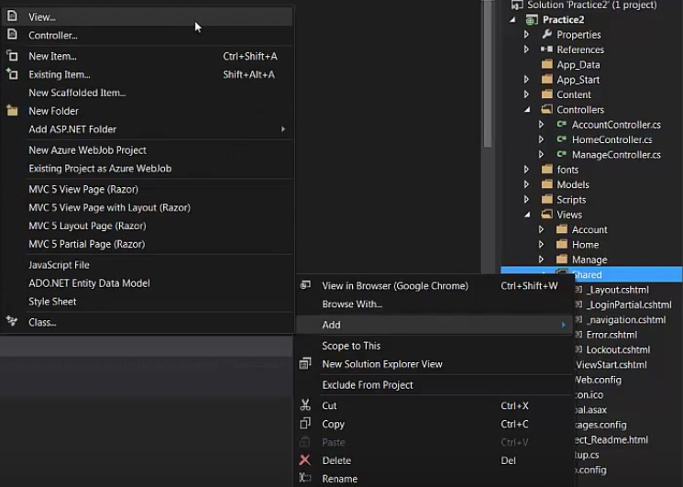
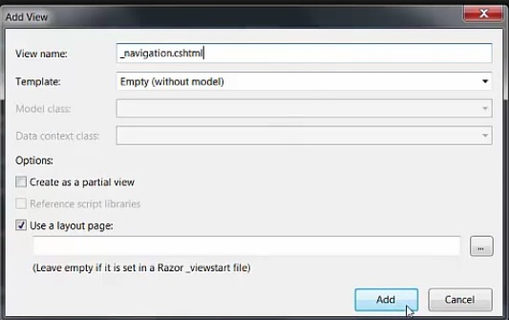
- Before we set up a method to create new data in our database there are a few things we will want to get ready. - First go over to our solution explorer and expand your views folder, right click on the shared folder and add a view. - Name this view _navigation.cshtml

Slide 3
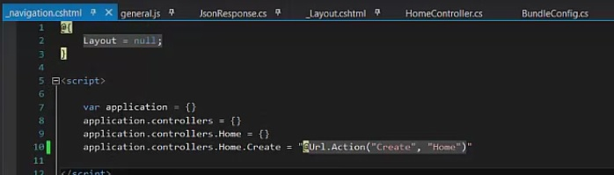
- Within _navigation.cshtml we are going to create a script tag. - In the script tag we are going to create var application = {}. -Next we create application.controllers = {}. - Then we create application.controllers.Home = {}. - This gives us a path to our Home comtroller. - Now we want to create a variable for our Create method within our home controller, to do so we declare : application.controllers.Home.Create =“@Url.Action(“Create”, “Home”)”

Slide 4
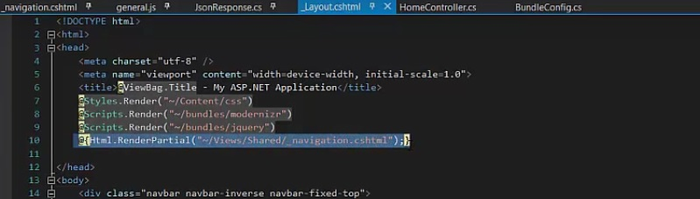
- Now in out _Layout.cshtml file we want to include this _navigation.cshtml file so it can be accessed throughout the entire project. - So to do this we want to use @Html.RenderPartial() - Within the parenthesis we give the string path to our _navigation.cshtml file : (“~/Views/Shared/_navigation.cshtml”) - We want to render this partial at the top of the Layout page where we render our scripts. (As seen below)

Slide 5
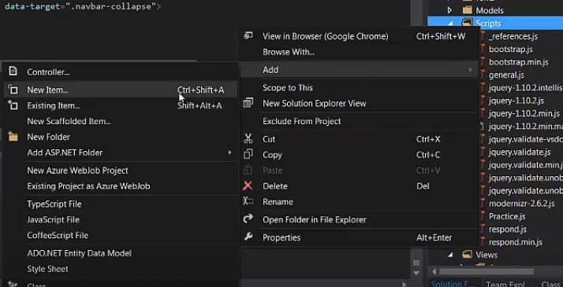
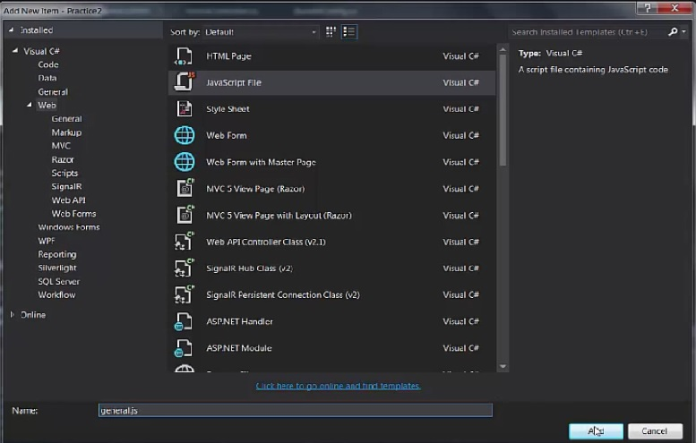
- Now we are going to go over to our Scripts folder, right click and add new item. - Choose JavaScript type file and name it general.js

Slide 6
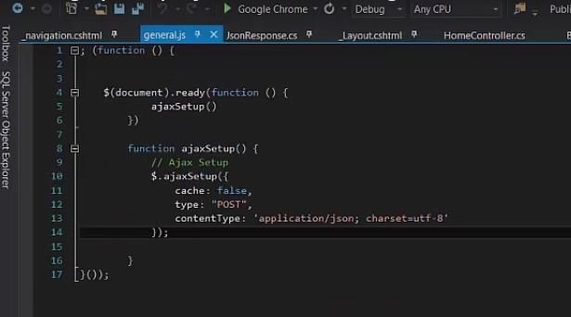
- Within the general.js file we are going to create our ajax setup - This is used for posting data to the server in our javascript files - The code for setting this up is shown below

Slide 7
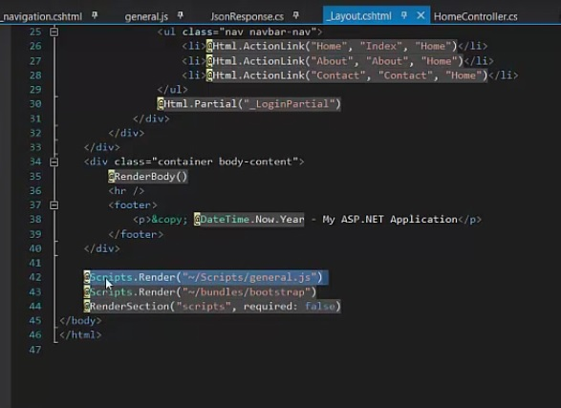
- Now we need to go back to our Layout file and down at the bottom before the closing tag for body we want to render our general.js script.

Slide 8
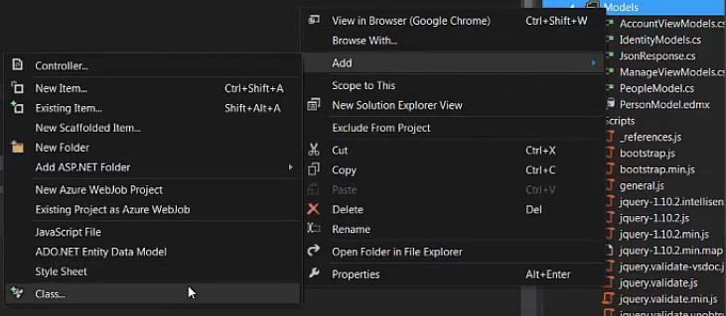
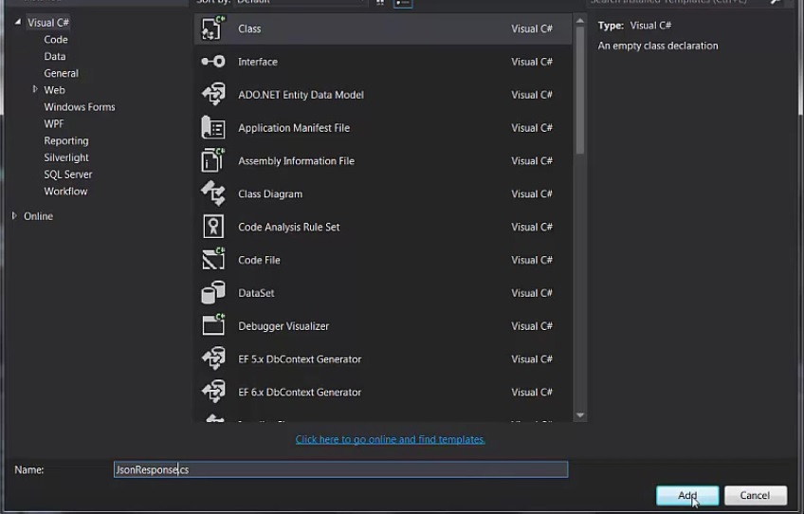
- Finally we are going to add one more file - We need to go over to our Models folder and right click, add, then click new class. - Choose Class type file and name it JsonResponse.cs and click add

Slide 9
- Within our JsonResponse.cs file we will just use a couple of the methods and only some of the attributes shown in the video. - The code we will need in later videos is shown below: Public class JsonResponse<T>{ public bool success {get;set;} public string message {get;set;} public T data {get;set;} public JsonResponse() { data = default(T); success = false; } public JsonResponse(bool success, string message, T data) { this.success = success; this.message = message; this.data = data } public void successful (string message, T data ) { this.success = true; this.message = message; this.data = data; } public void unsuccessful (string message, T data ) { this.success = false; this.message = message; this.data = data; } }

Slide 10
Finally, we are ready to start accessing our database and create some new data in it! Check out the next video to learn how to use what we have created.

