Slide 1
Deep Reinforcement Learning

Slide 2
Deep Reinforcement Learning
Using deep learning to improve reinforcement learning
Deep learning: Training (deep) neural networks to accurately map inputs to outputs
Reinforcement learning: Learning from experience

Slide 3
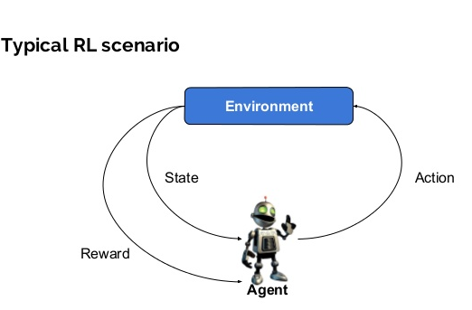
Deep Reinforcement Learning

Slide 4

Deep Reinforcement Learning

Slide 5

Q-Learning

Slide 6

Q-Learning

Slide 7
Q-Learning

Slide 8
Q-Learning
If and are finite we can simply store the q-value for each (s, a) pair in a lookup table.

Slide 9
Q-Learning
If and are finite we can simply store the q-value for each (s, a) pair in a lookup table.
But if either of them are infinite, or if there are simply too many states (or actions) to store the q-values in a lookup table, we need an alternative.

Slide 10
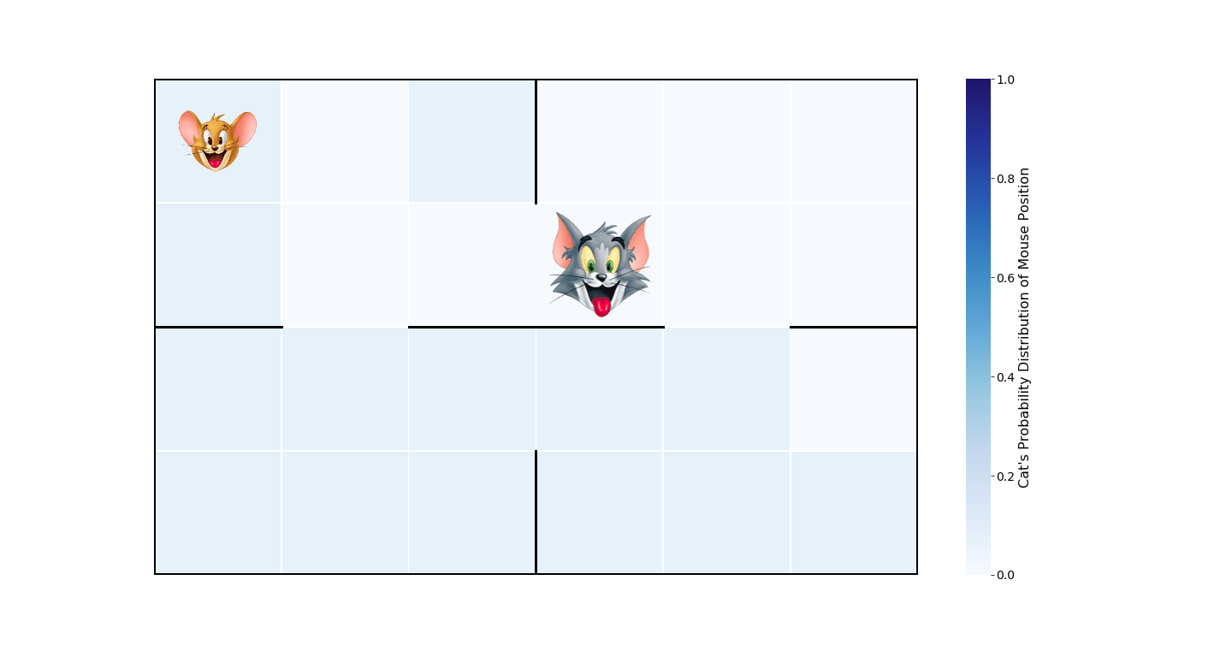
Deep Q-Learning

Slide 11
Q-Learning
Universal Approximation Theorem
A feed-forward neural network with a single hidden layer containing a finite number of neurons can approximate continuous functions on compact subsets of R^{n}, under mild assumptions on the activation function.
In other words:
Simple neural networks can represent a wide variety of interesting functions…

Slide 12
Q-Learning
Universal Approximation Theorem
A feed-forward neural network with a single hidden layer containing a finite number of neurons can approximate continuous functions on compact subsets of R^{n}, under mild assumptions on the activation function.
In other words:
Simple neural networks can represent a wide variety of interesting functions…
… Including Q functions!

Slide 13
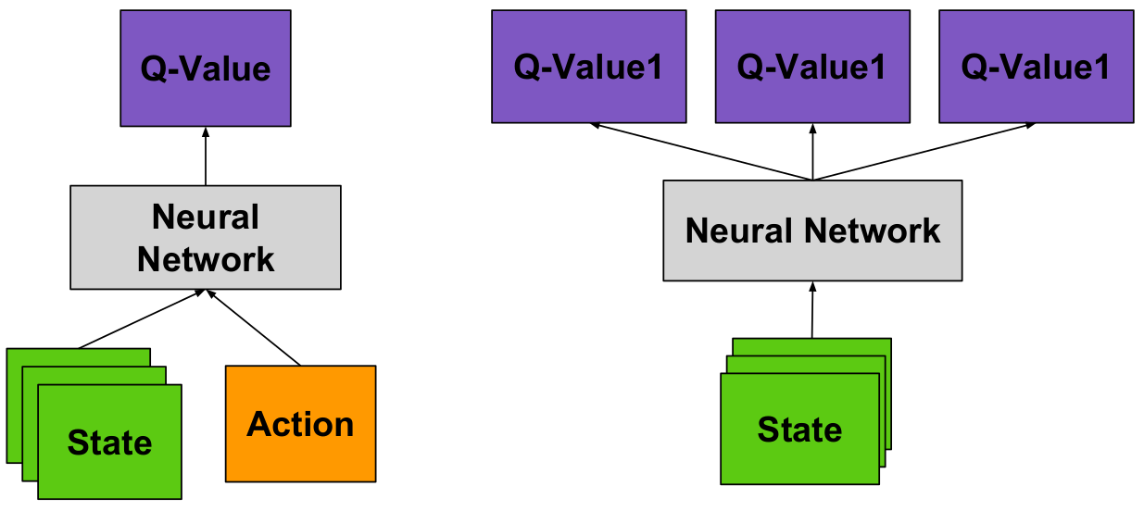
Deep Q-Learning
a₁
a₂
a₃

Slide 14
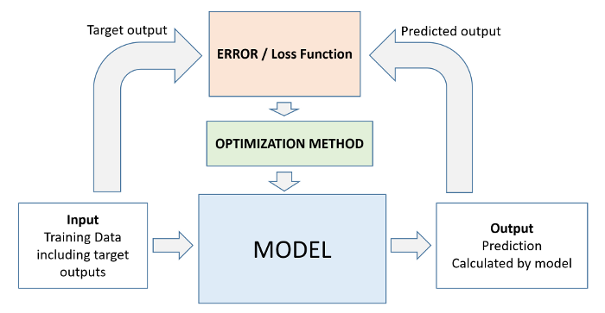

Deep Q-Learning
Cat
Cat
Cat: 0.8
Rug: 0.2

Slide 15
Deep Q-Learning
Cat
Q(s,a₁ ) = 0.15
Q(s,a₂ ) = 0.8
Q(s,a₃ ) = 0.05
State s

Slide 16
Deep Q-Learning
Cat
Q(s,a₁ ) = 0.15
Q(s,a₂ ) = 0.8
Q(s,a₃ ) = 0.05
State s

Slide 17

Deep Q-Learning
Traditional supervised learning
Q network (Reinforcement learning)
Target
True Q(s,a)
Prediction 5
Prediction 4
Prediction 3
Prediction 2
Target 4
Target 3
Prediction 4
Target 2
Prediction 3
Target 1
Prediction 2
Prediction 1
Prediction 1

Slide 18
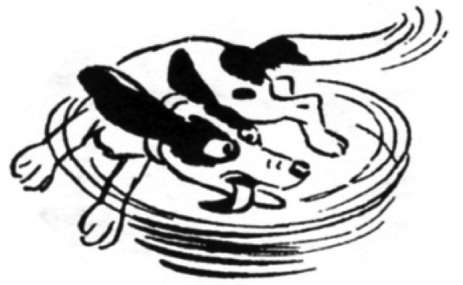
Deep Q-Learning
Q network (Reinforcement learning)
True Q(s,a)
Target 4
Target 3
Prediction 4
Target 2
Prediction 3
Target 1
Prediction 2
Prediction 1

Slide 19
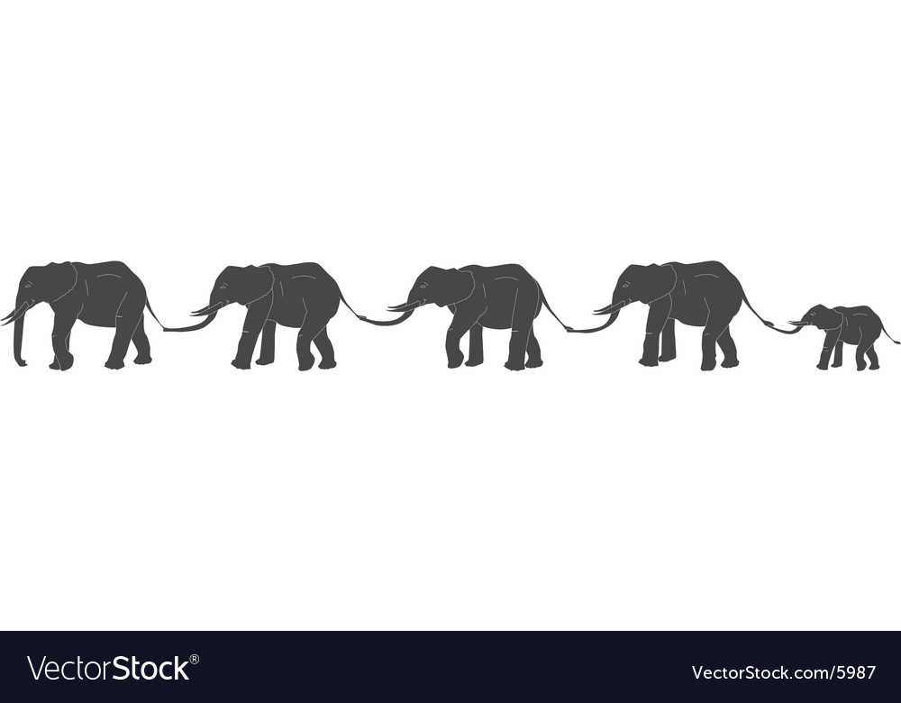
Deep Q-Learning
Q network (Reinforcement learning)
True Q(s,a)
Target 4
Target 3
Prediction 4
Target 2
Prediction 3
Target 1
Prediction 2
Prediction 1

Slide 20
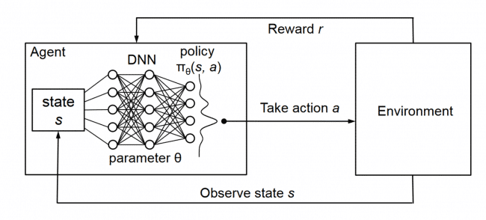
Challenges
Moving targets
  Two networks: behaviour and target

Slide 21
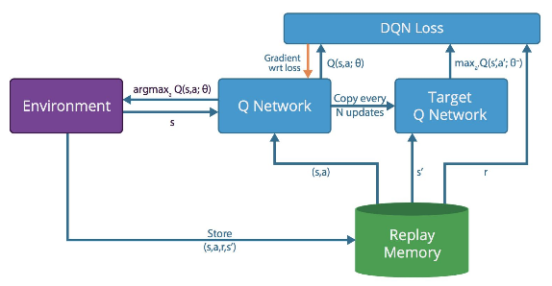
Challenges
Moving targets
  Two networks: behaviour and target
Correlated inputs (due to sequential states)
  Experience replay

Slide 22
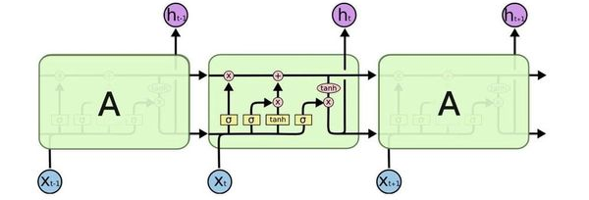
Challenges
Moving targets
  Two networks: behaviour and target
Correlated inputs (due to sequential states)
  Experience replay
Markovian
  Add recurrency to network

