Slide 1

Airline Information Management
First group project for the Algorithms and Data Structures class
Faculty
Pedro Ribeiro (lectures)
Ana Rocha (lectures)
Rosaldo Rosetti (recitations)
Students
Gonçalo Pinto (202004907)
Guilherme Magalhães (202005285)
Pedro Cerejeira (202007525)

Slide 2
Problem definition
Goal Create a management system to support an airline in its daily operations
In order to achieve this, the project should be
Simple and intuitive to use It ought to be possible to interact with the project via console/text file/CSV without too much hassle
Readable and well documented Aesthetics are to be prioritized over efficiency, so in the future other engineers have an easy time deciphering the code
Scalable and thoroughly tested Data abstraction should be fanatically imposed and all classes must be exhaustively tested
Runnable in a normal computer There’s no need to melt the airline’s CPUs, the code shouldn’t waste system resources for no reason

Slide 3
Solution description (1)
Gonçalo
Difficulties: eeeee
Solution: eee

Slide 4
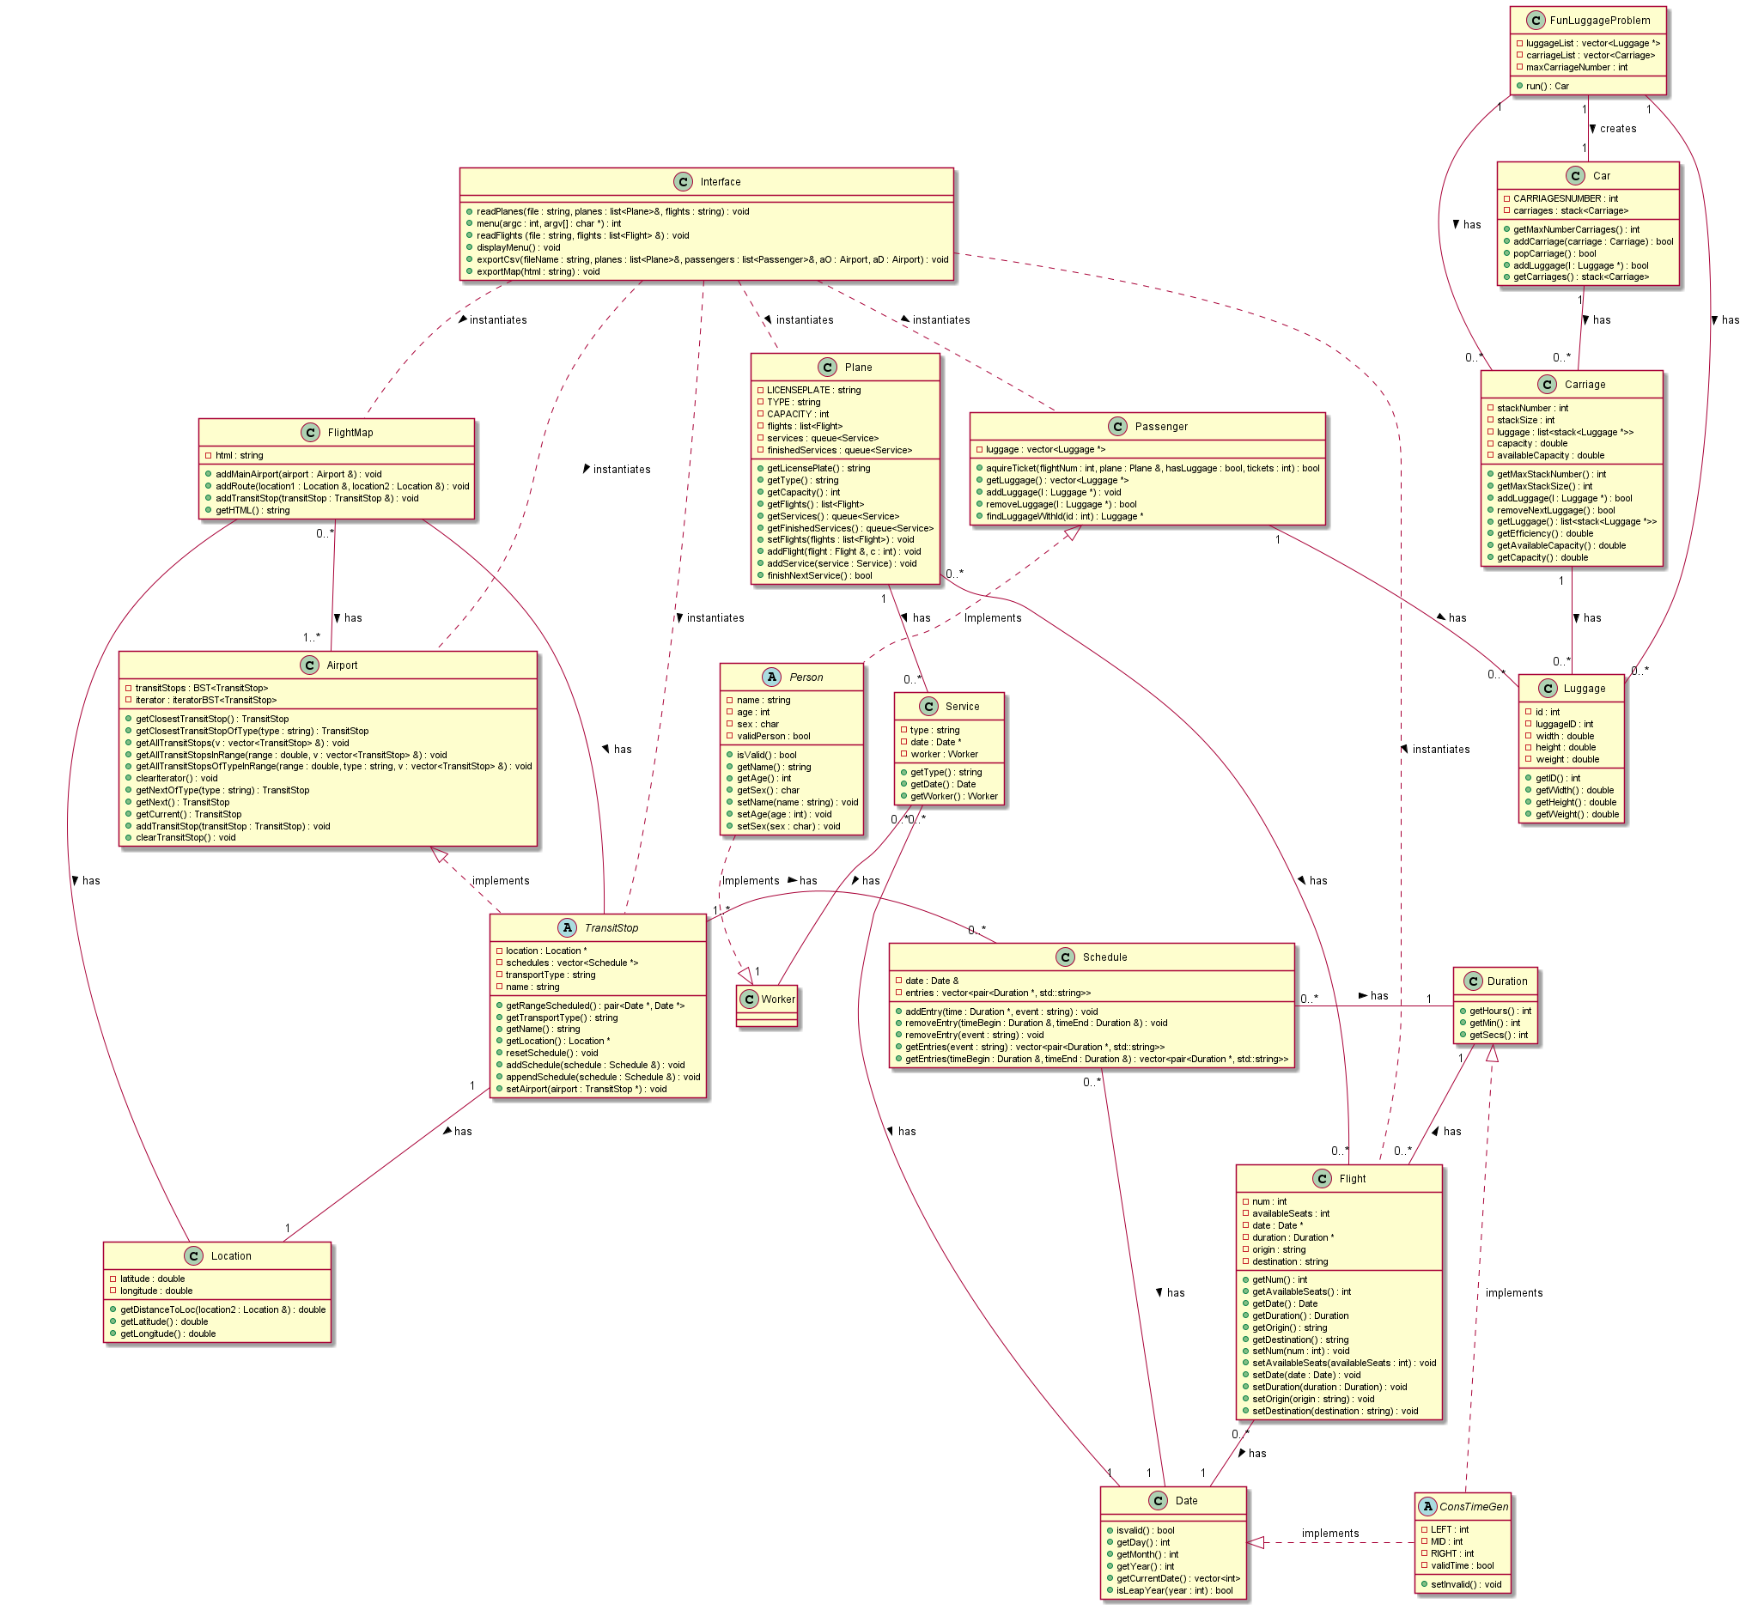
Class Diagram
Download the full diagram here

Slide 5
File Structure
Gonçalo
Difficulties: eeeee
Solution: eee

Slide 6
Implemented Functionalities (1)
FlightMap() – generates a new Map
void addMainAirport(Airport& airport) – adds one main airport to the Map
void addRoute(Location& location1, Location& location2) – given two Locations, the route between them is added to the Map
void addTransitStop(TransitStop& transitStop) – adds one transitStop to the Map, personalizing the feature with the given name and type
std::string getHTML()
Create Implemented- you can create new objects
Read Implemented- in the get methods
Update Implemented- you can add new methods to the Map
Delete Default Destructor- no reason to specify our own

Slide 7
Implemented Functionalities (2)
Superclass ConstTimeGen
ConstTimeGen (int left, int mid, int right)
void setInvalid ()
Subclass Date
Duration (int hours, int min, int secs)
int getHours ()
int getMin ()
int getSecs ()
Duration operator+ (Duration const &right) const
Subclass Date
static std::vector< int > getCurrentDate ()
static bool isLeapYear (int year)
Create Implemented- you can create new objects
Read Implemented- in the get methods
Update Not implemented- variables are const
Delete Default Destructor- no reason to specify our own

Slide 8
Fun Luggage Problem
Gonçalo
Difficulties: eeeee
Solution: eee

Slide 9
Main difficulties
Gonçalo
Difficulties: eeeee
Solution: eee
Guilherme
Difficulties: Getting used to and understanding better the use of pointers and references.
Solution: Experience solving problems that would arise.
Pedro
Difficulties: eeeee
Solution: eeee

