Slide 1

Airline Information Management
First group project for the Algorithms and Data Structures class
Faculty
Pedro Ribeiro (lectures)
Ana Rocha (lectures)
Rosaldo Rosetti (recitations)
Students (G77)
Gonçalo Pinto (202004907)
Guilherme Magalhães (202005285)
Pedro Cerejeira (202007525)

Slide 2
Problem definition
Goal Create a management system to support an airline in its daily operations
In order to achieve this, the project should be
Simple and intuitive to use It ought to be possible to interact with the project via console/text file/CSV without too much hassle
Readable and well documented Aesthetics are to be prioritized over efficiency, so in the future other engineers have an easy time deciphering the code
Scalable and thoroughly tested Data abstraction should be fanatically imposed and all classes must be exhaustively tested
Runnable in a normal computer There’s no need to melt the airline’s CPUs, the code shouldn’t waste system resources for no reason

Slide 3
Solution description
Fun luggage problem
Assigns luggage to carriages in a car, maximizing the capacity usage (luggage weight/carriage capacity) of carriages in front
Search luggage
Luggage is issued an ID so passengers can later find it
Interface
Connects all classes and allows user to interact with them
HTML Map Creation
An original html map file (exported from Python) is altered by simple string manipulation. Distances to the airport are calculated from coordinates.
Class Inheritance
Inheritance was widely used to save time, reduce the possibility of errors and, specifically, allow for airports to be included as transit stops seamlessly

Slide 4
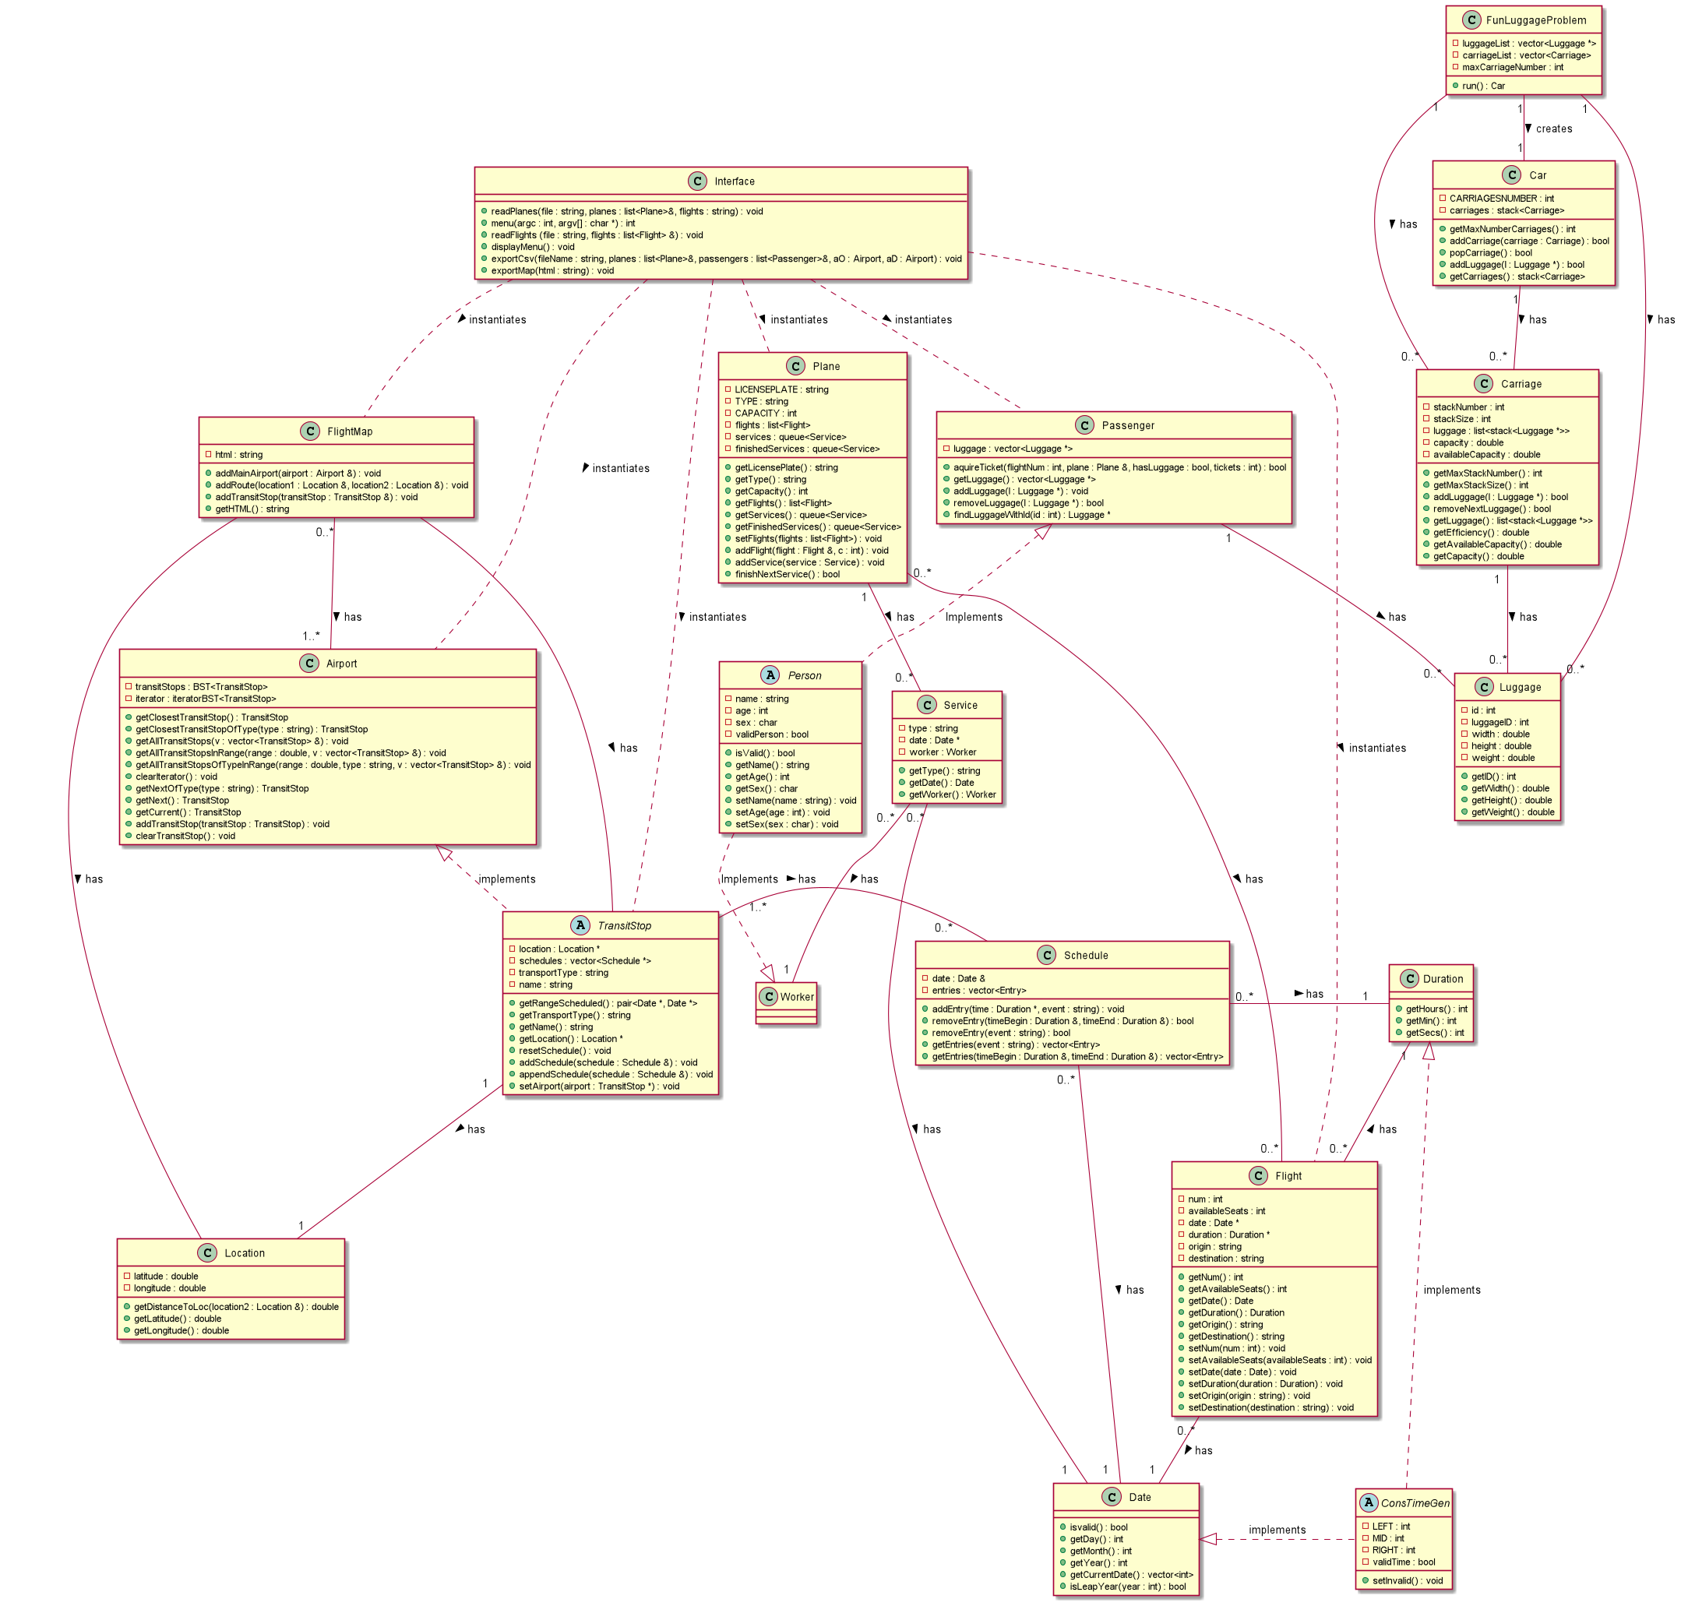
Class Diagram
Download the full diagram here

Slide 5
File Structure
We only use .csv files.
Their structure is self explanatory, since columns are named

Slide 6
Implemented Functionalities
It is possible to, via the interface:
simulate flights, from the creation of planes to buying tickets
posibility of exporting a map with marked fligths and the surroudings of an airport
run tests implemented for several parts of the program
import data (in .csv files) of airoports, planes, flights and transit stops
find a specific passenger’s luggage
It’s also possible to get into the fun luggage problem´s wild ride (explained next slide).
CRUD was implemented according to what seemed intuitive, for example:
Destructors weren’t implemented, because in the cases it made sense destructors would enter in conflict with pointers
Time classes have constant attributes, so they can’t be updated

Slide 7
Fun Luggage Problem (Feature)
Context
Luggage has weight, carriages have capacity: so how do we distribute the weight throw the carriages in an efficient way?
Solution
Inputs: luggage list, carriage list, max carriage number
Every possible layout of luggage is analyzed iteratively and the one with the most efficient carriage capacity use is chosen and added to the car
Luggage and carriage is removed and iteration is repeated until the car is built
If it is impossible to solve the problem (for example: not enough carriages), an empty car is returned
The algorithm has one drawback: there is a situation where it can’t find a solution
Used capacity of carriages in the front must be prioritized
therefore
Carriages are added or remove through the back

Slide 8
Main difficulties
Gonçalo
Difficulties: Adequate container’s choice (specially in fun luggage problem)
Solution: Test different containers for their efficiency
33%
Guilherme
Difficulties: Getting used to and understanding better the use of pointers and references.
Solution: Experience solving problems that would arise.
33%
Pedro
Difficulties: Exception handling in tests
Solution: Expected equal of error message
33%

