Slide 1

Public Transit Navigation
Second group project for the Algorithms and Data Structures class
Faculty
Pedro Ribeiro (lectures)
Ana Rocha (lectures)
Rosaldo Rossetti (recitations)
Students
Gonçalo Pinto (202004907)
Guilherme Magalhães (202005285)
Pedro Cerejeira (202007525)

Slide 2
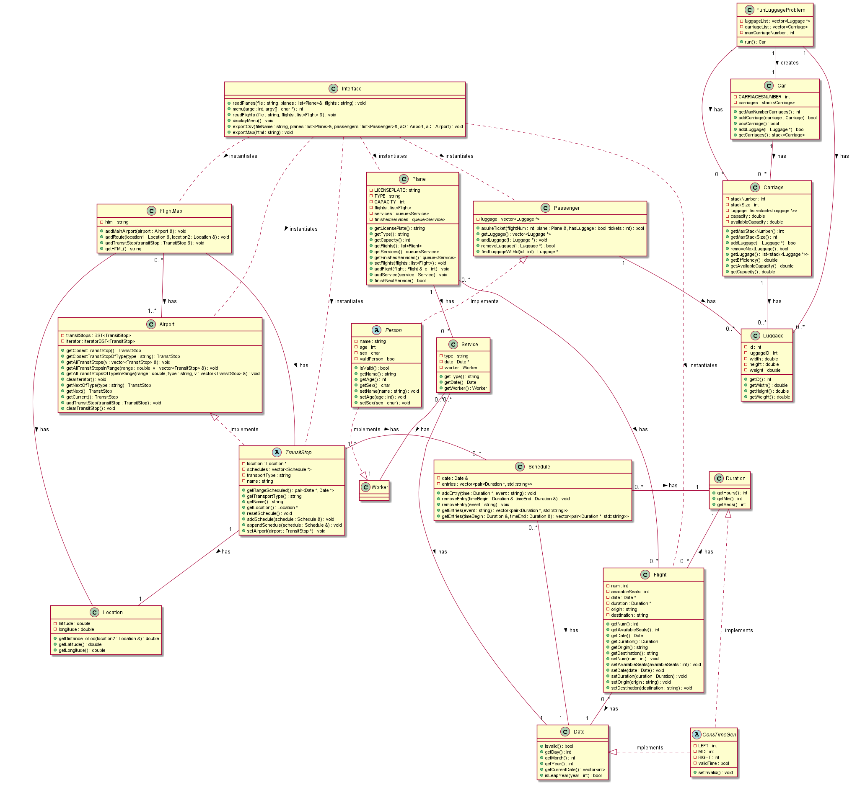
Class Diagram
Download the full diagram here

Slide 3
Dataset Reading
Data Interpretation
Nodes: stops
Edges: transit lines
Additions to the dataset
Some stops
A two-way line
A metropolitan line
Data storage
Persistent Memory Directory
Note Linecode files will be stored in a specific folder, to avoid cluttering the persistent memory file

Slide 4
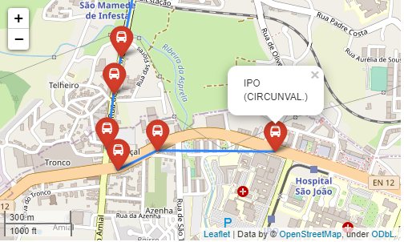
Used graphs
We create one graph per run, which:
is always weighted (default weight is 1)
isn’t always complete (especially during the night shift)
is implemented according to the adjacency list provided by faculty
Different features are therefore not implemented by creating different kinds of graphs, but rather by using them in different ways (more on that later)

Slide 5
Implemented functionalities
Graph Selection Flow
1 What are his priorities in the trip (pay less, switch lines as little as possible, go through the least stops or ride for the lowest distance)?
2 Is the user travelling on day of night shift?
3 What is the origin and the destination? Is it already a stop or a location? Is the user willing to walk between stops to catch another bus? For how long? And if he chose a location as an origin/destination, how much is he willing to walk to arrive there?
Final details

Slide 6
Implemented functionalities (1)
Searches using BFS
Path starting at a stop and ending at a location
Time complexity: O( n^3 )
Path starting at a location and ending at a stop
Time complexity: O( n^3 )
Path between two stops
Time complexity: O( n^2 )
Path between two locations
Time complexity: O( n^4 )

Slide 7
Implemented functionalities (2)
Searches using Dijkstra's algorithm
Path starting at a stop and ending at a location
Time complexity: O( n^2*log(n) )
Path starting at a location and ending at a stop
Time complexity: O( n^2*log(n) )
Path between two stops
Time complexity: O( log(n) )
Path between two locations
Time complexity: O( n^3*log(n) )

Slide 8
User Interface
Instruction handling All instructions will be inputed in the terminal
Path finding result Users can choose to receive results in the terminal or in output folder (CSV format)
Terminal
CSV Folders:
Input
Output
Persistent Memory
CSV
Visual interface
self explanatory
Edit transit info Users will receive model CSVs in output, which they can fill and deliver in input to update information
HTML map very similar to first project

Slide 9
Best functionality
implementation
We didn’t focus on creating a great feature, but rather on perfectly integrating our existing ones
Project requirements
Visual interface
Options in choosing trip specifications
Setup for processing metropolitan lines
Simple, direct, intuitive interface
User
Graph
Night shift differentiation
CSV export

Slide 10
Main difficulties
Gonçalo
Difficulties: Integrating the HTML map with graphs
Solution: Debug and further testing
33%
Guilherme
Difficulties: Difficulty implementing algorithms
Solution: Sketching how they would work on paper (a more theoretical approach)
33%
Pedro
Difficulties: Difficulty implementing algorithms
Solution: Redoing the recitations exercises (a more practical approach)
33%

