Slide 1

Public Transit Navigation
Second group project for the Algorithms and Data Structures class
Faculty
Pedro Ribeiro (lectures)
Ana Rocha (lectures)
Rosaldo Rossetti (recitations)
Students
Gonçalo Pinto (202004907)
Guilherme Magalhães (202005285)
Pedro Cerejeira (202007525)

Slide 2
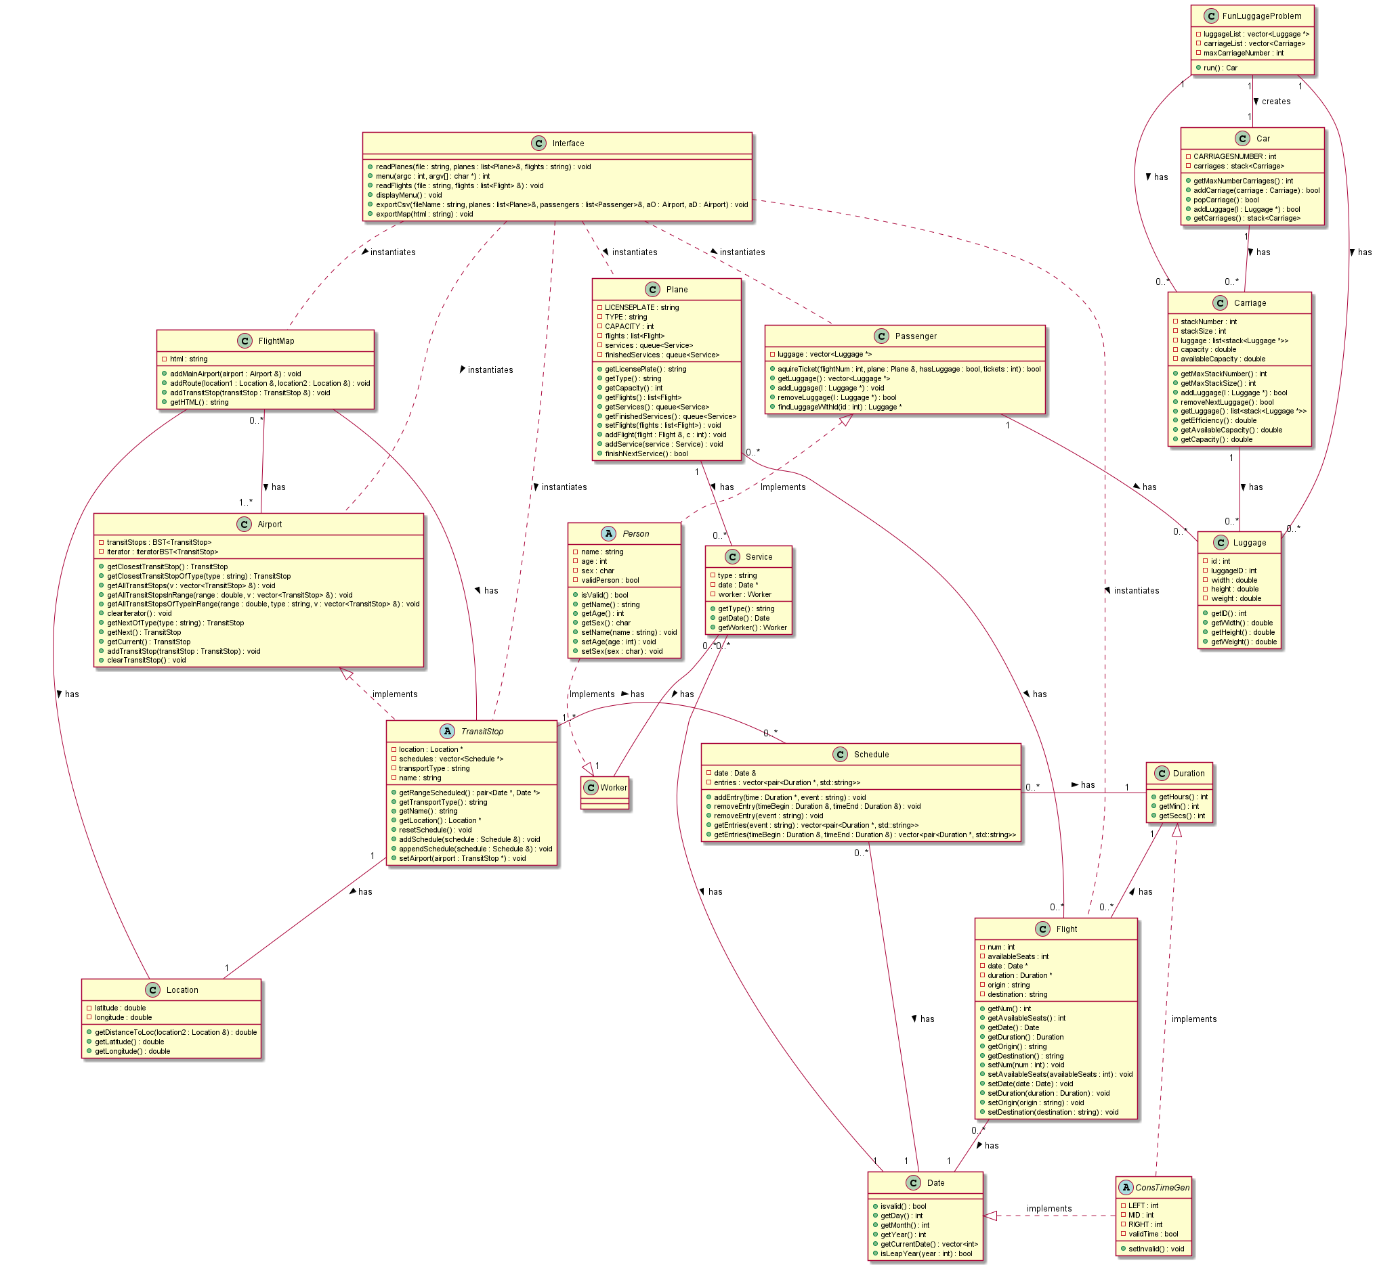
Class Diagram
Download the full diagram here

Slide 3
Dataset Reading
Dataset
The dataset is treated as a normal input, this will be elaborated in User Interface
Input
Persistent Memory
Note Linecode files will be stored in a specific folder, to avoid cluttering the persistent memory file

Slide 4
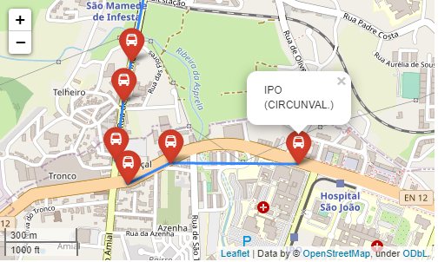
Used graphs
We create one graph per run, which:
is always weighted (default weight is 1)
isn’t always complete (especially during the night shift)
is implemented according to the adjacency list provided by faculty
Different features are therefore not implemented by creating different kinds of graphs, but rather by using them in different ways (more on that later)

Slide 5
Implemented functionalities
Graph Selection Flow
1 Origin/destination, is the user interested in arriving in a bus stop or a location? Where?
2 Is the user willing to walk between stops to catch another bus? For how long? And if he chose a location as an origin/destination, how much is he willing to walk to arrive there?
3 What are his priorities in the trip (pay less, switch lines as little as possible, )?

Slide 6
Implemented functionalities
Graph 1
I do this!

Slide 7
User Interface
Instruction handling All instructions will be inputed in the terminal
Path finding result Users can choose to receive results in the terminal or in output folder (CSV format)
Terminal
CSV Folders:
Input
Output
Persistent Memory
CSV
Visual interface
self explanatory
Edit transit info Users will receive model CSVs in output, which they can fill and deliver in input to update information
HTML map very similar to first project

Slide 8
Best functionality
implementation
We didn’t focus on creating a great feature, but rather on perfectly integrating our existing ones
Graph
Graph

Slide 9
Main difficulties
Gonçalo
Difficulties: None
Solution: Not applicable
33%
Guilherme
Difficulties:
Solution:
33%
Pedro
Difficulties:
Solution:
33%

