Slide 1
Apache Web Server(httpd)
Customizing httpd
Main configuration(conf/httpd.conf)
Directory listing Display Control(conf.d/autoindex.conf)
User home directory Control(conf.d/userdir.conf)
Access Control through Specific file(.htaccess)
VirtualHost(conf.d/virtualhost.conf)

Slide 2
1. Understanding httpd
  httpd test
  Customizing configuration file
  #vi /etc/httpd/conf/httpd.conf
    ServerName www.bingo.co.kr
    #httpd -t; systemctl start httpd <- enable
    #netstat -ntlp; ps -ef | grep httpd
  Customizing firewalld
    #firewall-cmd --permanent --add-service=http
    #firewall-cmd --reload
    #firewall-cmd -–list-services

Slide 3
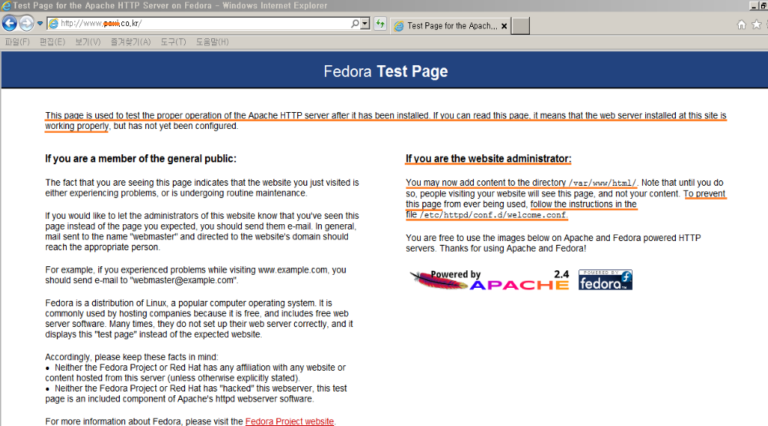
1. Understanding httpd
Upgrading to 2.4 from 2.2

Slide 4

1. Understanding httpd
#vi /var/www/html/index.html
#less /etc/httpd/logs/error_log
<-/var/log/httpd/error_log

Slide 5
2. Customizing httpd
# ls -l /etc/httpd
/conf
httpd.conf : main configuration
head part : directives’ information web site
#httpd -t
Syntax ok
/conf.d
welcome.conf
autoindex.conf : directory listing display control
userdir.conf : user’s home directory control
virtualhost.conf
/conf.moueles.d : dynamically loaded modules control

Slide 6
2-1. main configuration
  #vi /etc/httpd/conf/httpd.conf
  Section 1 : Global Environment
  ServerRoot “/etc/httpd” <- /logs/error_log
  Listen 203.247.192.100:80
  Include conf.module.d/*.conf <- #httpd -l
  User apache
  Group apache

Slide 7
2-1. main configuration
  Section 2 : Main server configuration
  ServerAdmin root@bingo.co.kr
  ServerName www.bingo.co.kr
  <Directory />
  AllowOverride none <- .htaccess is ignored
  Require all denied <- all hosts are denied access
  <Directory>
  deny access to the entirety of server’s filesystem

Slide 8
2-1. main configuration
  <Directory “/var/www”>
  AllowOverride none <- .htaccess is ignored
  Require all granted <- allow open access
  <Directory>
  <Directory “/var/www/html”>
  Options Indexes FollowSymLinks
  AllowOverride none
  Require all granted
  <Directory>
  further relax access to the default document root
Configures what features are
available in a particular directory

Slide 9
2-1. main configuration
  <IfModule dir_module>
  DirectoryIndex index.html
  </IfModule>
  set the file that Apache will serve if a dir is requested
  <Files “.ht*”>
  Require all denied
  </Files>
  .htaccess and .htpasswd are not being viewed by web clients

Slide 10
2-3. userdir.conf
  #vi /etc/httpd/conf.d/userdir.conf
  <IfModule mod_userdir.c>
  Userdir enabled babo
  UserDir public_html
  </IfModule>
  <Directory /home/*/public_html>
  AllowOverride FileInfo AuthConfig Limit Indexes
  Options MultiViews Indexes
  SymlinksIfOwnerMatch IncludesNoExec
  Require method GET POST OPTIONS
  </Directory>
$chmod 711 .
$chmod 755 public_htm

Slide 11
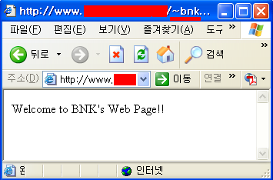
2-3. userdir.conf
    Creat User’s public_html directory
    $chmod 711 .
    $mkdir public_html
    $vi public_html/index.html
    Set seboolean value and change the Security context(SELinux)
    #setsebool -P httpd_enable_homedirs on
    #chcon –R –t httpd_user_content_t /home/username/public_html
Can’t access to 80 port even thought 755 permission
# ls –lRZ babo

Slide 12
2-4. Access control
Web Site Access Control
    httpd.conf
  <Directory “/var/www/html”>
  AllowOverride AuthConfig
  AuthType Basic <= plain test
  AuthName “bingo.co.kr”
  AuthUserFile /etc/httpd/conf/.htpasswdfile
  Require valid-user
  </Directory>
AuthConfig
  Allow use of the authorization directives
  (AuthType, AuthName, AuthUserFile, Require,
  AuthDBMGroupFile, AuthDBMUserFile, AuthGroupFile)

Slide 13
2-4. Access control
  Authentication User File Creation
#htpasswd -c /etc/httpd/conf/.htpasswdfile babo1
  New password :
  Re-type new password :
  Adding password for user babo1
#htpasswd /etc/httpd/conf/.htpasswdfile babo2
  New password :
  Re-type new password :
  Adding password for user babo2
#htpasswd /etc/httpd/conf/.htpasswdfile babo1
  New password :
  Re-type new password :
  Adding password for user babo2

Slide 14
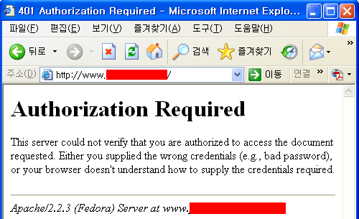
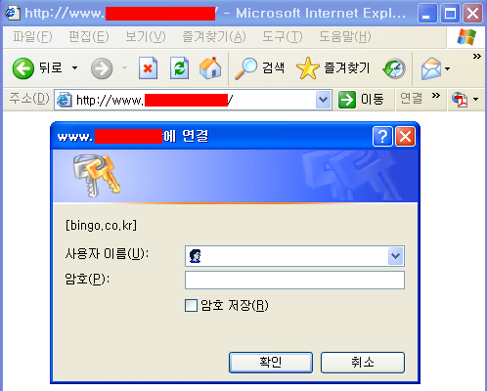
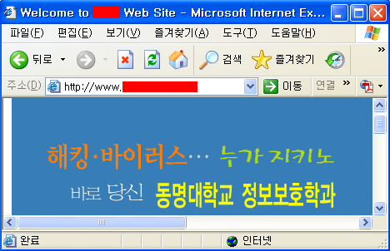
2-4. Access control

Slide 15
2-4. Access control
Web Site Member Directory Access Control (http://www.bingo.co.kr/member)
    .htaccess file creation
  #vi /var/www/html/member/.htaccess
  AuthType Digest
  AuthName “member only group”
  AuthUserFile /etc/httpd/conf/.htpasswdfile
  Require valid-user
    htdigest –c /etc/httpd/conf/.htpasswdfile “member only group” babo
    /etc/httpd/conf/httpd.conf modify
    <Directory “/var/www/html”>
    AllowOverride AuthConfig
    </Directory>
#less /etc/httpd/conf/.htpasswdfile
Declaration in Parent Dir of member Dir

Slide 16
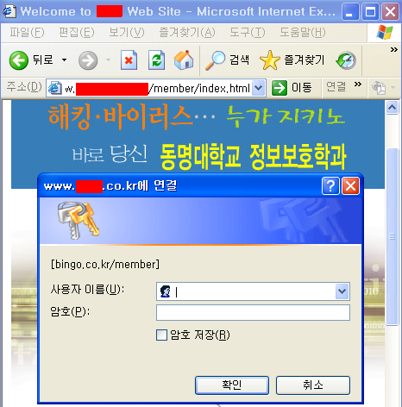
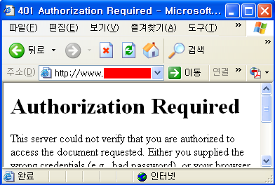
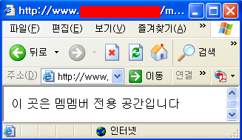
2-4. Access control

Slide 17
2-5. Virtual Hosts
  Name based virtual hosting
  : 1 web server provide multi-host web services over 1 ip address
    Add CNAME or A Record for multi-hosts to named zone file
    #vi /var/named/chroot/var/named/bingo.zone
    bingo IN A 192.168.100.200
    sales IN CNAME bingo
    planning IN CNAME bingo
    marketing IN A 192.168.100.200
    #systemctl restart named
Be able to add records to whois.co.kr, etc.
samsung.co.kr, sk.co.kr, gs.co.kr virtual
web hosts are possible in 1 web server

Slide 18
2-5. Virtual Hosts
  Configuration for virtual hosts
    #vi /etc/httpd/conf.d/virtualhost.conf
    <VirtualHost 192.168.100.200:80>
    ServerName www.bingo.co.kr
    </VirtualHost>
    <VirtualHost 192.168.100.200:80>
    ServerAdmin webmaster@sales.bingo.co.kr’
    DocumentRoot /var/www/sales
    ServerName sales.bingo.co.kr
    ErrorLog logs/sales_error_log
    CustomLog logs/sales_log common
    </VirtualHost>
Main Server

Slide 19

2-5. Virtual Hosts
  Edit web page & restart httpd service
    #vi /var/www/sales/index.html
    #systemctl restart httpd

Slide 20
2-5. Virtual Hosts
  IP based virtual hosting
  : using multiple LAN cards or ip aliasing, not use NameVirtualHost
    Add ‘A’ Record for multi-hosts to named zone file
    #vi /var/named/chroot/var/named/bingo.zone
    sales IN A 192.168.100.101
    planning IN A 192.168.100.102
    marketing IN A 192.168.100.103
    #service named restart
Be able to add records to whois.co.kr, etc.
samsung.co.kr, sk.co.kr, gs.co.kr virtual
web hosts are possible in 1 web server

Slide 21
2-5. Virtual Hosts
    IP aliasing
    : ifconfig eth0:alias# ip_addr up
    #ifconfig eth0:1 192.168.100.101
    #ifconfig eth0:2 192.168.100.102
    #ifconfig eth0:3 192.168.100.103

Slide 22
2-5. Virtual Hosts
  Configuration for virtual hosts
    #vi /etc/httpd/conf/vitualhost.conf
    <VitualHost 192.168.100.101:80>
    ServerAdmin webmaster@sales.bingo.co.kr’
    DocumentRoot /var/www/sales
    ServerName sales.bingo.co.kr
    ErrorLog logs/sales_error_log
    CustomLog logs/sales_log common
    </VirtualHost>

Slide 23
2-5. Virtual Hosts
    <VitualHost 192.168.100.102:80>
    ServerAdmin webmaster@planning.bingo.co.kr
    DocumentRoot /var/www/planning
    ServerName planning.bingo.co.kr
    ErrorLog logs/planning_error_log
    CustomLog logs/planning_log common
    </VirtualHost>
    <VitualHost 192.168.100.103:80>
    ServerAdmin webmaster@marketing.bingo.co.kr’
    DocumentRoot /var/www/marketing
    ServerName marketing.bingo.co.kr
    ErrorLog logs/marketing_error_log
    CustomLog logs/marketing_log common
    </VirtualHost>

Slide 24
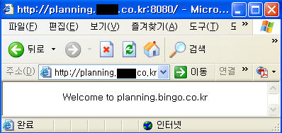

2-5. Virtual Hosts
  Edit web page & restart httpd service
    #vi /var/www/sales/index.html
    #vi /var/www/planning/index.html
    #vi /var/www/marketing/index.html
    #systemctl restart httpd

