Slide 1
Netflix Content Analysis
Insights from the Netflix Movies and TV Shows Dataset

Slide 2
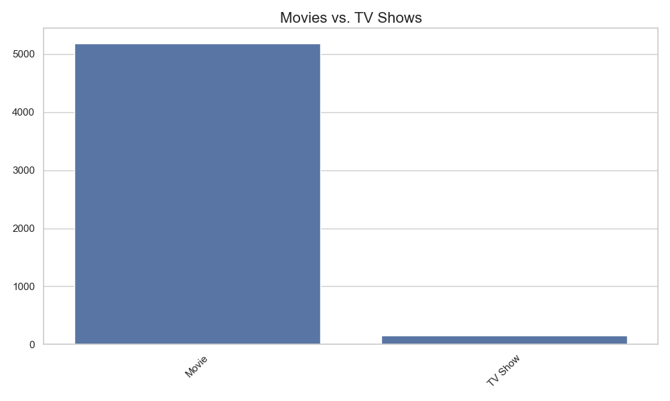
Movies vs. TV Shows

Slide 3
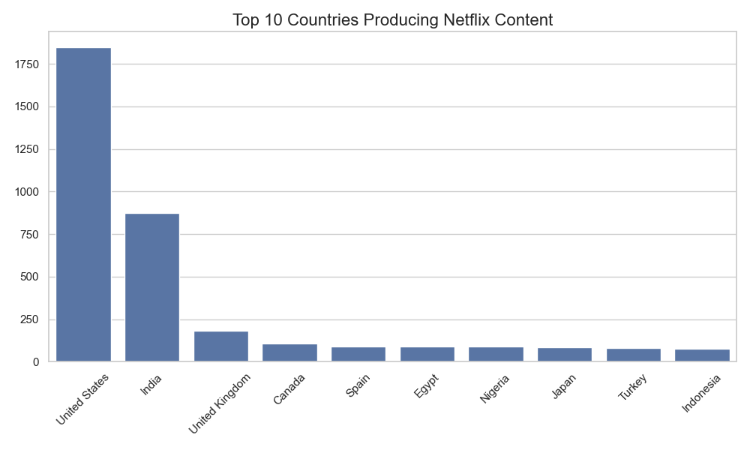
Top 10 Countries Producing Netflix Content

Slide 4
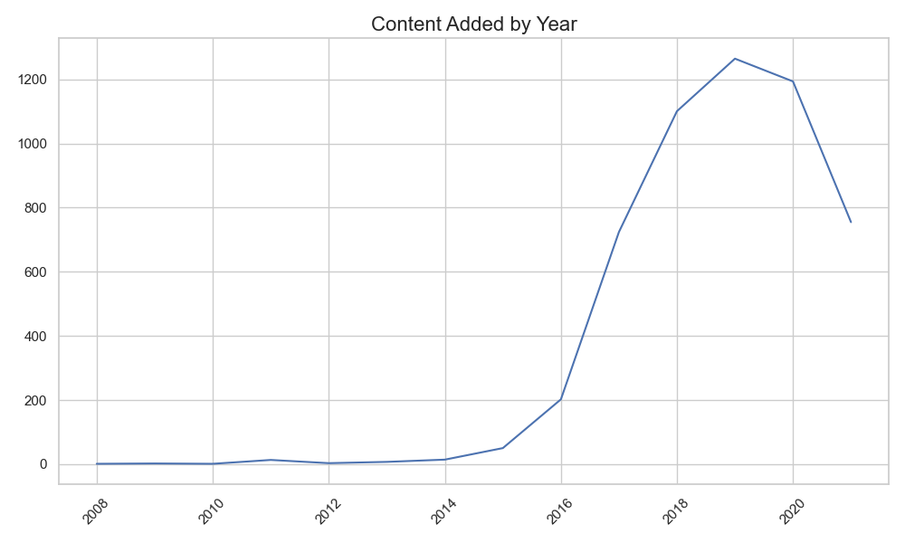
Content Added by Year

Slide 5
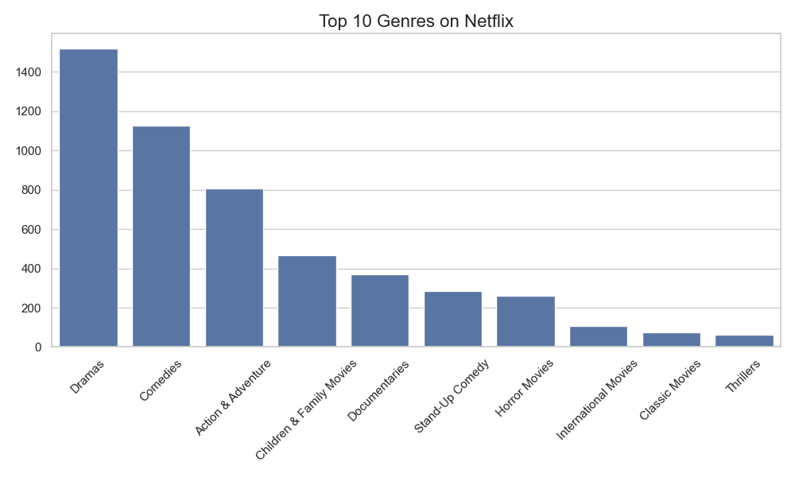
Top 10 Genres on Netflix

Slide 6
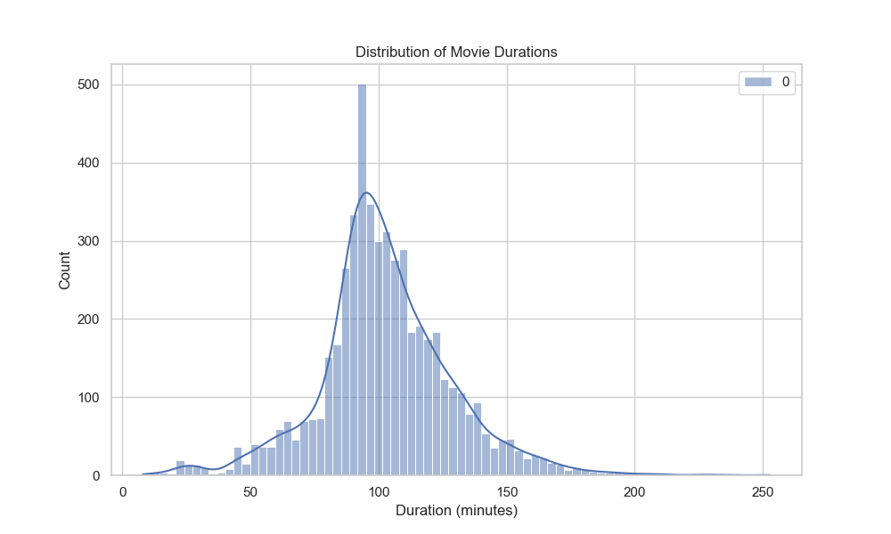
Distribution of Movie Durations

Slide 7
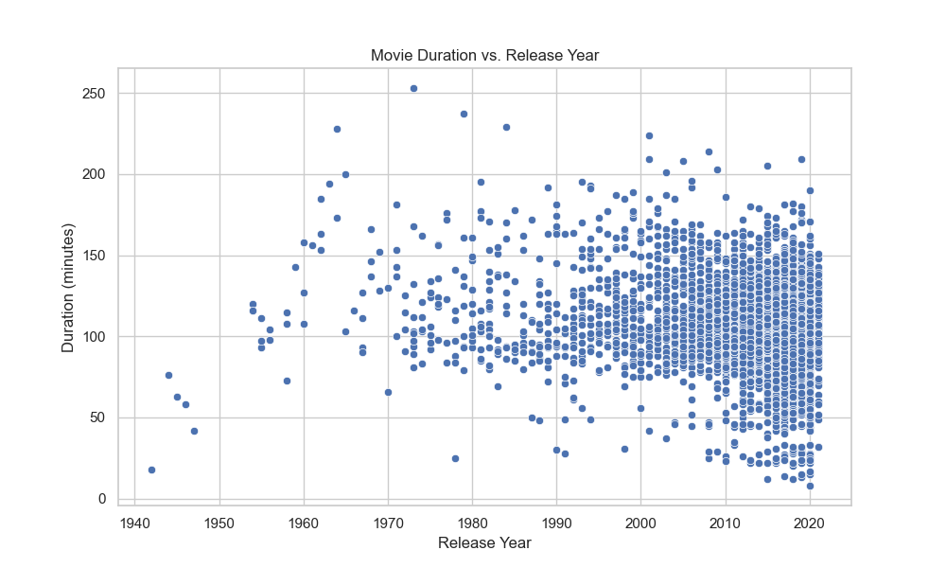
Movie Duration vs. Release Year

Slide 8
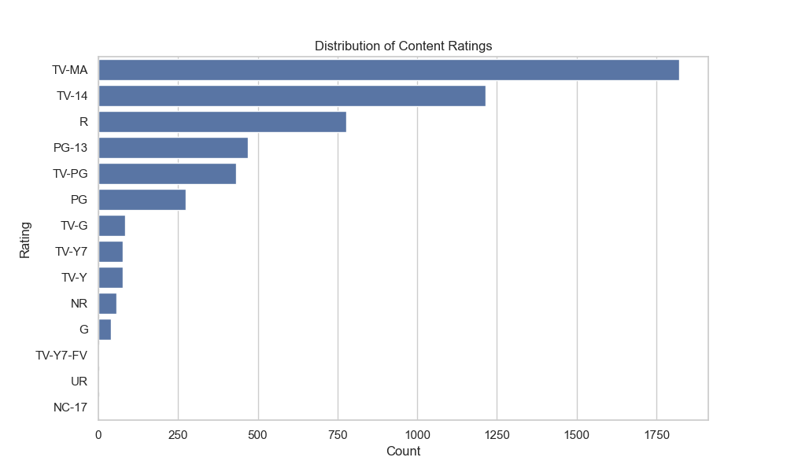
Distribution of Content Ratings

