Slide 1
Netflix Content Analysis
Insights from the Netflix Movies and TV Shows Dataset

Slide 2
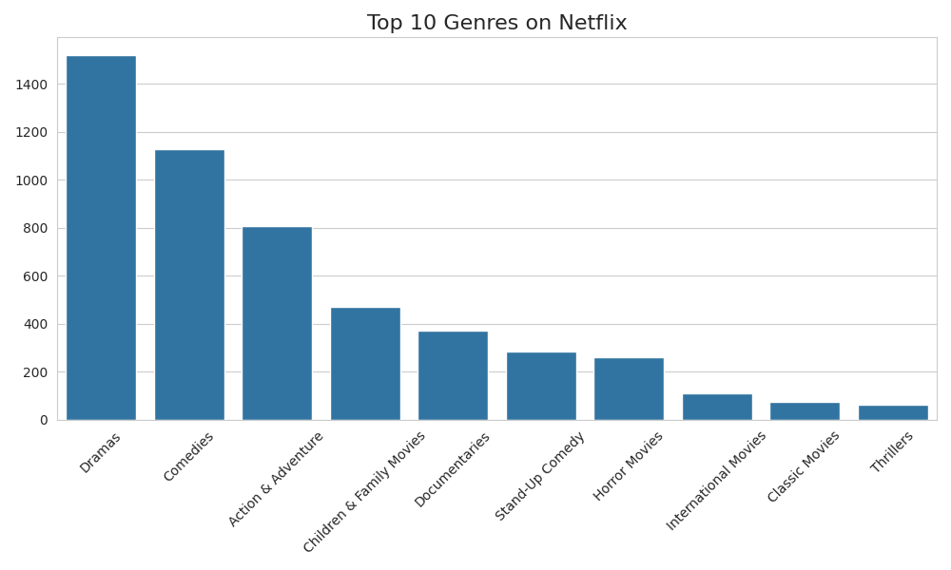
Top Genres

Slide 3
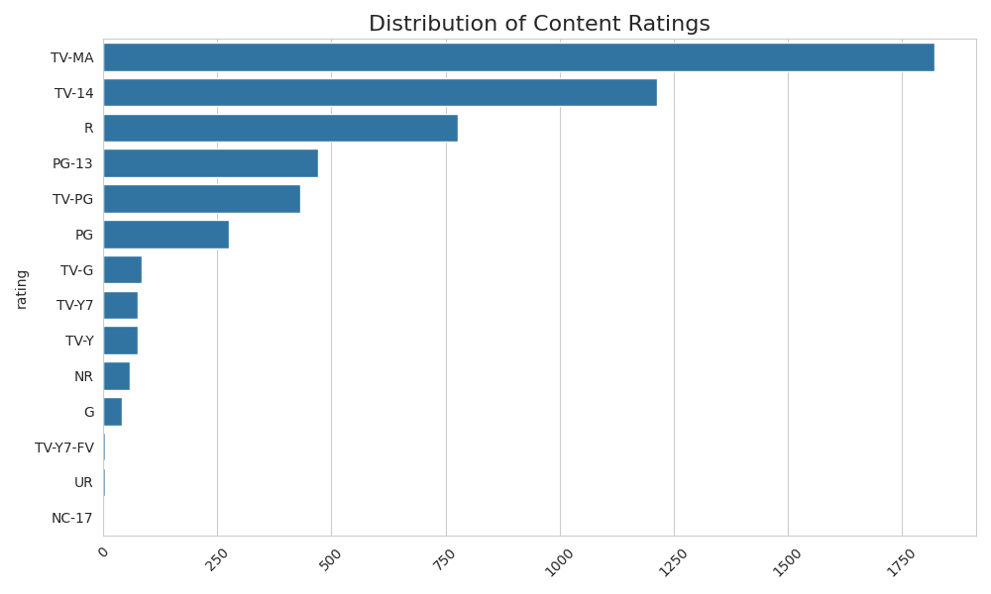
Rating Distribution

Slide 4
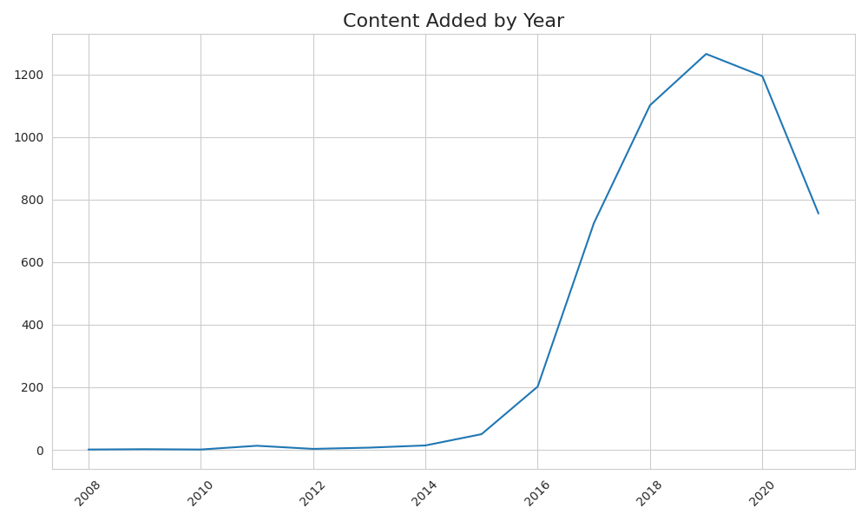
Content By Year

Slide 5
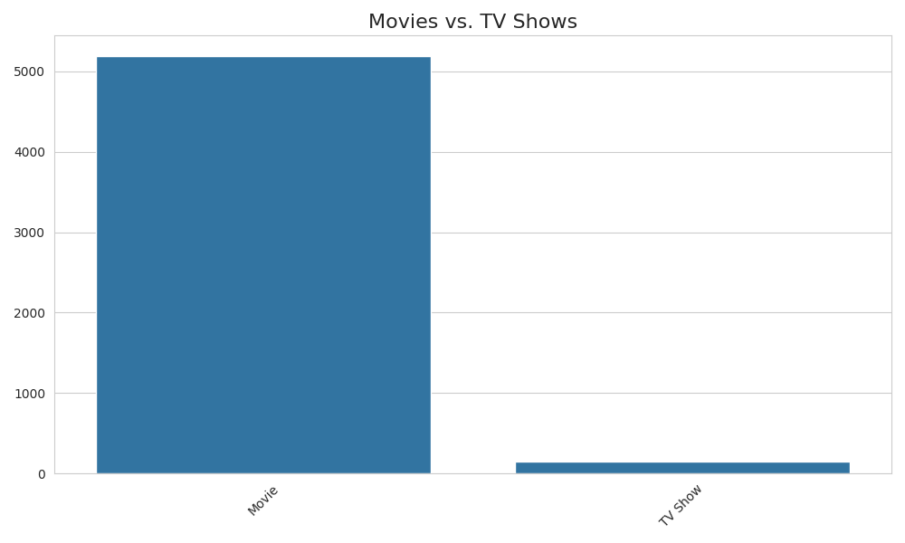
Content Types

Slide 6
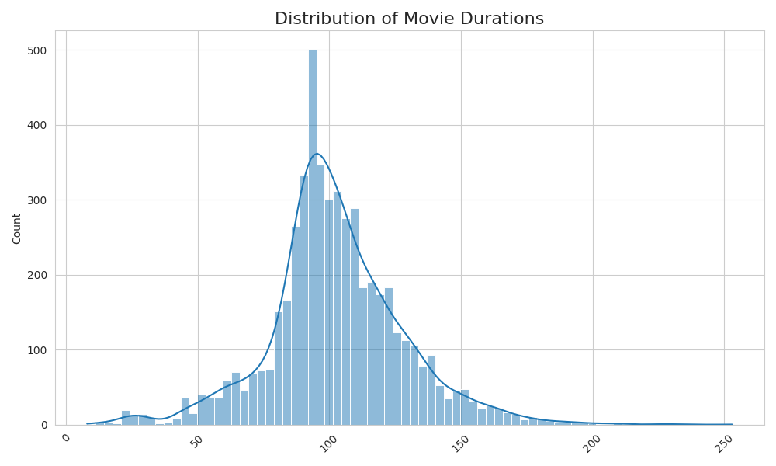
Movie Duration Dist

Slide 7
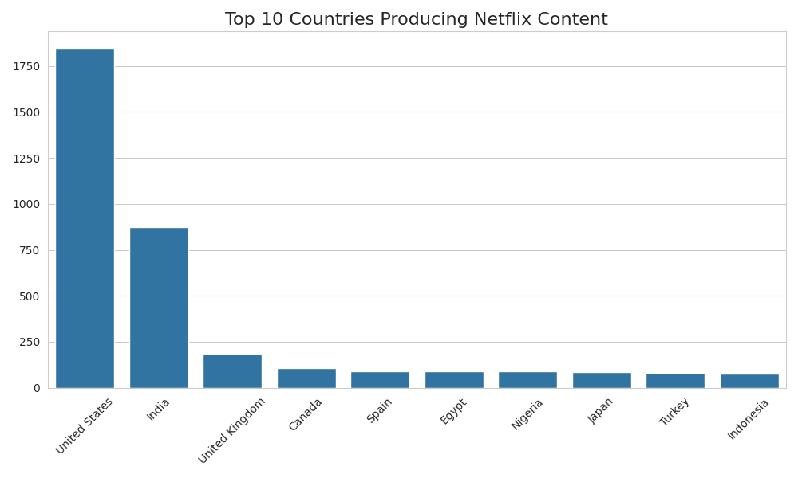
Top Countries

Slide 8
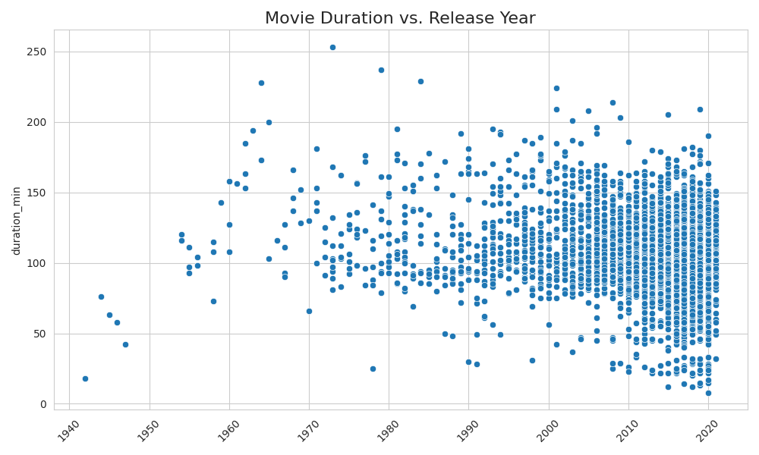
Duration Vs Year

