Slide 1


MSc IN BUSINESS ANALYTICS
MACHINE LEARNING & CONTENT ANALYTICS
SDG Classification-Topic Analysis
Instructor: Haris Papageorgiou
October 2020

Slide 2





Team Members
Aris Petrou
Elena Styliara
Eleni Kakagianni

Slide 3
Contents
Neural Networks
Definition of Neural Networks
Text classification & topic analysis
1
Assignment goal
Presentation of the business goal
2
Dataset
Annotation process
Final dataset presentation
Data preprocessing
3
Text classification
Text classification methods (MLP, CNN, RNN)
4
Results
Neural Network method selection
Evaluation metrics
Conclusion
5
Notes:
This template was inserted from Power-user, the productivity add-in for PowerPoint, Excel and Word.
Get thousands of templates, icons, maps, diagrams and charts with Power-user. Visit https://www.powerusersoftwares.com/!

Slide 4
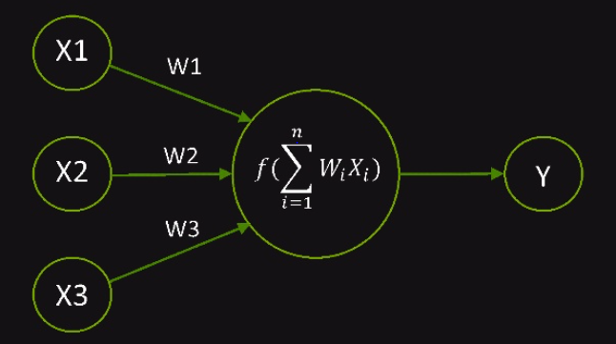
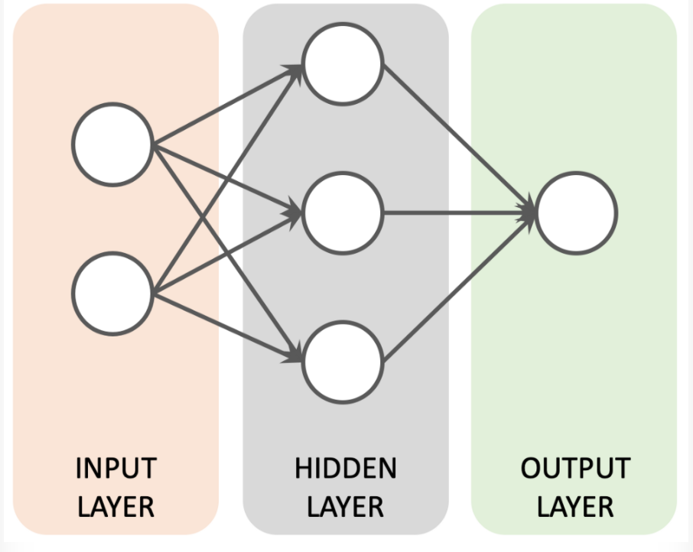
What is Neural Network?
Neural Network: A computational model that works in a similar way to the neurons in the human brain.
It consists of large number of highly interconnected neurons in it to carry information.
Each neuron takes an input, performs some operations then passes the output to the following neuron.

Slide 5
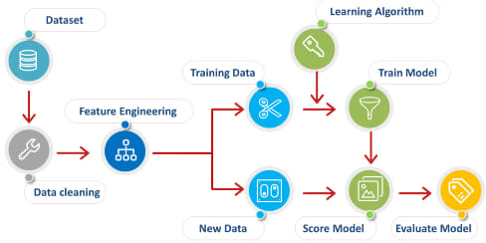
Model Process

Slide 6
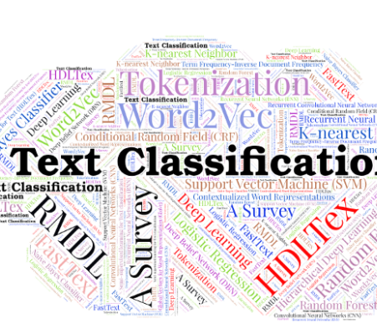
Text Classification - Topic Analysis
Analyze text
Topic Detection - Identify the theme or topic of a piece of text
Assign each document to classifier

Slide 7

Assignment Goals About SDGs: The Sustainable Development Goals (SDGs), also known as the Global Goals, were adopted by all United Nations Member States in 2015 as a universal call to action to end poverty, protect the planet and ensure that all people enjoy peace and prosperity by 2030.
Implementation of a tool (desktop app) that takes as input a text and returns its SDG
Train of a neural network model
Classification of scientific papers in United Nations online library
Notes:
This template was inserted from Power-user, the productivity add-in for PowerPoint, Excel and Word.
Get thousands of templates, icons, maps, diagrams and charts with Power-user. Visit https://www.powerusersoftwares.com/!

Slide 8

Annotation Process – Data collection
Gather almost 150 documents related to SDG13 via a scientific site
Annotate main components:
-Topic Annotation
-Research theme Annotation
-Argument Annotation(Evidence-Claim)
Dataset creation
Contains texts of six different SDGs

Slide 9
Data Preprocessing
Split the dataset into train and validation and we use the blind dataset for testing.
Our final dataset contains information about 889 documents from different SDG’s.
Input variables:
- extracted_title
- extracted_abstract
- initial_text
output: SDG
Remove all words that are part of stop-words list
Normalization of both input and output variables to 0,1
Convert all the word letters to lowercase
Remove all the special characters
Remove frequently-used words that are not stop-words
One Hot Encoding and Count Vectorizer to convert the data to numerical
Tokenization
Notes:
This template was inserted from Power-user, the productivity add-in for PowerPoint, Excel and Word.
Get thousands of templates, icons, maps, diagrams and charts with Power-user. Visit https://www.powerusersoftwares.com/!

Slide 10
Types of Neurons
Feed forward Neural Network (MLP) – Artificial Neuron
Recurrent Neural Network(RNN)
Recurrent Neural Network with multiple inputs(two)
Convolutional Neural Network(CNN)
Convolutional Neural Network with multiple inputs(two)

Slide 11
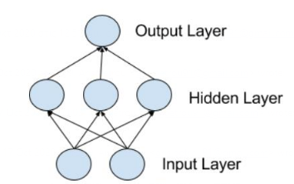
Feed forward Neural Network
Multilayer Perceptions, or MLPs for short, are the classical type of neural network.
They are comprised of one or more layers of neurons.
Data is fed to the input layer, there may be one or more hidden layers providing levels of abstraction and predictions are made on the output layer.
Parameters Configuration
max_words: the max words per input (max_words = 300)
nb_classes: number of classes for the output labels (nb_classes = 6)
nb_epochs: number of epochs that we will train our feed forward network (30 epochs)
batch_size: the batch size of the data that will be fed to the model while training (batch_size = 32)
dropout_rate: how many neurons should be shut down per epoch (dropout_rate = 0.4)
loss: “categorical_crossentropy”, since we have categorical output values
optimizer: “adam”, Adam optimization is a stochastic gradient descent method that is based on adaptive estimation of first-order and second-order moments.
metrics: “accuracy”

Slide 12
Convolutional Neural Network (CNN)
Use the concept of a “convolution”, a sliding window function or “filter” that passes over a matrix.
Identify important features and analyzing them one at a time, then reducing them down to their essential characteristics, and repeating the process.
During the training phase, a CNN automatically learns the values of its filters based on the task that we want to perform.
Parameters Configuration
embedding_dims: word embedding dimension (embedding_dims = 50)
nof_filters: number of filters (nof_filters = 25)
batch_size: the batch size of the data that will be fed to the model while training (batch_size = 64)
kernel_size: (width)*(height) of the filter mask (kernel_size = 3)
hidden_dims: the number of neurons in the hidden layer (hidden_dims = 50)
loss: “categorical_crossentropy”, since we have categorical output values
optimizer: “adam”, Adam optimization is a stochastic gradient descent method that is based on adaptive estimation of first-order and second-order moments.
metrics: “accuracy”
Trained 2 models:
with Dropout Rate
without Dropout Rate
Dropout hyperparameter is the probability of training a given
node in a layer.

Slide 13
Several layers of convolutions with nonlinear functions like ReLU applied to the results.
We use convolutions over the input layer to compute the output. An input sentence broken up into word embeddings (embedding lookup). Words are broken up into features and are fed into a convolutional layer.
The results of the convolution are “pooled” to a representative number. This number is fed to a fully connected neural structure, which makes a classification decision based on the weights assigned to each feature within the text.

Slide 14
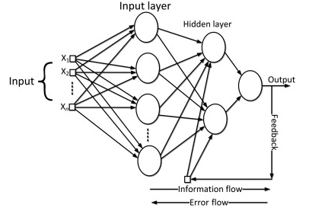
Recurrent Neural Network (RNN)
Connections between nodes form a directed graph along a temporal sequence.
The output from previous step is fed as input to the current step.
Main and most important feature of RNN is Hidden state (Hidden Layer), which remembers information about a sequence.
All the inputs are related to each other = > RNN model sequence of data so that each sample can be assumed to be dependent on previous ones.
Parameters Configuration
MAX_NB_WORDS (=50000)
embedding_dims: word embedding dimension (embedding_dims = 100)
batch_size: the batch size of the data that will be fed to the model while training (batch_size = 64)
dropout_rate: how many neurons should be shut down per epoch (dropout_rate = 0.2)
loss: “categorical_crossentropy”, since we have categorical output values
optimizer: “adam”, Adam optimization is a stochastic gradient descent method that is based on adaptive estimation of first-order and second-order moments.
metrics: “accuracy”
Trained 2 models:
with Dropout Rate
without Dropout Rate

Slide 15
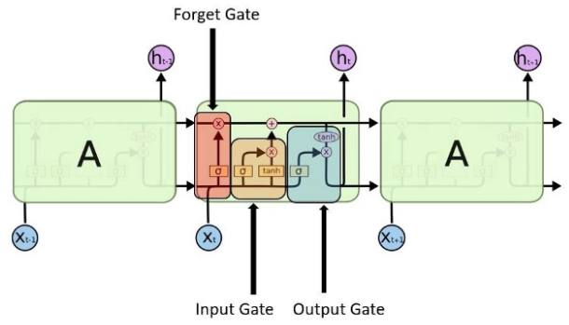
Long Short-Term Memory (LSTM)
A modified version of recurrent neural networks, which makes it easier to remember past data in memory and learn long-term dependencies. The vanishing gradient problem of RNN is resolved.
Well-suited to classify, process and predict time series given time lags of unknown duration. It trains the model by using back-propagation.
Multiple layers
In an LSTM network, three gates are present:
- Input gate
- Forget gate
- Output gate

Slide 16
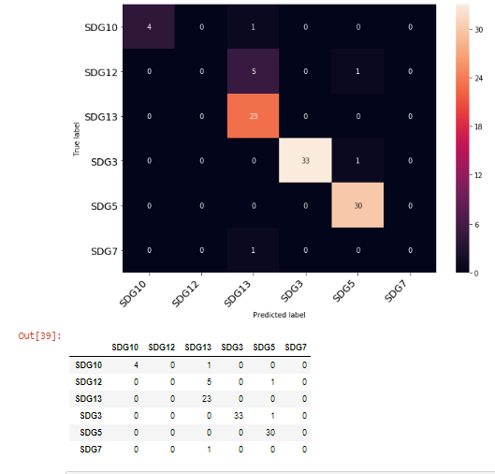
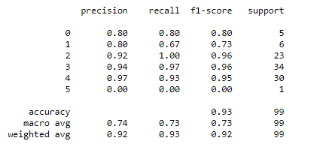
Best Neural Network Method selection
Selected Method: CNN (Convolutional Neural Network)
Reject RNN due to low accuracy results in all variations
Reject MLP due to overfitting → the gap between train and val. Accuracies while visualizing the plots is really large
CNN metrics
Variations average accuracy: 91.25%
ROC curves
Confusion matrices
Classification reports

Slide 17

Conclusions
Goal achieved: model’s accuracy > 90%
UN Online library implementation will be completed earlier than expected

Slide 18

Thank you

