Slide 1
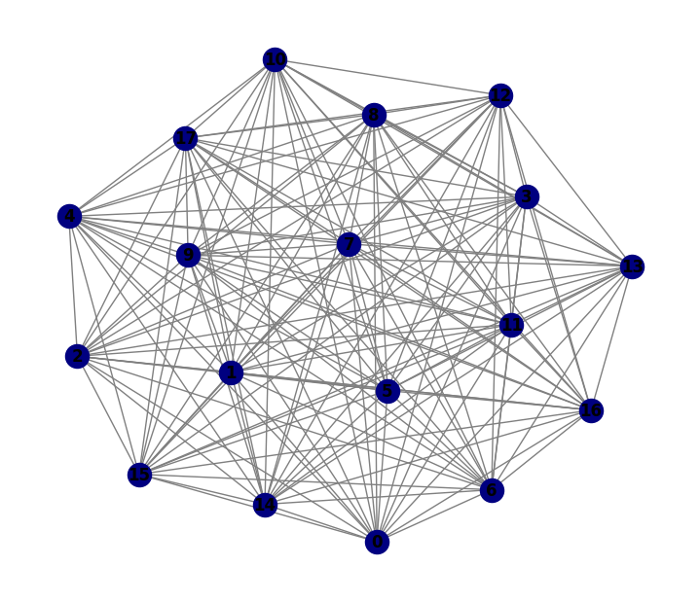
x 3 Layers 64 Hidden Channels
Input: 31 features
Variable # Nodes
Fully Connected Nodes
Output: 31 features
Global Mean Pool
GraphConv
Linear
BatchNorm1d
ReLU
Prediction: b-jet or not
Dropout

