Slide 1
Group 4
Collaborative Carrier Network
Christian Kruse
Kien Giang Phan
Linh Ngoc Le

Slide 2
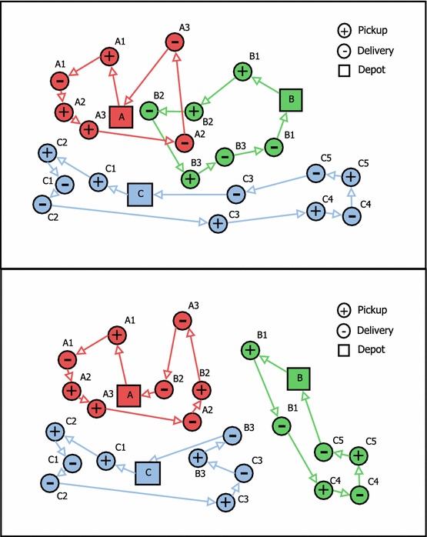
Problem description
Background: Network of collaborating freight carrier companies
Problem: Some requests cannot be efficiently integrated into the route of a carrier
Approach: Optimization-based collaboration with auction-based exchange mechanisms
Goal:
Maximize the overall profit of the network
Few information transfer
Target users: Pickup and delivery service, e.g., courier services
Source:
Klaus, P., 2003. Die “TOP 100” der Logistik: Berichtszeitraum 2001/2002.
https://doi.org/10.1016/j.ejor.2017.10.023

Slide 3
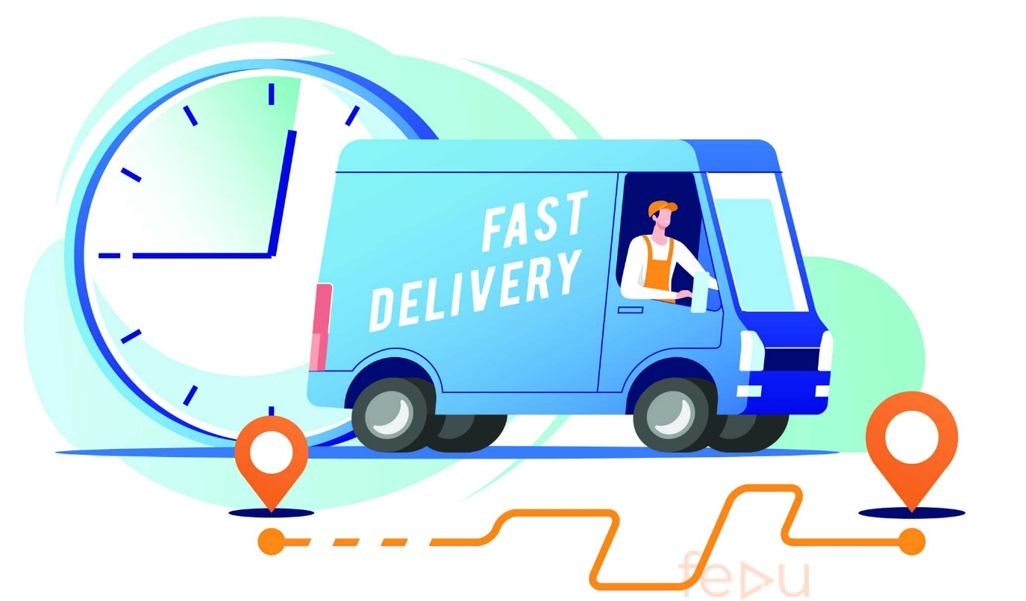

Outline
Solution
Quality of solution
Demo
Evaluation of SCRUM
Source: https://fedudesign.vn

Slide 4
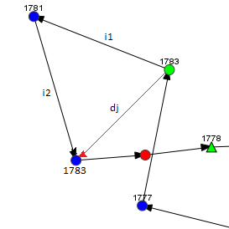
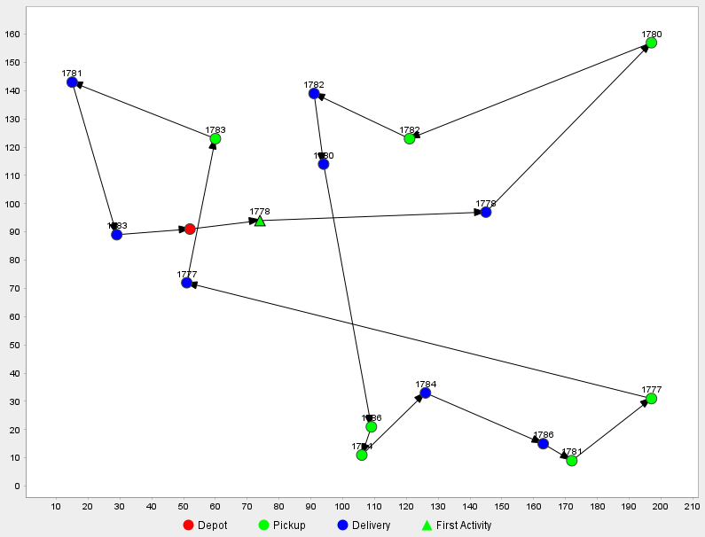
Cost calculation and Tour visualization
Price of request/order j: r_{j} = a₁ + a₂*d_{j}
Real cost: c_{j} = b₁ + b₂*l_{j}
l_{j} = L(N) – L(N\{j})
Open source Jsprit
Basic setting:
Capacity of vehicle is 2
Transport request is considered as 1

Slide 5
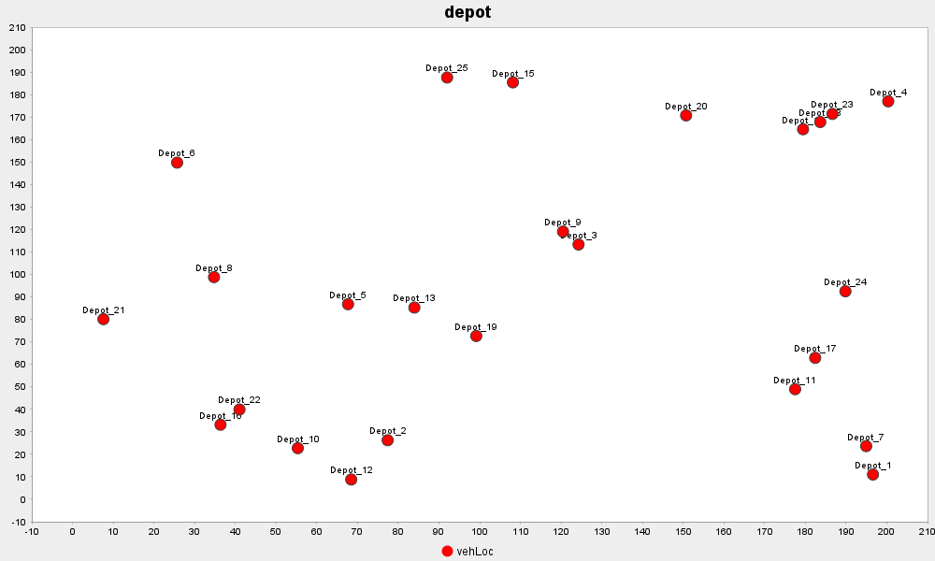
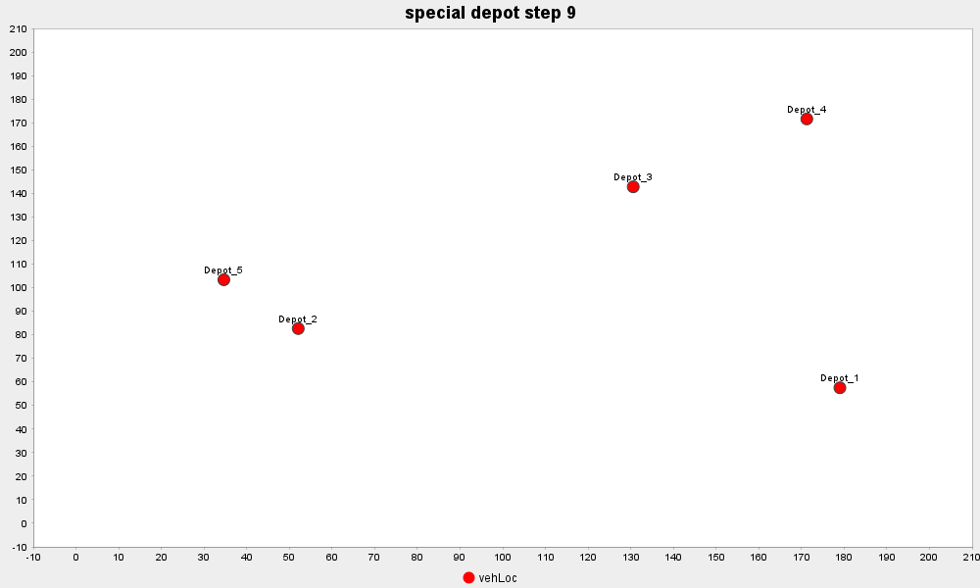
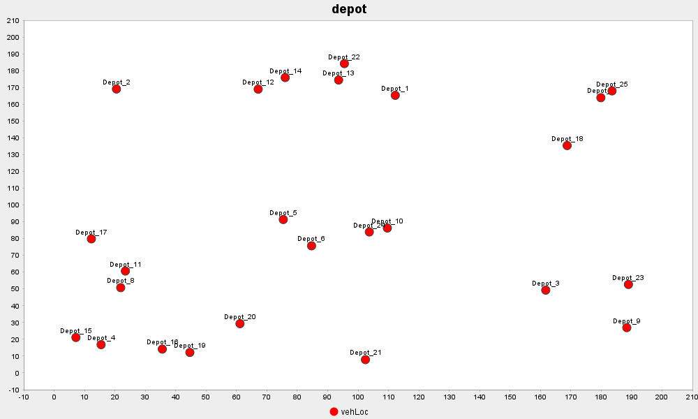
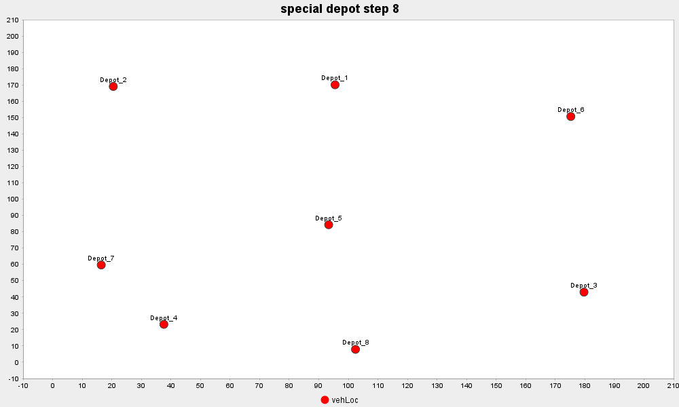

Slide 6
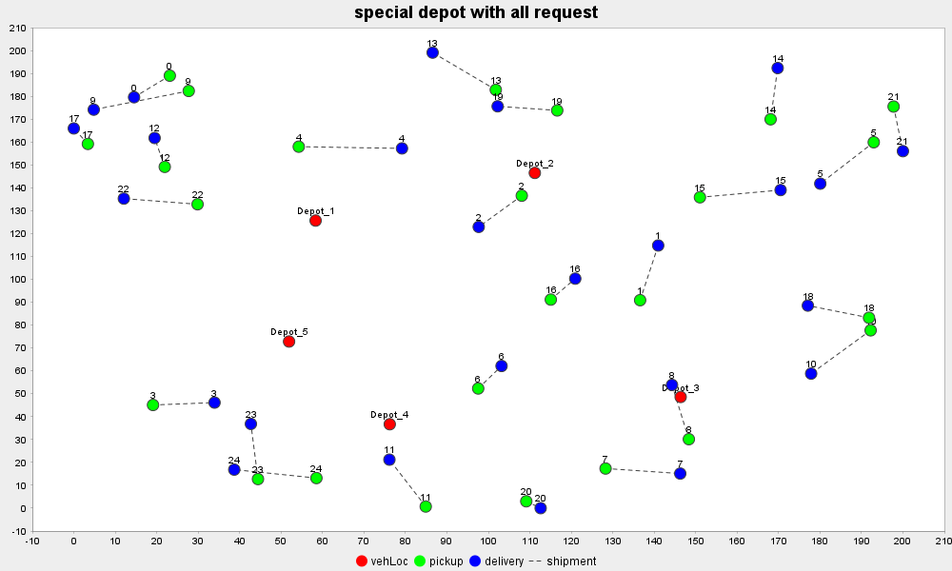
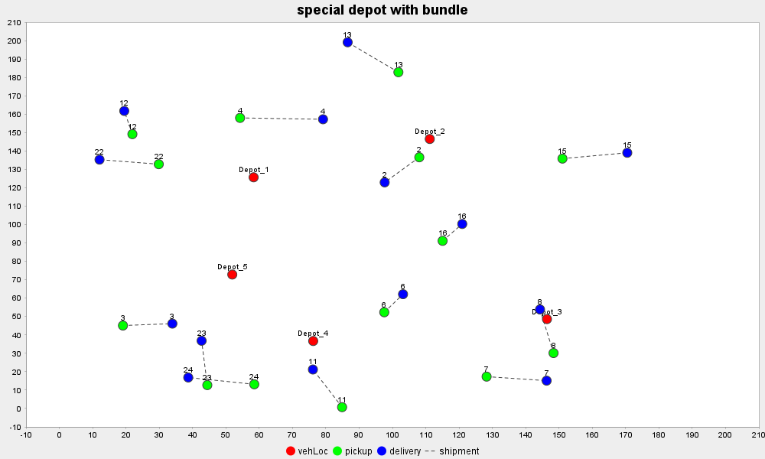

Slide 7

Improvement ideas
Option to add new transport requests
Auctioneer can control number of bidders OR
Carriers can decide whether to join auction process
Decentralized system
Option to set up new database
Automatic assignment of carriers in database
Multiple auctioneers
Source: https://img.freepik.com

Slide 8
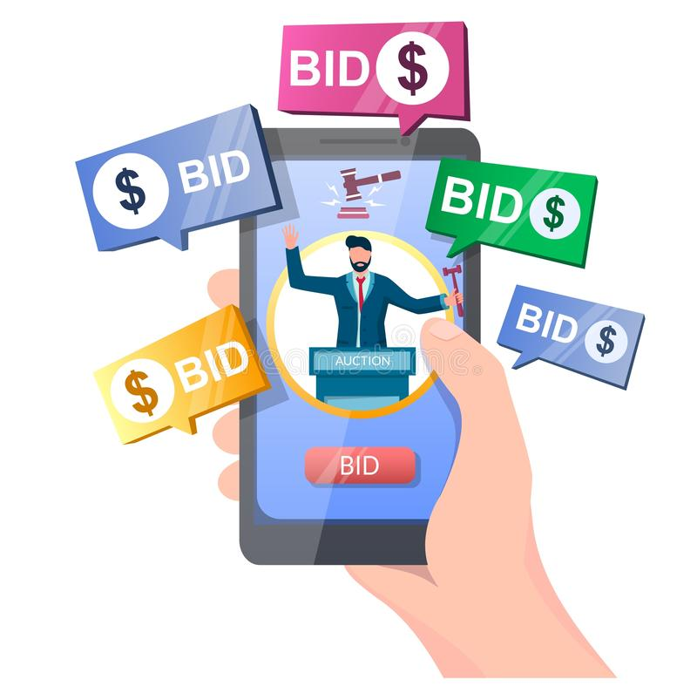
Quality of solution Auction process
Max profit of transport requests to be sold ≥ 0
Guaranteed: Only unprofitable requests are auctioned off
Min profit of transport requests to be bought ≥ 0
Guaranteed: Only profitable requests are bid on
Goal: Individual profit of the carriers can only be increased
Source: https://thumbs.dreamstime.com

Slide 9

Quality of solution Bundle strategy
Bundles contain only profitable transport requests to a special depot location
Goal: Maximize number of cost-effective bundles to carriers
Scenario: Carriers won same transport requests in different bundles:
Bundles are sold to carriers with higher total payment
Unsold transport requests are auctioned again
Goal: Maximize earning of sellers
Source: https://media.istockphoto.com

Slide 10

Evaluation of SCRUM
SCRUM feature | How useful?
Product backlog with user stories | Useful to define key focus for each sprint
2-week sprint | Bugs can be discovered in early stages.
Sprint planning + sprint backlog | Convert user stories in implementable tasks Give orientation to focus on
Sprint review | Mostly useful for product owner
Weekly meeting | Useful if takes place more frequently Good for effective communication
Source: https://wdrfree.com

Slide 11

Additional notes
Sources:
Product backlog
Lecture slides
Download instructions:
README.md in GitLab repository
Source: https://us.123rf.com

