Slide 1

From Numbers to Words: How the Model Actually Thinks
SOMA KESARA
PART 2
Our running example is still the same sentence: "What is my portfolio's exposure to emerging-market equities?"
Last time, we ended with every word turned into a bundle of numbers carrying meaning and position. Now we follow those numbers the rest of the way — into the model's "thinking," and back out as the answer that appears on your screen.

Slide 2


Where We Left Off — A One-Line Recap
Each token in our sentence is now a rich list of numbers. The model has what each word means and where it sits. But it still doesn't know how the words relate to each other.
That's the job of the next step — and it's the single most important idea in modern AI.

Slide 3
Attention: Letting Every Word Look at Every Other Word
The Problem Attention Solves
Look at our sentence again: "What is my portfolio's exposure to emerging-market equities?"
The word "exposure" is the key word. But "exposure" on its own is vague — exposure to what? To sunlight? To risk? To a chemical?
To answer correctly, the model has to figure out that "exposure" here is connected to "emerging-market equities". Those words, several positions away, give "exposure" its real meaning in this sentence.
This is what attention does: it lets every word in the sentence look at every other word and decide which ones matter for understanding it.

Slide 4
The Classroom Analogy
Imagine a classroom of students. Each student is one word in our sentence. The teacher asks every student: "Look around the room. Who else in here is relevant to you? Pay close attention to them. Ignore the rest."
"exposure" looks around
"equities" pays attention
"is" has little to figure out
Pays a lot of attention to "portfolio", "emerging", and "equities". It barely looks at "is" or "my".
Focuses on "emerging" and "market" — they describe what kind of equities.
Mostly looks at nothing in particular — it's grammar glue.
Every word does this at the same time, in parallel.
That's why GPUs matter — remember the stadium of accountants from Part 1? This is exactly the kind of work they were built for.
Because every word updates its meaning based on context, the model builds a rich, context-aware representation of the whole sentence — not just a bag of isolated word meanings. That is what makes attention far more powerful than earlier approaches like simple word embeddings.

Slide 5
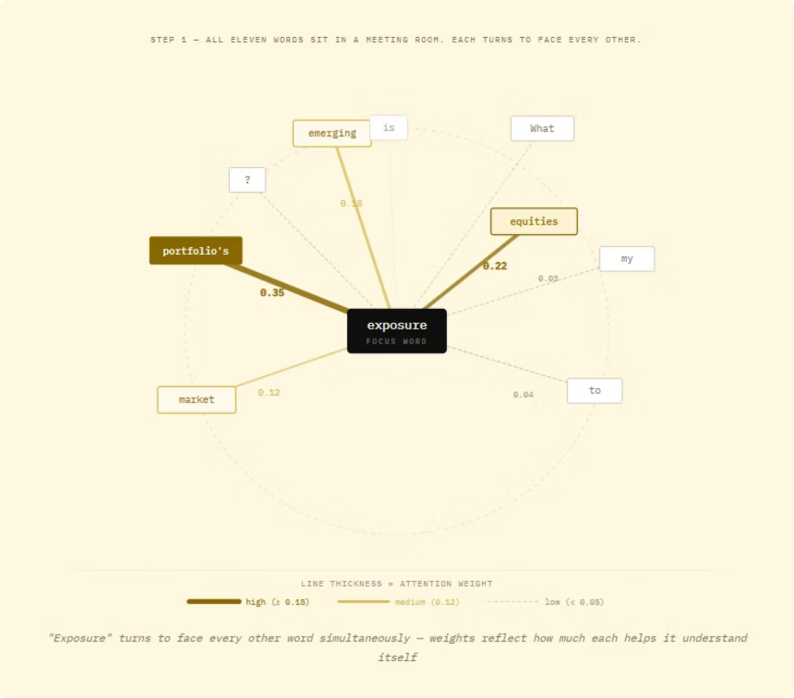
Attention Weights: A Visual
Each word in a sentence attends to every other word with different weights. The lines and connections in the diagram represent those attention scores.

Slide 6
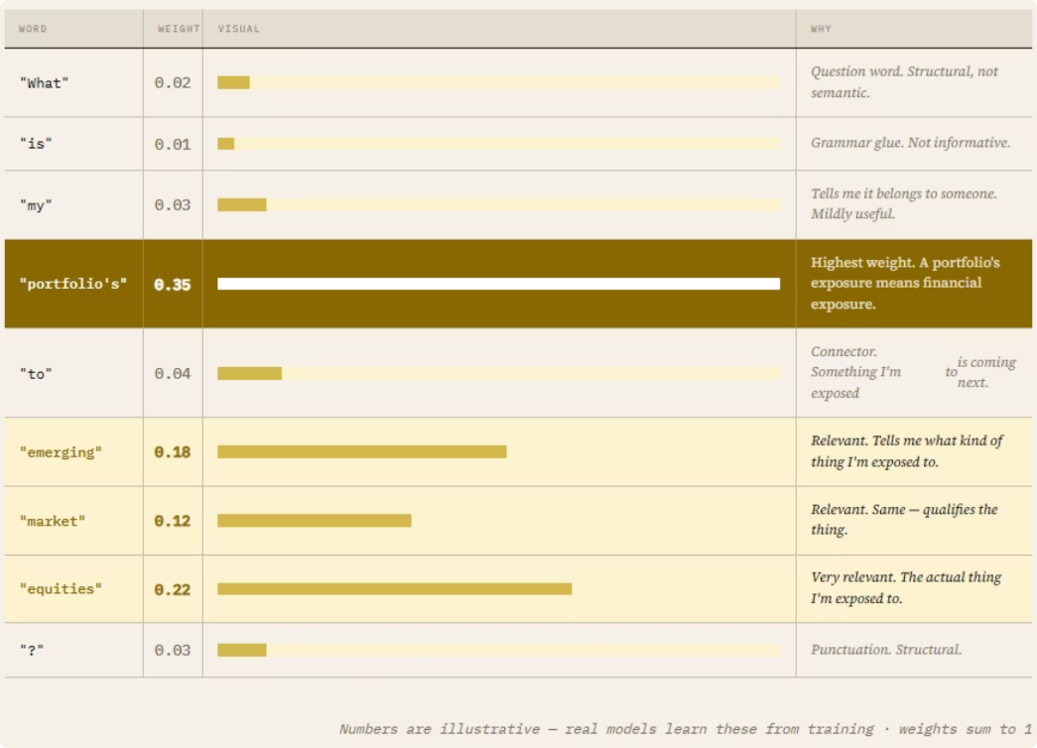
Multi-Head Attention: Many Conversations at Once
Real transformer models don't run attention just once per layer — they run it in parallel across multiple "heads," each one attending to different kinds of relationships simultaneously.
One head might focus on grammatical structure, another on semantic meaning.
another on long-range dependencies. The outputs of all heads are then combined
Giving the model a richer, multi-dimensional understanding of each word's context.

Slide 7
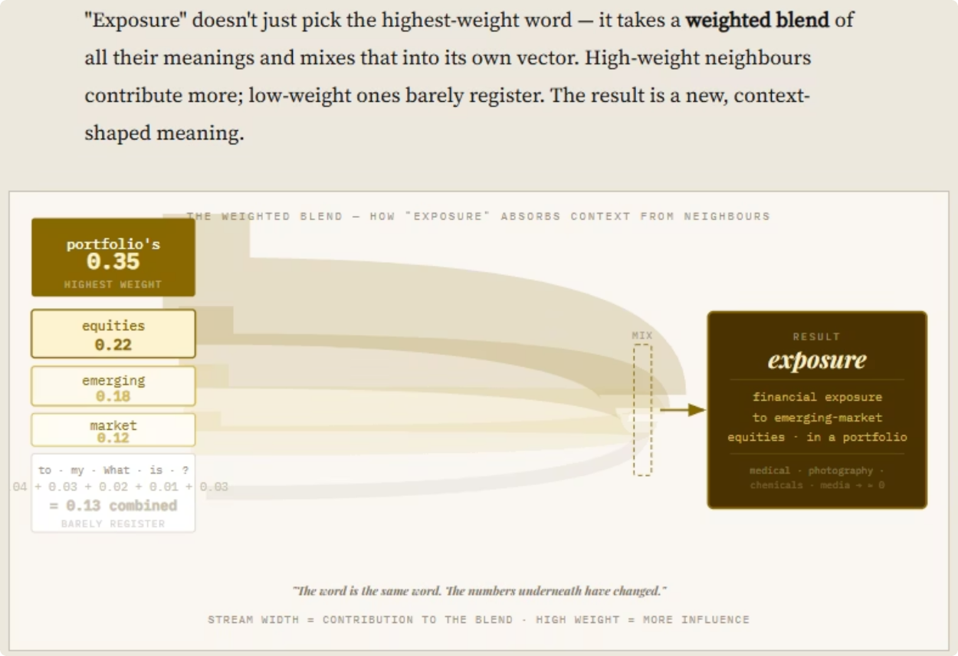

Slide 8
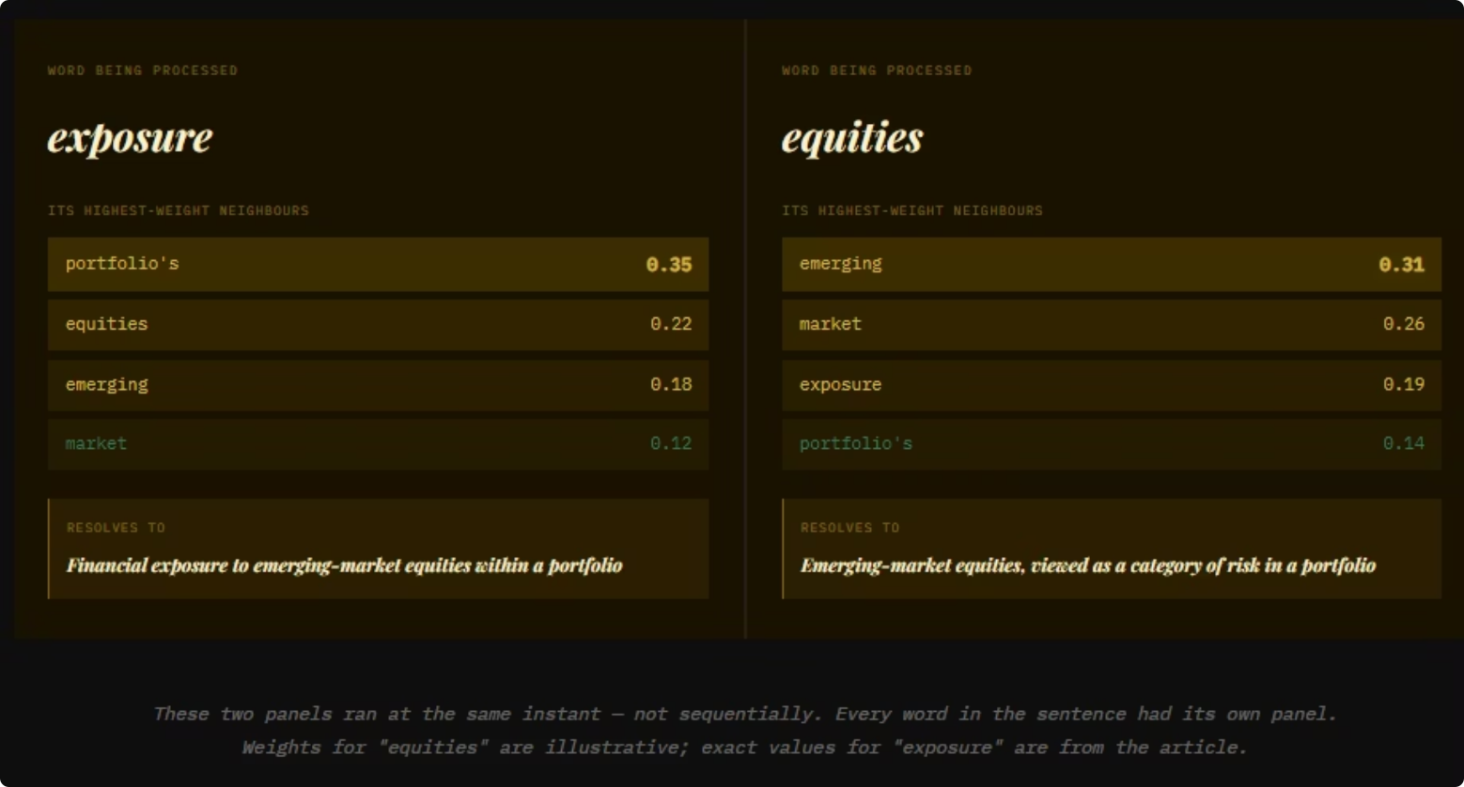

Slide 9
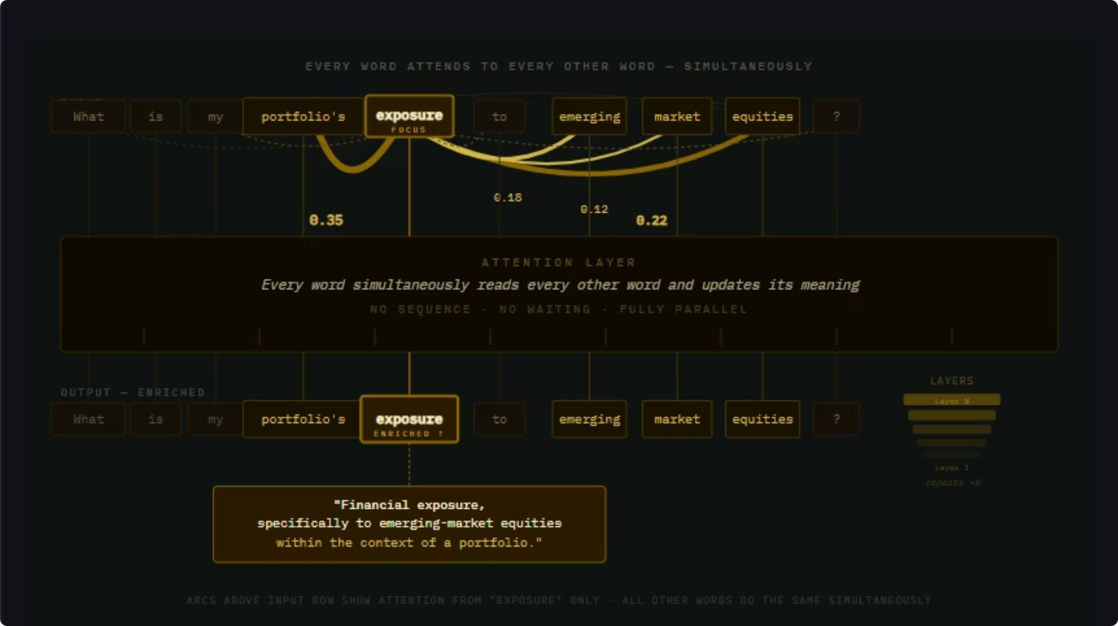

Slide 10

Why It's Called "Attention"
Because each word literally pays more attention to some words and less to others. The model assigns a weight — a number between 0 and 1 — to every pair of words.
A simplified picture of what "exposure" pays attention to in our sentence:
Word it's looking at
Attention Weight
"portfolio"
0.35
"equities"
0.25
"emerging"
0.20
"market"
0.15
"is", "my", "to", "?" (combined)
0.05
These weights tell the model: "When you're updating what 'exposure' means in this sentence, mostly use information from 'portfolio' and 'equities'."

Slide 11


Every Word, Every Other Word — All at Once
Here's the part that surprised researchers when this idea was introduced in 2017 (the famous paper was called "Attention Is All You Need"):
You don't need anything fancy. You don't need the model to read the sentence left-to-right like we do. You just let every word look at every other word, all at once, and figure out what to focus on.
That single idea is the foundation of every modern LLM — ChatGPT, Claude, Gemini, all of them.

Slide 12
Many Layers of Attention, Not Just One
One round of attention isn't enough. Real models do this many times in a row — typically 30 to 100 layers stacked on top of each other.
Layer 50
Layer 20
Preparing the shape of the answer.
Layer 5
Realises the whole sentence is a question about portfolio risk.
Layer 1
Catches that "emerging-market" is really one concept describing "equities."
Figures out simple things — which adjectives describe which nouns.
The big idea: After all these layers, the numbers representing "exposure" aren't just the generic meaning of "exposure" anymore. They've been reshaped to mean "exposure, in the specific context of a portfolio question about emerging-market equities."

Slide 13
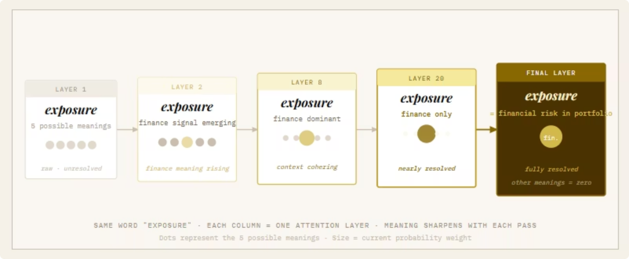

Slide 14
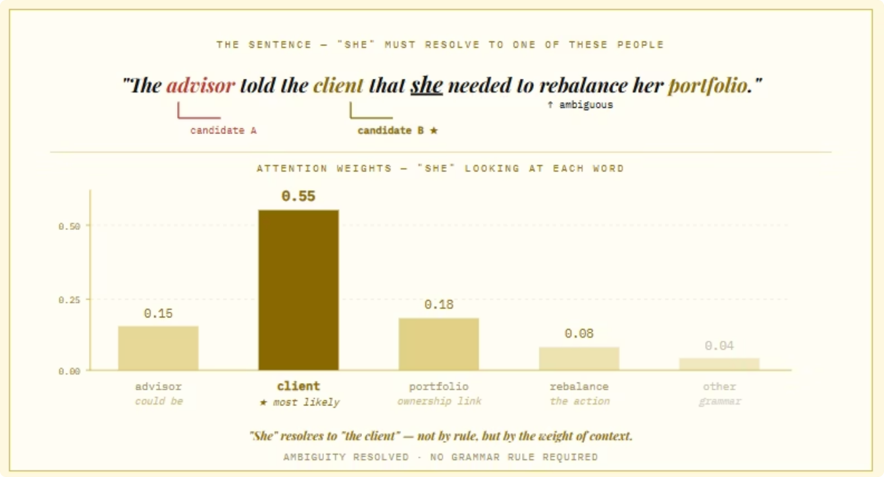

Slide 15
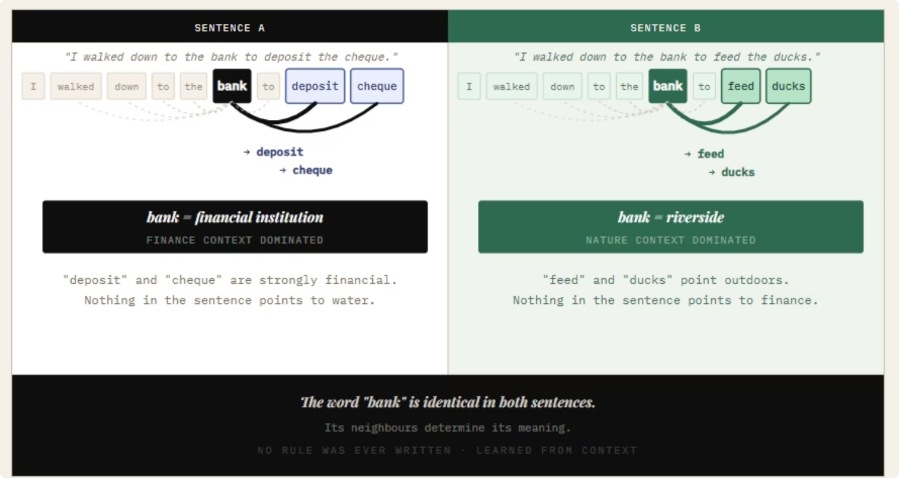

Slide 16
STEP 9 — Predicting the Next Word
What the Model Is Actually Doing
Here is the part most people find genuinely surprising:
An LLM is not answering your question. It's predicting the next word.
That's it. That's the whole game.
After all those layers of attention, the model arrives at one job: "Given everything I've just processed, what is the most likely next word?"
Then it does that again. And again. And again. One word at a time, until the answer is complete.

Slide 17
This Is Why Answers Stream in Word by Word
Remember the question from Part 1 — why does it reply one word at a time instead of returning the whole answer instantly?
This is the answer. The model literally cannot produce the whole reply at once, because each new word depends on all the words it has already written.
1
2
3
4
5
Predict word 1
Add word 1 to context
Predict word 2
Add word 2, re-read, predict word 3
...and so on
Re-read everything including word 1.
It's like a writer who can only see what they've written so far and has to decide the next word based on everything before it.

Slide 18

Probability Distributions: Not One Answer, But a Ranked List
The Model Doesn't Pick One Word — It Scores All of Them
Here's the next surprise. When the model predicts the next word, it doesn't say "the answer is 'your'." It produces a score for every single word in its vocabulary — all 100,000 or so of them.
What a probability distribution looks like
What this means
Possible next word
Probability
This ranked list is called a probability distribution. It says: "Here is how likely I think each possible next word is."
The model scores all 100,000+ words in its vocabulary every single time it needs to produce one token of output.
"Your"
42%
"Based"
18%
"Looking"
12%
The word it eventually picks is one choice from this big ranked list — never a certainty.
"I"
8%
"Currently"
5%
"The"
4%
...
...
"banana"
0.0001%
"xylophone"
0.00001%

Slide 19


Why This Matters
The model is never certain. Even when it sounds confident, underneath it's always working with probabilities. The word it eventually picks is one choice from this big ranked list.
This is the root of one of the questions from Part 1:
"Why does it sometimes give a wrong answer with complete confidence?"
Confidence in the words ≠ Confidence in the facts. The model picked the next word that sounded right based on patterns it learned. It has no built-in fact-checker telling it whether the resulting sentence is true. If millions of training documents used confident-sounding language for a particular topic, the model learned to sound confident — even when it's wrong.

Slide 20
STEP 11 — How the Model Picks One Word: Sampling
So we have a ranked list of 100,000 possible next words. Which one does the model actually use? This is called sampling, and it's where things get interesting — because there are several different strategies, and they each change the personality of the answer.
Strategy 1: Greedy — Always Pick the Top One
The simplest strategy: just pick the highest-probability word every time.
Pros
Cons
Predictable and consistent
Same question → same answer
Boring and repetitive
If you ask the same question twice, you get the exact same reply word-for-word
The "safest" word isn't always the best one — sometimes the 2nd or 3rd choice would have made a much better sentence

Slide 21
Strategy 2: Temperature — Adjusting How Adventurous the Model Is
Temperature is a dial that controls how willing the model is to pick lower-ranked words. Think of it as a creativity setting.
Temperature
What it does
Feels like
0.0
Always pick the top word (greedy)
Robotic, repetitive
0.3
Slight randomness, mostly safe choices
Careful, factual
0.7
Balanced — the everyday default
Natural, varied
1.0
More adventurous, considers more options
Creative, sometimes off-base
1.5+
Wild — picks unusual words often
Weird, unpredictable
Low Temperature
High Temperature
Like a cautious analyst who only says what they're sure of. Ideal for a wealth-management assistant — use 0.2–0.4 for consistency and accuracy.
Like a brainstorming partner who throws out unusual ideas — sometimes brilliant, sometimes nonsense. Use 0.9+ for writing poems or brainstorming product names.

Slide 22

Strategy 3: Top-K — Only Consider the Top K Options
Even with temperature, the model could occasionally pick an absurd word from far down the list. Top-K prevents that.
Top-K = 5 means: "Only look at the top 5 most likely words. Ignore everything else. Pick from those 5."
So instead of choosing from 100,000 candidates, the model chooses from a tiny shortlist. The exact word picked depends on temperature, but it's guaranteed to come from a sensible top group.
Common values: Top-K of 40 or 50 is typical.

Slide 23
Strategy 4: Top-P (Nucleus Sampling) — Adaptive Shortlist
Top-K has one weakness: sometimes only 2 words are sensible, and sometimes 50 words are all reasonable. A fixed K doesn't adapt.
Top-P fixes this. Instead of "pick from the top 5," it says: "Add up the top words until their combined probability reaches P. Pick from that group."
Top-P = 0.9
High confidence scenario
Spread-out scenario
Take the smallest set of top words whose probabilities sum to 90%.
If one word has 92% probability, the shortlist is just that one word.
If probabilities are spread out, the shortlist might include 30 words.
This is the most popular strategy in modern LLMs because it adapts to how confident the model is.

Slide 24
How They Combine in Practice
Real systems usually combine these strategies together:
temperature = 0.7
top_p = 0.9
top_k = 40
Read it as: "From the top 40 words whose combined probability covers 90% of the model's confidence, pick one — with a moderate level of randomness."
The trade-off in one line: lower temperature and tighter top-K/top-P = more accurate but boring; higher = more creative but riskier.

Slide 25
Detokenisation: Turning Numbers Back into Text
Remember Part 1, Step 4 — the moment text became numbers and the model never saw text again? Now we have to reverse that.
The Model Outputs a Token ID, Not a Word
When the model picks its next word, it doesn't output the word "Your." It outputs a token ID — a number, like 7927. That number has to be looked up in the same fixed vocabulary dictionary from Part 1, and converted back to the text fragment it represents.
Token ID
Text piece
7927
"Your"
19212
" portfolio"
706
" has"
220
" "
868
"12"
13
"."
20
"4"
4
"%"

Slide 26
Why This Looks Weird Sometimes
Recall: tokens aren't always whole words. So when the model is producing an answer, it might output tokens like:
"Your" · " portfolio" · " has" · " 12" · "." · "4" · "%" · " exposure" · " to" · " emerging" · "-" · "market" · " equities" · "."
Strung together, that becomes:
"Your portfolio has 12.4% exposure to emerging-market equities."
Notice the percentage 12.4% came out as four separate tokens (" 12", ".", "4", "%"). The model assembled the number piece by piece — it doesn't "know" numbers as numbers, it just predicts each piece in sequence.
This is also why LLMs sometimes make arithmetic mistakes. They're not calculating — they're predicting the next digit-token based on patterns. Ask one to multiply two large numbers and it might confidently produce a wrong answer because it's pattern-matching, not computing.

Slide 27
Streaming vs. All-at-Once
Two Ways to Send the Answer Back to You
Once the model starts producing tokens, the system has a choice about how to deliver them to your screen.
Streaming (the default in ChatGPT, Claude, Gemini)
Each token is sent to you the moment it's produced. You see the answer appear word-by-word, almost like watching someone type in real time.
Start reading immediately
Feels alive and responsive
Stop early if needed
No waiting — you begin reading as soon as the first word appears.
The experience feels dynamic and engaging, like a real conversation.
If the answer is going wrong, you can stop it early and save time.
Under the hood: Each token is sent over the internet as soon as the GPU produces it. The connection stays open the whole time, like a phone call rather than a letter.

Slide 28

All-at-Once (Batch Mode)
The system waits until the entire answer is finished, then sends it as one big chunk.
When it's used:
API calls where the receiving programme just wants the final text
Automated workflows that don't have a human waiting
When you need to do post-processing on the full answer before showing anything
Trade-off: You wait longer for the first thing to appear, but it can be slightly simpler to handle on the receiving end.

Slide 29

Why Streaming Doesn't Make It Faster
A common misconception: streaming feels faster, but the total time is roughly the same. The model is producing tokens at the same speed either way. Streaming just shows you each token as it's made, instead of holding them all back until the end.
It's the difference between a chef bringing each dish to your table as it's cooked, versus waiting until the whole meal is ready and bringing it all out together. Same total cooking time — very different experience.

Slide 30

Bringing It All Together — The Full Journey of Our Request
Here's the complete pipeline from Part 1 + Part 2:
You press Enter
Text is cleaned
Tokenisation
Embeddings
Attention
Sampling
Streaming
Stop
Every word looks at every other word, dozens of times, building up contextual understanding.
Temperature, top-K, and top-P decide which word to actually pick.
That piece of text appears on your screen.
When the model produces a special "end" token, or hits a length limit.
Your text leaves your device, encrypted.
Normalisation removes hidden messiness.
Text is chopped into chunks from the frozen vocabulary.
Each number is looked up in a giant table, becoming a rich row of meaning-numbers.
It arrives at a data centre
Context window is assembled
Token IDs
Position markers
Next-word prediction
Detokenisation
Repeat from step 9
Each chunk becomes a number.
Added so order isn't lost.
The model produces a probability distribution over the entire vocabulary.
The chosen token ID is looked up and turned back into text.
The new word becomes part of the input, and the model predicts the next one.
A load balancer routes it to an available GPU.
System prompt + history + your message, bundled together.
All of this happens in a few seconds. For each word.

Slide 31
Callbacks — The Questions from Part 1, Answered
We promised to come back to the open questions. Here's where we stand now:
"Why does it reply one word at a time?"
"Why does it sometimes give wrong answers with complete confidence?"
Because each word is predicted from everything that came before it. The model literally cannot produce the whole answer at once — it has to feed its own output back in, word by word.
Because it's predicting words that sound right based on patterns, not facts. Confidence in the language doesn't mean confidence in the content. There's no fact-checker built in.
"Why does running these models need so much computing power?"
"Does it really know English, Spanish, and Hindi?"
Because of attention. Every word looking at every other word, across dozens of layers, with thousands of meaning-numbers each — that's billions of multiplications for every single token of output.
It doesn't "know" any language the way we do. It learned which tokens tend to appear near which other tokens. The patterns of Hindi look different from English in the numbers — and the model captured both sets of patterns.

Slide 32


What's Still Open
Two questions remain — and they're the deepest ones:
Does it truly understand you?
Or does it just process numbers? The distinction between genuine understanding and sophisticated pattern-matching remains unresolved.
How is it like — or unlike — how we think?
If it's predicting the next word, what does that share with human cognition? What is fundamentally different?
These don't have settled answers, even among researchers. They're worth sitting with as you use these tools every day.

Slide 33

How Attention Actually Works
The Mechanism Behind Every Modern AI System
We've referenced attention throughout the series. It's time to slow down and look at it properly — because once you see how it works, you understand most of what's actually happening inside an LLM.
No history. No maths. Two worked examples, in plain language.

Slide 34
The One-Sentence Version
Attention is every word in a sentence looking at every other word, deciding which ones matter for understanding itself, and updating its meaning accordingly — all at the same time.
That's it. The rest of this document is just unpacking that sentence carefully, with examples.

Slide 35
The Setup
Recall from Part 1: by the time the model is ready to "think," every word in our sentence has been turned into a long row of numbers. That row captures the word's general meaning — the dictionary version of it.
But the dictionary version isn't enough. Take the word "exposure." On its own, it could mean:
Medical
Safety
Photography
Exposure to sunlight
Exposure to a chemical
Exposure in a photograph
Finance
Media
Exposure to risk
A journalist's exposé
The model needs to figure out which kind of exposure this is, based on the rest of the sentence. That's the job attention does. It takes each word's generic meaning and sharpens it using context.

Slide 36

Example 1: Our Running Sentence
Let's walk through it carefully, on our familiar example:
"What is my portfolio's exposure to emerging-market equities?"
Eleven words. The model is going to do attention on all of them in parallel, but to keep things readable, let's follow just one of them: "exposure."

Slide 37

Step 1: "Exposure" Looks Around the Room
Imagine all eleven words sitting in a meeting room. The model gives every word the same instruction:
"Turn to every other word in the room. Decide how relevant each one is to understanding yourself."
"Exposure" turns to each of the other ten words and asks itself: how much does this word matter for understanding me, right here, in this sentence?

Slide 38
Step 2: "Exposure" Assigns a Weight to Each Word
It scores each one — a number between 0 and 1 — reflecting how much attention to pay:
Word "exposure" is looking at
How relevant?
Why
"What"
0.02
Question word. Tells me this is a question, but doesn't tell me what kind of exposure.
"is"
0.01
Grammar glue. Not informative.
"my"
0.03
Tells me it belongs to someone. Mildly useful.
"portfolio's"
0.35
Highly relevant. This is what I belong to. A portfolio's exposure means financial exposure.
"to"
0.04
Connector. Tells me there's something I'm exposed to coming next.
"emerging"
0.18
Relevant. Tells me what kind of thing I'm exposed to.
"market"
0.12
Relevant. Same — qualifies the thing.
"equities"
0.22
Very relevant. This is the actual thing I'm exposed to.
"?"
0.03
Punctuation. Structural.
(Numbers are illustrative — a real model produces these values from training, and they sum to 1.)

Slide 39
Step 3: "Exposure" Updates Its Meaning
Now "exposure" takes a weighted blend of all those words' meanings, using these weights, and mixes it into its own.
The result: "exposure" is no longer the generic dictionary word with five possible meanings. It has been coloured by sitting near "portfolio's," "equities," "emerging," and "market." Its meaning shifts toward:
"Financial exposure, specifically to a category of equity investments, within the context of a portfolio."
The other four meanings — sunlight, chemicals, photography, journalism — fade away. They got almost no attention weight, because nothing in the sentence supports them.
The word is the same word. The numbers underneath have changed.

Slide 40
What Happened in Parallel
While "exposure" was doing this, every other word in the sentence was doing exactly the same thing, at the same instant.
"Equities" looked around
"My" looked around
Paid most attention to "emerging" and "market" (they describe what kind of equities) and to "exposure" (because it's the thing being asked about). It came out meaning "emerging-market equities, viewed as a category of risk in a portfolio."
Paid most attention to "portfolio's" — because "my" refers to the speaker's portfolio. It came out coloured as a possessive linked to that specific portfolio.
"Emerging" and "market" looked around
"What" looked around
Both locked onto "equities" — they're modifiers describing it. They came out tightly bound to "equities" as a single concept.
Found very little to attend to strongly — it's a question word, mostly contributing structure rather than meaning.

Slide 41

One Layer Done — Dozens More to Go
Every word's meaning has now been enriched by every other word's meaning, weighted by relevance. The sentence isn't just a sequence of words anymore. It's a network of meanings that have all influenced each other.
That's one round — one layer — of attention.
In a real model, this happens dozens of times in a row. Each layer takes the enriched words from the layer below and enriches them further. By the top of the stack, every word's meaning has absorbed context from the entire sentence, dozens of times over.

Slide 42

Example 2: Why Attention Is So Powerful
Let's try a trickier sentence:
"The advisor told the client that she needed to rebalance her portfolio."
There's a question hiding in this sentence: who does "she" refer to? Is it the advisor, or the client? In English, this is genuinely ambiguous from grammar alone.
Watch what attention does when it gets to the word "she." Its job: figure out which person in this sentence it refers to.
"She" looking at
Weight
Reasoning
"advisor"
0.15
Could be — also a person, also female-possible.
"client"
0.55
Much more likely — the client owns the portfolio in this sentence.
"portfolio"
0.18
Relevant — connects "she" to whose portfolio it is.
"rebalance"
0.08
The action being recommended.
Other words
0.04
Mostly grammar.
"She" comes out the other side meaning specifically "the client, who is being told to rebalance her portfolio." The ambiguity has been resolved — not by a hard rule, but by the model weighing the context.

Slide 43
Example 3: The Same Word, Two Different Sentences
Here's a final example that shows attention at its most powerful. Consider the word "bank" in these two sentences:
Sentence A
Sentence B
"I walked down to the bank to deposit the cheque."
"Bank" looks around. High-attention neighbours: "deposit" and "cheque." These strongly suggest the financial meaning.
Result: bank-the-institution.
"I walked down to the bank to feed the ducks."
"Bank" looks around. High-attention neighbours: "ducks" and "feed." These suggest something outdoorsy and natural.
Result: bank-the-riverside.
The model never had to be told the rule "if bank is near deposit, it means financial; if bank is near ducks, it means riverside." It learned, from billions of examples, what each word tends to attend to in what contexts. Attention plus training takes care of the rest.
This is why modern AI systems handle ambiguity so much better than earlier ones. Every word can re-shape itself based on its company.

Slide 44
Why This Matters for What You Do with These Tools
If you've followed the three examples, you now have a working intuition for the most important idea in modern AI. A few practical implications worth carrying with you:
Context is not optional — it's the entire mechanism
More relevant context is usually better than more context
When you give an LLM a vague prompt, you're not just being unclear. You're starving the attention mechanism of the neighbours it needs to sharpen the meaning of each word. "Write me something about exposure" gives the model almost nothing to work with. "Write a one-paragraph note for a client about their portfolio's exposure to emerging-market equities, in our firm's professional tone" gives every important word a roomful of neighbours to attend to.
Attention can pay attention to anything in the room. But noise in the room competes for that attention. Putting irrelevant documents into a RAG prompt doesn't just waste tokens — it dilutes the attention the model can give to the relevant material.

Slide 45
More Practical Implications
Position matters less than it used to, but still matters
Long context is genuinely powerful, not just a vanity number
Attention treats all positions equally in principle. But in practice, models pay slightly more attention to the start and end of long contexts than the middle. Important instructions at the start of a prompt; important questions at the end. Don't bury the key request in the middle of a wall of text.
When a vendor says their model handles a million tokens of context, they're saying every word in that million-token document can look at every other word and pull in relevant meaning. That's the same mechanism that resolves "she" to "client" in a one-sentence example — just scaled up enormously.

Slide 46
The One-Paragraph Version
Every word in a sentence enters a kind of meeting room. Each word looks at every other word in the room and assigns a weight reflecting how relevant that word is to understanding itself. Then it updates its own meaning by mixing in a weighted blend of the others. All words do this simultaneously, in parallel — no waiting, no sequence. The result is that every word's meaning has been sharpened by its context. "Exposure" sitting next to "portfolio" and "equities" comes out meaning financial exposure. "She" sitting next to "client" comes out referring to the client. "Bank" sitting next to "ducks" comes out meaning a riverside. This happens dozens of times in stacked layers, so every word ends up absorbing context from across the entire input. That's attention. That's the engine.
Once you see it, you can't unsee it. Every coherent answer a modern AI gives, every connection it draws across a long document, every time it picks the right interpretation of an ambiguous word — that's attention doing its work, quietly, billions of times a second.

