Slide 1
How LLMs Process Our Requests — Part 4
Choosing, Customising, and Trusting an LLM
The final part of the series.
Parts 1–3 answered how it works. From your keystroke through the data centre, through attention and probability and sampling, all the way out to a real assistant with tools, RAG, and guardrails.
Part 4 is about how to make decisions about it — the questions a business audience actually has to answer:
"Should we fine-tune a model on our data, or just use prompts?"
"What does it mean when a model has 'thinking' mode?"
"Can it read this PDF I just uploaded?"
"Does Anthropic train on our client data?"
"How do we know the answers are any good?"
Same running example throughout the series — "What is my portfolio's exposure to emerging-market equities?" — but now we're looking at the system around it, not the mechanics inside it.

Slide 2
STEP 24
The Knowledge Cutoff: Why the Model Doesn't Know What Happened Yesterday
Before anything else, a foundational point that explains a whole category of model mistakes.
Every LLM was trained on a fixed snapshot of text, finalised on a specific date. That date is called the knowledge cutoff — sometimes also called the training cutoff.
If the model was trained on text up to January 2025, then for the model:
The world ends in January 2025
No sense of today's date
Stale on current events
It doesn't know today's date unless someone explicitly tells it.
No latest election results, last quarter's earnings, current Fed rate, or yesterday's market close.
It has never heard of anything that happened after that date.

Slide 3

Why the Cutoff Matters for Our Example
If you ask the model "What's been driving EM equities recently?" and the cutoff was 14 months ago, the model will confidently answer with what was happening 14 months ago — phrased as if it were current. The words will sound right. The facts will be stale.
This is the single most common source of "the model is wrong" moments. And it's why the techniques from Part 3 — tool use, RAG, web search — are not optional luxuries. They are the only way to get the model out of its frozen world and into the present.
Callback to Part 1, Slide 6: "Why does it sometimes give a wrong answer with complete confidence?" The cutoff is half the answer. The model isn't lying — it just doesn't know its information is out of date, because to it, that information is the latest there is.

Slide 4
STEP 25
Reasoning Models: The "Thinking" Mode
A shift in how the newest models work
The picture from Part 2 was straightforward: the model predicts one word, you see it streamed, repeat. That picture is accurate for most LLMs you've used.
But starting in late 2024, a new category appeared: reasoning models. OpenAI's o1 and o3, Anthropic's Claude with extended thinking, DeepSeek's R1, Google's Gemini with deep think. These models work differently in one important way.
1
2
Standard Models
Reasoning Models
Predict one token at a time, stream directly to the user. Fast, transparent, and suitable for most everyday tasks.
Generate a long stream of hidden tokens — internal "thinking" — before producing the visible answer. Slower but dramatically more capable on hard problems.

Slide 5
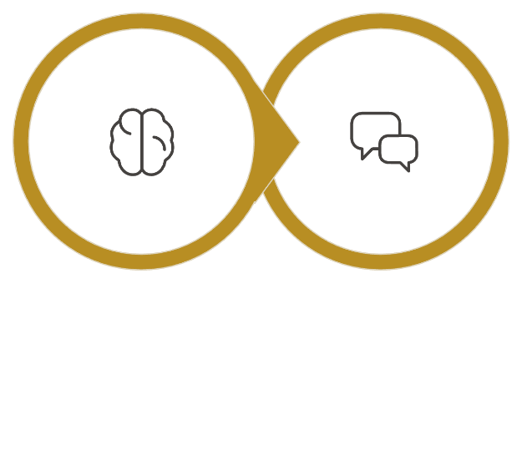
What Reasoning Models Actually Do
Before producing the answer the user sees, a reasoning model generates a long stream of hidden tokens — its own internal "thinking" — that the user never gets shown. Only after this hidden thinking is complete does the model produce the visible answer.
Imagine you asked a colleague a hard question and they said "Hmm, let me think for a moment." Then they sat there silently for thirty seconds, working it out in their head, before speaking. That's what a reasoning model is doing. The thinking is real work — real tokens being generated — it just isn't shown to you.
Hidden Thinking
Visible Answer
The hidden thinking phase is genuine computation — not a pause, but active token generation that shapes the quality of the final answer.

Slide 6

Why This Works
It turns out that LLMs are much better at hard problems when they're allowed to "talk to themselves" first. By generating reasoning tokens, the model effectively gives itself a scratchpad.
Example reasoning trace: "Let me check the holdings. EM equities means stocks in developing markets. The Vanguard FTSE EM ETF qualifies. The iShares EM bond fund does NOT, because it's bonds. Let me recompute..." — each reasoning token sits in the context window and helps shape what comes next.
It's the same model architecture as before. Same attention, same next-word prediction. The only change is that the model has been trained, during instruction tuning, to spend its first chunk of output on reasoning before giving the user-facing answer.

Slide 7

TRADEOFFS
The Tradeoffs of Reasoning Models
Where They Shine
The Costs
Mathematics and complex calculations
Code generation and debugging
Multi-step logic and planning
Complex analysis and edge cases
Much slower — hidden thinking may take 10–60 seconds before the first user-visible word appears
More expensive — hidden tokens are billed at output rates; a reasoning answer might consume 5,000–50,000 hidden tokens to produce a 200-token visible answer
Overkill for simple tasks — asking "What's the capital of France?" wastes time and money
The practical rule: Use reasoning models for hard problems that benefit from careful thinking (code, math, planning, complex analysis), and regular models for everyday tasks (summarisation, drafting, retrieval, conversation). Most modern products let you switch, or do it automatically.

Slide 8

What This Means for the Part 2 Picture
The streaming-one-word-at-a-time picture from Part 2 is still correct mechanically — reasoning models are doing the same token-by-token prediction.
What stays the same
What changes
The model is producing tokens the whole time. Same attention mechanism, same next-word prediction, same architecture underneath.
The difference is purely about which tokens get shown to the user. The system hides the first batch — the reasoning tokens — and only surfaces the final answer.

Slide 9
STEP 26
Multimodal: Images, Audio, PDFs, and Beyond
Beyond text
Every modern frontier model can handle more than text. You can paste a screenshot, upload a PDF, attach an audio file, even share a short video. The model "sees" or "hears" it and can talk about what's in it.
How? The answer is elegant — and connects directly back to Part 1.
Everything becomes tokens
Recall from Part 1: text is split into tokens, each token becomes an ID, each ID is looked up in an embedding table to produce a row of meaning-numbers. The same idea works for images, audio, and other media — just with different tokenisation rules:
Images
Audio
PDFs
Split into small patches (typically 14×14 or 16×16 pixels). Each patch is converted into a row of numbers by a vision encoder. Those rows become tokens in the context window.
Split into short frames (typically 25 milliseconds each). Each frame is converted into a row of numbers by an audio encoder. Those become tokens too.
Usually a hybrid — text gets extracted and tokenised normally, and any embedded images or scanned pages are tokenised as images.
The deep idea: Once everything is "a row of numbers in the context window," the model doesn't care where those numbers came from. Attention works the same way across words, image patches, and audio frames — all in the same sentence of thought.

Slide 10
A Concrete Example: The PDF Upload
An advisor uploads a client's quarterly statement (a PDF) and asks: "What's the EM equity exposure on page 3?"
PDF Parsing
Vision Encoding
Context Assembly
The PDF is parsed. Text on each page is tokenised normally.
Page 3 contains a pie chart. The chart image is split into patches and tokenised by the vision encoder.
All tokens — text from all pages, image patches from the chart — go into the context window. The user's question is added at the end.
Cross-Modal Attention
Answer Generation
The model uses attention across everything: text and image patches alike. When attending to "page 3," it focuses on image tokens from that page.
The model emits its answer — possibly with a tool call to verify the number against the portfolio system.

Slide 11


The Limits Worth Knowing
Images consume a lot of tokens
A single high-resolution image might be 1,000–3,000 tokens. A 20-page PDF with charts can easily eat 20,000+ tokens of your context window.
Vision is still weaker than text
Models often misread small numbers in tables, mistake similar logos, or hallucinate details in busy images. Don't trust extracted numbers without verification.
Audio and video are even more token-heavy
A one-minute audio clip might be 1,500 tokens. A one-minute video, far more.
The mental model: When you upload anything, ask yourself "How is this getting converted to tokens, and how many?" The answer drives both cost and accuracy.

Slide 12
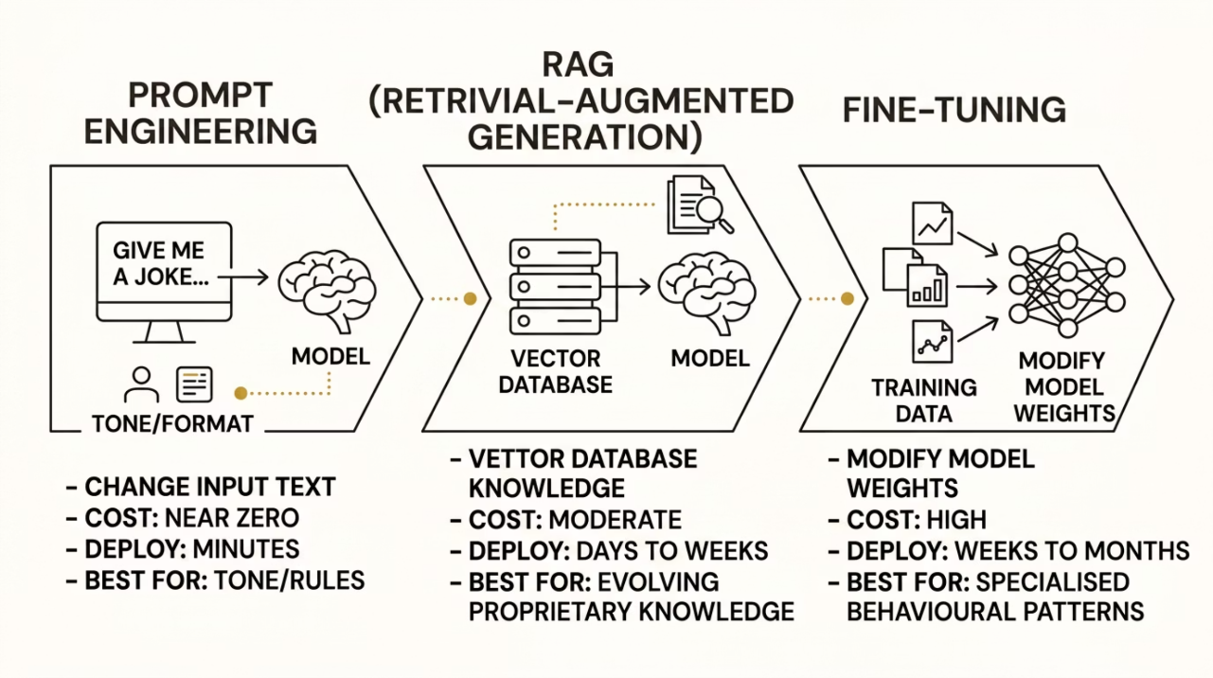
STEP 27
The Customisation Question: Prompt, RAG, or Fine-Tune?
This is the most common business question about LLMs. "We have proprietary data and a specialised use case. How do we make the model good at our specific job?"
There are three answers, and they work at very different layers, costs, and timescales.

Slide 13


Option 1: Prompt Engineering
What it is
Key characteristics
Write a very good system prompt. Include examples of ideal outputs (called few-shot examples). Structure the inputs carefully. That's it — you change what you say to the model, not the model itself.
Cost: Almost zero — you're paying for the extra tokens in the prompt
Speed to deploy: Minutes — edit a string
Best for: Behaviour, tone, format, simple rules
Limits: Can't add new knowledge; can't fix fundamental capability gaps
Example: Getting our wealth assistant to match the firm's tone of voice. "Always round to 1 decimal. Never give tax advice. Respond in this JSON structure." Pure prompt-engineering territory.

Slide 14

Option 2: RAG (Retrieval-Augmented Generation)
What it is
Key characteristics
Put your knowledge into a vector database; retrieve relevant chunks per query; inject them into the prompt.
Cost: Moderate — pay for embedding documents once, storing them, and extra input tokens per query
Speed to deploy: Days to weeks — you need a pipeline that indexes documents and stays fresh
Best for: Letting the model use specific, evolving, or proprietary knowledge
Limits: Quality depends entirely on retrieval; failure modes include bad chunking, stale indexes, misses
Example: Making our assistant aware of the firm's house views, current product lineup, and compliance rules. Classic RAG territory.

Slide 15
Option 3: Fine-Tuning
What it is: Actually modify the model itself. Take a pre-trained model and run additional training on it using your own examples — usually thousands of input/output pairs showing the behaviour you want. The model's weights shift. The result is a new model, derived from the original but tailored to your task.
Cost
Speed to deploy
High. Thousands to hundreds of thousands of dollars per training run, depending on model size. Plus a higher per-token rate at inference time.
Weeks to months. You need a high-quality dataset, training infrastructure, and an evaluation process.
Best for
Limits
Specialised tasks where the style or format of output matters and is hard to specify in a prompt. Or where you need behaviour that even the best prompt can't reliably achieve.
Brittle to maintain. Fine-tuning doesn't reliably add facts — it shapes behaviour. Trying to teach facts via fine-tuning usually produces a model that hallucinates them confidently.
Example: Training a model to draft regulatory filings in your firm's exact format and language — but probably also needs RAG for the current numbers.

Slide 16
A Decision Rule: The Right Order of Operations
1
Start with Prompt Engineering
2
Add RAG
3
Consider Fine-Tuning
When the model needs knowledge it doesn't have, especially knowledge that changes over time.
Only when prompting and RAG together aren't enough — usually because you need a very specific behavioural pattern and have a stable, high-quality dataset to train on.
Always. It's free, fast, and you'll be surprised how far it goes.
The rookie mistake: Reaching for fine-tuning first, because it sounds the most sophisticated. It's almost always the wrong starting point. Fine-tuning is the most expensive, least flexible, and most brittle option. In practice, most enterprise LLM systems are 90% prompting + RAG + tools, and 10% fine-tuning where it really pays off.

Slide 17
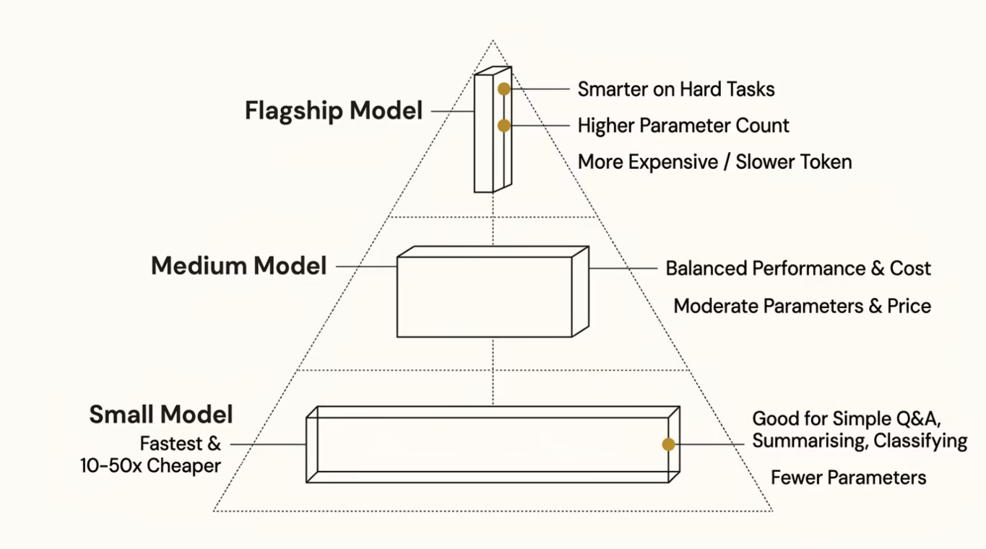
STEP 28
Model Size, Speed, and the Routing Game
Bigger isn't always better
When LLM vendors release new models, they typically release a family: a big flagship model, a medium model, and a small model. For example: Opus, Sonnet, Haiku. Or GPT-4, GPT-4-mini, GPT-4-nano.

Slide 18

How Smaller Models Exist: Distillation
A small model doesn't just appear from nowhere. It's typically created by distillation — training a small model to imitate the outputs of a larger model.
The Teacher
The Student
The large, powerful model. Generates high-quality outputs across a wide range of tasks. Acts as the source of truth during distillation training.
The small, fast model. Trained to approximate the teacher's outputs. Ends up much smaller and faster, but approximates the teacher's quality on most tasks. This is why model families feel coherent — the smaller members are derived from the larger ones, sharing much of the same training and personality.

Slide 19



The Routing Pattern
Production systems usually don't pick one model — they pick the right model per request. This is called model routing.
Simple Request
Medium Request
Complex Request
"Classify this email as urgent or not" → small, fast, cheap model
"Summarise this client meeting transcript" → medium model
"Plan a multi-step rebalancing strategy across these constraints" → flagship reasoning model
The lesson: Model choice is a per-request decision, not a system-wide one. Picking the flagship for everything is wasteful. Picking the cheapest for everything is risky. The right answer is almost always a mix. The router itself is often another small LLM, or a simple classifier, that looks at the incoming request and decides which model to hand it to.

Slide 20
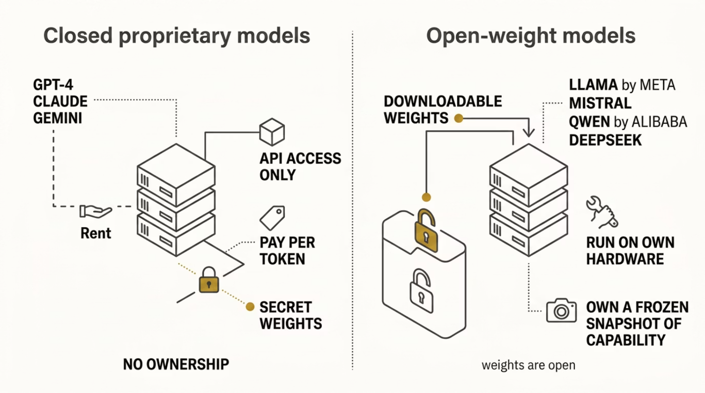
STEP 29
Open vs Closed Models
Two worlds
LLMs come in two broad categories that have very different strategic implications.

Slide 21

What Changes with Open-Weight Models
On-Premises Deployment
Deep Fine-Tuning
No client data leaves your network. Major appeal for finance, healthcare, defence, legal. For our wealth-management assistant, this can be the difference between "compliant" and "compliance nightmare."
With closed models, fine-tuning is limited to what the vendor permits. With open models, you have full control of the weights.
Operational Burden
Quality Gap
Hosting an LLM is non-trivial. GPUs are expensive. Scaling, monitoring, patching, security — all on you. What was a billing relationship becomes an infrastructure project.
As of 2026, the best open-weight models are competitive with mid-tier closed models on many tasks, but the absolute frontier is still in closed labs. This gap fluctuates.
The pragmatic answer: Most enterprises end up with a hybrid — closed models for general-purpose assistant use, open models for specific high-volume, privacy-sensitive, or cost-sensitive workloads. It's rarely either/or.

Slide 22

STEP 30
Embeddings as a Standalone Product
A quick aside on something that's easy to miss. We've talked about embeddings throughout the series — the row of numbers that captures the meaning of a word, a sentence, or a document. So far, embeddings have appeared as a step inside the LLM pipeline.
But embeddings are also a product in their own right. Every major provider offers an embedding API: send text, get back its row of numbers. Use those numbers however you want — without ever invoking the full LLM.
Semantic Search
Clustering
Deduplication
Classification
Recommendation
Find documents similar in meaning to a query, not just keyword matches. "Client wants to reduce volatility" matches "low-risk portfolio rebalancing" even though no words overlap.
Group similar items together — emails by topic, clients by question type, research notes by theme.
Detect near-duplicate documents that aren't exactly identical.
Train a tiny classifier on top of embeddings to label things ("is this email about a complaint or a question?").
Suggest similar research notes, similar funds, similar past cases.
Why this matters: Embeddings are 10–100× cheaper than full LLM calls, and often dramatically faster. For many business problems framed as "find the relevant thing" rather than "generate something new," you don't need a chat model at all. You just need embeddings.

Slide 23
STEP 31
Privacy and Data Handling at the Provider Level
The question every enterprise asks
Before adopting any LLM, every serious organisation asks the same question:
"What does the provider do with our data?"
This is bigger than the cross-conversation isolation covered in Part 1, Slide 24 — that was about whether your own conversations leak across each other. This is about whether your data leaves your control at all.

Slide 24
Three Things Providers Do (or Don't) with Your Data
1
2
3
Training
Retention
Access
Does the provider use your prompts and responses to train future model versions?
How long does the provider store your data, and who can access it?
Who at the provider can see your data, under what circumstances?
Most providers retain API requests for 30 days for abuse monitoring, then delete.
Zero-retention agreements (ZDR) are available to enterprise customers.
Storage location matters — some enterprises require data to stay in specific geographies.
Standard answer: nobody, except for narrow abuse review processes.
Subpoenas and legal requests are a separate issue and vary by jurisdiction.
Free consumer tiers — by default, yes. You can usually opt out in settings.
Paid consumer tiers — varies by provider. Often no by default for paid plans.
API and enterprise tiers — almost universally no. Providers contractually commit not to train on API data.

Slide 25

What This Means in Practice
For a wealth-management assistant handling real client data, the requirements are typically:
API or Enterprise Plan
No Training on Inputs
Zero or Short Retention
Data Residency
Audit Logs
On-Prem or VPC Deployment
The firm controls them.
Contractually confirmed.
Matching client regulations.
Never the free consumer tier.
Confirmed in writing.
Model runs in infrastructure the firm controls; no data crosses the provider's network.
The lesson: "Does Anthropic / OpenAI / Google train on our data?" is the wrong shape of question. The right shape is "Under which specific tier, contract, and deployment are we using their service, and what are the precise data-handling guarantees of that arrangement?"

Slide 26
STEP 32
Evaluation: How Do You Know It's Working?
The compliance problem
For a wealth-management assistant, "the model seems to give good answers" is not a defensible position. Regulators, internal audit, and your own risk team will want evidence that:
Measurable quality level
Stable over time
Failures detected promptly
No harmful outputs
That quality is stable over time and doesn't silently degrade.
The system performs at a measurable quality level that can be reported and defended.
When things go wrong, they are caught quickly — not discovered by a client or regulator.
The system doesn't give tax advice, leak client data, or hallucinate numbers.
This evidence comes from a discipline called evaluation (or just evals). Every serious LLM deployment needs it. Most don't have nearly enough.

Slide 27
The Four Layers of Evaluation
1
2
Automated Benchmarks
Task-Specific Test Sets
Standard tests like MMLU (general knowledge), HumanEval (code), GSM8K (math). Useful for picking a base model. Not very useful for your specific use case.
A handpicked set of representative questions for your actual use case, each with an expected answer or quality rubric. For our wealth assistant, this might be 200–500 real (anonymised) advisor questions with expert-validated correct answers.
3
4
LLM-as-Judge
Human Review
Use a second LLM to evaluate the answers of the first. Cheaper than human review, can be run continuously. Imperfect — judges have their own biases — but valuable as an early warning system.
For sensitive or high-stakes use cases, qualified humans (compliance officers, senior advisors) review a sample of real responses. Slow, expensive, but the only way to catch subtle failures that automated tools miss.

Slide 28

What Evaluation Actually Catches
Regressions
Drift
You changed the system prompt to fix one issue, and accidentally broke five others. Without an eval set, you'd never know.
The model behind your API changed (vendors update models silently). Quality shifted overnight. Evals catch this.
Edge Cases
Compliance Violations
The system is great 95% of the time but catastrophically wrong on a specific class of question — say, anything involving currency conversion. Evals expose this.
The model gave tax advice 3% of the time despite the system prompt forbidding it. Audit trail caught it.
The uncomfortable truth: Most production LLM systems run with almost no evaluation. Teams release changes based on whether things feel better, not whether they measurably are. For consumer products, this is sometimes okay. For regulated industries handling real money, it isn't.

Slide 29
STEP 33
A Note on What's Still Hard
After 30+ steps across four parts, you've seen the engineering reality of how these systems work. Worth a sober note on what they still struggle with — because no part of this series will fully prepare you for the gap between what LLMs do well and what people assume they do well.
Arithmetic
Counting
Knowing what they don't know
They predict digits as patterns, they don't compute. Always pair with tools for any real calculation.
"How many times does the letter R appear in 'strawberry'?" Famously hard for LLMs because of tokenisation. Don't trust their counts.
Models are bad at calibrating their own confidence. They sound equally certain about things they're right about and things they're making up.
Long-horizon planning
Anything time-sensitive
Consistency under rephrasing
Reasoning models help, but multi-step plans with many constraints still trip them up. They can lose track of constraints over long contexts.
Cutoff dates. Need tools or RAG.
Ask the same question two slightly different ways and you can get meaningfully different answers. This is a known failure of probability-based generation.
The shape of the right relationship: Use them where they're strong, scaffold them where they're weak, verify where it matters. Trust nothing important without a check.

Slide 30
Bringing All Four Parts Together
From the second you press Enter, to the strategic questions a CTO has to answer — here is the full picture.
Part 1 — Delivery
Part 3 — The Real Assistant
How your text travels from your keyboard to a GPU, gets cleaned, bundled with context, tokenised, embedded, and positioned. The mechanical journey of a request.
Instruction tuning. System prompts. Tool use. Agentic loops. RAG. Guardrails. Stop conditions. Context-window management. The KV cache. Cost mechanics and prompt caching. The architecture of a working system.
1
2
3
4
Part 2 — Thinking
Part 4 — Decisions
How the model processes those tokens. Attention. Next-word prediction. Probability distributions. Sampling (temperature, top-K, top-P). Detokenization. Streaming. The mechanics of generation.
Knowledge cutoffs. Reasoning models. Multimodal inputs. The prompt-vs-RAG-vs-fine-tune decision. Model size and routing. Open vs closed models. Embeddings. Privacy and data handling. Evaluation. The honest limits.

