Slide 1
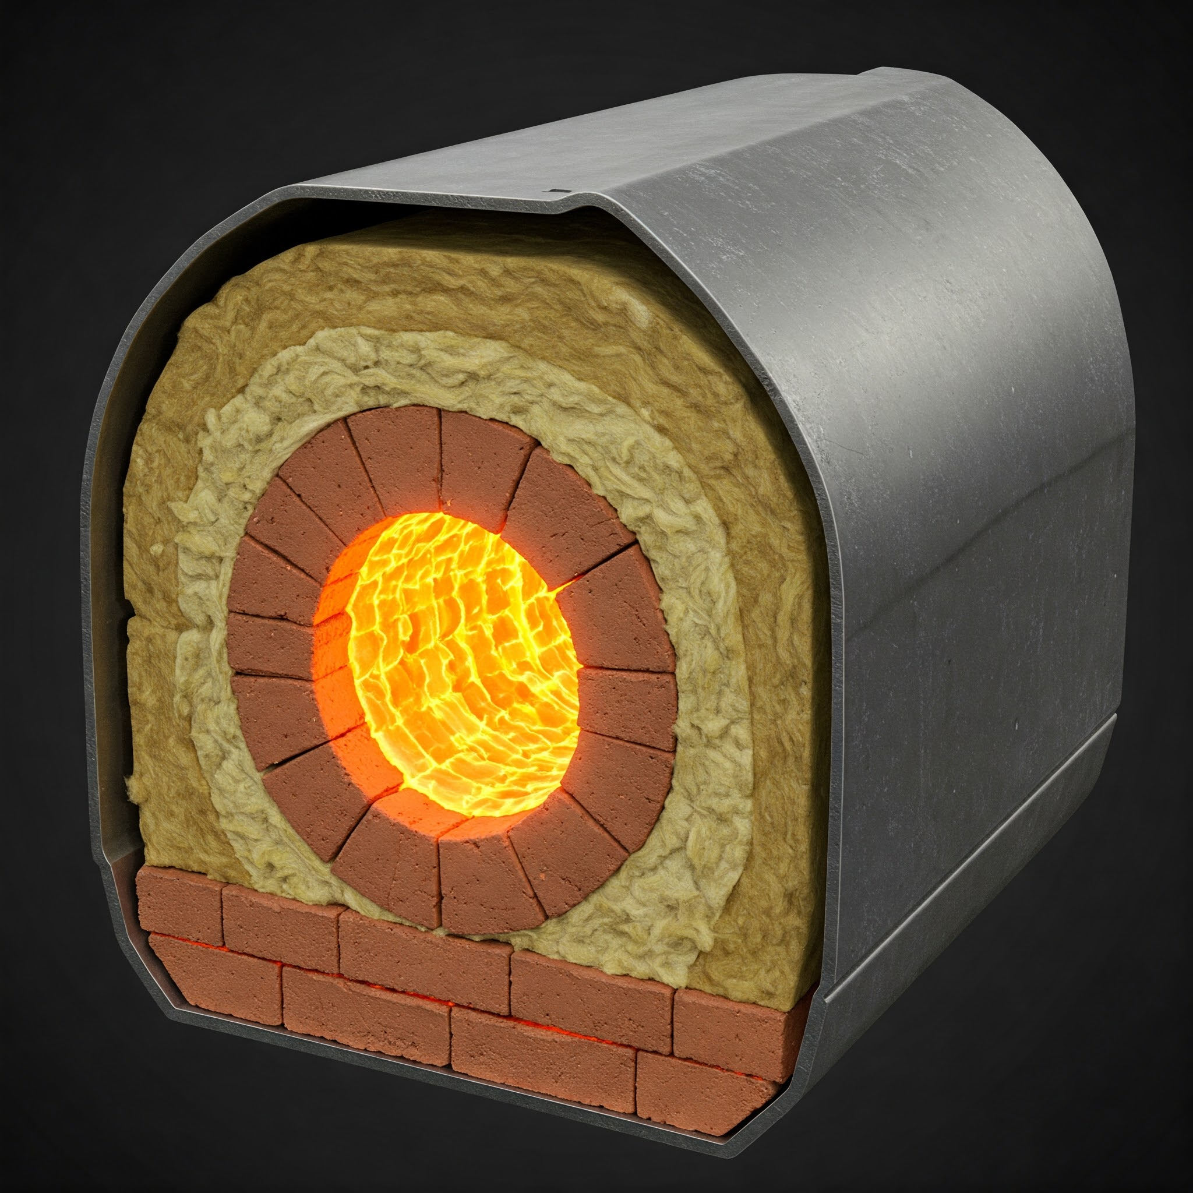
Furnace
Ceramic
Glass Wool
Steel
Air
A
B
Ta
T1
A
T2
Temperature
B
T3
T4
Tb
Distance across the composite wall

