Slide 1
Collection of trading data using Yahoo finance API to predict global index
Goal
Compare online Regression vs Batch Regression / Time Series forecasting and discuss the performance
Romain Bernard, Vincent Tchoumba, Guillaume Philippe

Slide 2
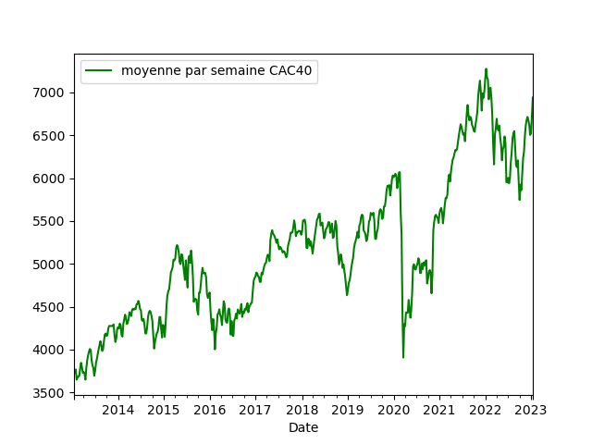
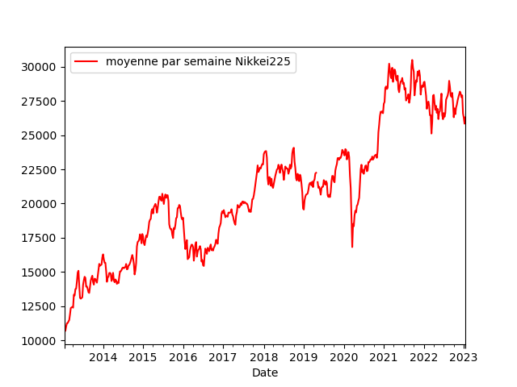
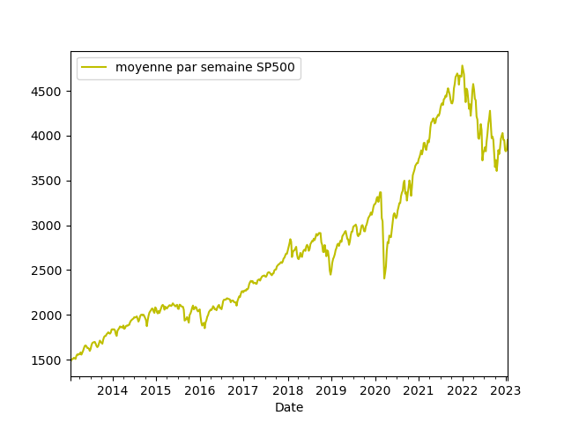
Glogal Index chosen for prediction
SP500
CAC40
Nikkei225

Slide 3
Online Regression with the use of Kafka
Kafka producer to ingest data

Slide 4
Online Regression with the use of Kafka
Kafka consumer to predict global index

Slide 5
Results obtained with online regression

Slide 6
Batch Regression
Models used :

Slide 7
Results obtained with Batch Regression

Slide 8
Comparisons of performance

