Slide 1
EpiDEMExtended
A disease spreading simulation based on epiDEMBasic

Slide 2
What is it?
EpiDEMEXtended is a NetLogo simulator, extension of epiDEMBasic.
epiDEMBasic simulates an SIR epidemiologic model where individuals move randomly, infecting each other due to closeness. It allows to modify the following parameters:
Population size
Infection transmission probability
Average time for recovery
Probability of actually recovering after the recovery time
epiDEmBasic also shows various outputs to check how the infection is spreading.
EpiDEMExtended starts from here, adding various elements to the simulation.
Notes:
Puntualizzare che la probability of actually recovering è perché un individuo è effettivamente guarito solo dopo che, al termine del recovery time, un numero randomicamente estratto soddisfa quella probabilità

Slide 3
Added elements
The enhancements that epiDEMExtended apports to epiDEMBasic are:
People divided into age classes with different susceptibilities to the disease
People divided into families
Addition of a house (immobile agent) per family
People now move following user-defined cycles to reach activities
Addition of the just mentioned activities (immobile agents)
Addition of the possibility to enforce different levels of quarantine, closing activities and thus modifying people movements
Addition of the possibility to activate an environmental disease transmission
Various outputs to check the results of all these new elements
Notes:
Dire che si procede a spiegare meglio tutti questi elementi

Slide 4
Activities
Immobile agents reached by people during their movement cycle. They are divided into 4 categories:
Leisure activities -> all kinds of recreational activities (restaurants, bars, parks, cinemas etc.)
Education activities -> schools and universities
Health activities -> hospitals, clinics, chemists’ etc.
Professional activities -> all other work-related activities (banks, offices, factories etc.)
Activities may suffer the establishment of different levels of quarantine:
Level 0 -> no quarantine declared, all activities open
Level 1 -> education activities closed
Level 2 -> only factories, hospitals and clinics stay open
Level 3 -> only hospitals and clinics stay open
Notes:
Pretty much tutto già qui

Slide 5
Activities
Activities can be added by the user by specifying in the proper .txt files their variables:
kind -> a string describing the activity ("restaurant" etc.)
production-value -> a number 0 to 1 indicating the economical importance
smart-working-capability -> a number 0 to 1 telling how possible it would be to work from home
The production value and the smart working capability have been used to create a new output, showing the overall productivity of the area as the quarantine level varies.
Notes:
Spiegare meglio come funziona l'output productivity

Slide 6
People
Moving agents divided into age classes (percentage of each age class can be edited in the proper .txt file):
0-4 -> stay home
5-14 -> attend the activity called "primary school"
15-19 -> attend the activity called "secondary school"
20-24 -> attend the activity called "university"
25-39 -> young workers, working in the various activities
40-64 -> old workers, working in the various activities
65 and over -> elders, frequent recreational activities
Each age-class has a different disease susceptibility, also depending on the activity currently performed, based on real data from an Italian Covid-19-related study.
Notes:
Dire che l'attività scritta di fianco ad ogni age-class è solo la principale per quell'età e che i cicli sono composti da diverse attività, spiegare meglio cosa siano le susceptibilities (probabilità di essere infettati)

Slide 7
Families
People are furtherly divided into families and to each is assigned a house. The division in families is operated depending on user-defined parameters by file (how many parents are there, how many siblings, how many people live alone etc.) and a set of rules:
People 0-4, 5-14, 15-19 always have two parents
People 20-24 may live with parents or alone or with a roommate
People 25-39, 40-64 may live alone or in a couple (with or without children)
People 40-64 may live alone or in a couple
Families will have at most 4 members
Families will have at most 2 children
The last two rules, though, may not always hold.
Notes:
Dire che i parametri modificabili dall'utente definiscono pool da cui estrarre individui per creare le famiglie, spiegare come mai le ultime due regole potrebbero non essere sempre seguite (esempio di un child che non trova entrambi i genitori quindi assegnato ad una already exixsting family è rapido e comprensibile)

Slide 8
Movement
People move following user-defined activities cycles. The user must specify in the proper .txt file an activities cycle per age-class, by defining what activities are in it and what their durations are. The possible activities are:
"home" -> going to the home of the current individual and remaining there for the specified duration
"school" -> going to the appropriate education activity for the age class of the current individual and remaining there for the specified duration
"work" -> going to the work-related activity of the current individual and remaining there for the specified duration
"recreation" -> going to a randomly determined leisure activity and remaining there for the specified duration
Any number of any of the above separated by a hyphen to make so that each time fot that time slice one of them will be randomly chosen
Durations should be specified considering a single cycle to be 24 hours (ticks) long. However this would lead activities to be shorter than the average travelling time. To avoid this the user can turn on the switch more-realistic-activities-durations?.
Notes:
Dire che l'allungamento durata attività ha impatto anche su altri time-related elements per mantenere tutto allineato e perché non vogliamo attività così corte (poco realistico e poi problema illegal behaviours ma solo accennato che ne parlo la slide dopo)

Slide 9
Movement
People movements can be modified by the establishment of quarantine: each time an individual should have done a certain activity but this results closed due to the quarantine, then he will substitute that activity with "home". This does not always hold if the user enabled the switch possible-illegal-behaviours?: in this case when determining the next activity 5% of the people will not follow the law and will move to a random leisure activity. Enabling this switch will also automatically turn on more-realistic-activities-durations? to avoid an "indirect" increment of the 5% probability to behave illegally at higher quarantine levels, caused by a much more frequent next activity determination. The factor by which multiply the activities durations, however, has to be fine-tuned and this falls under the future developments.
= travel duration
= activity duration
= time slice (sum of durations)
Without longer activities
Shorter time slices: more frequent next activity determination
Quarantine level ↑↑
Mostly remaining home -> no travels
Travel times are insignificant: time slices remain uniform at all quarantine levels
With longer activities
Quarantine level ↑↑
Mostly remaining home -> no travels
Notes:
Spiegare direttamente commentando l'immagine e sottolineare che sia necessario un approfondito fine tuning del fattore per cui moltiplicare la durata delle attività evitando il problema descritto ma anche che le simulazioni durino un'infinità e che tale tuning fa parte degli sviluppi futuri

Slide 10
Infection
People can get infected in two ways:
Direct disease transmission, due to closeness
Environmental disease transmission, if activated by the user
The direct transmission can happen when a susceptible individual is in the neighbourhood of an infected one if both are moving or when they are on the same patch doing the same activity. The probability of infection will be appropriately chosen based on the situation (moving/type of activity) and the age class of the susceptible person.
With the environmental disease transmission, infected people will leave behind them an "infected trail". Susceptible people passing through will have a chance of getting infected based on user-defined parameters and on how long the patch they are passing on has been infected for: the infected particles will evaporate with time, making the patch less infectious as time passes.
Notes:
Riformulare più brevemente, i concetti sono già detti nella slide

Slide 11
Infection
With the current susceptibilities the spreading speed of the infection is extremely high, even without the environmental component, to the point that the various quarantine levels effects are hardly visible. To better appreciate the quarantine effects the user can modify the variable infect-each-n-ticks, normally set to 1. Varying it will affect both direct transmission and environmental transmission, so that the infection will be spread only every infect-each-n-ticks ticks.
Various outputs regarding the infection have been added:
Counters for the number (and percentage) of people infected in each situation
Counters of the cumulative number of infected people and current number of infected people
Notes:
Dire che anche infect-each-n-ticks richiede tuning

Slide 12
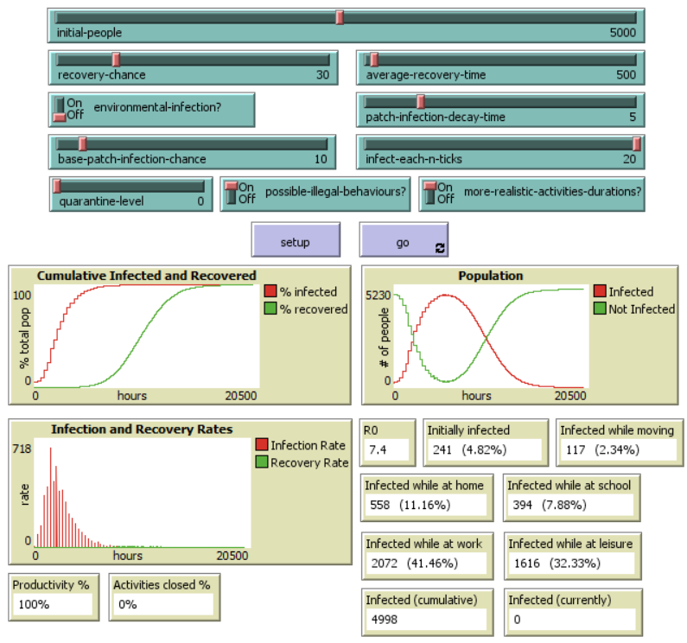
Results
The used parameter configuration (the same for all shown runs) is able to limit the illegal behaviours problem by scaling up the time related elements, most importantly activities durations, by 15.
Results of a run without quarantine:
Nearly all people got infected
Most of the people got infected while doing their main dutiful activity
Notes:
Introdurre la configurazione usata specificando che limita solo l'illegal behaviours problem, non lo risolve perché come detto prima per far ciò serve del fine tuning, ma comunqune con questa configurazione si ottengono buoni risultati in tempi accettabili. Non molto da dire sui risultati del livello 0, molto più utile confrontarli coi livelli successivi

Slide 13
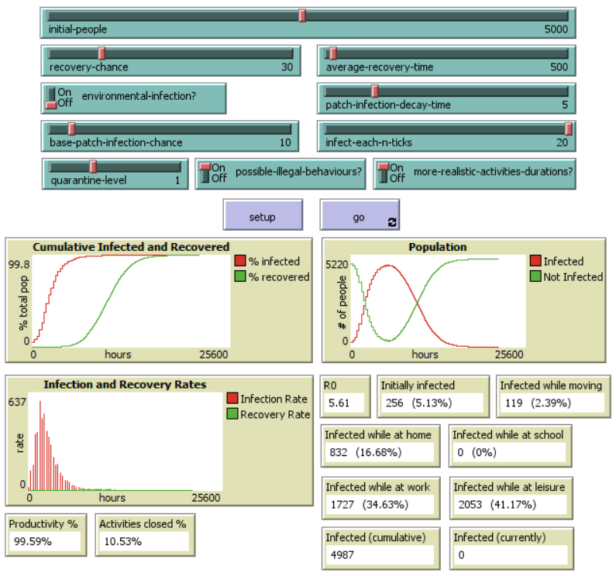
Results
Results of a quarantine level 1 run:
Still a considerable number of people got infected -> understandable though since the difference between level 0 and 1 is not that big
No people infected at school and less at work -> thanks to schools being closed and students and teachers not being infected there
Higher infections at leisure activities and home -> due to students and teachers
Slight productivity loss
Notes:
Spiegare come mai il maggior numero di infetti nelle leisure e at home è dovuto a students e teachers -> non essendo stati infettati a scuola, lo sono stati o a casa o mentre erano alle leisure (anche a causa dei comportamenti illegali), inoltre il maggior tempo passato a casa aumenta il rischio di contagiare altri familiari se malati o di essere contagiati da essi se loro sono malati. Ripetere che la quarantena chiudendo attività influenza la produttività

Slide 14
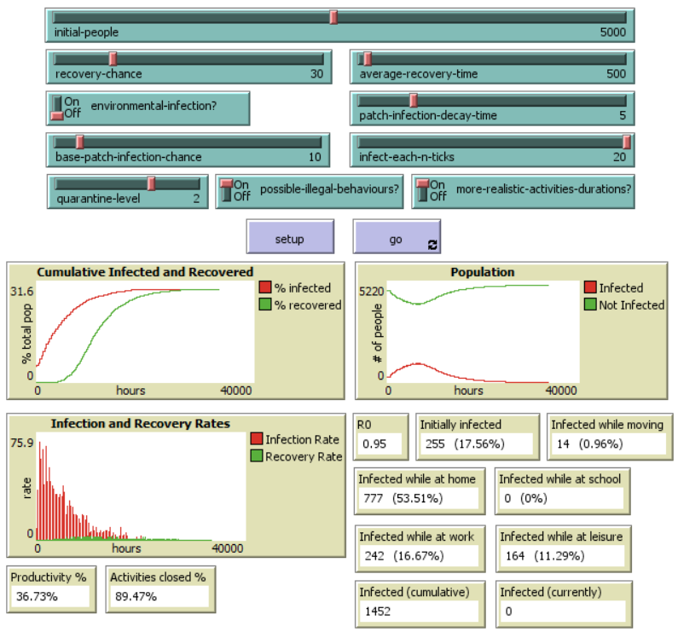
Results
Results of a quarantine level 2 run:
Significant improvement in the number of infections -> level 2 limits movements a lot more -> infected while moving is really low
Relatively high number of infections at home -> due to the limited movements
Some people infected while at leisure -> due to illegal behaviours
R0 very low but the productivity resented of the quarantine
Notes:
Ripetere la differenza tra i livelli di quarantena 1 e 2

Slide 15
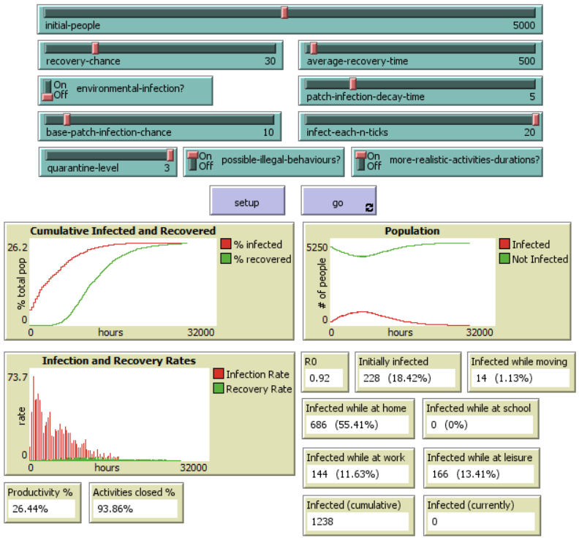
Results
Results of a quarantine level 3 run:
Similar results to level 2 -> since the effects of the two levels are not too different -> movements similarly limited -> same number of people infected while moving
Still infected while at leisure due to illegal behaviours
Less infected while at work -> since factories got closed
Overall number of infections and R0 went down but the productivity is very low
Notes:
Ripetere la differenza tra i livelli 2 e 3, sottolineare che le factories sono le attività con la productivity più alta e quindi nonostante siano poche, chiuderle fa abbassare molto la produttività

Slide 16
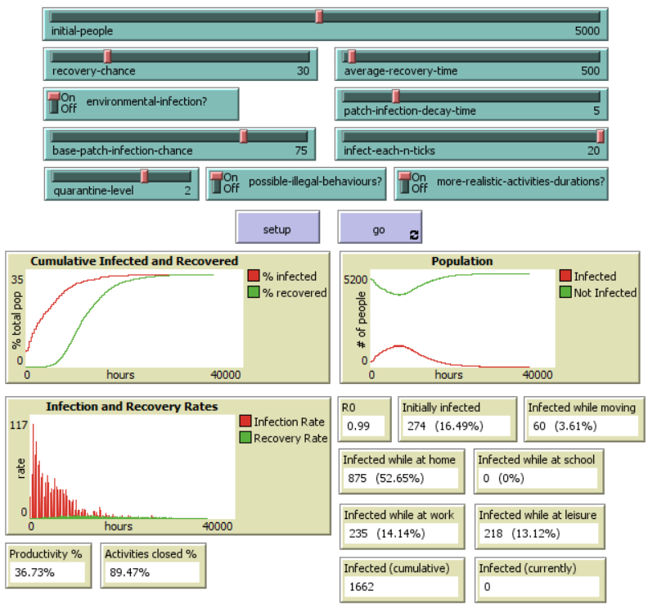
Results
Results of a quarantine level 2 run with environmental infection:
Similar results to the normal level 2 run -> due to the environmental infection being affected by infect-each-n-ticks -> results do not vary much
Can be noticed a higher number of people infected while moving -> due to the environmental infection
Notes:
Ripetere che anche l'environmental infection è affected da infect-each-n-ticks, dire che comunque c'è un generale aumento del numero di infetti

Slide 17
Thanks for your time and attention!

