Slide 1
EpiDEMExtended
A NetLogo disease spreading simulation based on epiDEMBasic

Slide 2
What is it?
EpiDEMEXtended is a NetLogo simulator, extension of epiDEMBasic.
epiDEMBasic is a simple disease spreading simulator:
SIR model
Individuals move randomly
Infection due to closeness
Allows to modify:
- Population size
- Infection transmission probability
- Average recovery time
- Probability of recovering
Shows various outputs
Notes:
Descrivere SIR

Slide 3
Added elements
The enhancements that epiDEMExtended apports to epiDEMBasic are:
People divided into age classes
People divided into families
Houses
Activities
People now move following cycles of activities
Quarantine
Environmental disease transmission
Various outputs
Notes:
Riformulare i vari punti

Slide 4
Activities
Immobile agents reached by people during their movement cycle. They are divided into 4 categories:
Leisure activities
Education activities
Health activities
Professional activities
Activities may suffer the establishment of different levels of quarantine:
Level 0 -> no quarantine declared, all activities open
Level 1 -> education activities closed
Level 2 -> only factories, hospitals and clinics stay open
Level 3 -> only hospitals and clinics stay open
Notes:
Fare esempi per le categorie delle attività

Slide 5


Activities
Activities can be added by the defining their:
kind
production-value
smart-working-capability
Productivity of the area
Notes:
Descrivere meglio l'output productivity

Slide 6
People
Moving agents divided into age classes:
Age class | Main activity
0-4 | Stay home
5-14 | Primary school students
15-19 | Secondary school students
20-24 | University students
25-39 | Young workers
40-64 | Old workers
>= 65 | Recreational
Each age-class has a different disease susceptibility (based on real data from an Italian Covid-19-related study).
Notes:
Dire che ogni age class ha il suo set di susceptibilities, ognuna dipendente dall'attività currently performed, dire che lo study ci ha dato info sui contatti medi da cui abbiamo ottenuto le susceptibilities

Slide 7
Families
Groups of people created depending on user-defined parameters and a set of rules:
People 0-4, 5-14, 15-19 always have two parents
People 20-24 may live with parents or alone or with a roommate
People 25-39, 40-64 may live alone or in a couple
Families will have at most 4 members
Families will have at most 2 children
may not always hold
Notes:
Fare qualche esempio delle probabilities user-defined e dire che definiscono pool di individui da cui estrarre per creare le famiglie, spiegare come mai le ultime due regole non sono sempre rispettate (esempio di un child che non trova entrambi i parents ed è assigned to an already existing family)

Slide 8
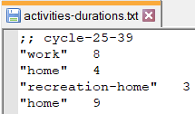
Movement
People move following activities cycles. The user must define activities and their duration. The possible activities are:
"home"
"school"
"work"
"recreation"
Combinations of them (variability)
A single cycle should last 24 hours (ticks) -> activities may be shorter than the average travelling time -> switch more-realistic-activities-durations?.
Quarantine limits movement -> substitutes closed activities with "home".
Notes:
Sottolineare che c'è un diverso cycle per age class, descrivere i cicli anche usando l'immagine (specialmente per la variability)

Slide 9
Illegal behaviours problem
Possibility to activate illegal behaviours -> switch possible-illegal-behaviours?.
Automatically enables more-realistic-activities-durations? to avoid the illegal behaviours problem.
= travel duration
= activity duration
= time slice (sum of durations)
Without longer activities
Shorter time slices: more frequent next activity determination
Quarantine level ↑↑
Mostly remaining home -> no travels
Travel times are insignificant: time slices remain uniform at all quarantine levels
With longer activities
Quarantine level ↑↑
Mostly remaining home -> no travels
Proper tuning of the multiplicative factor is critical.
Notes:
Spiegare direttamente commentando l'immagine e sottolineare che sia necessario un approfondito fine tuning del fattore per cui moltiplicare la durata delle attività evitando il problema descritto ma anche che le simulazioni durino un'infinità e che tale tuning fa parte degli sviluppi futuri

Slide 10
Infection
People can get infected in two ways:
Direct disease transmission -> due to closeness
Environmental disease transmission -> due to infected floating particles
Direct transmission
Environmental transmission
Spreading speed may be too high -> infect-each-n-ticks.
Various infection counters have been added as outputs.
Notes:
Riformulare i vari punti

Slide 11
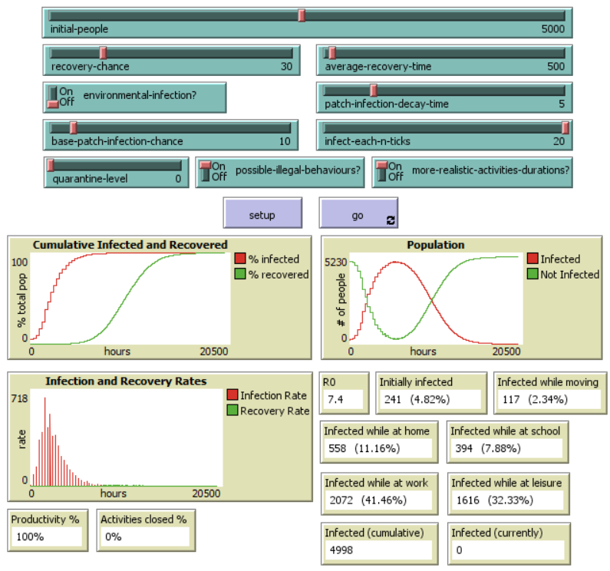
Results – no quarantine run
The used parameter configuration scales up the time related elements by 15.
Nearly all people got infected
Most of the people got infected while doing their main dutiful activity
Notes:
Introdurre la configurazione usata specificando che limita solo l'illegal behaviours problem, non lo risolve perché come detto prima per far ciò serve del fine tuning, ma comunque con questa configurazione si ottengono buoni risultati in tempi accettabili. Non molto da dire sui risultati del livello 0, molto più utile confrontarli coi livelli successivi

Slide 12
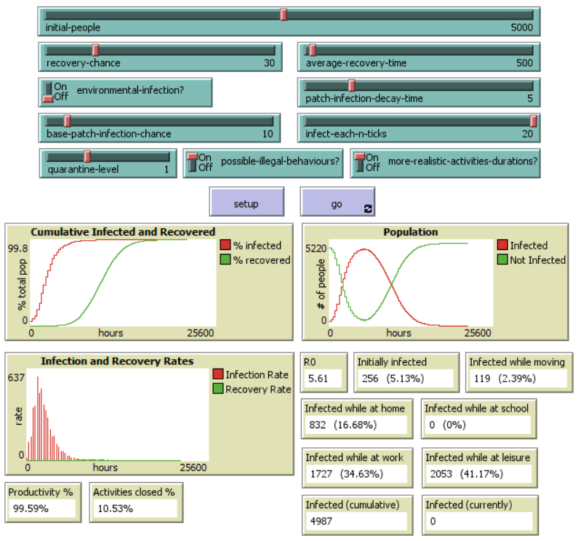
Results – quarantine level 1 run
Still high number of infections
No people infected at school and less at work
Higher infections at leisure activities and home
Slight productivity loss
Notes:
Spiegare come mai il maggior numero di infetti nelle leisure e at home è dovuto a students e teachers -> non essendo stati infettati a scuola, lo sono stati o a casa o mentre erano alle leisure (anche a causa dei comportamenti illegali), inoltre il maggior tempo passato a casa aumenta il rischio di contagiare altri familiari se malati o di essere contagiati da essi se loro sono malati. Ripetere che la quarantena chiudendo attività influenza la produttività

Slide 13
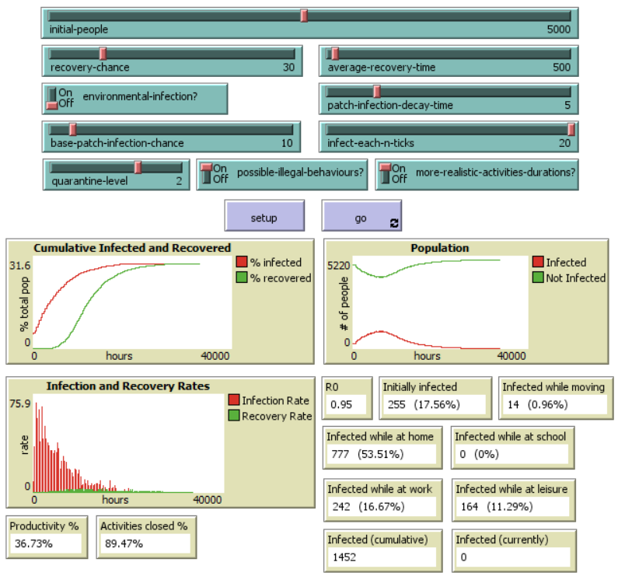
Results – quarantine level 2 run
Results of a quarantine level 2 run:
Significant improvement in the number of infections
Relatively high number of infections at home
Some people infected while at leisure
R0 very low
Productivity dropped
Notes:
Ripetere la differenza tra i livelli di quarantena 1 e 2

Slide 14
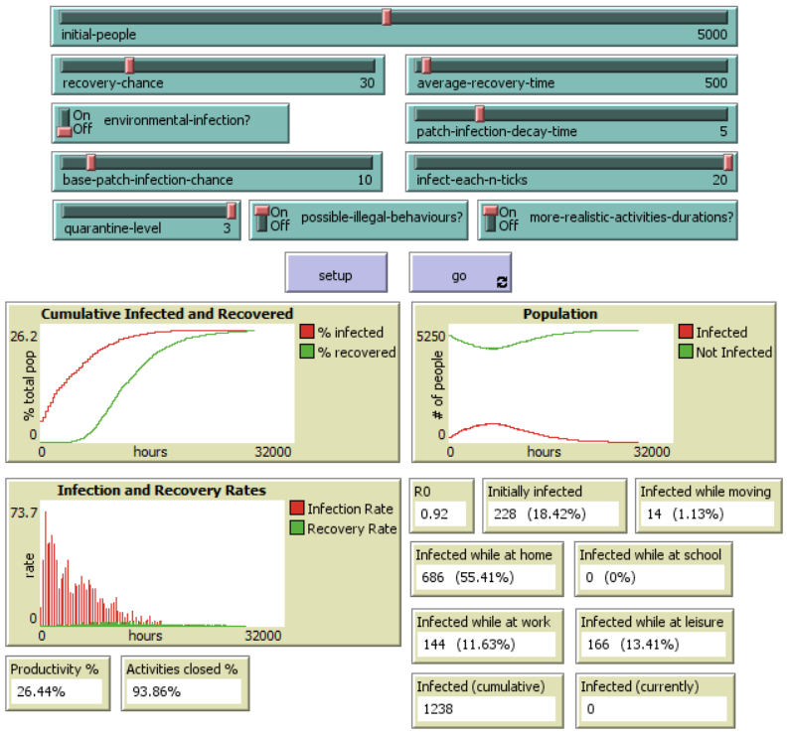
Results – quarantine level 3 run
Results of a quarantine level 3 run:
Similar results to level 2
Less infected while at work
R0 went slightly down
Productivity is extremely low
Notes:
Ripetere la differenza tra i livelli 2 e 3, sottolineare che le factories sono le attività con la productivity più alta e quindi nonostante siano poche, chiuderle fa abbassare molto la produttività

Slide 15
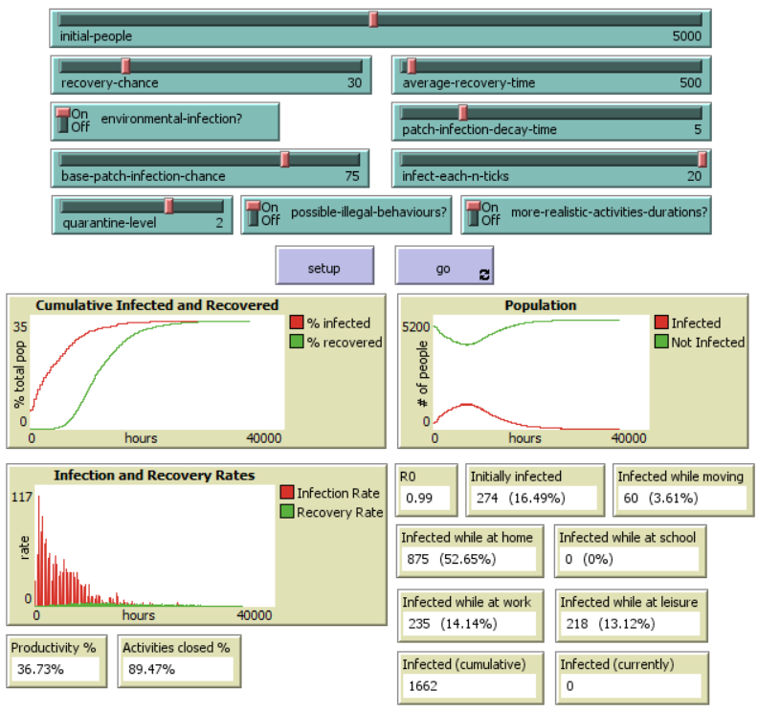
Results – environmental infection run
Similar results to the normal level 2 run
Higher number of people infected while moving
Notes:
Ripetere che anche l'environmental infection è affected da infect-each-n-ticks, dire che comunque c'è un generale aumento del numero di infetti

Slide 16
Thanks for your time and attention!

