Slide 1










LEAFLET.JS : from ZERO to HERO
Special guests:
#ODS16 - Summer Edition - Messina, 03/09/2016
@opendatasicilia - @strettodigitale

Slide 2
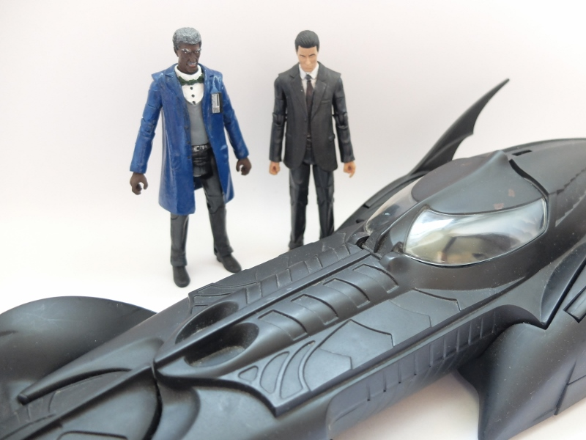




Slide 3
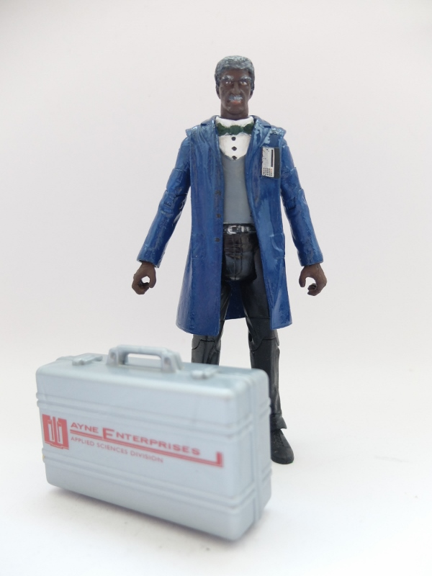






GIUSEPPE PIZZIMENTI
https://www.linkedin.com/in/giuseppepizzimenti
https://twitter.com/gpizzimenti
https://plus.google.com/+GiuseppePizzimenti
https://www.facebook.com/giuseppe.pizzimenti
https://www.slideshare.net/giuseppe.pizzimenti
https://github.com/gpizzimenti

Slide 4
http://leafletjs.com/
Es. 1 – Le componenti di base
<html>
<head>
<title>#ODS16 | Leaflet</title>
<meta charset="utf-8" />
<link rel="stylesheet" href="https://npmcdn.com/leaflet@0.7.7/dist/leaflet.css" />
<script src="https://npmcdn.com/leaflet@0.7.7/dist/leaflet.js"></script>
</head>
<body>
<div id="mapContainer" style="width: 100%; height: 100%"></div>
</body>
</html>

Slide 5


Slide 6
Es. 2 – Il Tile Layer
<div id="mapContainer" style="width: 100%; height: 100%"></div>
<script>
var mappa = L
.map('mapContainer')
.setView([38.19941,15.55602], 16); // LAT, LONG
L
.tileLayer(
'http://{s}.tile.openstreetmap.org/{z}/{x}/{y}.png',
{
attribution: 'Map data &copy; <a href="http://openstreetmap.org">OpenStreetMap</a>',
maxZoom: 20
}
)
.addTo(mappa);
</script>

Slide 7
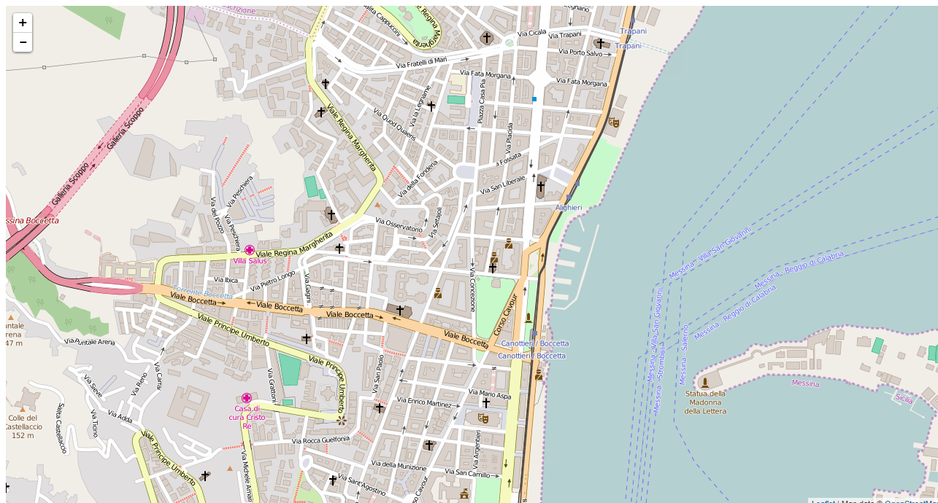

Slide 8
Es. 3 – Markers
<script>
var mappa = L
.map('mapContainer')
.setView([38.19941,15.55602], 16); // LAT, LONG
L
.tileLayer(
'http://{s}.tile.openstreetmap.org/{z}/{x}/{y}.png',
{
attribution: 'Map data &copy; <a href="http://openstreetmap.org">OpenStreetMap</a>',
maxZoom: 20,
}
)
.addTo(mappa);
var markerCospecs = L.marker([38.19941,15.55602])
.addTo(mappa);
var markerMarina = L.marker([38.19943,15.55889])
.addTo(mappa);
</script>

Slide 9
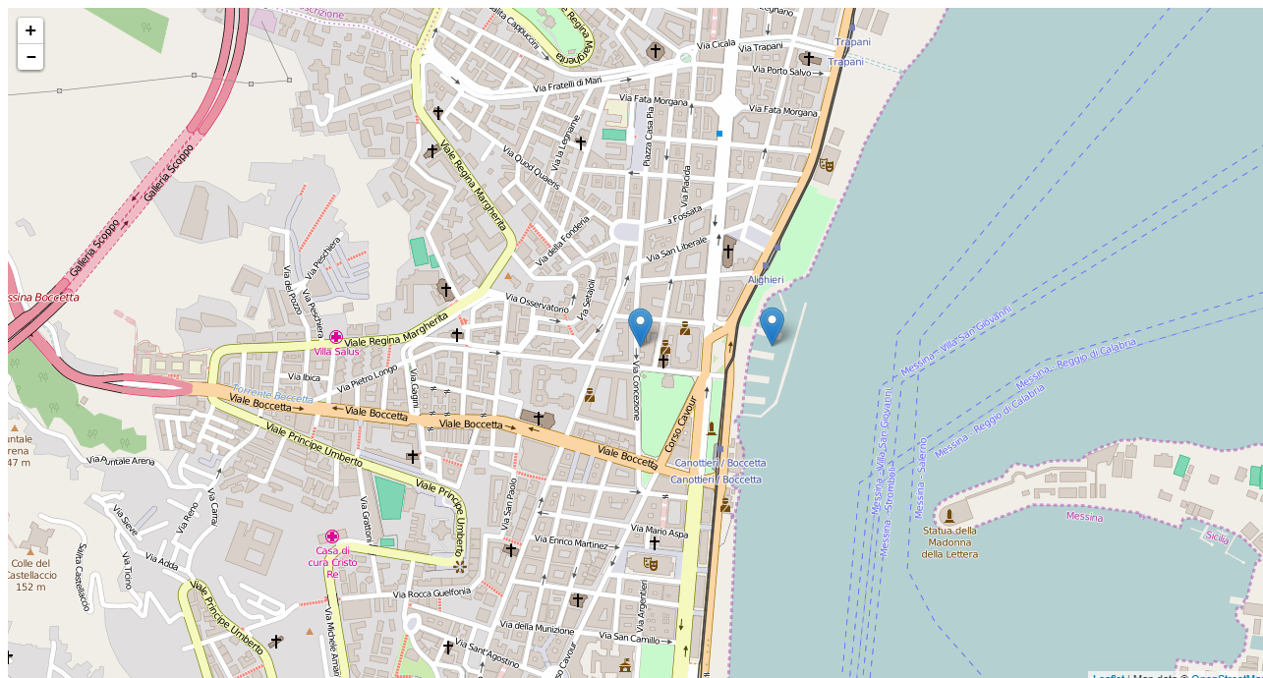

Slide 10
Es. 4 – Popups
<script>
var mappa = L
.map('mapContainer')
.setView([38.19941,15.55602], 16); // LAT, LONG
L
.tileLayer(
'http://{s}.tile.openstreetmap.org/{z}/{x}/{y}.png',
{
attribution: 'Map data &copy; <a href="http://openstreetmap.org">OpenStreetMap</a>',
maxZoom: 20,
}
)
.addTo(mappa);
var markerCospecs = L.marker([38.19941,15.55602])
.addTo(mappa);
var markerMarina = L.marker([38.19943,15.55889])
.addTo(mappa);
markerCospecs
.bindPopup("<b>COSPECS</b><br><i>Voi siete qui</i>")
.openPopup();
markerMarina
.bindPopup("<b>Marina del Nettuno</b><br><i>Stasera si va qui</i>");
</script>

Slide 11
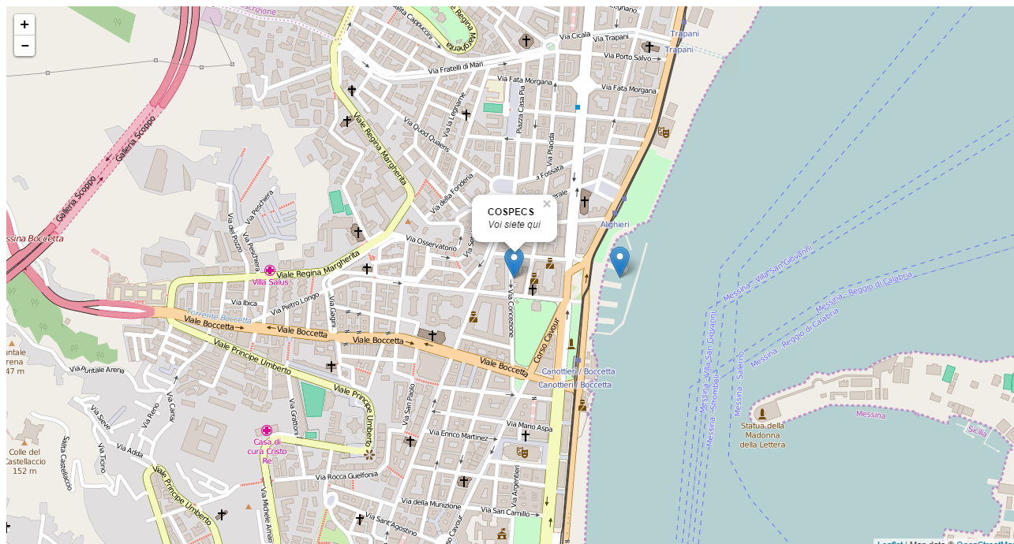

Slide 12
Es. 5 – Linee, Cerchi e Poligoni
var percorso = L.polyline([
[38.19941,15.55602],
[38.199037,15.555988],
[38.198927,15.558060],
[38.199636,15.558178],
[38.19943,15.55889]
],
{
color: 'blue',
weight: 7,
opacity: .7,
dashArray: '20,15',
lineJoin: 'round'
})
.addTo(mappa);
var polyCospecs = L.polygon([
[38.199863 , 15.556016],
[38.199827 , 15.556423],
[38.199106 , 15.556257],
[38.199135 , 15.556021],
],
{
color: 'green',
fillColor: 'lightgreen',
fillOpacity: 0.5
})
.addTo(mappa);
var circleMarina = L.circle([38.19943,15.55889], 10, //raggio in mt.
{
color: 'red',
fillColor: '#FFF',
fillOpacity: 0.5
})
.addTo(mappa);

Slide 13
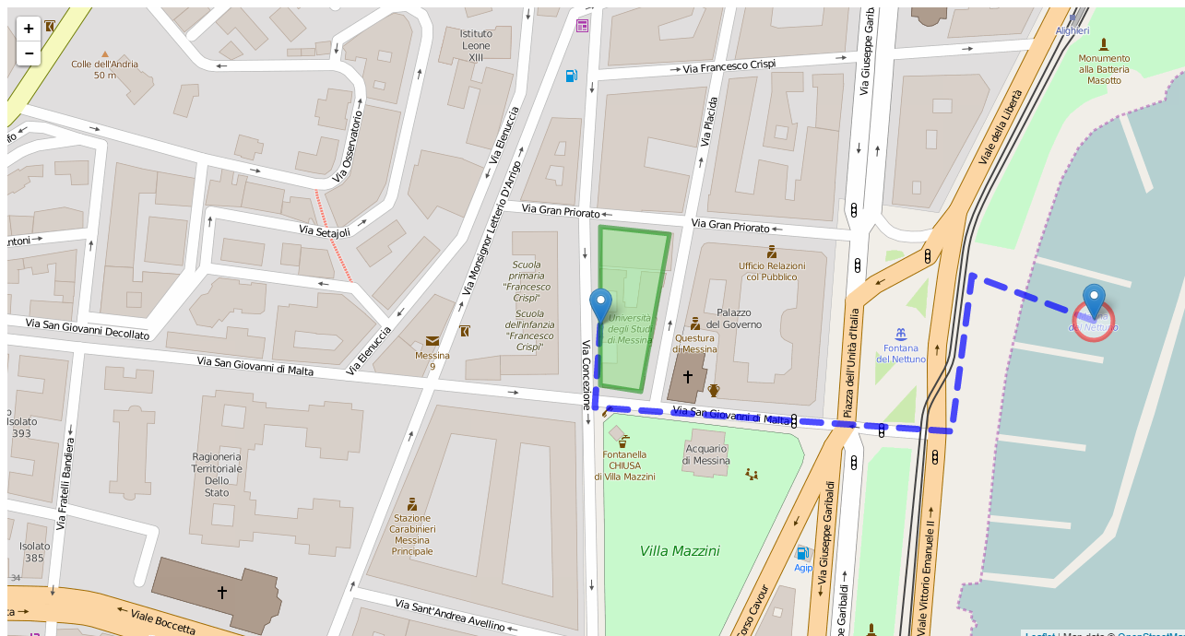

Slide 14
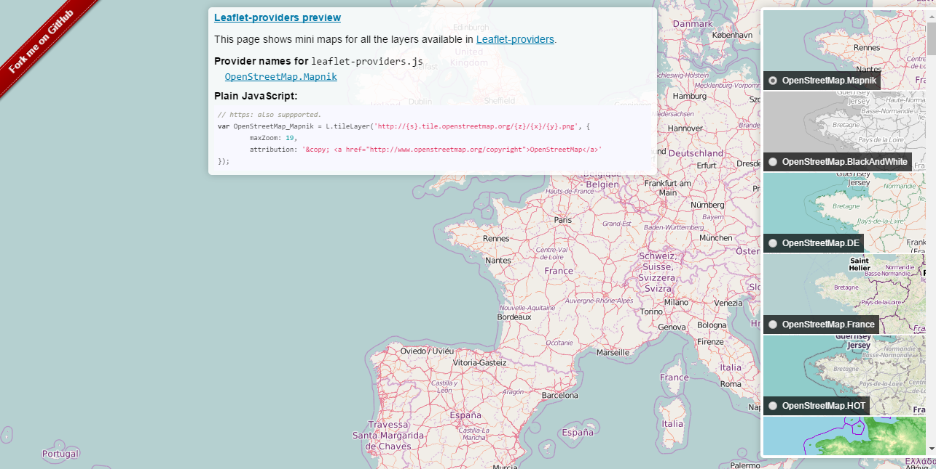
Es. 6 – Layer groups
https://leaflet-extras.github.io/leaflet-providers/preview/

Slide 15
Es. 6 – Layer groups
var mappa = L.map('mapContainer')
.setView([38.19941,15.55602], 16); // LAT, LONG
var baseOpenStreetMap = L.tileLayer(
'http://{s}.tile.openstreetmap.org/{z}/{x}/{y}.png',
{
attribution: 'Map data &copy; <a href="http://openstreetmap.org">OpenStreetMap</a>',
maxZoom: 18
}
)
.addTo(mappa);
var baseOpenTopoMap = L.tileLayer(
'http://{s}.tile.opentopomap.org/{z}/{x}/{y}.png',
{
attribution: 'Map data: &copy; <a href="http://www.openstreetmap.org/copyright">OpenStreetMap</a>, <a href=”http://viewfinderpanoramas.org">SRTM</a> | Map style: &copy; <a href="https://opentopomap.org">OpenTopoMap</a> (<a href="https://creativecommons.org/licenses/by-sa/3.0/">CC-BY-SA</a>)',
maxZoom: 18
}
);
var baseEsriWorldImageryMap = L.tileLayer(
'http://server.arcgisonline.com/ArcGIS/rest/services/World_Imagery/MapServer/tile/{z}/{y}/{x}',
{
attribution: 'Tiles &copy; Esri &mdash; Source: Esri, i-cubed, USDA, USGS, AEX, GeoEye, Getmapping, Aerogrid, IGN, IGP, UPR-EGP, and the GIS User Communit',
maxZoom: 18
}
);

Slide 16
Es. 6 – Layer groups
var markerCospecs = L.marker([38.19941,15.55602]);
var markerMarina = L.marker([38.19943,15.55889]);
var percorso = L.polyline([
[38.19941,15.55602],
[38.199037,15.555988],
[38.198927,15.558060],
[38.199636,15.558178],
[38.19943,15.55889]
],
{
color: 'blue',
weight: 7,
opacity: .7,
dashArray: '20,15',
lineJoin: 'round'
});
var polyCospecs = L.polygon([
[38.199863 , 15.556016],
[38.199827 , 15.556423],
[38.199106 , 15.556257],
[38.199135 , 15.556021],
],
{
color: 'green',
fillColor: 'lightgreen',
fillOpacity: 0.5
});
var circleMarina = L.circle([38.19943,15.55889], 10, //raggio in mt.
{
color: 'red',
fillColor: '#FFF',
fillOpacity: 0.5
});

Slide 17
Es. 6 – Layer groups
var shapes = L.layerGroup([percorso, polyCospecs, circleMarina]);
var markers = L.layerGroup([markerCospecs, markerMarina]);
var baseLayers = {
"Strade": baseOpenStreetMap,
"Topografia": baseOpenTopoMap,
"Fotografica" : baseEsriWorldImageryMap
};
var overlays = {
"Edifici & Percorsi": shapes,
"Entrate": markers
};
L.control
.layers(baseLayers,overlays)
.addTo(mappa);

Slide 18
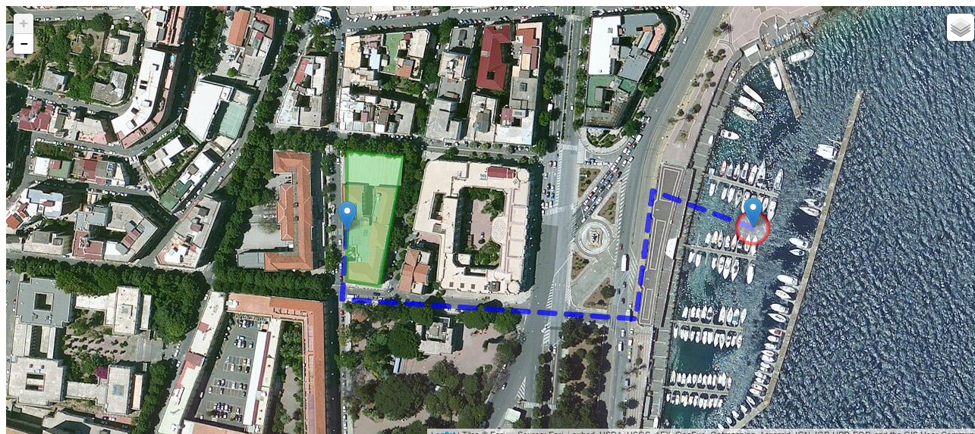

Slide 19
Es. 7 – GeoJSON e altri formati di dati
JSON
è un semplice formato per lo scambio di dati basato su un sottoinsieme del Linguaggio di Programmazione JavaScript
var markers = [
{
"point":new GLatLng(40.266044,-74.718479),
"homeTeam":"Lawrence Library",
"awayTeam":"LUGip",
"markerImage":"images/red.png",
"information": "Linux users group meets second Wednesday of each month.",
"fixture":"Wednesday 7pm",
"capacity":"",
"previousScore":""
},
{
"point":new GLatLng(40.211600,-74.695702),
"homeTeam":"Hamilton Library",
"awayTeam":"LUGip HW SIG",
"markerImage":"images/white.png",
"information": "Linux users can meet the first Tuesday of the month to work out harward and configuration issues.",
"fixture":"Tuesday 7pm",
"capacity":"",
"tv":""
}
]

Slide 20
Es. 7 – GeoJSON e altri formati di dati
GeoJSON
è un formato aperto utilizzato per archiviare una collezione di geometrie spaziali i cui attributi sono descritti attraverso JSON.
var someFeatures = [{
"type": "Feature",
"properties": {
"name": "Coors Field",
"show_on_map": true
},
"geometry": {
"type": "Point",
"coordinates": [-104.99404, 39.75621]
}
}, {
"type": "Feature",
"properties": {
"name": "Busch Field",
"show_on_map": false
},
"geometry": {
"type": "Point",
"coordinates": [-104.98404, 39.74621]
}
}];

Slide 21
Es. 7 – GeoJSON e altri formati di dati
TopoJSON
è un'estensione di GeoJSON che codifica topologie invece di geometrie. (!)
GPX
è uno schema XML progettato per il trasferimento di dati GPS tra applicazioni software.
KML
è un linguaggio basato su XML creato per gestire dati geospaziali in tre dimensioni nei programmi Google.

Slide 22
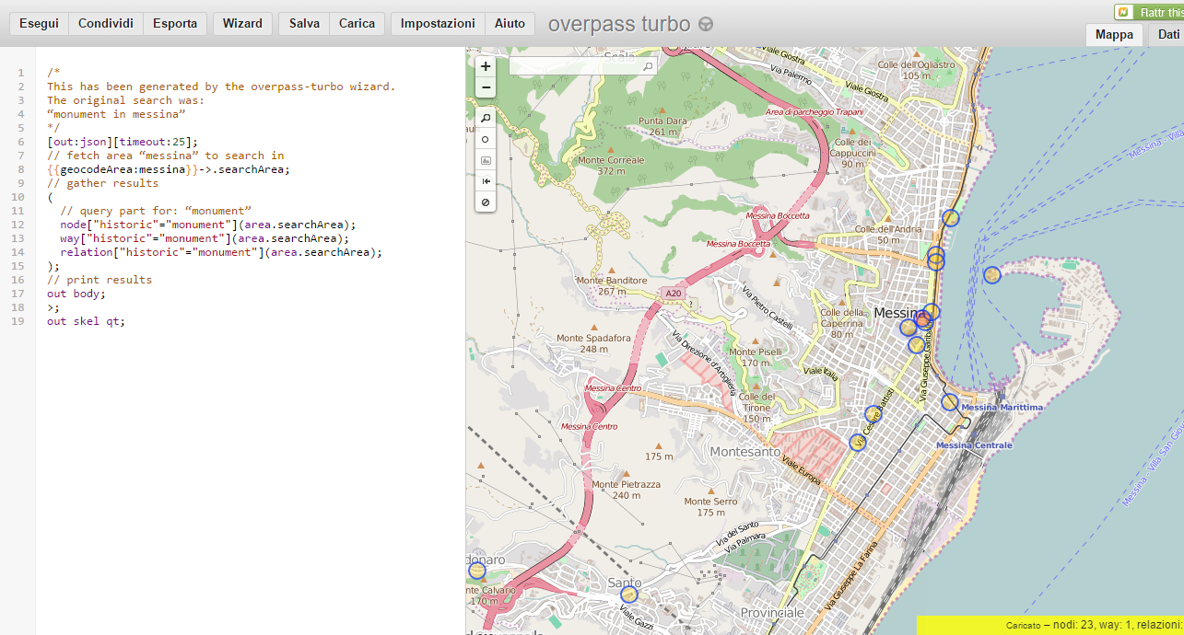
Es. 7 – GeoJSON e altri formati di dati
https://overpass-turbo.eu/

Slide 23
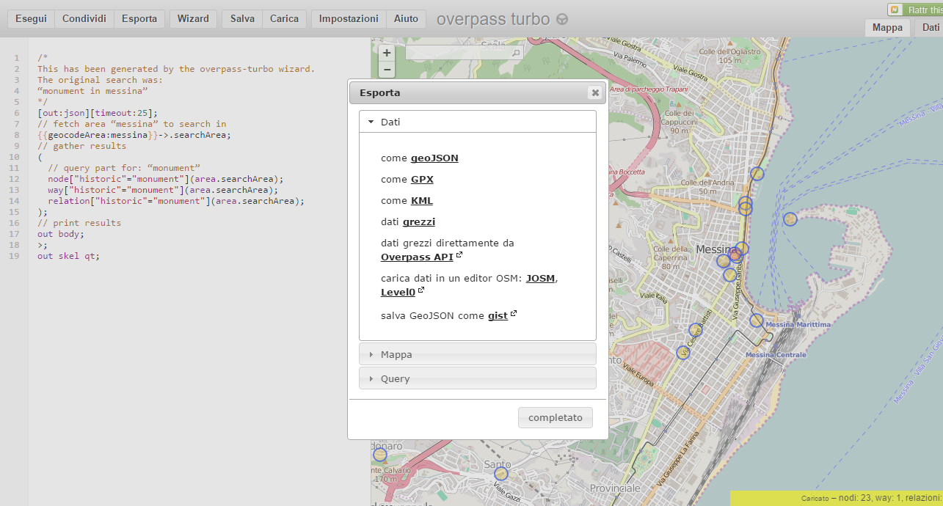
Es. 7 – GeoJSON e altri formati di dati
https://overpass-turbo.eu/

Slide 24
Es. 7 – GeoJSON e altri formati di dati
<script src="../lib/jquery-3.1.0.min.js"></script>
<script>
var mappa = L.map('mapContainer')
.setView([38.19941,15.55602], 16); // LAT, LONG
L.tileLayer(
'http://{s}.tile.openstreetmap.org/{z}/{x}/{y}.png',
{
attribution: 'Map data &copy; <a href="http://openstreetmap.org">OpenStreetMap</a>',
maxZoom: 18,
}
)
.addTo(mappa);
var $req = $.ajax({
dataType: "json",
url: 'https://gist.githubusercontent.com/gpizzimenti/e0bdc49ae9511a8e55b0a52a696c65fe/raw/d3b0f0aef521cd28c69bce52e089f71787d5f5ab/monumentsinmessina.overpass.geojson'
});
$.when($req)
.then(elaboraDati, gestisciErrore);
function elaboraDati(data) {
var layerMonumenti = L.geoJson().addTo(mappa);
layerMonumenti.addData(data);
};
function gestisciErrore() {
alert("Si è verificato un errore!");
};
</script>

Slide 25
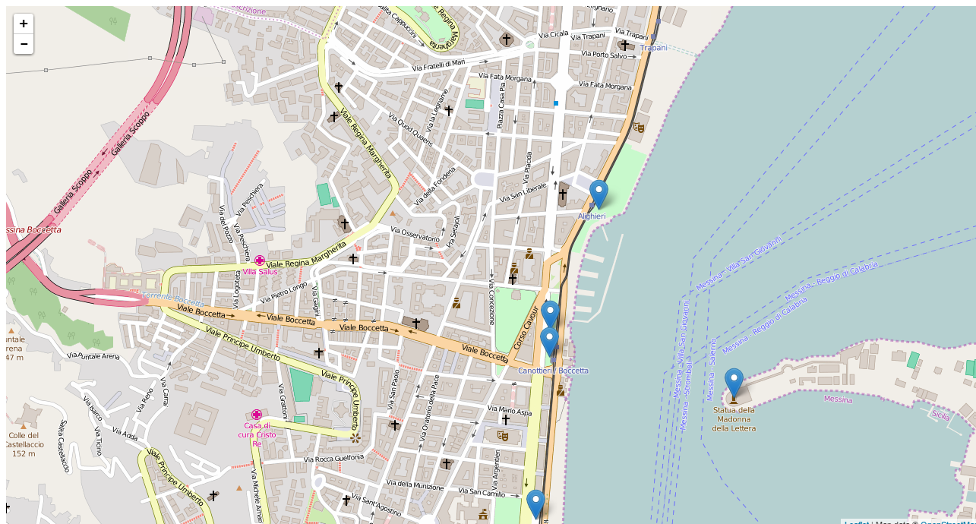

Slide 26
Es. 7 – GeoJSON e altri formati di dati
var geojsonMarkerStyle = {
radius: 12,
fillColor: "blue",
color: "#000",
weight: 1,
opacity: 1,
fillOpacity: 0.5
};
var cannonIcon = L.icon({
iconUrl: 'cannon.png',
iconSize: [32, 32],
iconAnchor: [16, 37],
popupAnchor: [0, -28]
});

Slide 27
Es. 7 – GeoJSON e altri formati di dati
function elaboraDati(data) {
var layerMonumenti = L.geoJson(data, {
style: function(feature) {
if (feature.geometry.type == "Polygon") {
return {
color: "red",
fillColor: "gold",
fillOpacity: 0.5
}
}
},
pointToLayer: function (feature, latlng) {
if (feature.properties && feature.properties.name && feature.properties.name == "Monumento alla Batteria Masotto") {
return L.marker(latlng, {icon: cannonIcon});
} else {
return L.circleMarker(latlng, geojsonMarkerStyle);
},
onEachFeature: function (feature, layer) {
if (feature.properties && feature.properties.name) {
layer.bindPopup(feature.properties.name);
}
},
filter: function(feature, layer) {
return (feature.geometry.type == "Polygon" || feature.geometry.coordinates[0] > 15.50);
}
}).addTo(mappa);
};

Slide 28
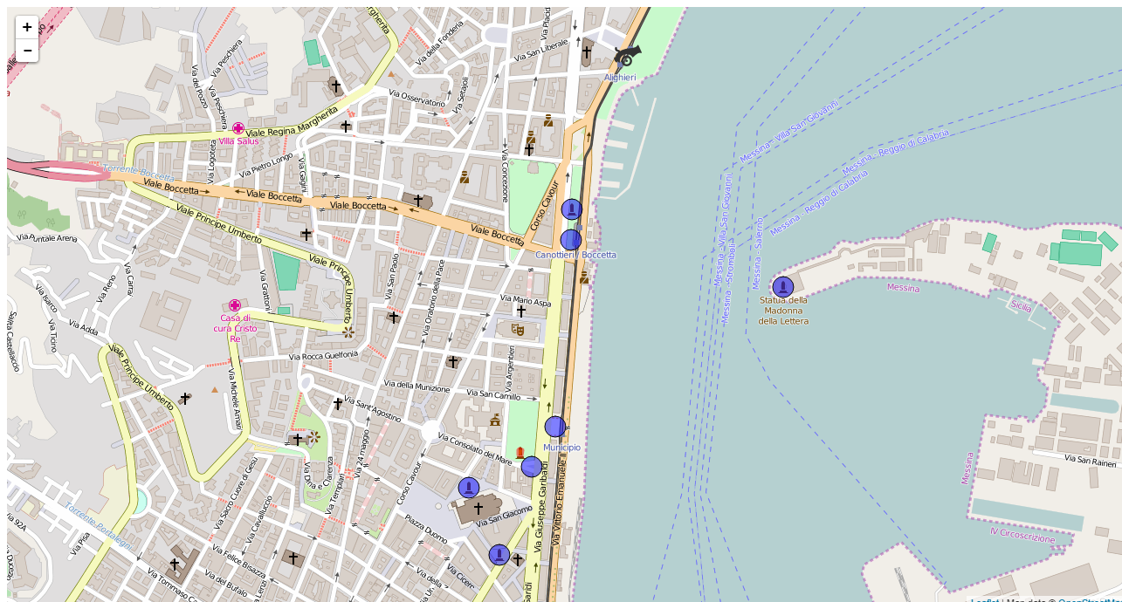

Slide 29
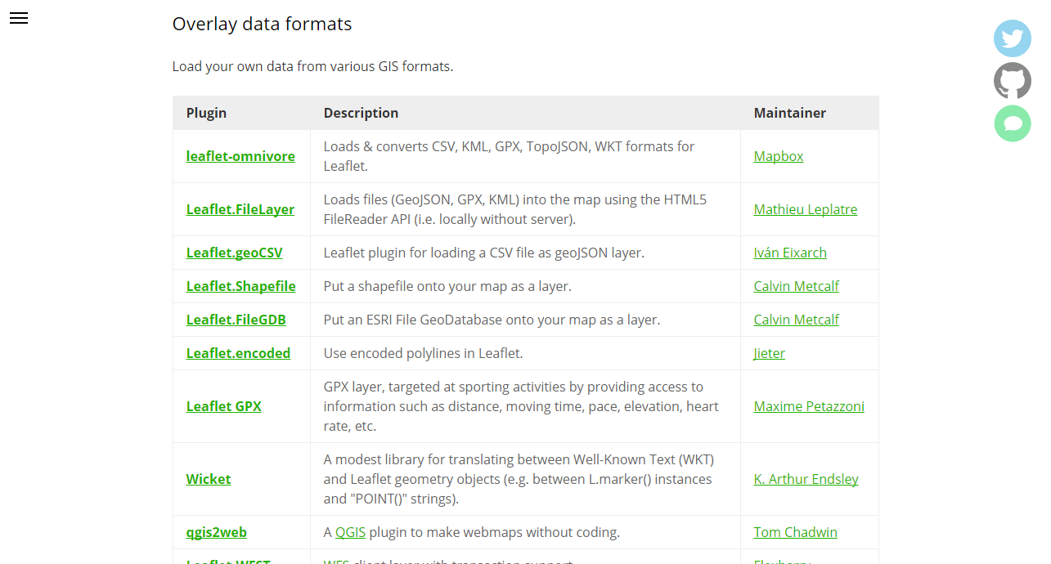
Es. 7 – GeoJSON e altri formati di dati
http://leafletjs.com/plugins.html#overlay-data-formats

Slide 30
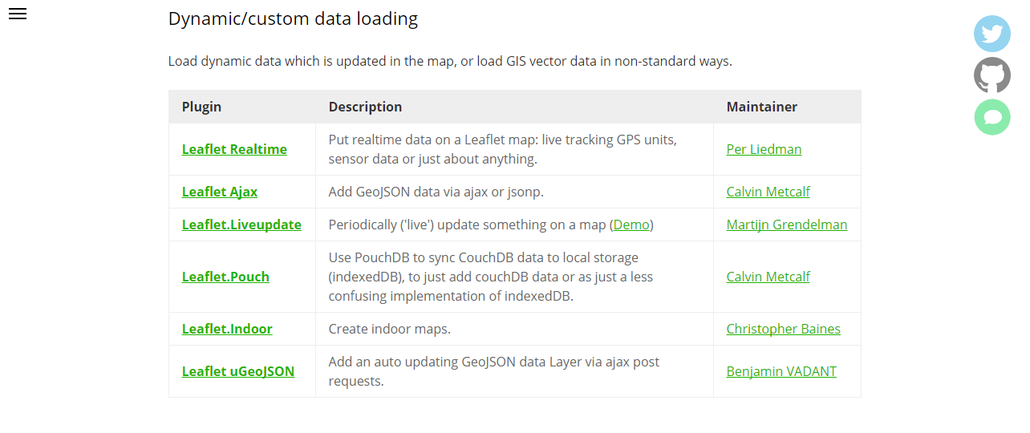
Es. 7 – GeoJSON e altri formati di dati
http://leafletjs.com/plugins.html#dynamiccustom-data-loading

Slide 31
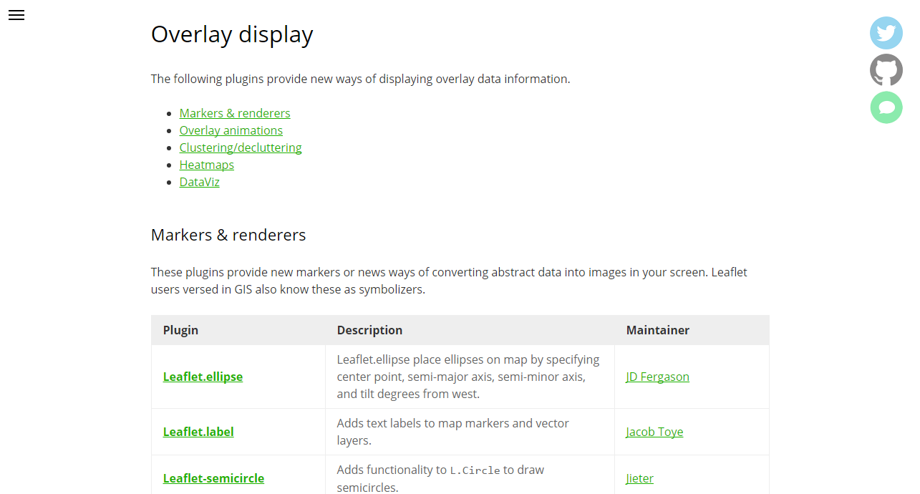
Es. 7 – GeoJSON e altri formati di dati
http://leafletjs.com/plugins.html#markers--renderers

Slide 32
Es. 8 – Eventi
var layerProvince = L.geoJson(pData,
{
style: styleProvincia,
onEachFeature: featureEvents
})
,
layerRegioni = L.geoJson(rData,
{
style: styleDensity,
onEachFeature: featureEvents
});

Slide 33
Es. 8 – Eventi
var styleDensity = function styleDensity(feature) {
return {
fillColor: getColor(feature.properties.density),
weight: 2,
opacity: 1,
color: 'white',
dashArray: '3',
fillOpacity: 0.7
};
}
var getColor = function getColor(d) {
return d > 1000 ? '#800026' :
d > 500 ? '#BD0026' :
d > 200 ? '#E31A1C' :
d > 100 ? '#FC4E2A' :
d > 50 ? '#FD8D3C' :
d > 20 ? '#FEB24C' :
d > 10 ? '#FED976' :
'#FFEDA0';
}

Slide 34
Es. 8 – Eventi
var featureEvents = function featureEvents(feature, layer) {
layer
.bindPopup("<b>" + (feature.id || feature.properties.name ) + "</b>")
.on({
mouseover: highlightFeature,
mouseout: resetHighlight,
click: zoomToFeature
});
}

Slide 35
Es. 8 – Eventi
var highlightFeature = function highlightFeature(e) {
var layer = e.target;
layer.setStyle({
weight: 5,
color: '#666',
dashArray: '',
fillOpacity: 0.7
});
if (!L.Browser.ie && !L.Browser.opera) {
layer.bringToFront();
}
layer.openPopup();
}

Slide 36
Es. 8 – Eventi
var resetHighlight = function resetHighlight(e) {
var layer = e.target;
layerProvince.resetStyle(layer);
layerRegioni.resetStyle(layer);
}
var zoomToFeature = function zoomToFeature(e) {
var layer = e.target;
mappa.fitBounds(layer.getBounds());
}

Slide 37
Es. 8 – Eventi
layerRegioni.addTo(mappa);
mappa.on('zoomend', function() {
if (mappa.getZoom() > 7 && mappa.hasLayer(layerRegioni)) {
mappa
.removeLayer(layerRegioni)
.addLayer(layerProvince);
}
if (mappa.getZoom() < 8 && !mappa.hasLayer(layerRegioni)) {
mappa
.addLayer(layerRegioni)
.removeLayer(layerProvince)
.fitBounds(layerRegioni.getBounds())
.panTo(new L.LatLng(42.0,12.71216));
}
});

Slide 38
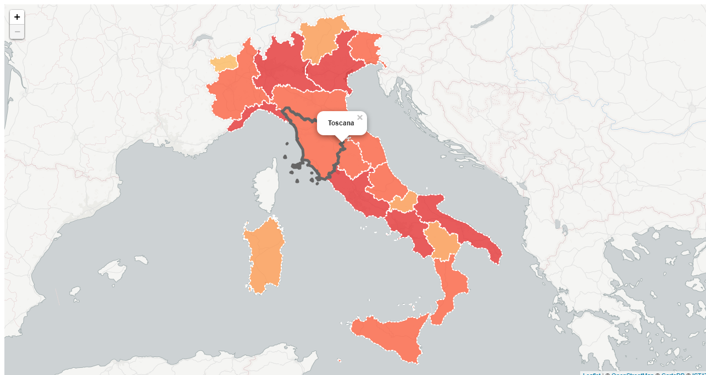
Es. 8 – Eventi

Slide 39
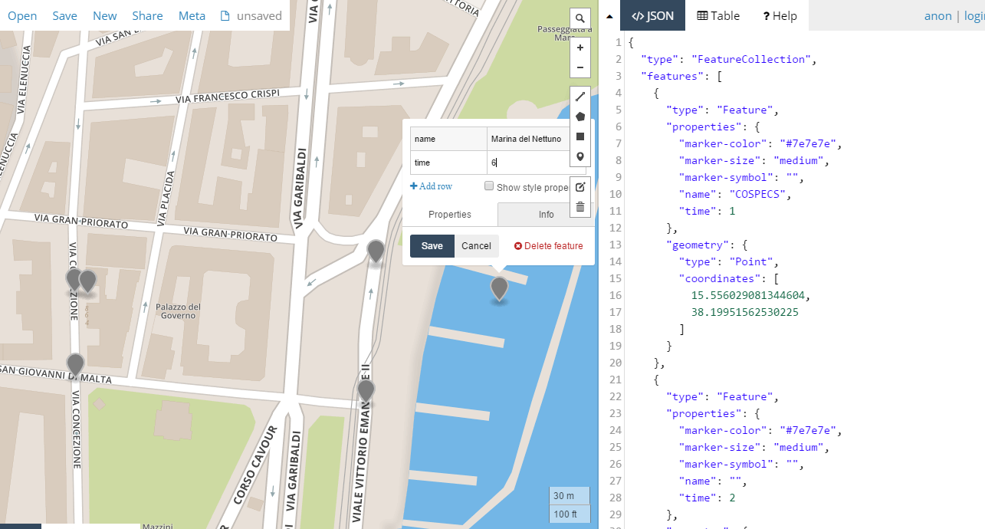
http://geojson.io/#map=18/38.19904/15.55730

