Slide 1
Logistic Regression

Slide 2
Introduction
Logistic regression measures the relationship between the categorical dependent variable and one or more independent variables by estimating probabilities using a logistic function.
It's a classification technique used to predict the likelihood occurrence of an event, resulting in yes or no.
Decision Boundary
To predict which class a data belongs, a threshold can be set. Based upon this threshold, the obtained estimated probability is classified into classes.
Say, if predicted_value ≥ 0.5, then classify email as spam else as not spam.

Slide 3
Types of Logistic Regression:
1. Binary Logistic Regression:
The categorical response has only two 2 possible outcomes. Example: Spam or Not
2. Multinomial Logistic Regression:
Three or more categories without ordering. Example: Predicting which food is preferred more (Veg, Non-Veg, Vegan)
3. Ordinal Logistic Regression:
Three or more categories with ordering. Example: Movie rating from 1 to 5

Slide 4
Pros and Cons
Pros
Probabilistic approach, gives information about statistical significance of features
Simple and linear, reliable, no parameters to tune.
Cons
The Logistic Regression Assumptions.
Cannot handle non-linearity in the data

Slide 5
K – Means Clustering

Slide 6
Introduction
It is a supervised learning method.
The K-means clustering algorithm is used to find groups which have not been explicitly labeled in the data.
The results of the K-means clustering algorithm are:
The centroids of the K clusters, which can be used to label new data
Labels for the training data (each data point is assigned to a single cluster)

Slide 7
Examples of use cases are:
Behavioral segmentation:
Segment by purchase history
Segment by activities on application, website, or platform
Define personas based on interests
Create profiles based on activity monitoring.
Inventory categorization:
Group inventory by sales activity
Group inventory by manufacturing metrics

Slide 8
Pros and Cons
Pros
Simple to understand, easily adaptable.
Works well on small or large datasets.
Fast, efficient and performant.
Cons
Need to choose the number of clusters

Slide 9
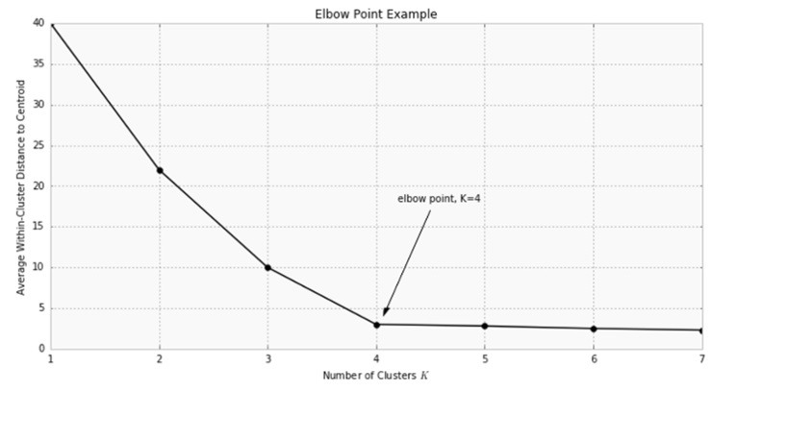

Slide 10
S.V.M
Support Vector Machine

Slide 11
Working
SVM is one of the powerful technique for Classification, Regression & Outlier detection
SVM uses a technique called the kernel trick to transform your data and then based on these transformations it finds an optimal boundary between the possible outputs.
It comes under Supervised Learning Algorithm.
For a data having p-dimensions the hyperplane(boundary) is built by using (p-1) dimensions.

Slide 12
Working Continued…
The primary focus while drawing the hyperplane is on maximizing the distance from hyperplane to the nearest data point of either class.
The Points which are influencing the hyperplane are called Support Vectors

Slide 13
Advantages
Classication and Regression problems
Works very well for large no. of features and also when features > no. of samples
Non-Linear data can also be classified using customized hyperplanes built by using kernel trick.

Slide 14
Disadvantages
No choice of kernel leading to more errors
Sample size and accuracy are inversely proportional
More time and memory are needed to implement with complex calculations involved

Slide 15
Real Time Usage
Facial Expression Classification
Speech Recognition
Handwritten Digit Recognition & Text Classification

Slide 16
Classifier | Handling Large Data | Handling More Features | Processing Time | Complexity
Linear
Logistic
Naïve Bayes
K-Means
SVM | No | Yes | Slow | Yes
Decision Tree

