Slide 1

AETHER 360 | PATIENT & MEMBER 360
Cited clinical and regulatory document copilot
Team Name: Aether 360
Team Leader Name: Gopal Kanase
Team Size: 2 | Gopal Kanase, Pramoda Devi B
Problem Statement: Connect synthetic records to evidence-cited care decisions.
CHALLENGE: Patient and Member 360 and Clinical or Regulatory Document Copilot

Slide 2

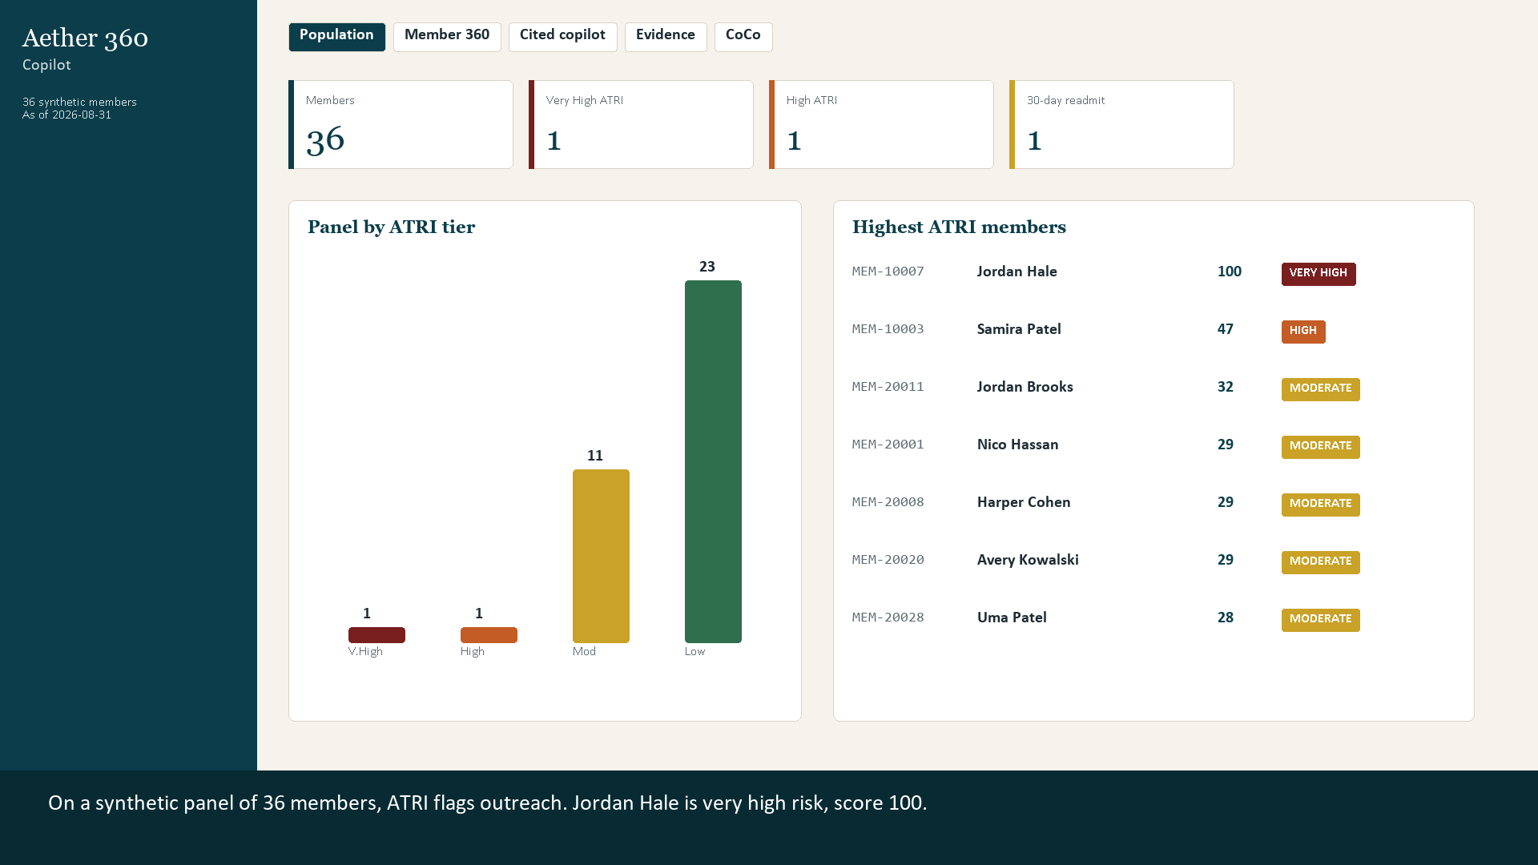
1. Problem brief
Fictional Aether Care Alliance; every member, claim, note and document in this prototype is synthetic.
BUSINESS PROBLEM
Care teams work across separate EHR, payer-claims and policy/document systems. Risk and coverage answers are slow to assemble and difficult to audit.
TARGET USERS
Care managers, clinical pharmacists, prior-authorization nurses and quality teams.
CURRENT PAIN > PROTOTYPE RESPONSE
Fragmented records and unsupported answers > one member view, a source-linked ATRI factor ledger, cited document retrieval, and an explicit abstain/refuse path.
DOMAIN
WORKING LOCAL STREAMLIT PROTOTYPE > SAMPLE DATA ONLY
Healthcare operations and clinical / regulatory evidence review. This prototype is not medical advice or a production clinical service.
36
41
16
members
claims
documents

Slide 3
2. Architecture & CoCo workflow
Prototype data path and intended CoCo lifecycle; the Snowflake warehouse / Cortex Agent are not represented as deployed.
CoCo CLI lifecycle prompts
Planning > Development > Execution > Testing | Prompts numbered 01 to 04
Synthetic sources
Conform & prepare
Explain & retrieve
Local app
EHR + payer CSVs
Clinical / policy Markdown
Crosswalk + normalized data
Silver tables / document chunks
MEMBER_360 + ATRI factors
Clinical / regulatory evidence
Member 360
Cited answer / abstain
LOCAL PROTOTYPE > Python data / retrieval modules + Streamlit UI; citations point to synthetic source rows and document chunks.
Planned Snowflake path
CoCo skill references
SQL scripts describe AETHER_CARE bronze > silver > gold, Cortex Search / Agent and Streamlit integration.
Project prompts name synthetic-care-data, patient-360-builder, cited-clinical-qa and risk-strat-explainer.
Transparency: skill definitions and a CoCo CLI execution recording are not included; the named skills are prompt references, not claimed as run.

Slide 4
3. Impact statement
Measured prototype scope from the bundled synthetic corpus; operational time / accuracy impact has not yet been measured.
36
41
16
7 / 7
synthetic members
synthetic claims
synthetic documents
unit tests passing
DEMONSTRATED CAPABILITIES
Explainable risk
Evidence-first answers
Reusable delivery path
Rule-based ATRI factor points display their source objects and evidence.
Retrieved examples show citations; missing support can abstain; real-person lookups are refused.
Python app, SQL deployment sequence, CoCo prompts, MCP server and guardrail hook are in the repo.
NEXT-PILOT MEASURES
Track care-gap review time vs. baseline, citation correctness, abstention/refusal correctness and workflow completion with domain reviewers. Scale by adding governed sources and evaluating each connector; no clinical efficacy or savings are claimed.

Slide 5
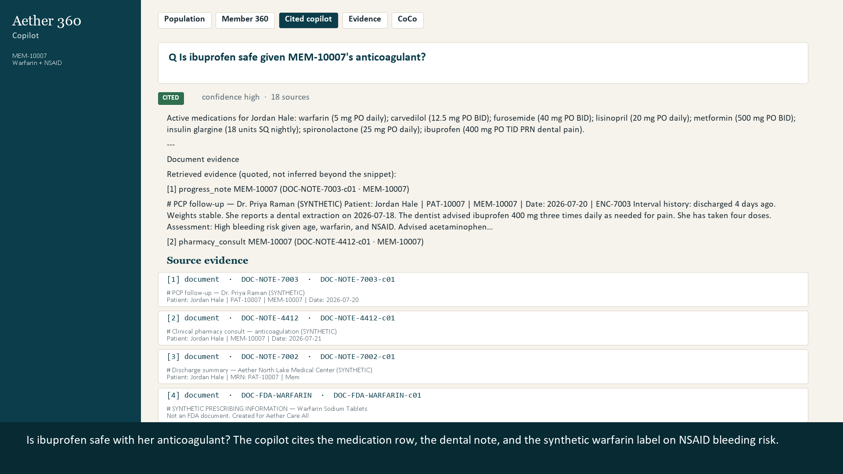
Prototype workflow | 3 modular capabilities
Synthetic example: review a medication-safety question with Jordan Hale; all member identifiers shown are synthetic.
1 Select
2 Explain
3 Retrieve
4 Respond
Synthetic member
ATRI + source rows
Notes + policy chunks
Cite / abstain / refuse
01 > ATRI risk explanation
aether360/risk.py implements a transparent, rule-based factor ledger.
02 > Cited clinical QA
aether360/qa.py retrieves synthetic notes / labels and cites evidence or abstains.
03 > Care-ops action
Local MCP exposes synthetic care-gap tickets / safety-review workflows; guardrails constrain unsafe SQL.
Narrated prototype walkthrough (1:54; not a CoCo CLI screen recording):
https://raw.githubusercontent.com/gplkanase/aether-360-copilot/main/docs/demo/Aether360-demo.mp4

Slide 6

GITHUB.COM/GPLKANASE/AETHER-360-COPILOT | FULLY SYNTHETIC DEMONSTRATION

