Slide 1


Rainwater harvestation and Purification
The Era Engineers- Akarsh Kr. Mishra

Slide 2
Overview
There is a huge problem of flood as well as dry.
This idea will solve both the problems.
It is a good startup with less investments and high profit.

Slide 3
Long-term goal
To harvest rainwater.
To save groundwater.
Selling to drought areas.

Slide 4
The Present Situation
In today's life we can see that there is more need of water in almost every drought area.
Not only for drinking but also for other purposes like bathing, cloth washing, and many more.

Slide 5
Development up to present
Mineral water for drinking is available.
Borewells and taps are inserted.
Water reservire and dams are developed.
Highways are introduced

Slide 6
Strategy for the startup
It will done in two phases in which we plant the tubes and harvest rainwater.
In the second one we will purify it but using physical methods.
Then it will be supllied.

Slide 7
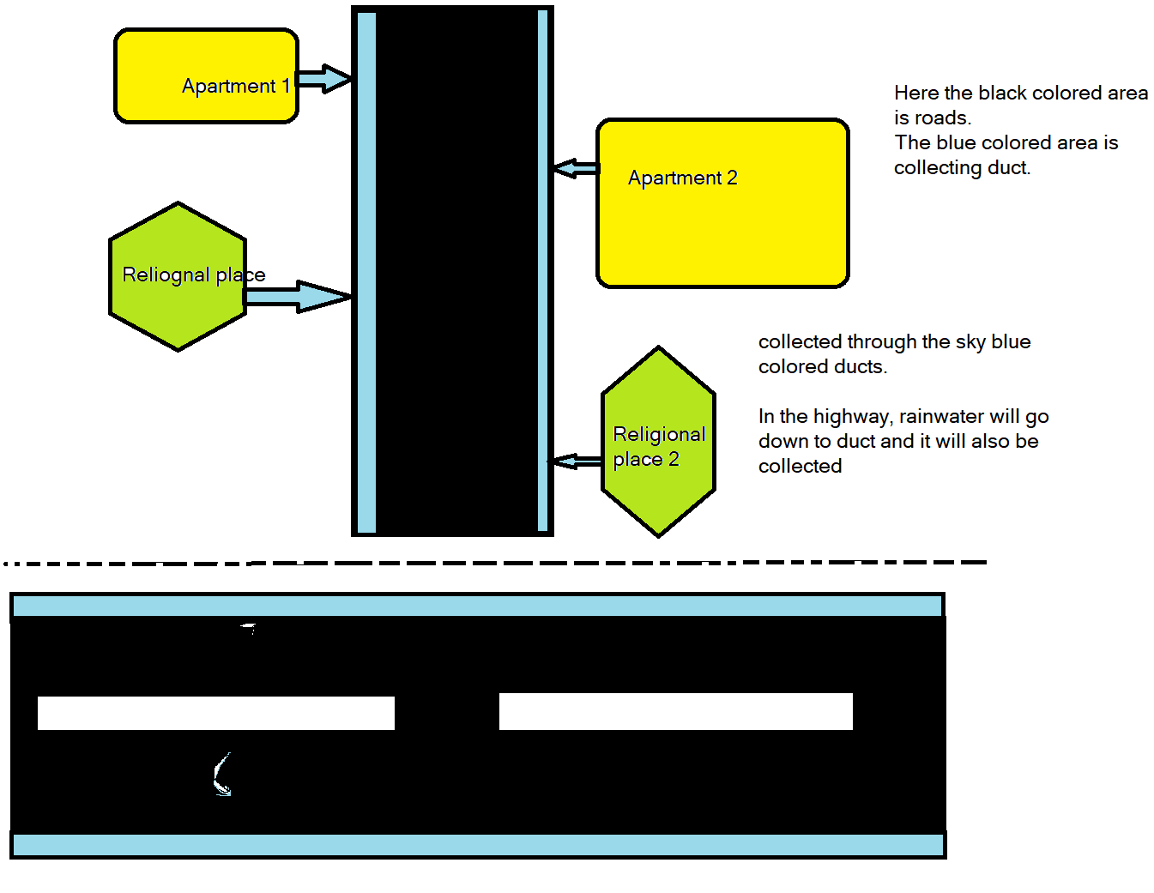

Slide 8
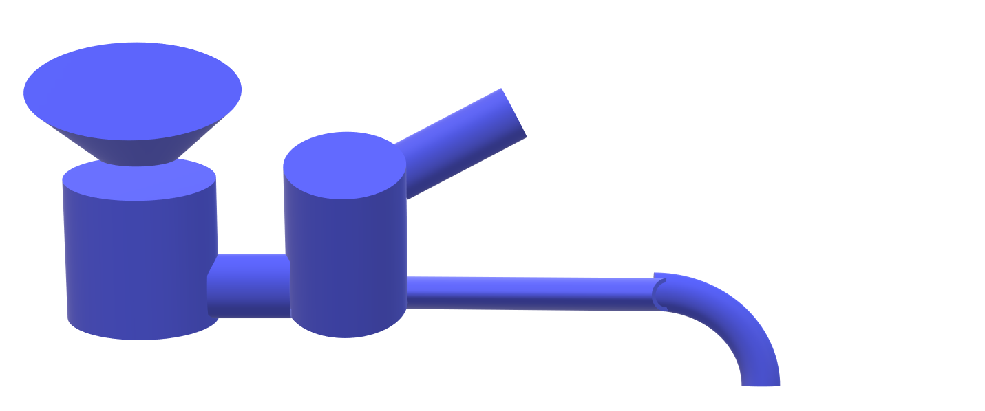
Phase 2
There the first diagram describes a funnel like structure to store direct rainwater and the second cylindrical tank shows water from other sources.

Slide 9
Final step
It will go to the factories where we purify the water as the following. Methods are Bar screen, coagulation, Sedimentation and Aeration.

Slide 10
About methods
In bar screens there are some bars where the bigger plastics, stones can be filtered out.
In the second step Coagulation, the ink, oil, grease and the other liquid substances are removed.
In Sedimentation, the sand, dir and human excretory materials are settled down and they will create some natural fertilizers.

Slide 11
About methods
In the last method, Aeration a pressure of air will be applied to the water then it will be purified and able to use in bathing, cloth and car washing, and other non-drinking works.
According to a research, this type of water will clean more dirts from materials.

Slide 12
Prose and cons
Easy raw material availability.
Long term plan.
Good for nature.
Huge investment.
Dependent on rains

Slide 13
Conclusion
This may take a huge investment but it will be a long term business.
It is from the nature, by the nature and to the nature.

