Slide 1




HTTP/1.1 vs HTTP/2
Networking Layer

Slide 2
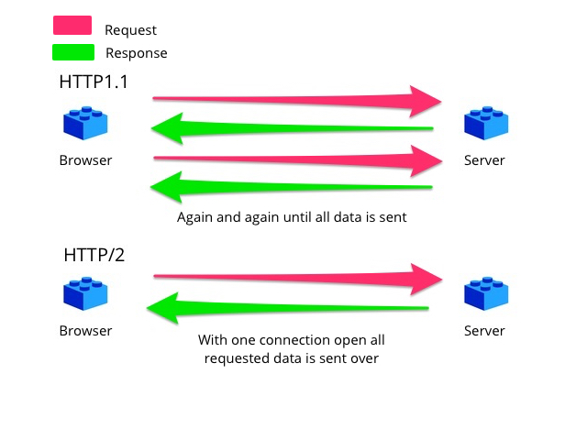
HTTP/1.1 vs HTTP/2
1
Introduction
2
HTTP/2 follows SPDY protocol developed by Google.
From the technical point of view, HTTP/2 introducing binary framing layer in addition to the existing internet protocol layer which encapsulates all messages in binary format but maintains same HTTP semantic to ensure the web apps developed before http/2 also continue to support on this new protocol
HyperText Transfer Protocol (HTTP/1.1) is a standard protocol for communication on WWW. From the release, it was in usage till 2015.
The updated version to deal with latest updated UI and graphic interface.
HTTP/2 is developed in the intention of reducing webpage latency.

Slide 3

References
https://www.digitalocean.com/community/tutorials/http-1-1-vs-http-2-what-s-the-difference
Notes:
When conducting research, it is easy to go to one source: Wikipedia. However, you need to include a variety of sources in your research. Consider the following sources:
Who can I interview to get more information on the topic?
Is the topic current and will it be relevant to my audience?
What articles, blogs, and magazines may have something related to my topic?
Is there a YouTube video on the topic? If so, what is it about?
What images can I find related to the topic?

Slide 4
Notes:
You can use this slide as your opening or closing slide. Should you choose to use it as a closing, make sure you review the main points of your presentation. One creative way to do that is by adding animations to the various graphics on a slide. This slide has 4 different graphics, and, when you view the slideshow, you will see that you can click to reveal the next graphic. Similarly, as you review the main topics in your presentation, you may want each point to show up when you are addressing that topic.
Add animation to images and graphics:
Select your image or graphic.
Click on the Animations tab.
Choose from the options. The animation for this slide is “Split”. The drop-down menu in the Animation section gives even more animations you can use.
If you have multiple graphics or images, you will see a number appear next to it that notes the order of the animations.
Note: You will want to choose the animations carefully. You do not want to make your audience dizzy from your presentation.

