Slide 1

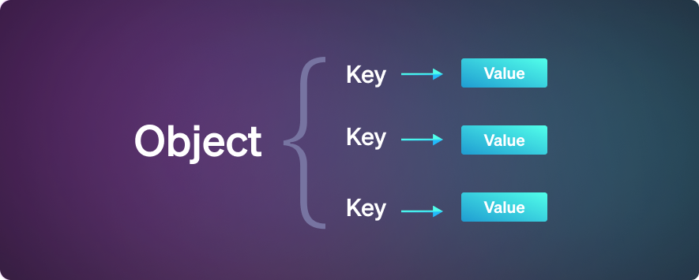
JavaScript
Objects:
In JavaScript, an object is a standalone entity, with properties and type. A variable can be an object in JavaScript. In general, all values except primitive data types are Objects.
The data in objects are stored in key-value pairs. Where each key-value pair is called a property. The key is the name of the property and the value is the value of the property.

Slide 2
JavaScript
Objects Example:
For Example, below mentioned is a person object which consist of property and its value stored in key value pair.
var person = {
firstName: “Naveen",
lastName : “p",
age : 30
};

Slide 3
JavaScript
Objects Creation in JavaScript:
Javascript objects can be created by,
Object Literal
Create method
Constructor
Class
Object Literal:
This is the simplest way to create object by curly braces.
Var obj = {};
Properties can be added to the empty object
Obj.firstname = “testing”;

Slide 4
JavaScript
Objects Creation in JavaScript:
Create Method :
Var obj = {};
Create Method:
Var obj1 = Object.create(obj);
Properties can be added to the newly created object from previous object.
Obj1.firstname = “testing”;

