Slide 1


BDfCP: ARC and TAU
Gabriele Poccianti, 18/02/2025

Slide 2
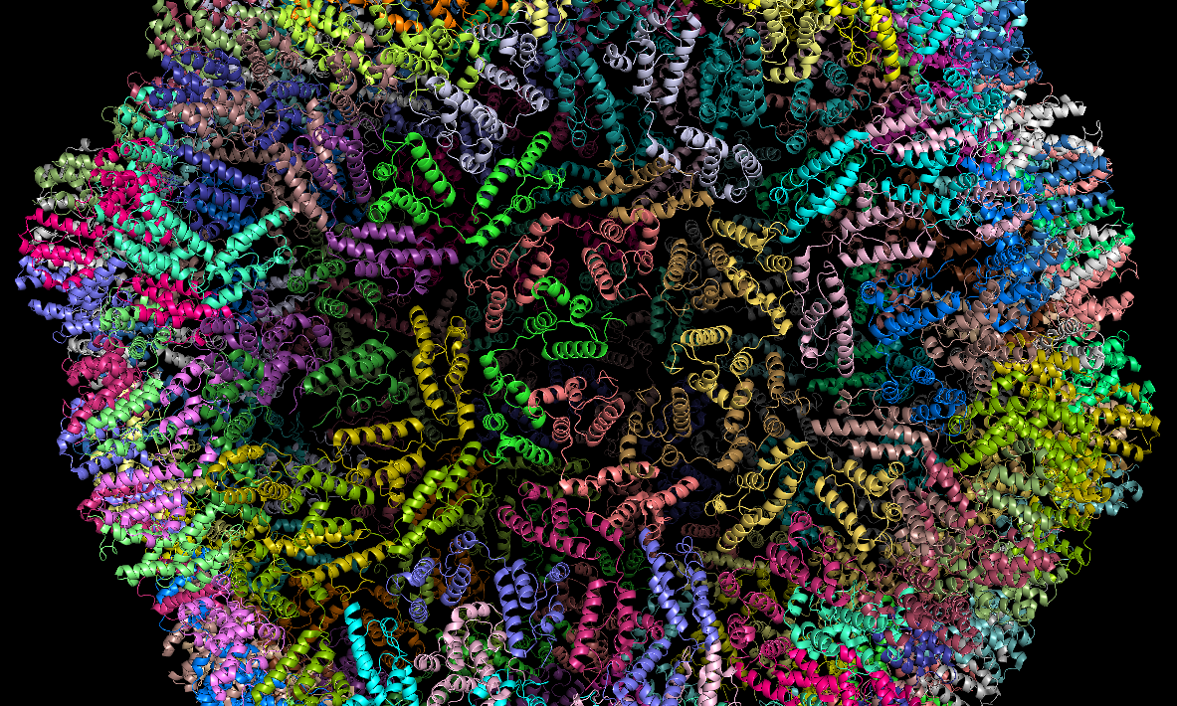
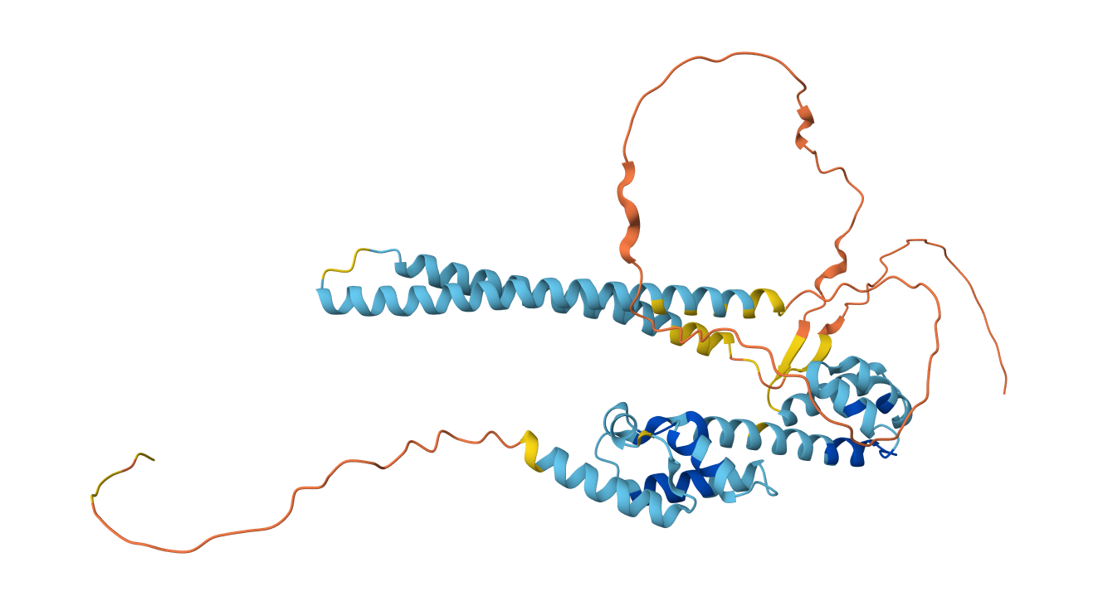
ARC (Q7LC44)
(Activity-regulated cytoskeleton-associated protein)
Mediates synaptic plasticity in mammals
Self-assembles -> Virus-like capsid
Implicated in AD
Notes:
1) Synaptic plasticity -> regulates trafficking of AMPA receptors [linked to memory process: Arc promotes the endocytosis of AMPA receptors, reducing synaptic efficacy and facilitating LTD (long time depression). This process is critical for balancing synaptic strength].
2) Arc self-assembles into virus-like capsids that encapsulate RNA. Form viral structure in Neuron (Arc mRNA inside) -> EV -> endocytosis in new Neurons.
[Influences gene expression in the brain (?)]
->
3) Gag retroelements have been repurposed during evolution to mediate intercellular communication in the nervous system
3) Can be found: Monomeric structure OR Viral Structure (seen in retroviral Gag proteins)
4) Arc has a Capsid Domain -> Similar to RETROVIRUS structure
5) FIGURES: biological assembly of Drosophila dArc1, Arc generated with AlphaFold
6) Regions of ARC:
N-Terminal Domain:
Structure: In mammals, this domain is extended (~200 amino acids) and may interact with RNA or other cellular components.
Function: Involved in binding RNA and potentially other functions related to capsid assembly.
Arc N-Lobe (207-278):
Structure: Forms a four-helical bundle with an additional β-strand at its N-terminus.
Function: Contains a hydrophobic pocket essential for intermolecular binding with synaptic proteins like TARPγ2 (Stargazin) and CaMKII peptides.
Arc C-Lobe (278-370):
Structure: Similar to the HIV capsid protein's C-terminal domain, it includes an extensive α-helix.
Function: Together with the N-lobe, forms the bi-lobar Gag-like domain responsible for self-assembling into capsids.
Capsid Assembly Region:
This region enables Arc to form virion-like structures similar to retroviral Gag proteins, facilitating RNA encapsulation and transport between cells.

Slide 3
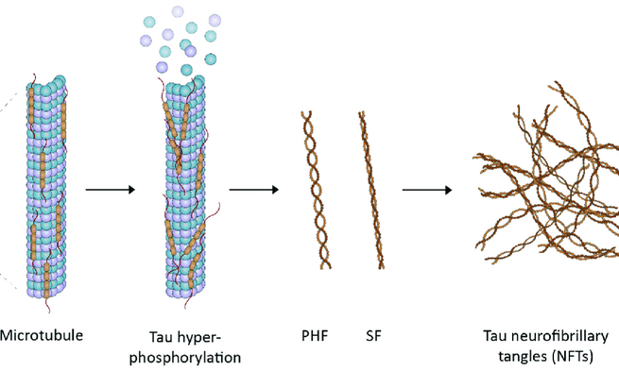
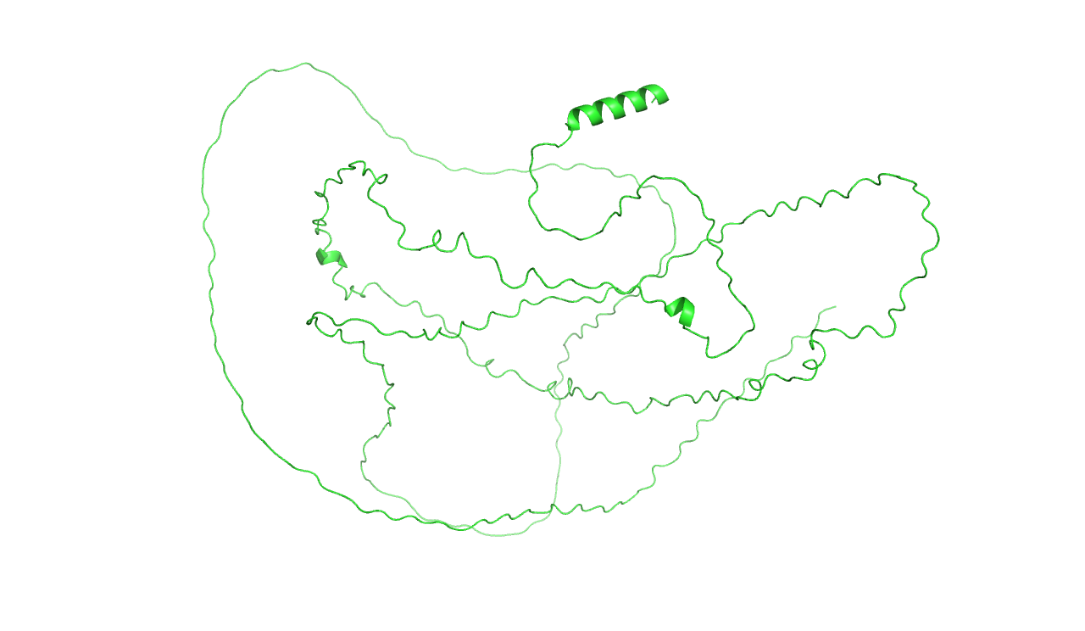
TAU (2N4R, P10636-8)
Isophorm 8:
two N-terminal inserts (N1 and N2)
four microtubule-binding repeats (R1-R4)
Role: microtuble stabilization
Very mobile
Misfolded aggregates -> NFTs
Characterize Taupathies (e.g. AD)
Notes:
1) Mobility -> possibly due to few stable secondary structures (as beta sheets)
2) Tau 2N4R includes an N-terminal projection domain for cytoskeletal interactions, a proline-rich region for signaling interactions, four MTBRs for stabilizing microtubules, and a C-terminal tail contributing to its basic charge profile
NFTs=NEUROFIBRILLARY TANGLES
3) TAU primarily stabilizes microtubules, but several studies indicate
that its misfolded aggregates (known as NEUROFIBRILLARY TANGLES) correlate with neurodegenerative
diseases such as Alzheimer’s disease (AD) and Parkinson’s disease

Slide 4
The problem
ARC-TAU complex has a role in Taupathies
Our question: How does hTau interacts with Arc ?
In particular:
Does Arc maintain a stable monomeric structure ?
Can it still form a Capsid ?
Notes:
Normal for normal Learning Plasticity
Important for spreading mechanism in the disease (of TAU)

Slide 5

Alphafold
In 2020, Demis Hassabis and John Jumper presented an AI model called AlphaFold2
AI system developed by DeepMind
Predicts protein structures
Remarkable accuracy
Tackle Protein Folding Problem
Further improvements with Alphafold3

Slide 6
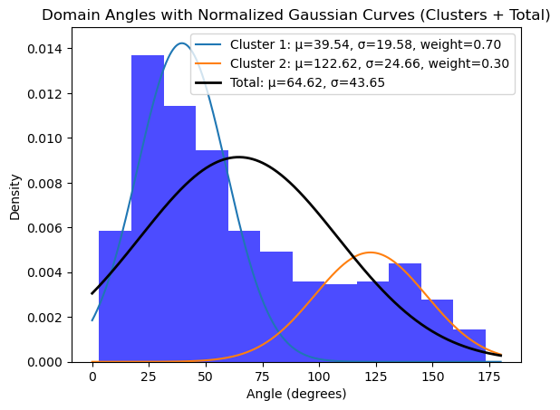
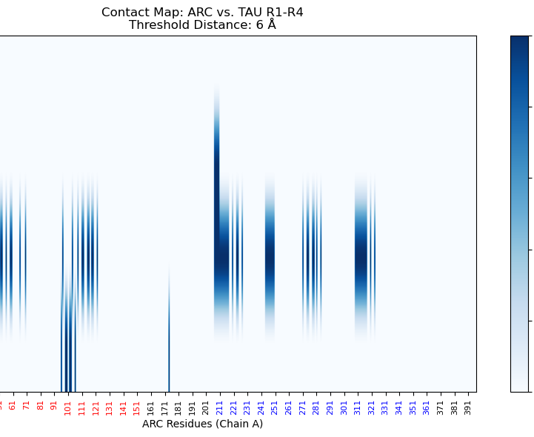
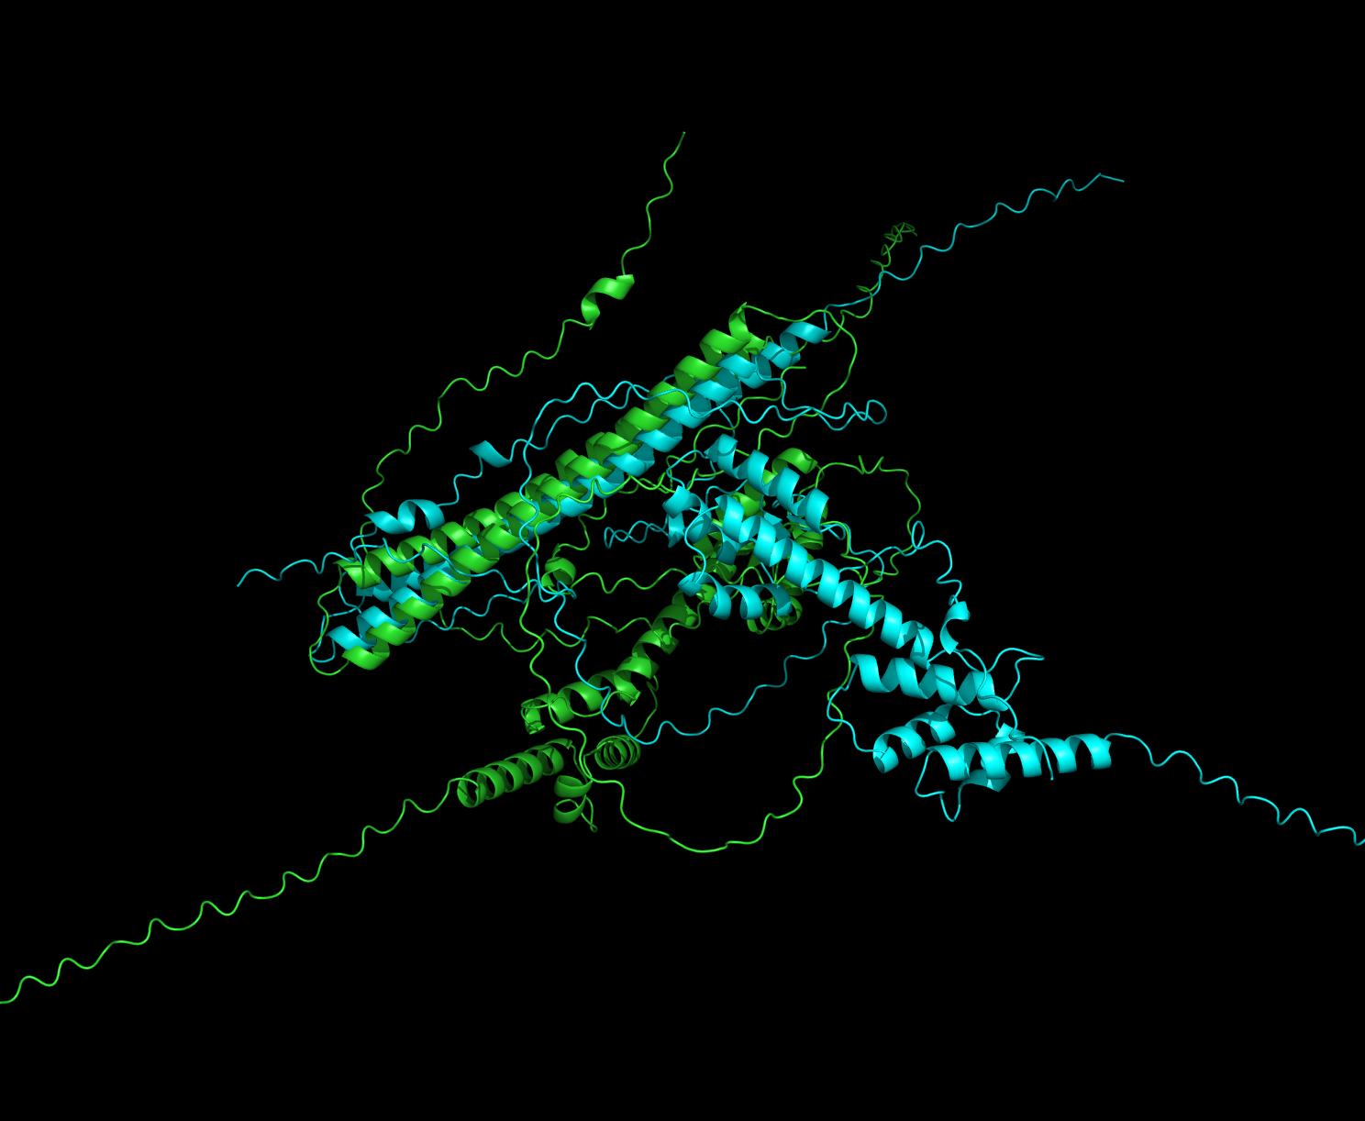
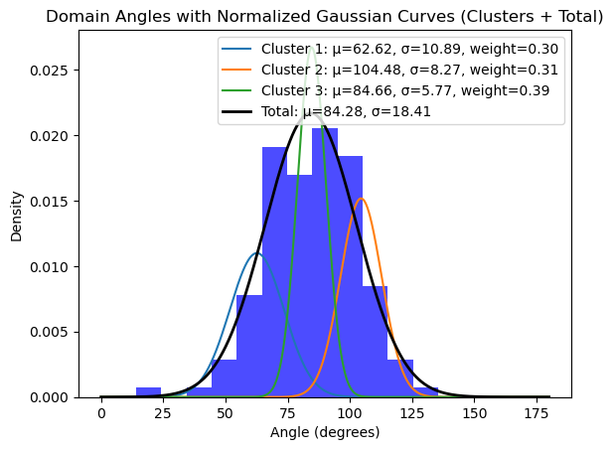
Methods
Preliminary population analysis -> Alphafold
Statistical Analysis
Simulations (OpenMM)
Notes:
Preliminary population analysis -> Generated 106*5 structures with Alphafold -> Angles, contact patterns, compatibility with dArc1 viral domain
compatibility with dArc1 viral domain: sequence alignement (Clusta Omega) + alignement with chains of dArc1 and dArc2 -> best fit: dArc1 (ASYMMETRIC UNIT)
Statistical Methods: two one-sided t-test (TOST) to determine whether the difference between two means was within a predefined equivalence margin θ:
e-way ANOVA to determine whether the fraction of interactions with the N-terminal (Nterminal_fraction) significantly differed across the four TAU domains (R1,R2, R3, R4). If significant, we applied Tukey’s Honestly Significant Difference (HSD) test for pairwise comparisons.

Slide 7
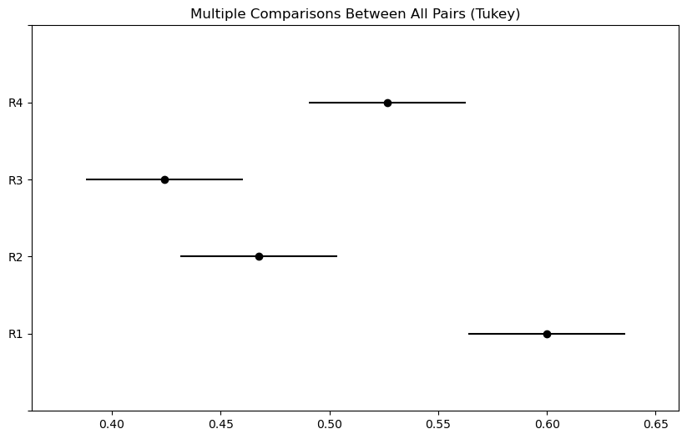
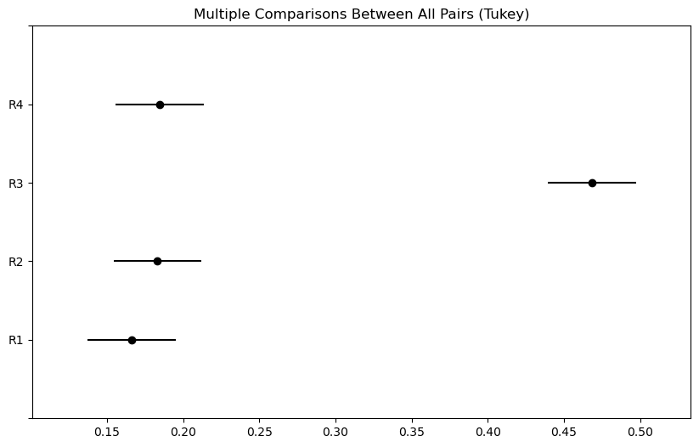
Preliminary Analysis
Angles clustering
Interacting fractions
Comparaison with dArc viral structure
Notes:
Angles between n-terminal and viral domain
Statistical Methods: two one-sided t-test (TOST) to determine whether the difference between two means was within a predefined equivalence margin θ:
e-way ANOVA to determine whether the fraction of interactions with the N-terminal (Nterminal_fraction) significantly differed across the four TAU domains (R1,R2, R3, R4). If significant, we applied Tukey’s Honestly Significant Difference (HSD) test for pairwise comparisons.
Sequence alignement with dArc1 (dArc2) Drosophila usign CLUSTEL OMEGA. -> RMSD with each chain of the asymmetric unit -> Choose the best fit
In this way we see: dArc1 fits best.

Slide 8
Simulations
Kept only R1-4 for TAU (residues 244-369)
Generated Complex ARC+TAU with Alphafold
Solvated (Octahedron simulation box), optimized placing
Neutralize (Packmol)
(N,P,T), 1 bar, 2 fm
Arc N terminal/ Viral domain -> rigid bodies
Notes:
LangevinMiddleIntegrator, T=300K
simulations were conducted locally on a Windows 11 machine with an NVIDIA
4060 Ti GPU (16 GB RAM
Forcefield: AMBERFF14, AMBERFF14/TIP3

Slide 9
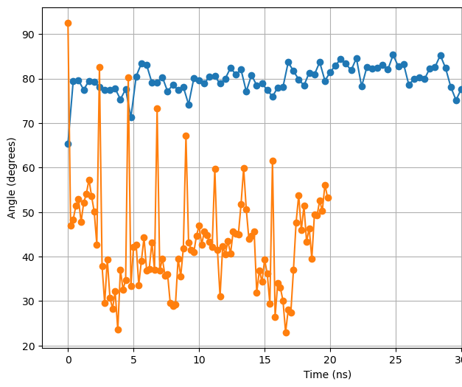
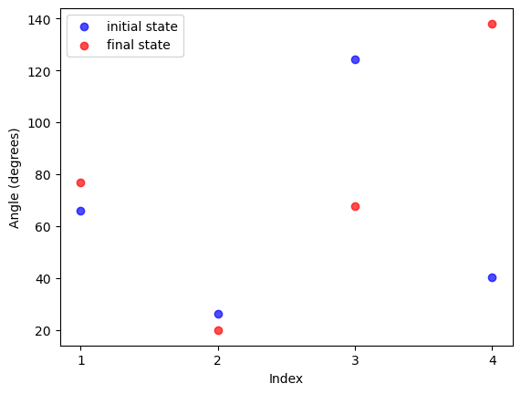
Results
Arc and Tau form a fuzzy complex (Angles N-terminal/ Viral domain)
Structures belonging to the same initial clusters do not have the same dynamical behavior
Some structure seem to open and close
Notes:
Fuzzy complex: we observe that both Arc and Tau change structure: RMSD wrt initial structure (grows + have spikes -> particular conformation during the dynamcis), RMSD wrt dArc1 gro
Angles: no clear final pattern emerges !
In sim2 the structure closes periodically.

Slide 10
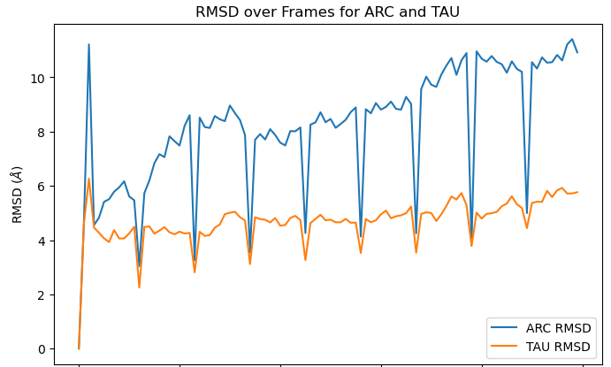
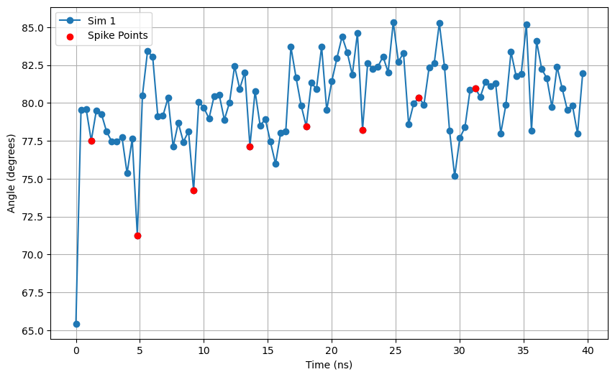

Slide 11
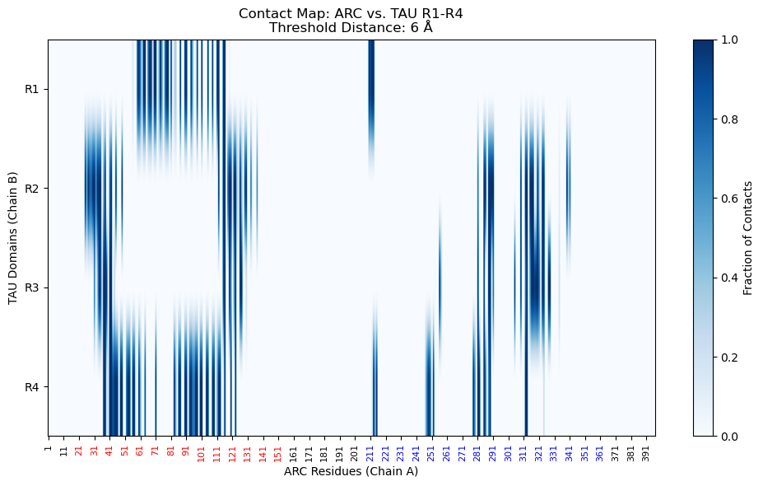
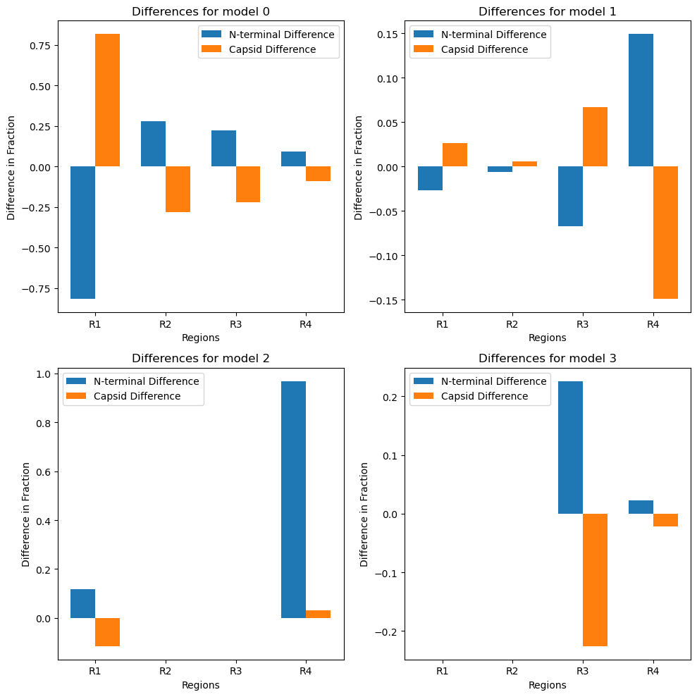
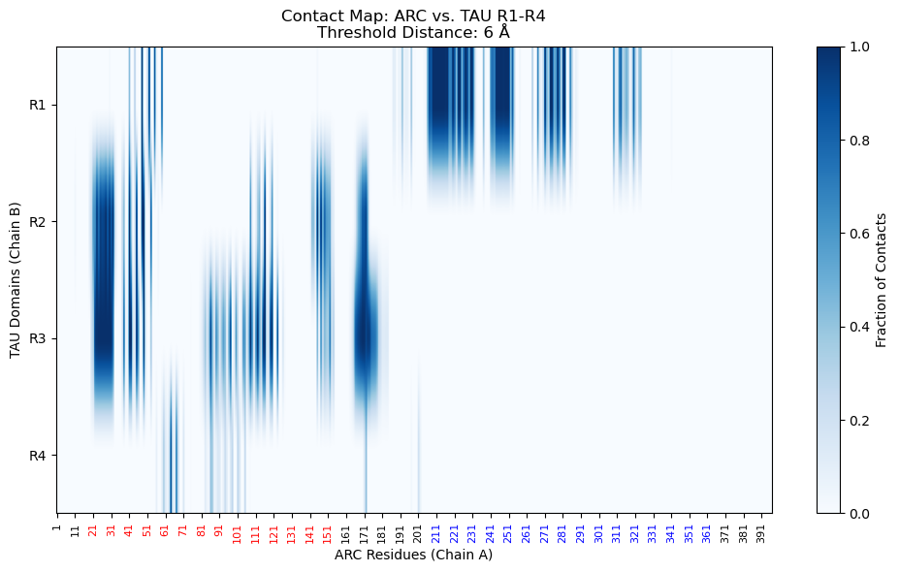
Results
Arc and Tau form a fuzzy complex (Contact patterns)
Notes:
Difference mostly in one R (1-4): probably interactions localized [it’s possible that domains don’t interact all with the same importance]
2) we observe that the interaction of
Tau with the N-terminal appear to be more stable than those with the Gag domain (even after the dynamics)
3) Sim1:
{'R1': {'N-terminal_fraction': 0.8864313222289497, 'Capsid_fraction': 0.11356867777105024}, 'R2': {'N-terminal_fraction': 0.8685293479137524, 'Capsid_fraction': 0.13147065208624759}, 'R3': {'N-terminal_fraction': 0.38920887752878836, 'Capsid_fraction': 0.6107911224712115}, 'R4': {'N-terminal_fraction': 0.7903938292176852, 'Capsid_fraction': 0.2096061707823148}}
Sim3:
{'R1': {'N-terminal_fraction': 0.1646176739465786, 'Capsid_fraction': 0.835382326053421}, 'R2': {'N-terminal_fraction': 0.999695684355623, 'Capsid_fraction': 0.0003043156443770748}, 'R3': {'N-terminal_fraction': 1.0, 'Capsid_fraction': 0.0}, 'R4': {'N-terminal_fraction': 0.9816869758405476, 'Capsid_fraction': 0.008313024159452238}}

Slide 12
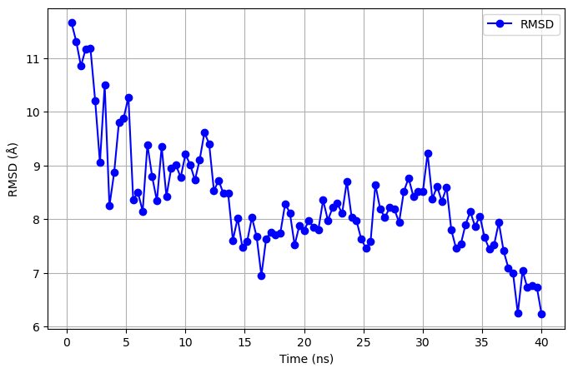
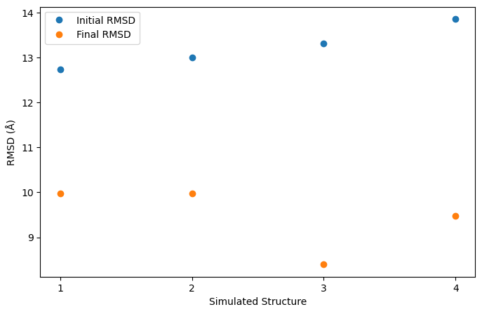
Results
2) Viral capsid
It seems that TAU stabilizes the capsid structure formation
Notes:
1) RMSD with dARC1 after dynamics decreases -> better fit with our known Capsid structure (Biological Assembly) –>

Slide 13
Conclusions
Fuzzy complex: no stable monomeric structure
Might affect synaptic plasticity
2. Viral domain more stable
Trasmission fo hTau in EV

Slide 14
Future directions
Beta structure
Longer/ more simulations
Relax constaints
Notes:
1) Unstable tructure -> Extracellular release in Arc capsid ?

