Slide 1
CWRU Data Analytics Boot Camp Spring 2020 Final Project Using Natural Language Processing to Analyze Tweet Topics. (Disaster or Not?) Website: https://gpolavaram0.github.io/cwrubootcampfinalproject/
Goutham Polavaram, Ibrahim Oumar, Ryan Klueg, Ali Rizvi

Slide 2
Background & Objective
Use Natural Language Processing models to create a machine learning algorithm to determine whether or not a tweet is discussing a disaster.
Decided to partake in the Real or Not? NLP with Disaster Tweets Kaggle competition aimed at producing an accurate model for tweet analysis.
Major Objective: Accurate classification of tweets as either a disaster tweet or not.

Slide 3
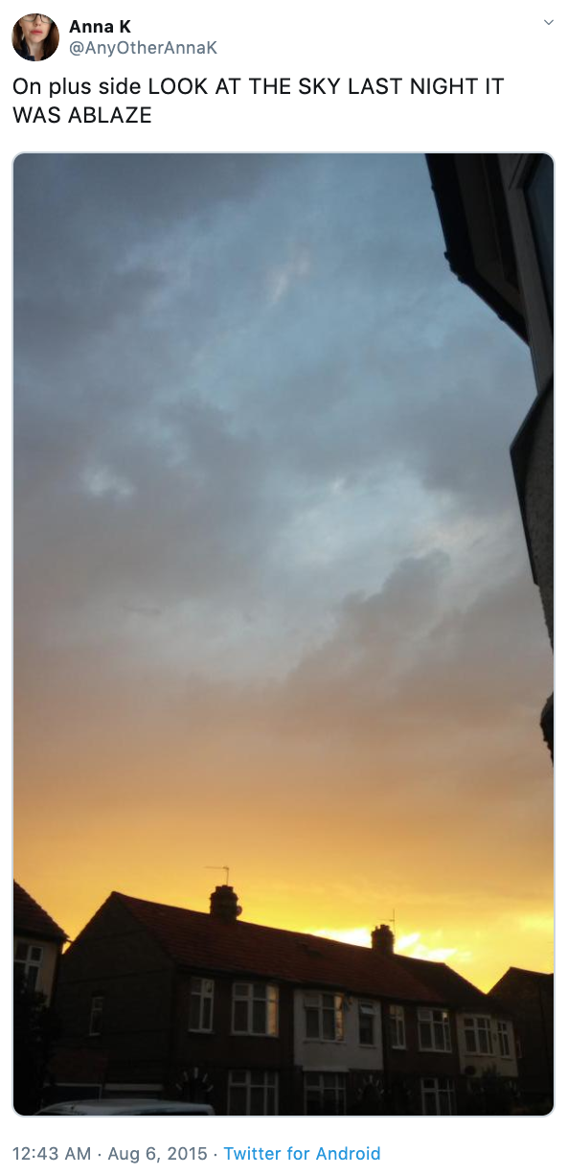

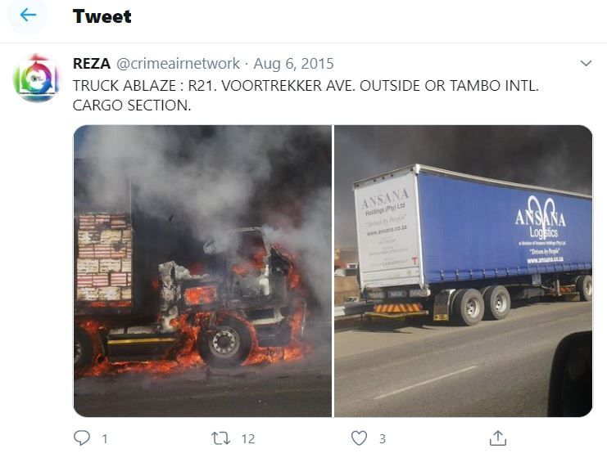

Data Sources
Twitter through Kaggle
Disasters encompasses non-natural occurrences as well

Slide 4
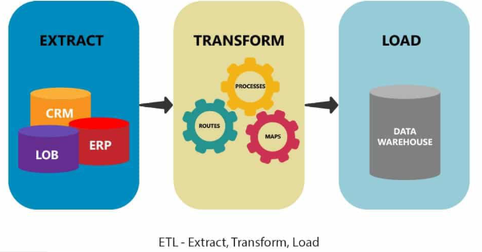


Methodology
ETL Process on the Data Source
Cleaned using Regex in Python
Stored in AWS bucket
Load into Google Colab for model creation and testing
Pyspark for creation of classification models and model testing
Naïve Bayes
Random Forest
Logistic Regression
SVC
MNB
SGDC

Slide 5
Model Success
Naïve Bayes was our most successful model with a 80.11% accuracy
SVC (Support Vector Classifier) 72.63%
Logistic Regression 71.94%
SGDC (Stochastic Gradient Descent Classifier) 71.77%

Slide 6
Naïve Bayes
A multinomial Naïve Bayes model was used
This model used vectors that represent the frequencies in which certain words appear in the document
We used Lidstone smoothing (with a value of 1.1 for the pseudocount) to ensure no probability estimates were zero
Probability estimates of zero break the model by turning all probabilities where the respective class and vector appear to be zero

Slide 7
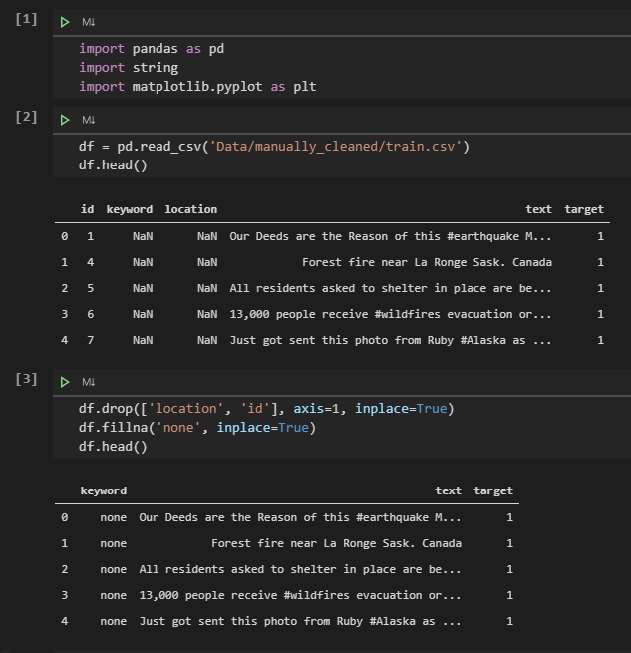
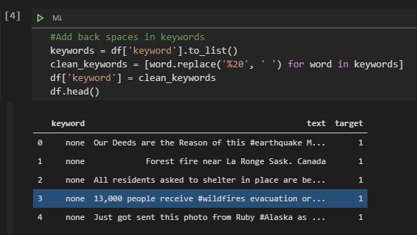
Model Walkthrough: Data Cleaning (Imports)

Slide 8
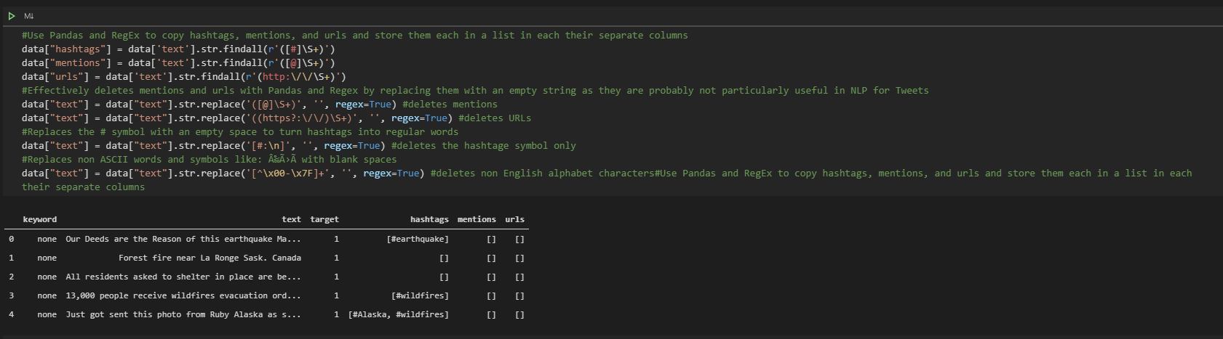
Model Walkthrough: Data Cleaning (Regex)

Slide 9
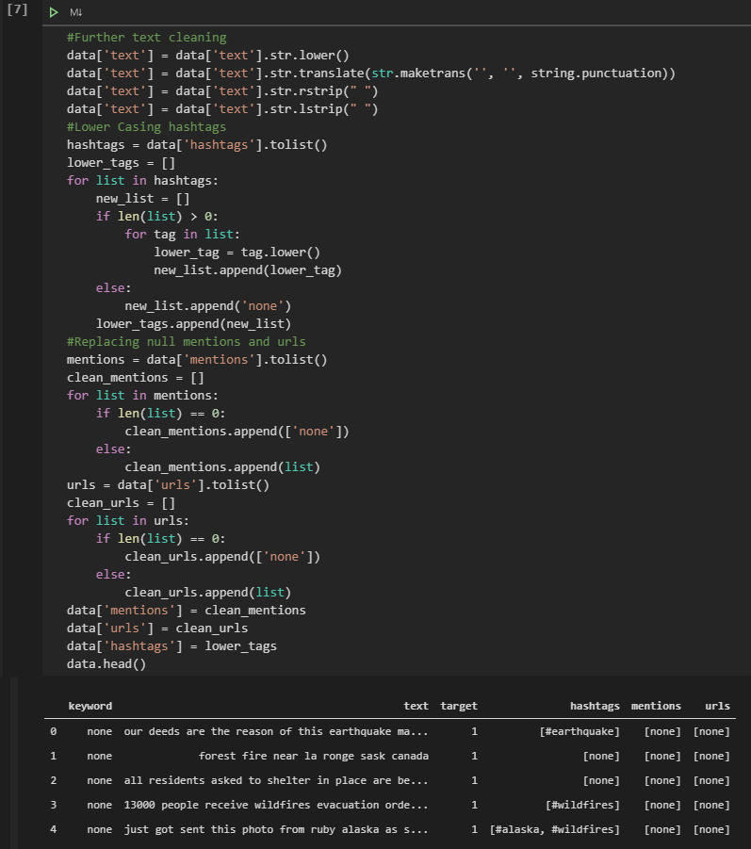
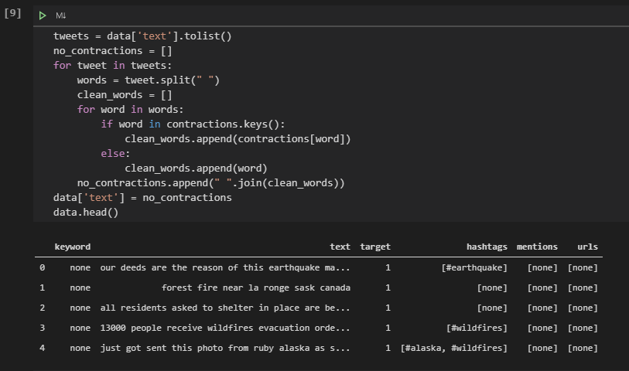
Model Walkthrough: Data Cleaning (Non Regex)

Slide 10
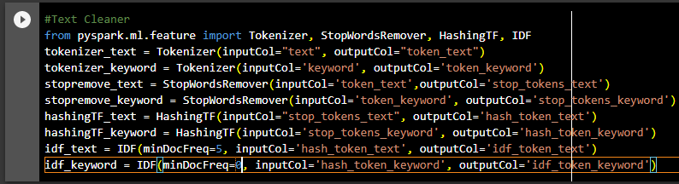
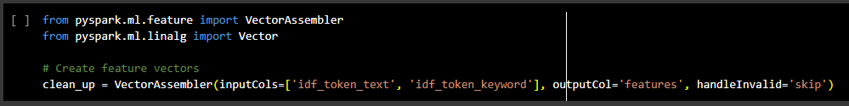
Model Walkthrough: Pipeline

Slide 11
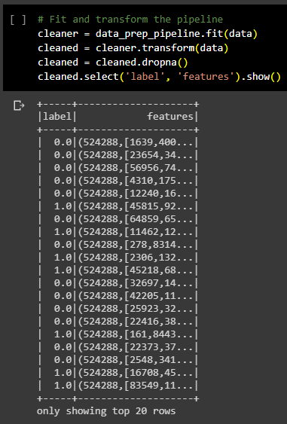
Model Walkthrough: Fitting the Model

Slide 12
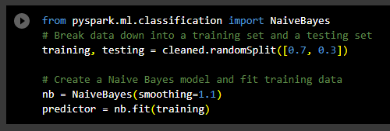
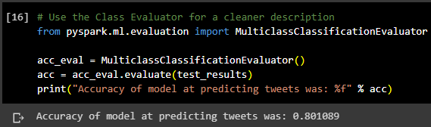
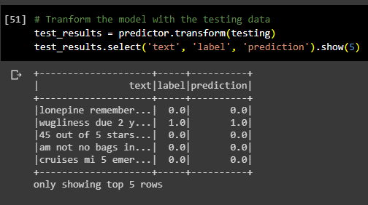
Model Walkthrough: Model Testing

Slide 13
Future Steps
Adding a user experience to the website
Allow tweet input for the algorithm to classify as disaster or not.
Tweaking the model to further improve accuracy
Further data cleaning
Testing of other statistical models

Slide 14
Questions?

