Slide 1
AI FOR BHARAT
BHARATSEVA AI
AI-Powered Multilingual Government Scheme Assistant
“The Right Scheme. The Right Information. Every Citizen.”
Team: [Team Name] · [Members] · [College] · [Hackathon]
Notes:
BHARATSEVA AI is an AI-powered multilingual government scheme assistant. The goal is simple: help every citizen find the right scheme, the right information, and a clearer path forward.

Slide 2





THE ACCESS GAP
Government benefits exist. Accessing them is the challenge.
Fragmented information
Language barriers
Regional-language support is limited.
Across multiple portals.
Complex criteria
Unclear next steps
Official language makes eligibility hard to understand.
Documents and application paths are unclear.
Notes:
The challenge is not the absence of benefits. It is the distance between a citizen and the information needed to use them: fragmented portals, language barriers, complex eligibility criteria, and unclear documents or application paths.

Slide 3
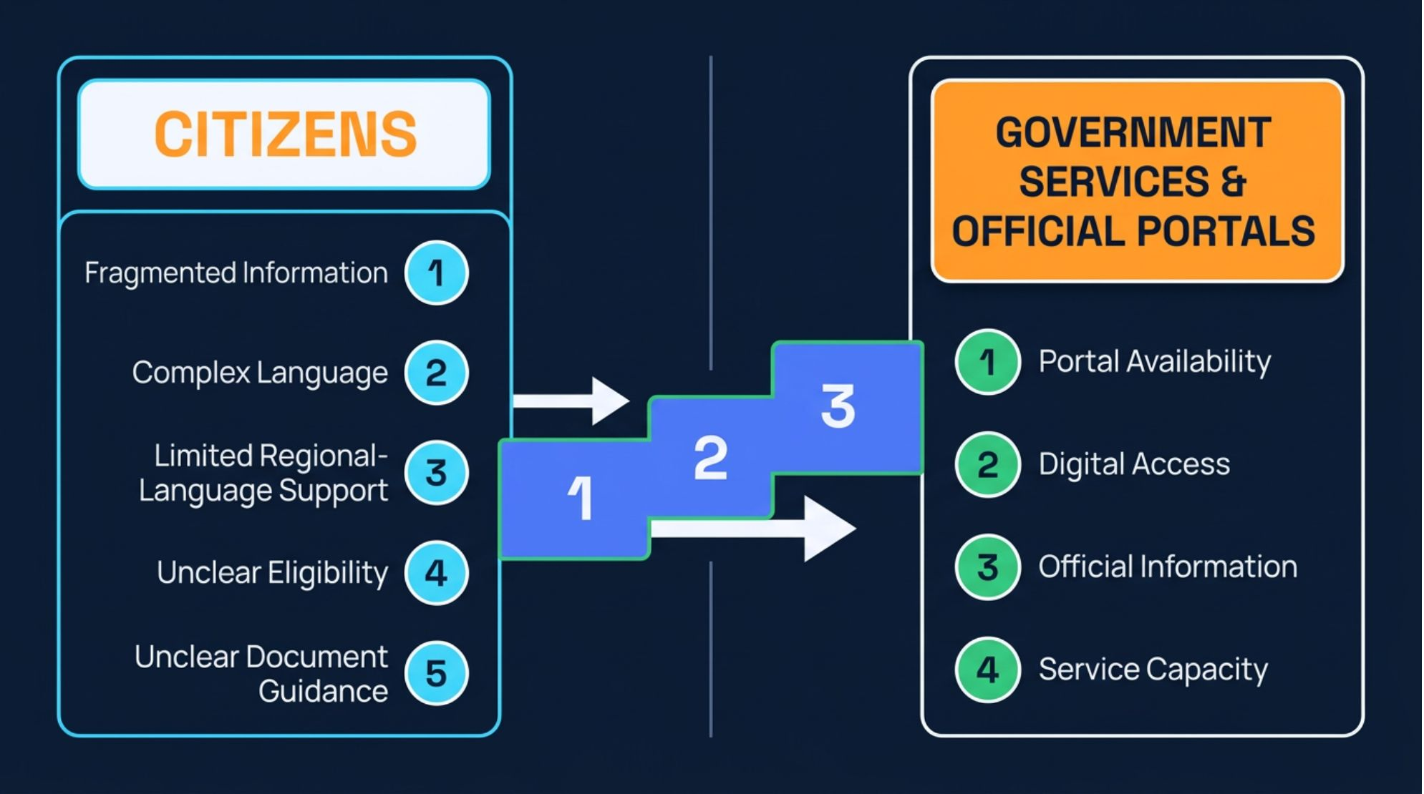
THE GAP
Bridging the gap between citizens and government services
Many citizens face barriers caused by fragmented information, complex language, limited regional-language support, and unclear eligibility and document guidance.
Impact: rural and underserved communities may struggle to identify relevant schemes, understand procedures, and find the correct official portals.
Notes:
The gap is informational and practical. Citizens may know that support exists, but still struggle to identify the right scheme, understand the procedure, and reach the correct official portal.

Slide 4





THE ASSISTANT
One intelligent assistant. Simpler access for every citizen.
Answer questions in regional languages
Explain eligibility criteria in simple terms
Recommend potentially relevant schemes from user-provided details
Generate document checklists
Guide users to verified official application portals
Informational guidance only; no guarantee of eligibility and no claim of government authority.
Notes:
The assistant turns a complex search into a guided conversation. It can answer in regional languages, explain criteria simply, use citizen-provided details to suggest potentially relevant schemes, prepare document checklists, and point to verified official portals. It remains informational guidance only.

Slide 5
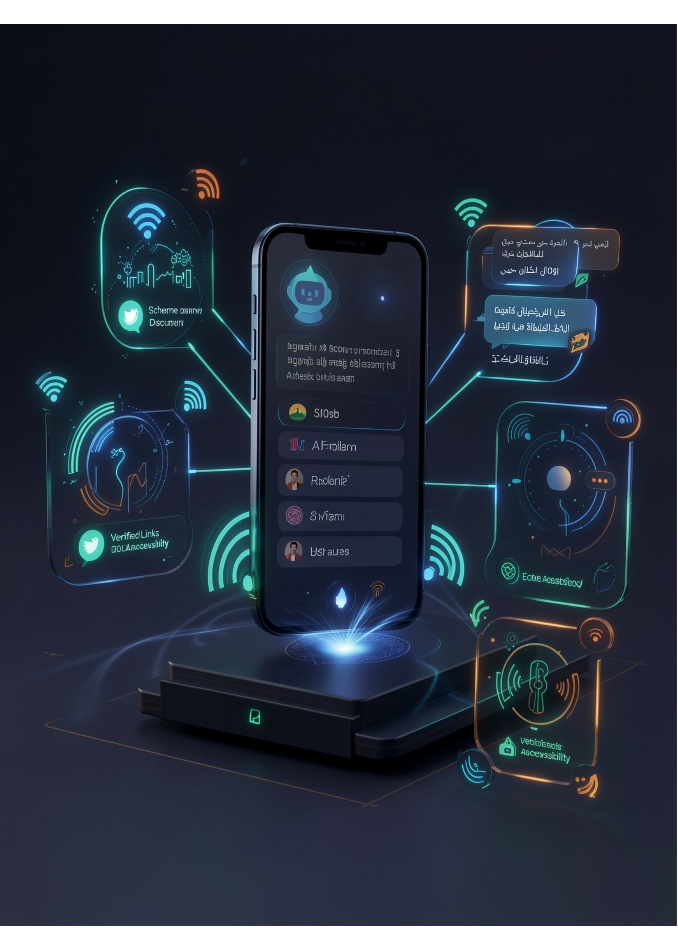





CITIZEN-CENTERED DESIGN
Intelligence designed around citizens
Multilingual AI chatbot
Smart scheme discovery
Eligibility explainer
Document checklist
Verified official links
Accessible, mobile-friendly interface
Notes:
The product is designed around the citizen’s experience, not around a portal’s structure. Six capabilities work together: multilingual conversation, discovery, eligibility explanation, document preparation, verified links, and a mobile-friendly interface.

Slide 6






THE JOURNEY
From citizen query to clear guidance
Citizen enters
AI identifies
System searches
A question or basic details
The query and supported language
A curated scheme knowledge base
Schemes matched
AI explains
Citizen receives
Potentially relevant schemes against published criteria
The scheme, eligibility, and required documents
Verified official source links and application guidance
Notes:
The flow begins with a citizen’s question or basic details. The system identifies the query and language, searches a curated knowledge base, matches against published criteria, explains the result, and returns verified official links with application guidance.

Slide 7
PROPOSED ARCHITECTURE
Built with practical, scalable AI technology
Proposed stack
Architecture
Frontend: React.js, HTML, CSS, JavaScript
Backend: Python with FastAPI or Flask
AI and language processing: LLM API, multilingual NLP, translation where needed
Data layer: PostgreSQL, MySQL, or Firebase
Knowledge sources: curated government scheme data, verified official websites, eligibility rules, source URLs
Optional: speech-to-text, text-to-speech, voice interaction, accessibility support
Citizen Interface →
Backend API →
Language Processing →
Scheme Knowledge Retrieval →
Eligibility Matching →
Grounded AI Response →
Official Source Links
These are proposed implementation choices, not claimed completed integrations.
Notes:
The proposed stack is practical and scalable: React.js, HTML, CSS, and JavaScript at the frontend; Python with FastAPI or Flask at the backend; an LLM API, multilingual NLP, and translation where needed; and PostgreSQL, MySQL, or Firebase for the data layer. The flow stays grounded in curated sources and official URLs.

Slide 8
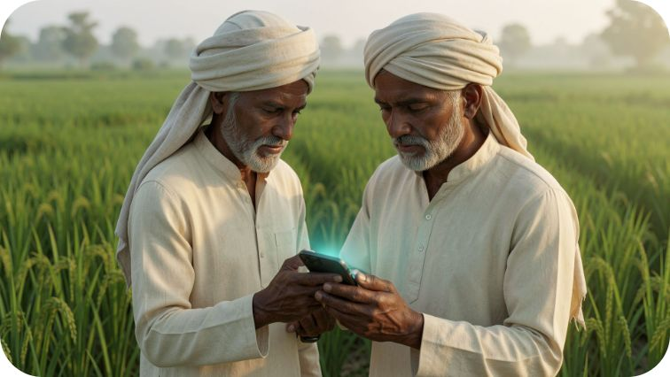



PILOT USE CASES
AI that can make a real difference
Farmers
Students
Senior citizens
Rural families
Potentially relevant agricultural assistance schemes
Scholarship opportunities
Pension information
Relevant welfare schemes
Pilot evaluation: information accuracy, official-link validity, time to locate relevant information, understanding across supported languages, and ease of use for people with limited digital literacy.
Notes:
The value becomes tangible in everyday situations: farmers discovering potentially relevant agricultural assistance, students exploring scholarships, senior citizens finding pension information, and rural families understanding welfare schemes. A pilot should evaluate accuracy, links, time, language understanding, and ease of use without implying proven outcomes.

Slide 9
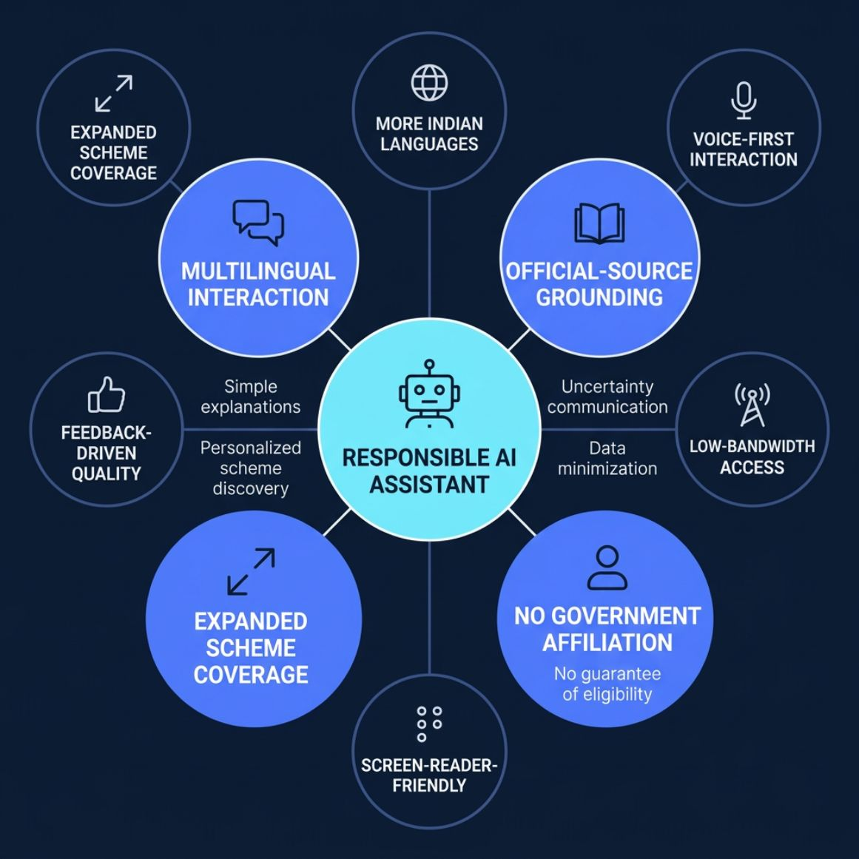

TRUST BY DESIGN
Accessible AI. Responsible guidance. Inclusive governance.
Multilingual interaction plus personalized scheme discovery
Simple explanations of complex government information
Responses grounded in official sources
Clear communication of uncertainty and missing information
Data minimization and no claim of government affiliation
No guarantee of eligibility
Future scope: more Indian languages, voice-first interaction, low-bandwidth access, screen-reader-friendly design, expanded scheme coverage, feedback-driven quality improvements.
Notes:
Trust is part of the product. Responses should be grounded in official sources, communicate uncertainty, minimize data, and clearly state that BharatSeva AI has no government affiliation and cannot guarantee eligibility. Future scope includes more Indian languages, voice, low-bandwidth access, screen readers, broader coverage, and feedback-driven improvement.

Slide 10
Making public services easier for every Indian
“One Platform. Multiple Languages. Easier Access to Government Schemes.”
BharatSeva AI aims to bridge the information gap between citizens and public services through accessible, multilingual, AI-powered guidance.
Thank you · [Team Name] · [Contact Details]
Notes:
BharatSeva AI aims to make public services easier for every Indian by bridging the information gap with accessible, multilingual, AI-powered guidance. Thank you.

