Slide 1

G2M Insight for Cab Investment Firm
Submitted by Gordon Poon
17/07/2023

Slide 2
AGENDA
Executive Summary
Problem Statement
Approach
Datasets
EDA
EDA Summary
Hypothesis testing
Recommendations

Slide 3
PROBLEM STATEMENT

Slide 4
PROBLEM STATEMENT
Problem
XYZ is a private firm in US. Due to remarkable growth in the Cab Industry in last few years and multiple key players in the market, it is planning for an investment in Cab industry and as per their Go-to-Market(G2M) strategy they want to understand the market before taking final decision.
Objective:
Provide recommendations and valuable insights from their provided datasets that would help XYZ identify the appropriate firm for investment

Slide 5
APPROACH

Slide 6
APPROACH
Understand and visualize Datasets
EDA
Hypothesis testing
Recommendations

Slide 7
UNDERSTANDING AND VISUALIZING DATA

Slide 8
DATASETS
Cab_Data.csv
  Provides information of transaction of both cab companies (Yellow and Pink)
City.csv
  Provides information of users and populations in each US city for both companies
Transaction_ID.csv
  Provides information of transactions including unique identifier code and payment mode
Customer_ID.csv
  Provides information regarding user, specially the demographic

Slide 9
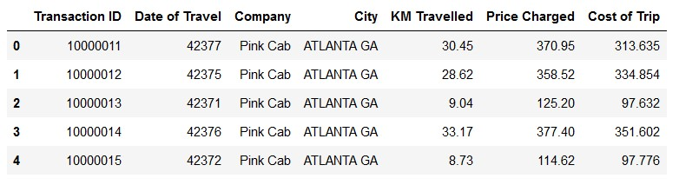
EXAMPLE: CAB_DATA.CSV

Slide 10
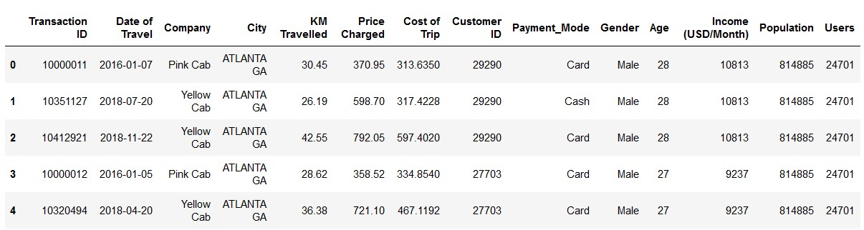
MERGED DATASET

Slide 11
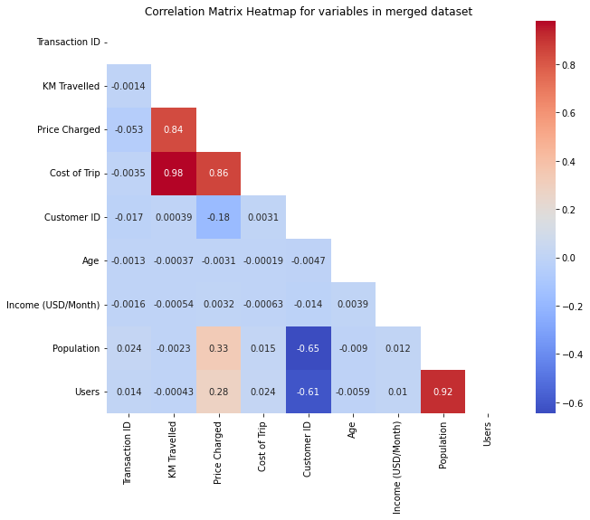
CORRELATION BETWEEN VARIABLES
Strong correlation between:
- Price Charged, KM Travelled and Cost of Trip
- Users and Populations

Slide 12
EDA

Slide 13
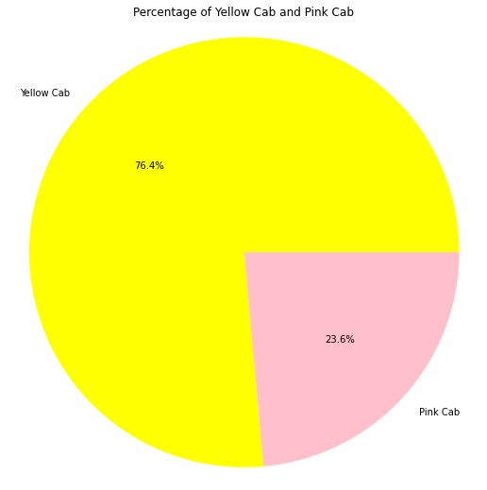
PERCENTAGE OF USERS –COMPANY
- Most Cab users are Yellow Cab users (76.4%) with the rest (23.6%0 being Pink Cab users

Slide 14
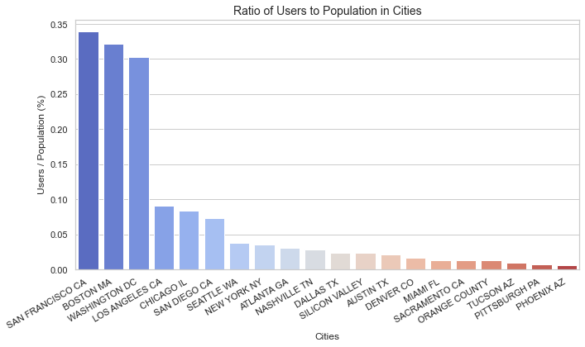
RATIO OF USERS TO POPULATION
- San Francisco, Boston and Washington DC all have the highest user percentage by a significant margin with all of them having a user percentage of 30%
- The next highest group with a user percentage between 5-10% being: Los Angeles, Chicago and San Diego
- The rest of the other cities all have a user percentage below 4%, showing the untapped potential of these markets.

Slide 15
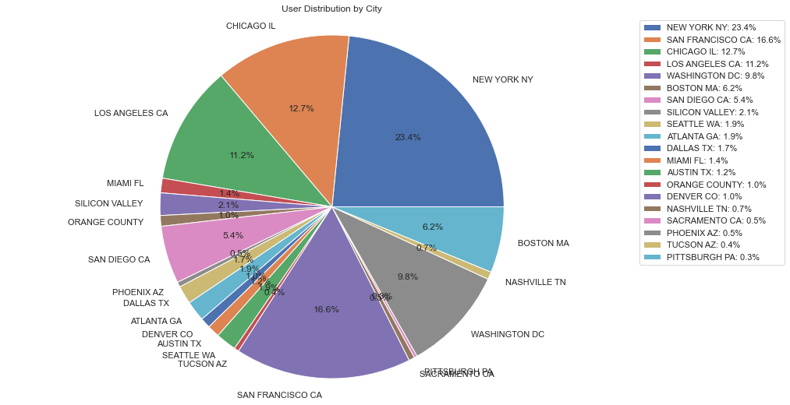
USER DISTRIBUTION BY CITY
Cities with the highest users as of now:
- New York (23.4%)
- San Francisco (16.6%)
- Chicago (12.7%)

Slide 16
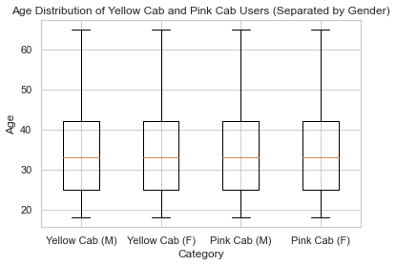
AGE DISTRIBUTION OF YELLOW AND PINK CAB USERS
- All demographics appear to have an identical distribution
- Average age appear to be 35 years old

Slide 17
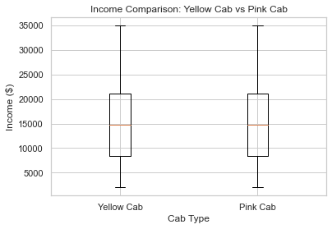
AGE DISTRIBUTION OF YELLOW AND PINK CAB USERS
- Both companies’ users have a similar income distribution
- Average income of $15000

Slide 18
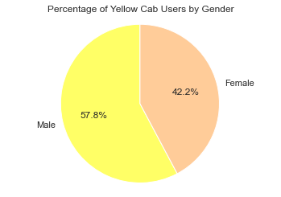
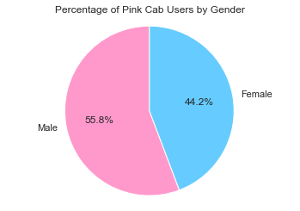
PERCENTAGE OF USERS - GENDER
Both companies have similar gender make-ups with male users being 55-57% of total user population

Slide 19
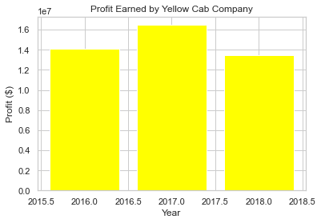
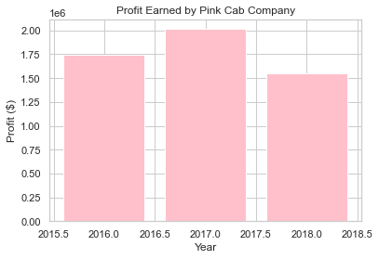
COMPANY - YEARLY PROFIT EARNED
The Yellow Cab company appears make about 8x the profit the Pink Cab company makes yearly

Slide 20
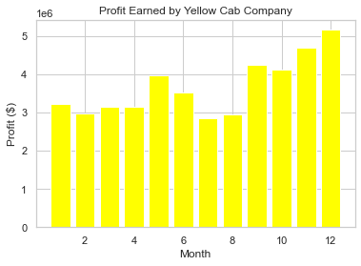
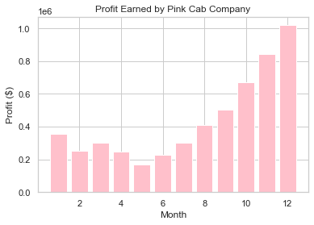
COMPANY - MONTHLY PROFIT EARNED
  A similar trend follows as the mean of the yellow cab monthly profit is 8.1x that of pink cab monthly profit, however pink cab monthly profit varies more significantly than yellow cab

Slide 21
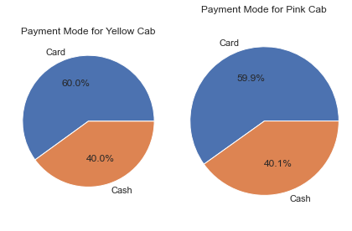
COMPANY – PAYMENT MODE
- Both companies appear to have an identical make up of users from each payment mode
- Cash users make up 40-40.1% for both companies

Slide 22
EDA SUMMARY

Slide 23
EDA SUMMARY
Findings
  There are significantly more Yellow Cab users (76%) than Pink Cab Users (24%)
  San Francisco, Chicago and NYC are cities with the most users (53% in total)
  Age , income and gender distribution of user are identical for both Yellow Cab and Pink Cab users
  Yellow Cab makes 8x more profit, but Pink Cab has a higher growth rate

Slide 24
HYPOTHESIS TESTING

Slide 25
HYPOTHESIS 1 - IS THERE A SIGNIFICANCE DIFFERENCE IN PROFIT BASED ON GENDER?
H0: There is no significant difference in profit based on gender
H1: There is a significant difference in profit based on gender

Slide 26
Conclusion: No difference regarding gender between both companies

Slide 27
HYPOTHESIS 2: IS THERE A SIGNIFICANCE DIFFERENCE IN PROFIT BASED ON INCOME?
H0: There is no significant difference in profit based on income
H1: There is a significant difference in profit based on income

Slide 28
Conclusion: There is a significant difference in income between both companies

Slide 29
HYPOTHESIS 3: IS THERE A SIGNIFICANCE DIFFERENCE IN PROFIT BASED ON AGE?
H0: There is no significant difference in profit based on age
H1: There is a significant difference in profit based on age

Slide 30
Conclusion: There is significance difference in profit based on age for both companies

Slide 31
HYPOTHESIS 4: IS THERE A SIGNIFICANCE DIFFERENCE IN PROFIT BASED ON PAYMENT METHOD?
H0: There is no significant difference in profit based on payment method
H1: There is a significant difference in profit based on payment method

Slide 32
Conclusion: No significant difference in payment mode between companies

Slide 33
HYPOTHESIS 5: IS THERE A SIGNIFICANCE DIFFERENCE IN PROFIT BETWEEN THE YELLOW AND PINK CAB COMPANIES?
H0: There is no significant difference in profit between the Yellow and Pink Cab companies?
H1: There is a significant difference in profit between the Yellow and Pink Cab companies?

Slide 34
Conclusion: There is a significant difference in profit between both companies

Slide 35
RECOMMENDATIONS

Slide 36
RECOMMENDATIONS
Yellow Cab makes more profit per year
Yellow Cab has a higher profit margin
Yellow Cab has a larger market share
Yellow Cab has more relatively stable sales per month
Therefore, Yellow Cab Company is better suited for investment.

