Slide 1
Washington D.C Bike Rental Analysis
Group No. 3
Asna, German, Hina, Savanha, Mark

Slide 2
Washington D.C Bike Rental Analysis Motivation
Purpose
Identify COVID-19 impact on the bike rentals in Washington DC in 2020
Questions
1. (a) What is the ‘Overall Ridership” in Q2 (April, May, and June) of 2020 compare to Q2 of 2019.
1. (b) Did the impact of the ”Quarantine Lockdown” in April and may of 2020 reduce the number of rides and by how much?
(insert data frame screen shot here)
2. Has the bike rental ‘User Type’ been impacted between Casual riders and Members?
*User Type/Member Type – Indicates whether user was a "registered" member (Annual Member, 30-Day Member or Day Key Member)
or a ”Casual" rider (Single Trip, 24-Hour Pass, 3-Day Pass or 5-Day Pass)
3. (a) What ‘Time of Day’ are most bike trips taken?
3. (b) What ‘Time of Day’ are most bike trips taken for Members?
3. (c) What ‘Time of Day’ are most bike trips taken for Casual riders?
4. (a) Which ‘Day(s) of the Week’ are most bike trips taken?
4. (b) Which ‘Day(s) of the Week’ are most bike trips taken for Members?
4. (c) Which “Day(s) of the Week’ are most bike trips taken for Casual riders?
5. Which day of the week has the longest duration of bike rental (in 2019 and 2020)?

Slide 3

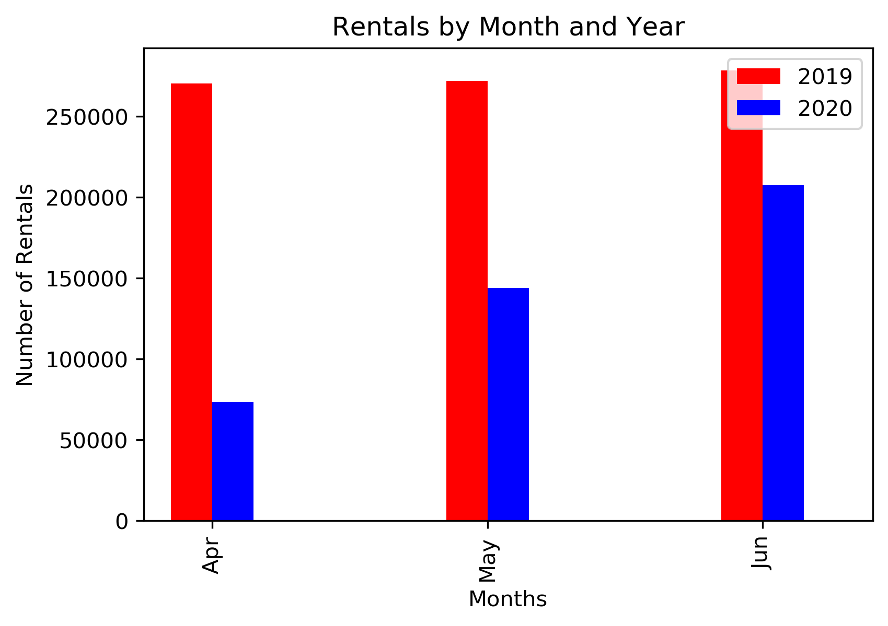
1. (a) What is the ‘Overall Ridership” in Q2 (April, May, and June) of 2020 compare to Q2 of 2019. - We found that the ”Overall Ridership” in 2020 was significantly reduced compared to 2019, and that the impact of the lockdown did effect bike rentals. 1. (b) Did the impact of the ”Quarantine Lockdown” in April and may of 2020 reduce the number of rides and by how much?

Slide 4
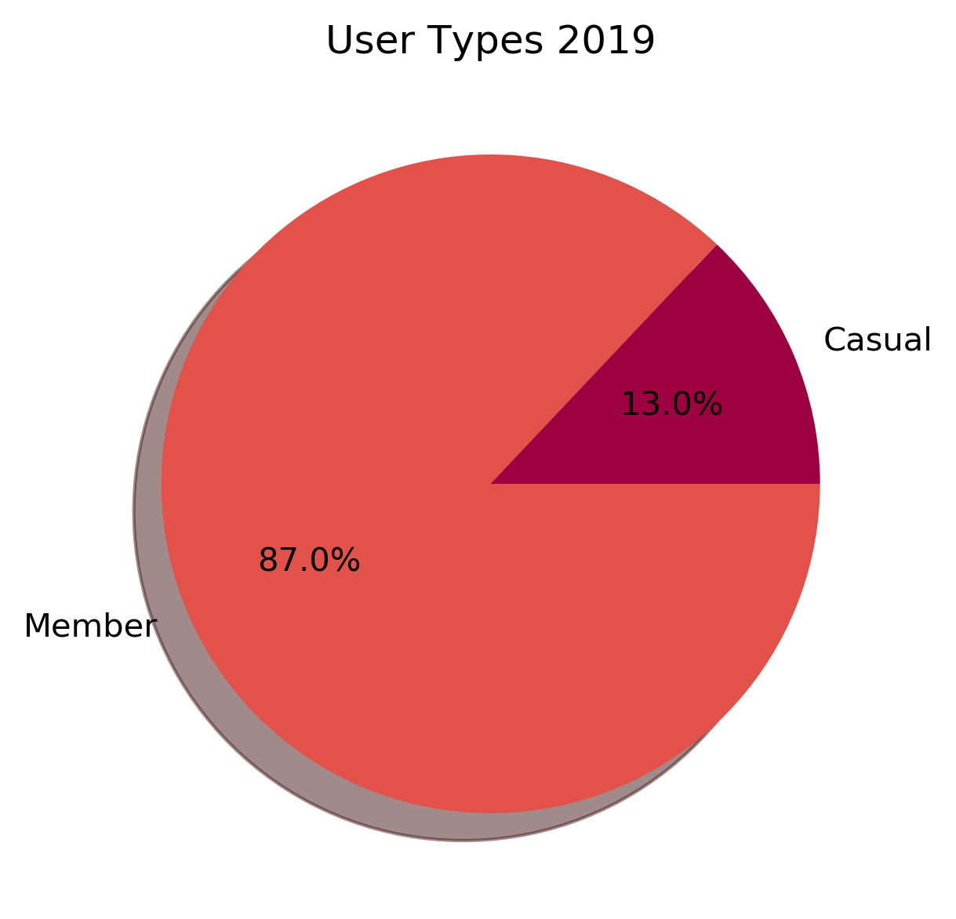
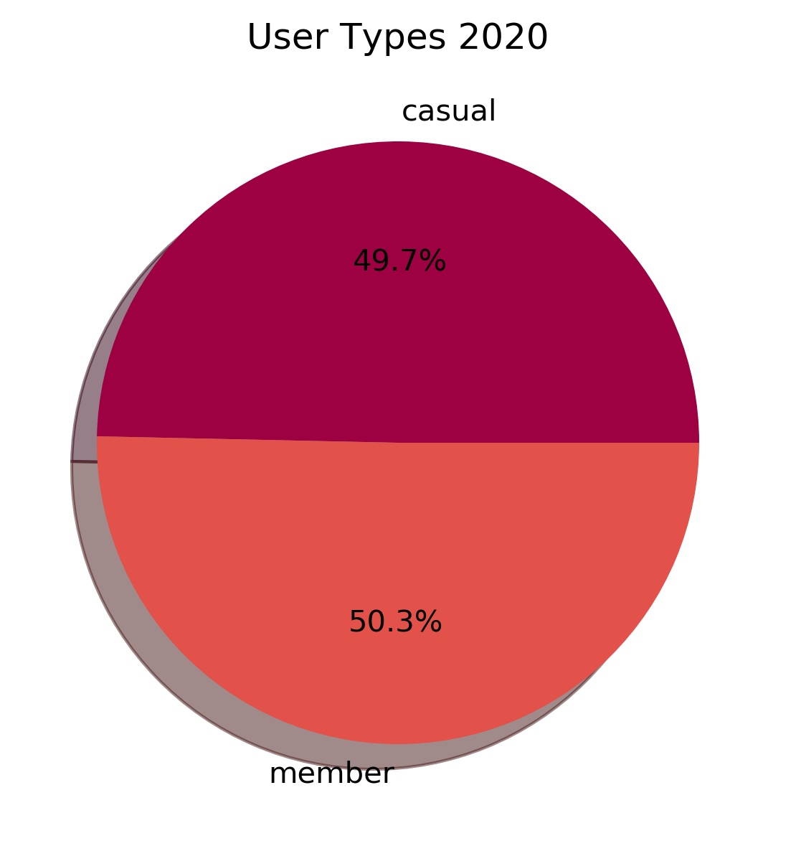
2. Has the bike rental ‘User Type’ been impacted between Casual riders and Members?
*User Type/Member Type – Indicates whether user was a "registered" member (Annual Member, 30-Day Member or Day Key Member) or a ”Casual" rider (Single Trip, 24-Hour Pass, 3-Day Pass or 5-Day Pass)
We found that although the ”Overall Ridership” did significantly decrease in Q2 of 2020, the number of Casual riders increased significantly, most likely due to popularity of bike riding as it is an outdoor activity that follows social distancing guidelines. As gyms are slowly reopening biking is becoming one of the many popular outdoor physical activities during the current pandemic.

Slide 5
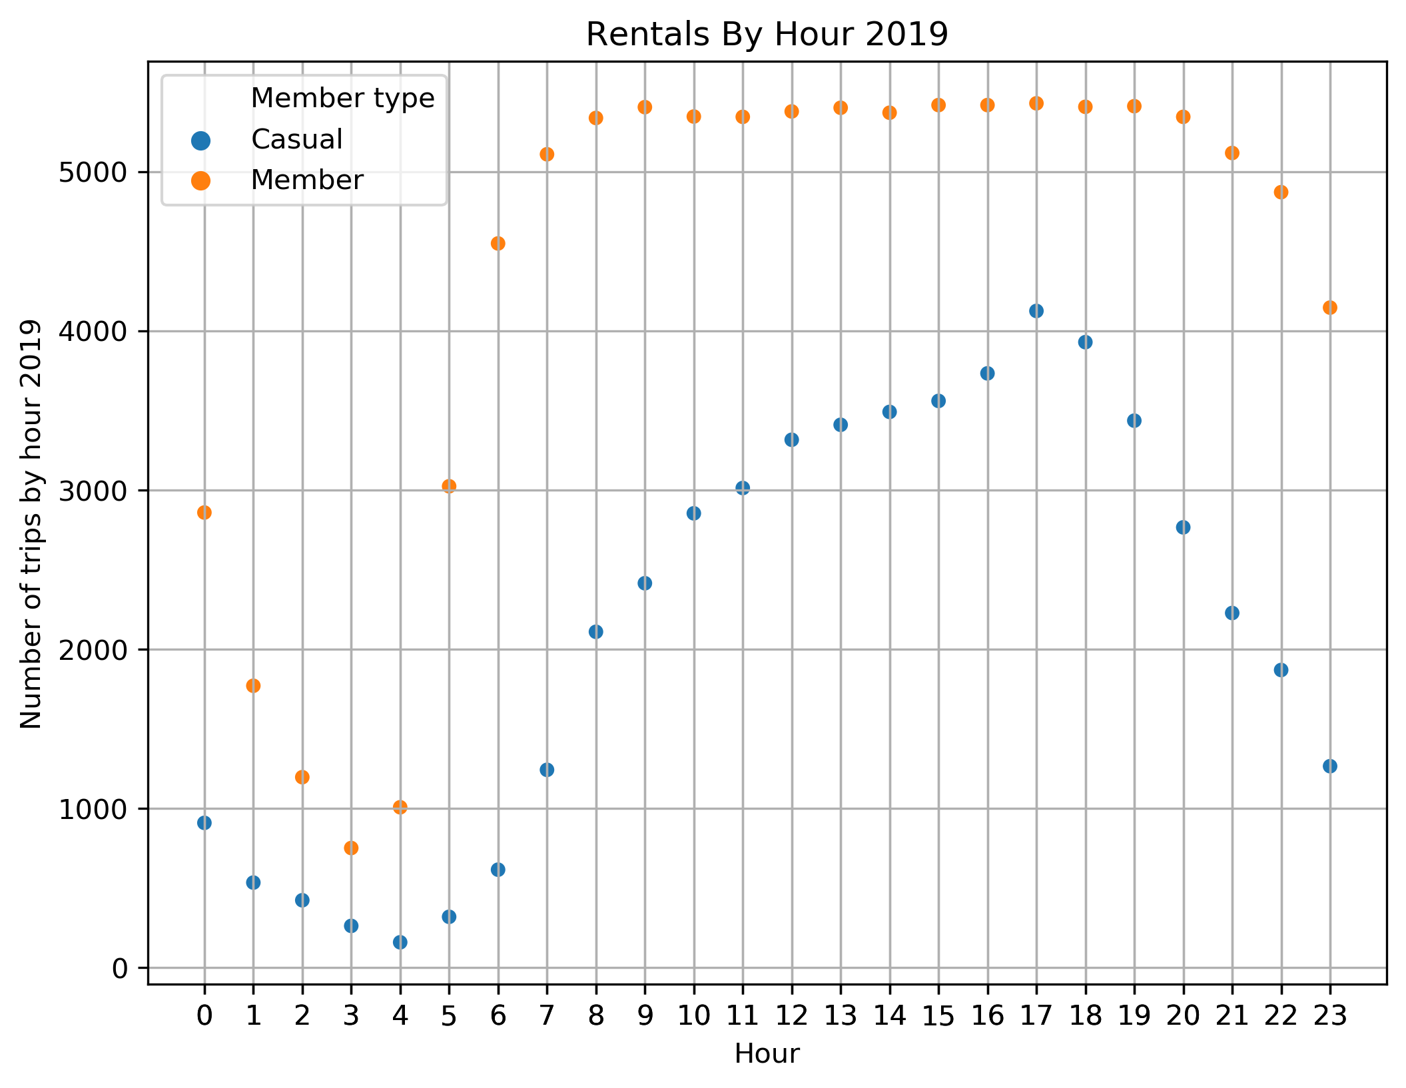
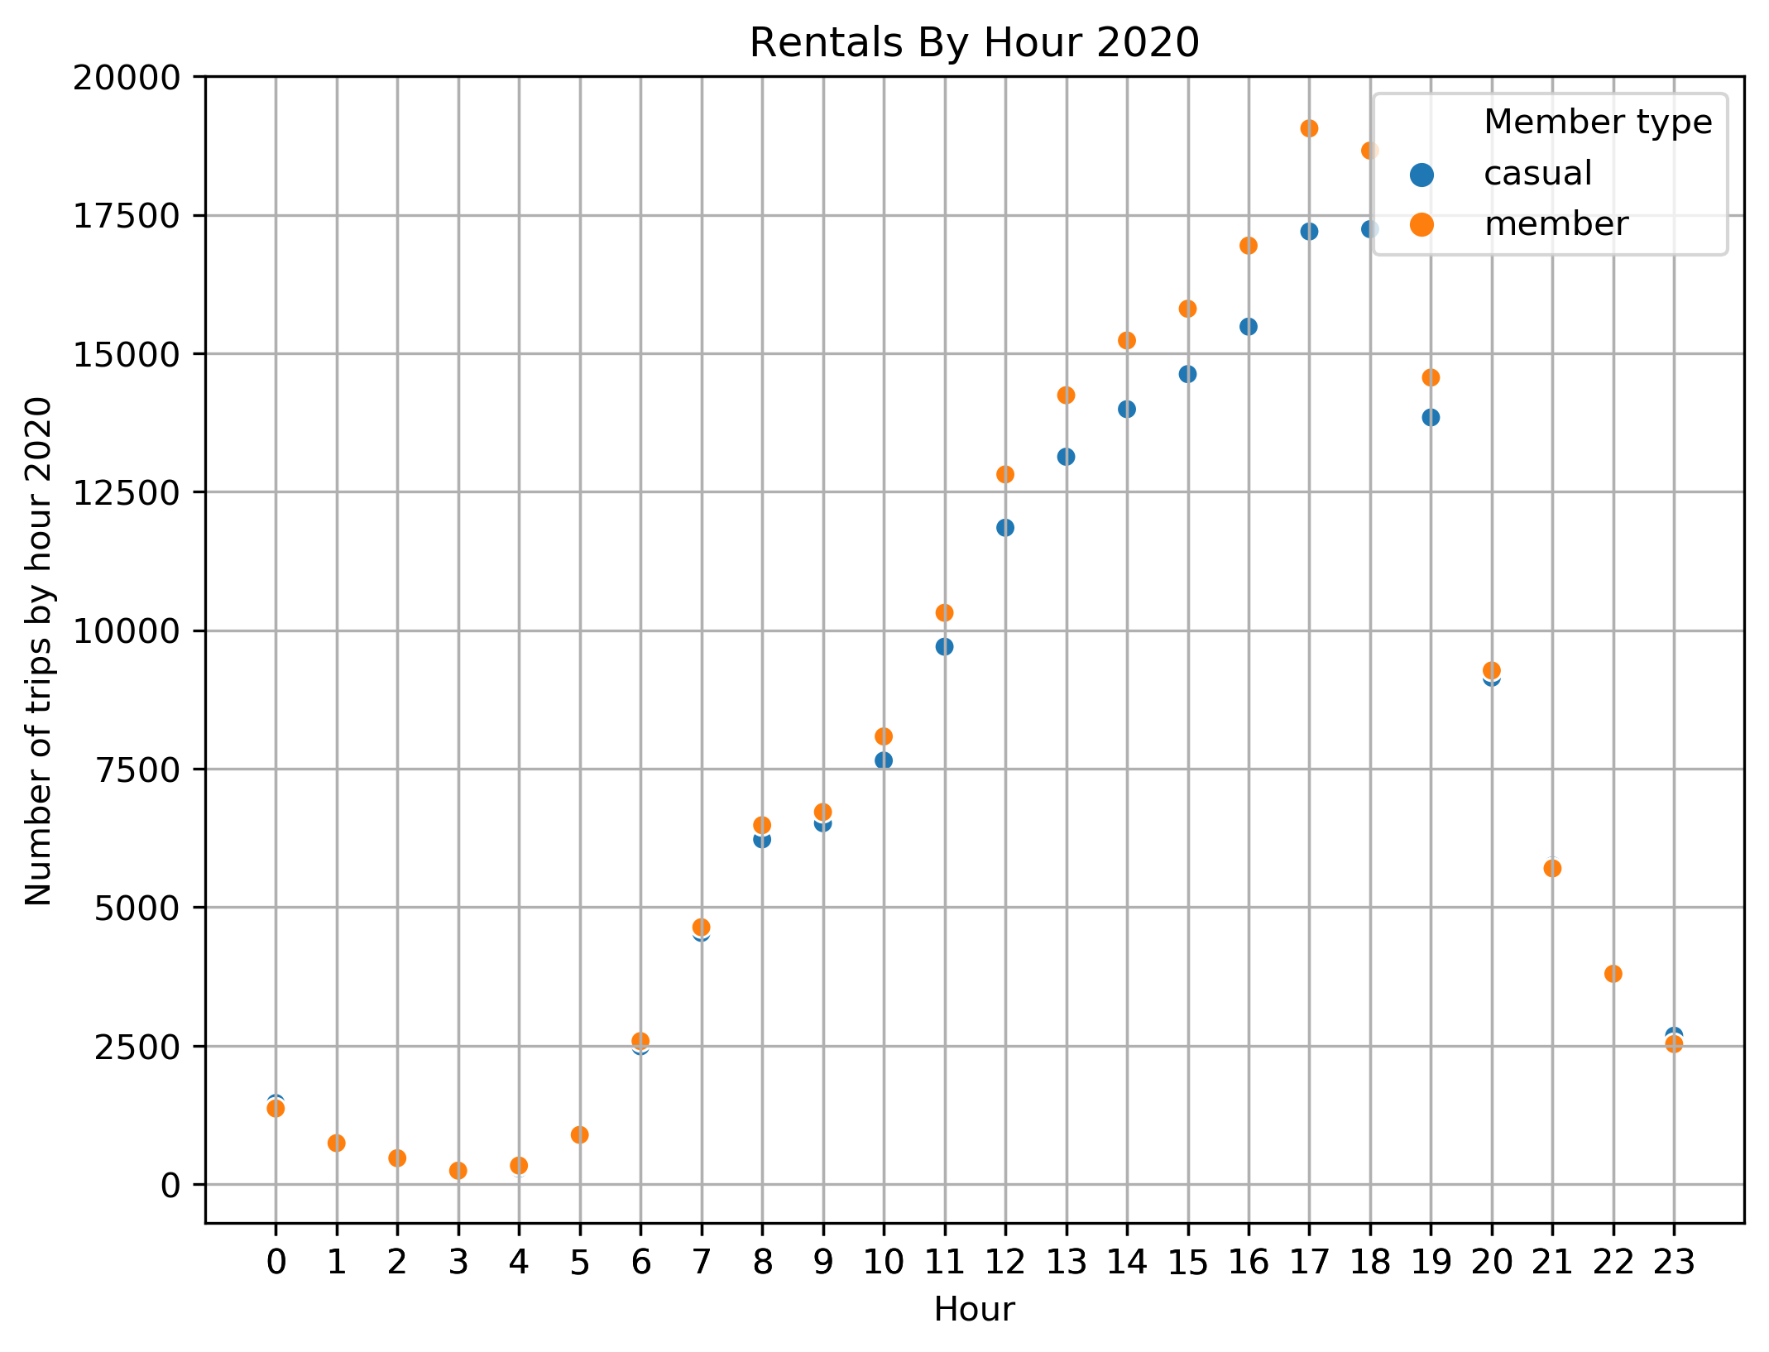
3. (a) What ‘Time of Day’ are most bike trips taken?
Peak time was 5pm
3. (b) What ‘Time of Day’ are most bike trips taken for Members?
Members peak time was 5pm
3. (c) What ‘Time of Day’ are most bike trips taken for Casual riders?
Casual riders peak time was 5pm
The Covid-19 epidemic quarantine has closed the gap on member/casual ridership. The change may be due to more and more individuals are working from home and exercising at the end of their work day. The increase is also due to bar and restaurant adhering to social distancing guidelines.

Slide 6
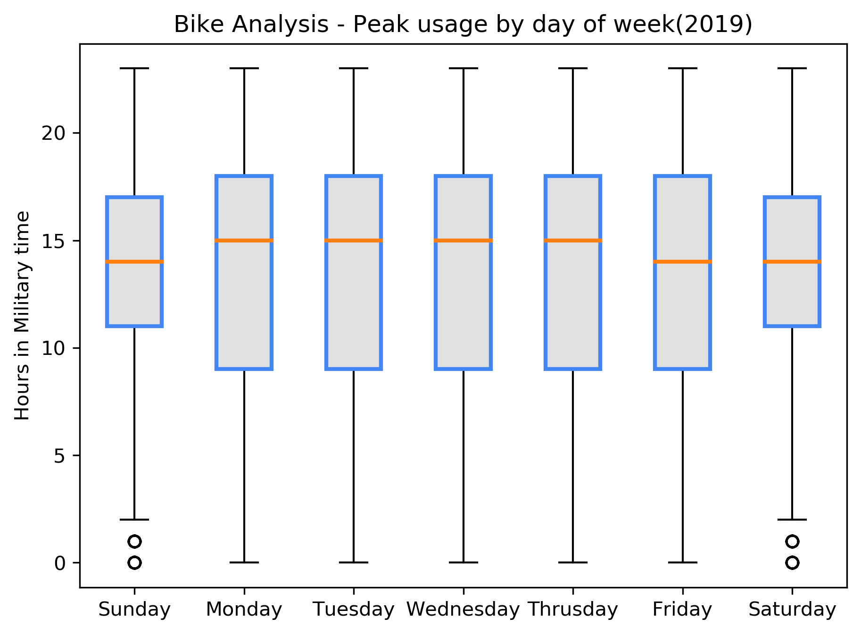
4. (a) Which ‘Day(s) of the Week’ are most bike trips taken?
Answer 4. (a) For 2019 most bike trips are taken Monday through Friday on average

Slide 7
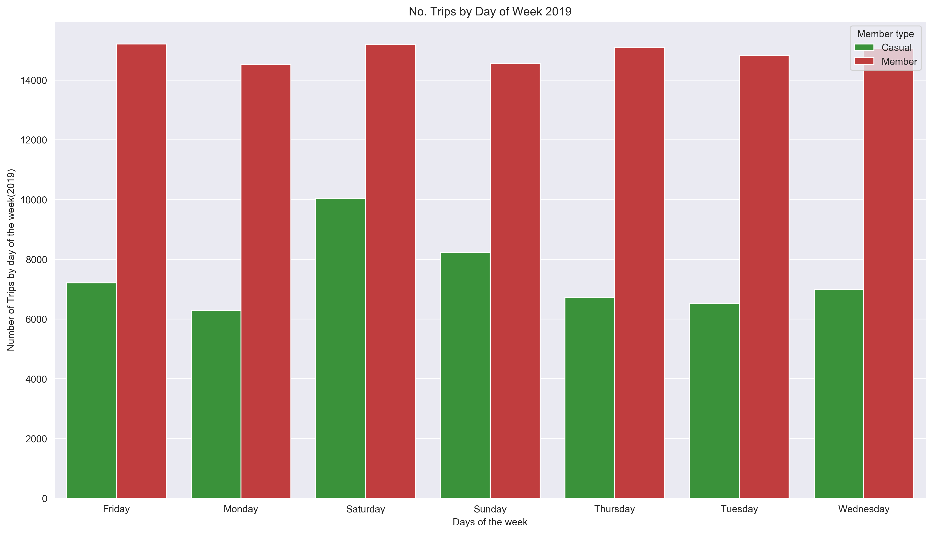
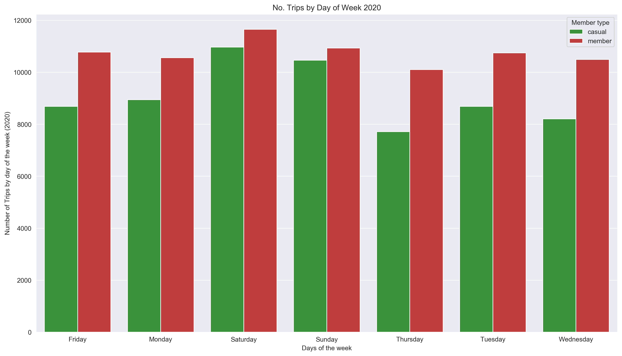
4. (b) Which ‘Day(s) of the Week’ are most bike trips taken for Members?
2019 Members Friday and Saturdays were when most bike trips were taken, although they were pretty consistent in their ridership through the week. For 2020 Members continue to have a pretty consistent ridership through out the week, but Saturday is their peak for the week.
4. (c) Which “Day(s) of the Week’ are most bike trips taken for Casual riders?
2019 and 2020 Casual riders’ peak day of the week is Saturday.

Slide 8
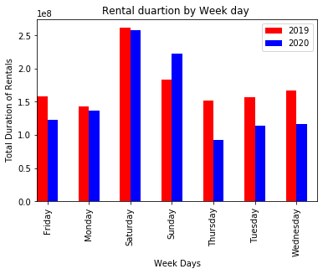
5. Which day of the week has the longest duration of bike rental (in 2019 and 2020)?
In 2019 and 2020 we found that Saturdays were when bike rentals had the highest duration. This is one consistency that we found for 2019 and 2020.

Slide 9
Summary of Findings
1. (a) What is the ‘Overall Ridership” in Q2 (April, May, and June) of 2020 compare to Q2 of 2019.
1. (b) Did the impact of the ”Quarantine Lockdown” in April and may of 2020 reduce the number of rides and by how much?
Answer 1. (a) We found that the ”Overall Ridership” in 2020 was significantly reduced compared to 2019, and that the impact of the lockdown did effect bike rentals.
Answer 1 (b) (insert data frame screen shot here)
2. Has the bike rental ‘User Type’ been impacted between Casual riders and Members?
*User Type/Member Type – Indicates whether user was a "registered" member (Annual Member, 30-Day Member or Day Key Member) or a ”Casual" rider (Single Trip, 24-Hour Pass, 3-Day Pass or 5-Day Pass)
Answer 2. We found that although the ”Overall Ridership” did significantly decrease in Q2 of 2020, the number of Casual riders increased significantly, most likely due to popularity of bike riding as it is an outdoor activity that follows social distancing guidelines. As gyms are slowly reopening biking is becoming one of the many popular outdoor physical activities during the current pandemic.
3. (a) What ‘Time of Day’ are most bike trips taken?
Answer 3. (a) Peak time was 5pm
3. (b) What ‘Time of Day’ are most bike trips taken for Members?
Answer 3. (b) Members peak time was 5pm
3. (c) What ‘Time of Day’ are most bike trips taken for Casual riders?
Answer 3. (c) Casual riders peak time was 5pm
4. (a) Which ‘Day(s) of the Week’ are most bike trips taken?
Answer 4. (a) For 2019 most bike trips are taken Monday through Friday on average
4. (b) Which ‘Day(s) of the Week’ are most bike trips taken for Members?
Answer 4. (b) For 2019 Members Friday and Saturdays were when most bike trips were taken, although they were pretty consistent in their ridership through the week. For 2020 Members continue to have a pretty consistent ridership through out the week, but Saturday is their peak for the week.
4. (c) Which “Day(s) of the Week’ are most bike trips taken for Casual riders?
Answer 4. (c) For 2019 and 2020 Casual riders’ peak day of the week is Saturday.
5.. Which day of the week has the longest duration of bike rental (in 2019 and 2020)?
Answer 5. In 2019 and 2020 we found that Saturdays were when bike rentals had the highest duration. This is one consistency that we found for 2019 and 2020.

Slide 10
Required Data to Answer Questions
Data Reformat
Bike Data was acquired from https://www.capitalbikeshare.com/system-data
Datasets across timeframes did not match
Created an additional 16 columns IOT match data format across both time periods
Conducted google api query to extract lat/lon IOT to match current year format and to determined distance traveled per rental
created unique Id per rental IOT determine peak day of the week and hour of rental
from start and end date of Bike rentals extracted Month , Year, Day of the week, and hour.
Created a duration column for uniformity purpose and matching of datasets
Created a Custom Id column for each rental to get the total numbers of rental for each year (two additional columns)
We had to modify the ”Start Date” column, and “End Date” to datetime

