Slide 1
Discussion 1
Clinician Knowledge

Slide 2


Recap of Case Study
Your AI model has been deployed in the local hospital’s emergency department
Model automates the ordering of tests (this speeds up – and standardizes) how we deliver care
Model was validated with a 92% accuracy
Each group has a different model architecture, with different development and validation processes

Slide 3
AI Education in Medicine
[to be added]

Slide 4
Discussion 2 – Questions
What technical knowledge would physicians who use AI need?
Is the same knowledge needed to develop the four different models?
Do all physicians need the same level of knowledge? Why?
What role can physician play in ensuring model performance?

Slide 5
TIME TO SHARE WITH THE LARGE GROUP
Share both overall thoughts – as well as those specific to your model’s architecture and validation process

Slide 6
LARGE GROUP DISCUSSION
Consider your model type in communicating your thoughts to the group
Model A
Model B
Non-Generative Model
Non-generative, Image-based Model
Model C
Model D
Multimodal Model
Generative Model

Slide 7
EVIDENCE & RESOURCES
In the following slides, we recommend relevant evidence and resources related to this discussion

Slide 8
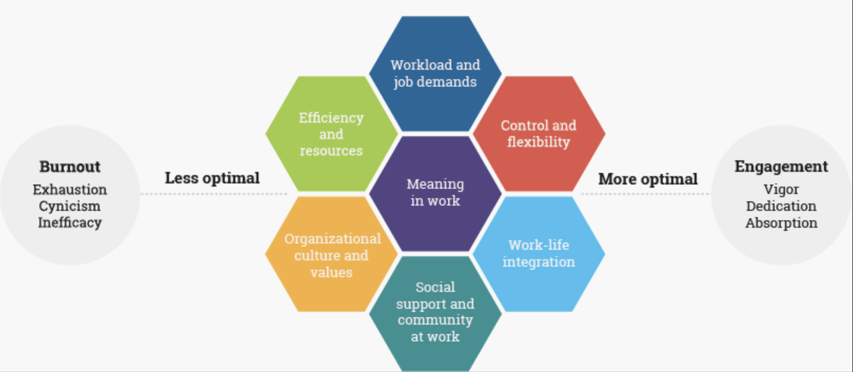
Physician Burnout

Slide 9
Augmented Intelligence
An alternative conceptualization that focuses on AI’s assistive role, emphasizing the fact that its design enhances human intelligence rather than replaces it
AMA CLRPD, A Primer on Artificial and Augmented Intelligence, 2019

Slide 10

Augmented Intelligence
Better – only if the physician is trained to use AI properly
Freidman. A ”fundamental theorem” of biomedical informatics. J Am Med Inform Assoc. 2009 Mar-Apr; 16(2): 169-70

Slide 11
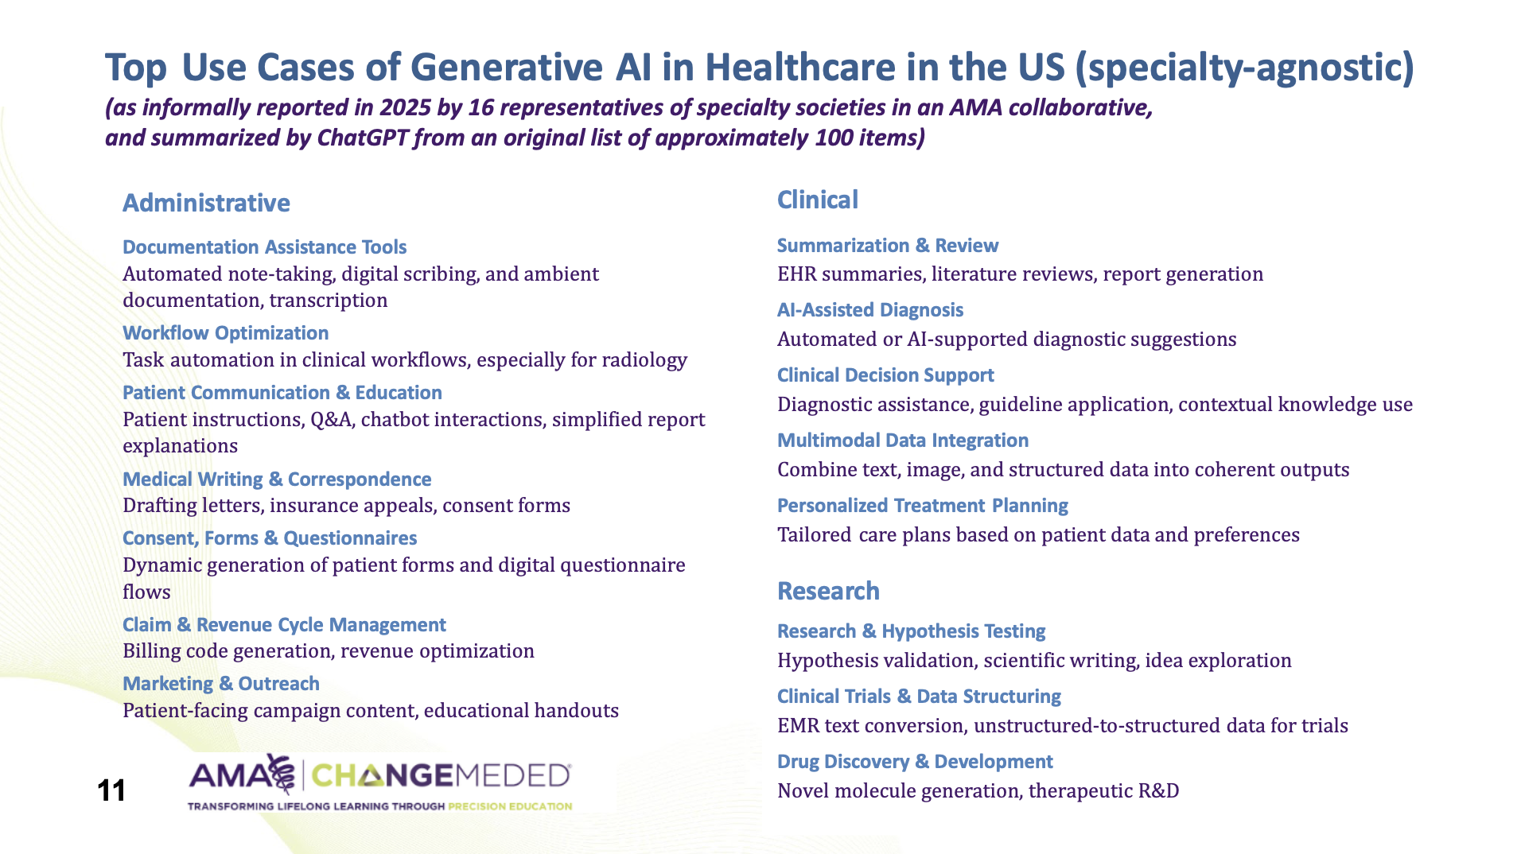

Slide 12
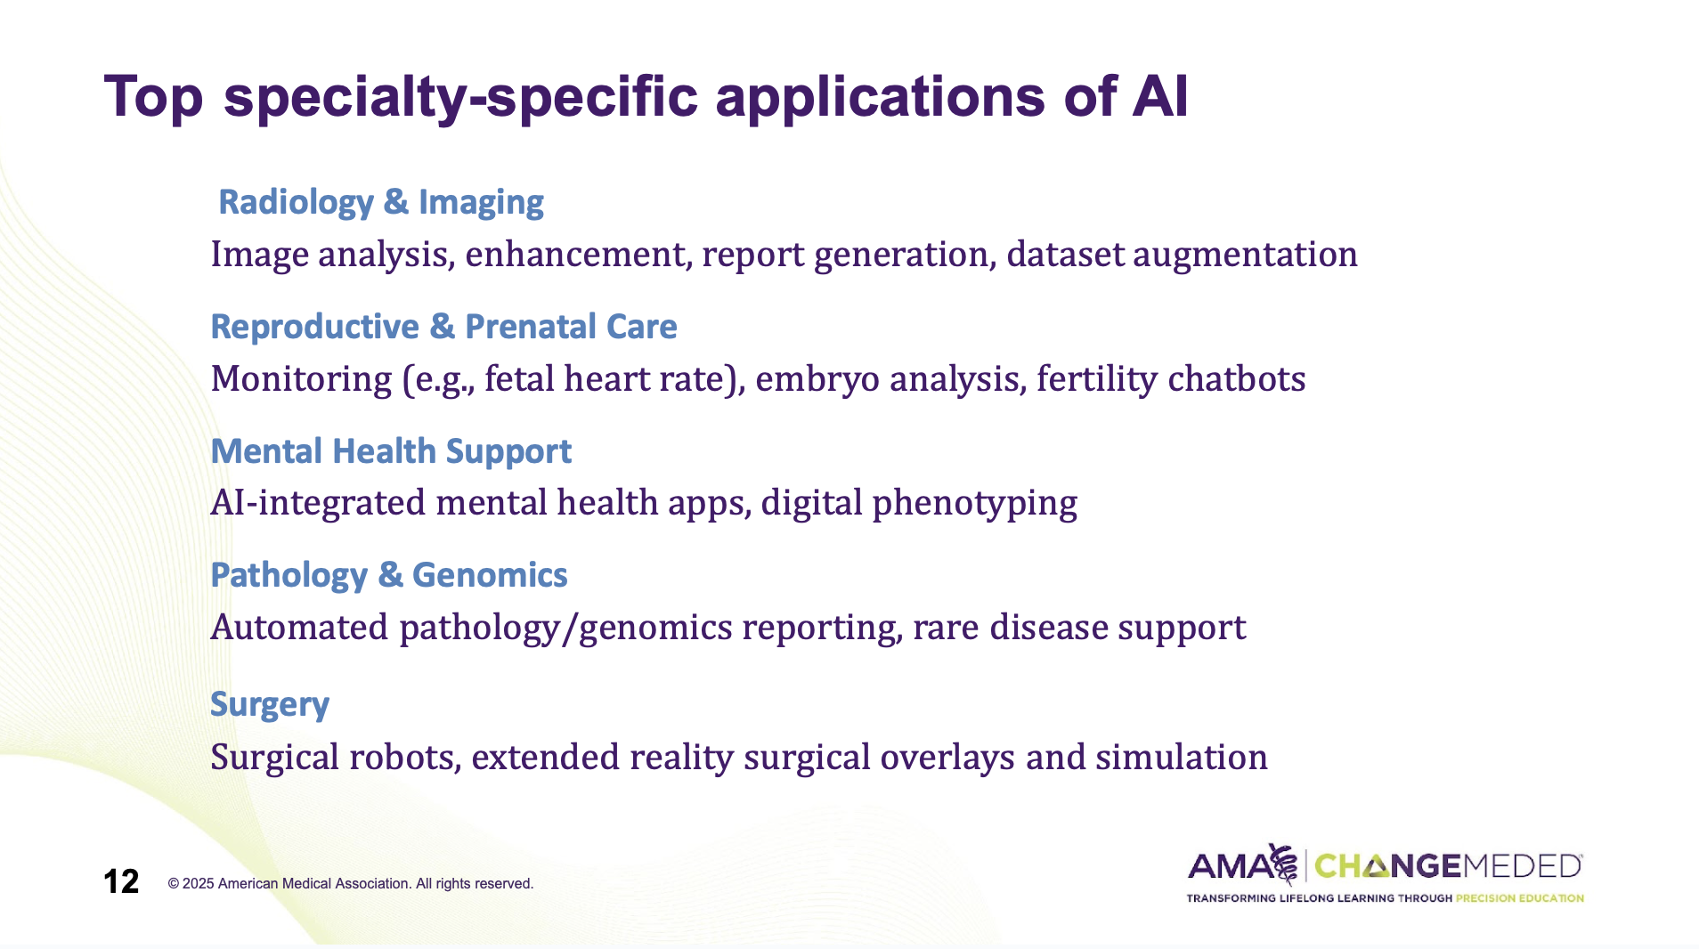

Slide 13
Relevant Readings
Sendak, M. P., et al. (2020). “The human body is a black box”: supporting clinical decision-making with machine learning. Journal of the American Medical Informatics Association, 27(10), 1530–1536.
Abràmoff, M. D., et al. (2020). From periphery to center: integrating AI into the clinic. npj Digital Medicine, 3(1), 1–3.
Topol, E. (2019). High-performance medicine: the convergence of human and artificial intelligence. Nature Medicine, 25(1), 44–56.

Slide 14
THANK YOU FOR PARTICIPATING
Time for another discussion!

