Slide 1
Discussion 3
User Interfaces

Slide 2


Recap of Case Study
Your AI model has been deployed in the local hospital’s emergency department
Model automates the ordering of tests (this speeds up – and standardizes) how we deliver care
Model was validated with a 92% accuracy
Each group has a different model architecture, with different development and validation processes

Slide 3
User Interfaces (UI)
UI: the point of interaction between a human and computer system.
UI includes all the visual elements and processes that allow users to communicate with and operate a system/model,
The UI can take many forms – apps, websites, ML tool in a clinical setting
Key consideration in developing a UI is who will be using it and what they will need to do with the insight

Slide 4
Key Components of UI
Input controls – Buttons, forms, sliders, checkbox (automatic input?)
Navigation – Menus, tabs, breadcrumbs
Information displays – Graphs, tables, alerts
Feedback mechanisms…

Slide 5
Related Terms
User Experience: How the user feels while interacting with the system
Human-Computer Interaction (HCI): The broader field studying design principles for UI/UX

Slide 6
Discussion 3 – Questions
[to be completed]

Slide 7
TIME TO SHARE WITH THE LARGE GROUP
Share both overall thoughts – as well as those specific to your model’s architecture and validation process

Slide 8
LARGE GROUP DISCUSSION
Consider your model type in communicating your thoughts to the group
Model A
Model B
Non-Generative Model
Non-generative, Image-based Model
Model C
Model D
Multimodal Model
Generative Model

Slide 9
EVIDENCE & RESOURCES
In the following slides, we recommend relevant evidence and resources related to this discussion

Slide 10
Relevant Readings
Johnson, C. M., Johnson, T. R., & Zhang, J. (2005). A user-centered framework for redesigning health care interfaces. Journal of Biomedical Informatics, 38(1), 75–87
Ratwani, R. M., & Fong, A. (2015). Designing for clinician cognition: Cognitive load theory and EHR usability. Journal of the American Medical Informatics Association, 22(6), 1012–1016.
Bussone, A., Stumpf, S., & O’Sullivan, D. (2015). The role of explanations on trust and reliance in clinical decision support systems. 2015 International Conference on Healthcare Informatics.
Amann, J., Blasimme, A., Vayena, E., Frey, D., & Madai, V. I. (2022). Explainability for artificial intelligence in healthcare: a multidisciplinary perspective. BMC Medical Informatics and Decision Making, 22(1), 1–9.

Slide 11
GOALS
Mars
Jupiter
Saturn
Despite being red, Mars is actually a very cold place
It’s a gas giant and the biggest planet in the Solar System
Saturn is composed mostly of hydrogen and helium

Slide 12
METHODS
Study
Hypothesis
Report
Problem
Data Collect
Experimentation
Venus is the second planet from the Sun
Saturn is the ringed one and a gas giant
Earth is the planet where we live on
Mercury is the smallest planet
Despite being red, Mars is a cold place
Jupiter is the biggest planet of them all

Slide 13
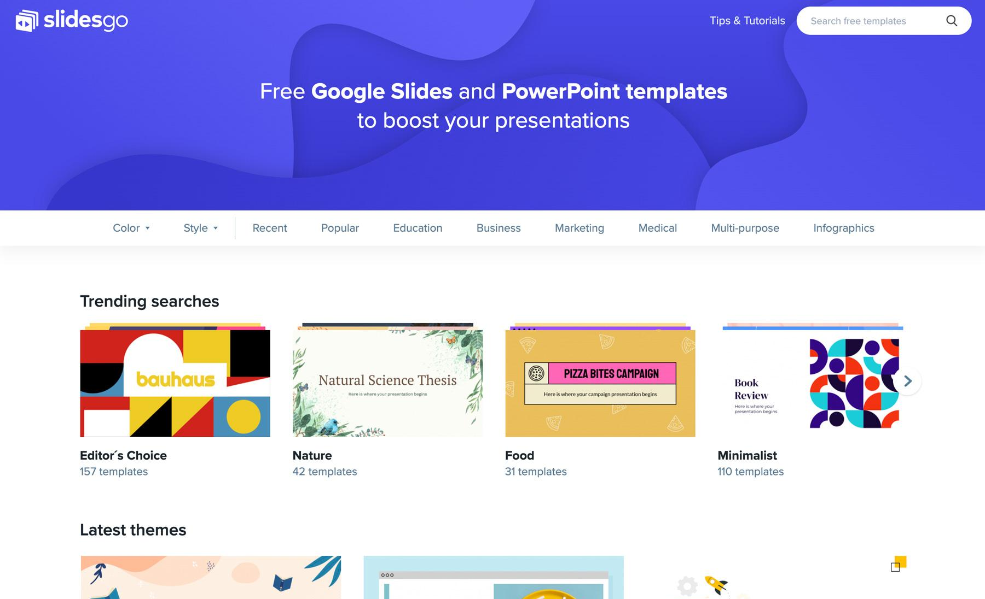
DESKTOP SOFTWARE
You can replace the image on the screen with your own work. Just delete this one, add yours and center it properly

Slide 14
ALTERNATIVE RESOURCES

Slide 15
RESOURCES
Microscope in a clinical laboratory
Woman scientist with microscope
Medical infographic female and charts
Technology background
Human body system collection
Medical infographic woman and man charts

Slide 16
THANK YOU FOR PARTICIPATING
Time for another discussion!

