Slide 1
Discussion 5
How should we navigate ethical considerations of models once deployed?

Slide 2


Recap of Case Study
Your AI model has been deployed in the local hospital’s emergency department
Model automates the ordering of tests (this speeds up – and standardizes) how we deliver care
Model was validated with a 92% accuracy
Each group has a different model architecture, with different development and validation processes

Slide 3
Deployment Considerations
Data Drift: Gradual change in data distribution over time in deployed settings
Model errors – how are these identified and reported? Who is liable

Slide 4
Discussion 5 – Questions: Considerations
How are models monitored overtime?
What changes in performance are considered noteworthy?
What responsibilities do developers have? Clinicians? Regulators?

Slide 5
TIME TO SHARE WITH THE LARGE GROUP
Share both overall thoughts – as well as those specific to your model’s architecture and validation process

Slide 6
LARGE GROUP DISCUSSION
Consider your model type in communicating your thoughts to the group
Model A
Model B
Non-Generative Model
Non-generative, Image-based Model
Model C
Model D
Multimodal Model
Generative Model

Slide 7
EVIDENCE & RESOURCES
In the following slides, we recommend relevant evidence and resources related to this discussion

Slide 8
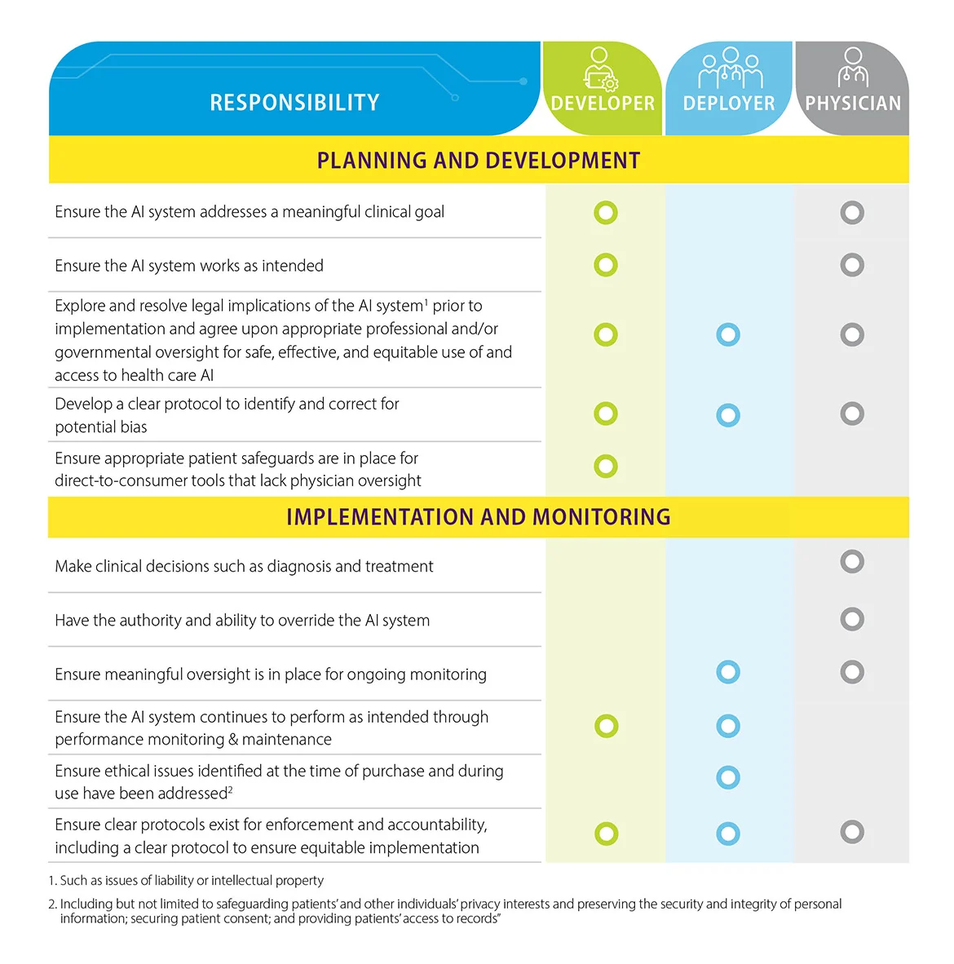
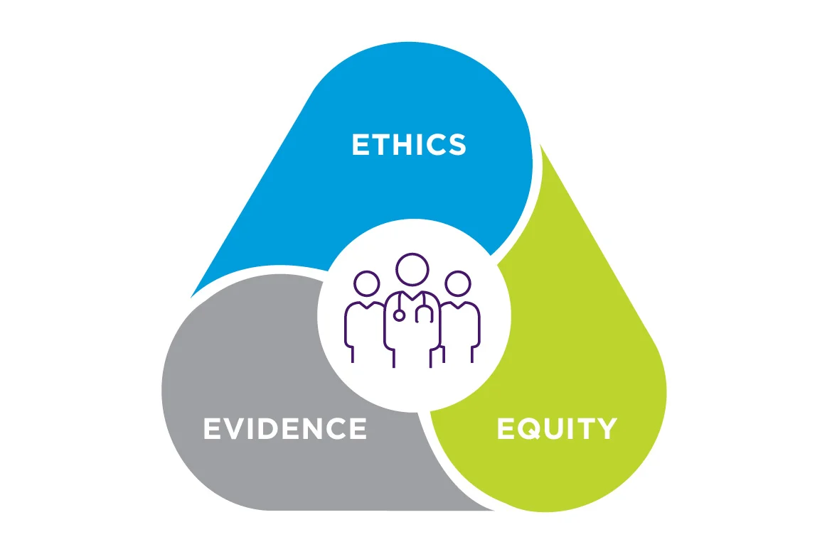
Ethical Duties of Various Roles
AMA Framework
Source: https://www.ama-assn.org/practice-management/digital-health/advancing-health-care-ai-through-ethics-evidence-and-equity

Slide 9
Institutional Structure Needed to Support Ethical AI Use
[Content to be added]

Slide 10
Relevant Readings
Char, D. S., Shah, N. H., & Magnus, D. (2018). Implementing machine learning in health care—addressing ethical challenges. New England Journal of Medicine, 378(11), 981–983.
Leslie, D. (2019). Understanding artificial intelligence ethics and safety. The Alan Turing Institute.
Obermeyer, Z., Powers, B., Vogeli, C., & Mullainathan, S. (2019). Dissecting racial bias in an algorithm used to manage the health of populations. Science, 366(6464), 447–453.

Slide 11
THANK YOU FOR PARTICIPATING
Time for another discussion!

